Slide 1
Accelerating AI-Driven Genome Analysis
via Algorithm-Architecture Co-Design
Can Firtina | canfirtina@gmail.com
Senior Researcher and Lecturer at ETH Zurich
Incoming Assistant Professor of Computer Science at UMD
June 16, 2025
PASC25, Challenges in Systems Design for Omics, Switzerland

Slide 2
The Goal of Computing: Beyond Numbers
“The purpose of computing is [to gain] insight, not numbers”
Richard Hamming
"Numerical Methods for Scientists and Engineers," Richard Hamming, 1962.

Slide 3
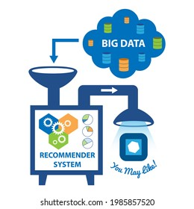


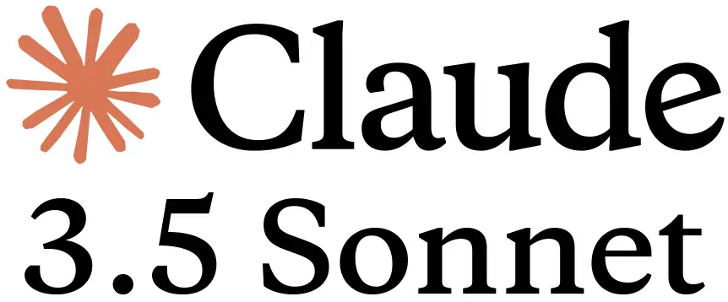
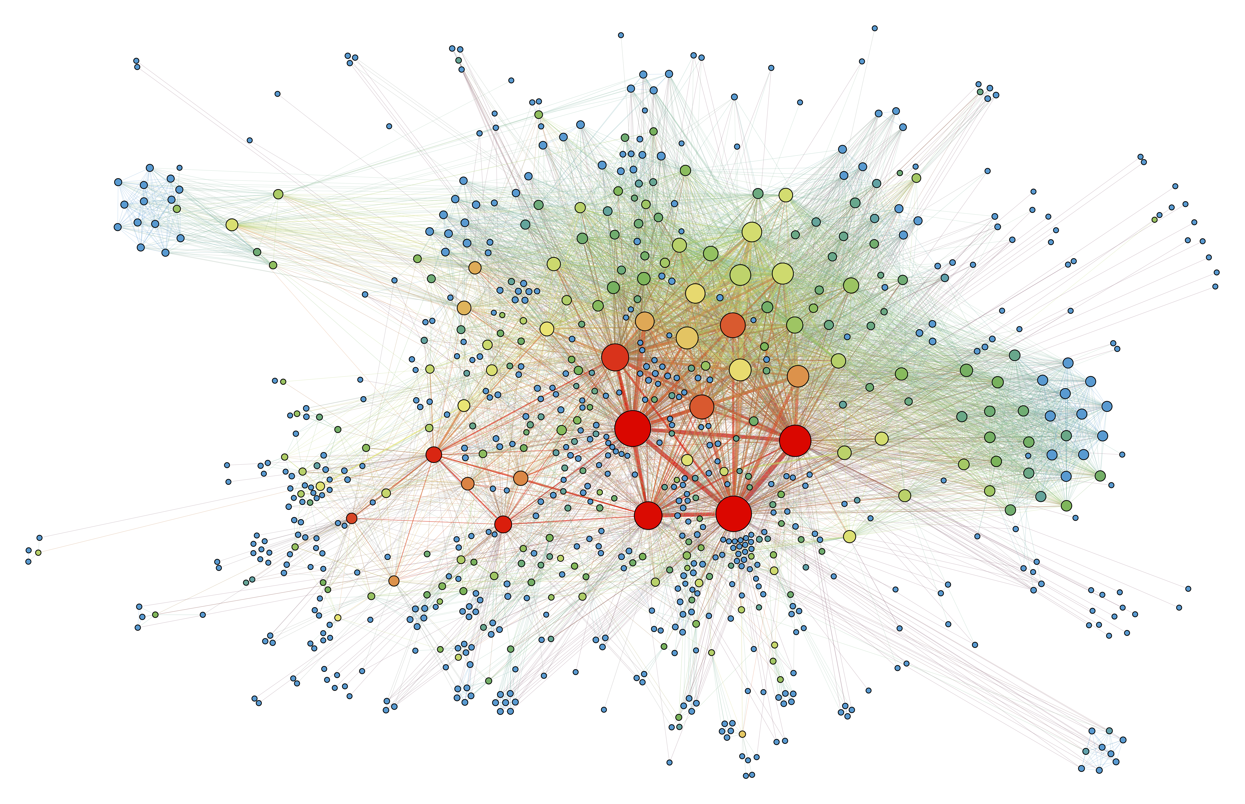
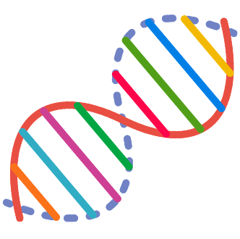
Big Data is Everywhere
Large recommender systems
Large Language Models
Graph/Tree Processing
Genomics

Slide 4
Computing is Bottlenecked by Data
Data movement →
Performance & Energy Bottleneck
Large recommender systems
Large Language Models
Graph/Tree Processing
Genomics

Slide 5

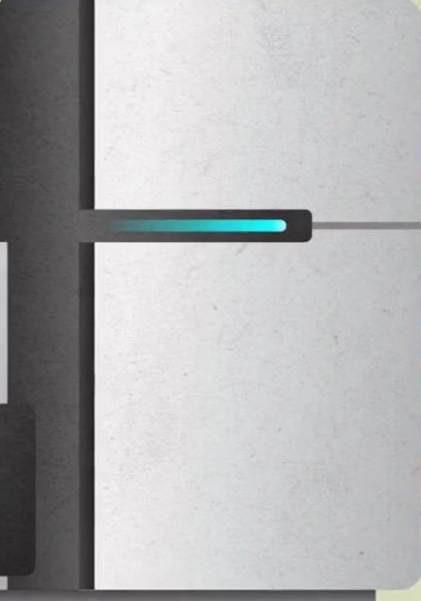

Problems with Data Analysis Today
Special-Purpose Machine
for Data Generation
General-Purpose Machine
for Data Analysis
FAST
SLOW
Processing capabilities oblivious to data analysis requirements
Large amounts of data movement

Slide 6




Data Movement Dominates Performance
Data movement dominates performance and is a major system
energy bottleneck (accounting for 40% - 62%)
Data Movement
Sequencing
Machine
Storage (SSD/HDD)
Main Memory
Microprocessor
Single memory request consumes >160$×$ - 800$×$ more energy compared to performing an addition operation
⁻ Boroumand et al., “Google Workloads for Consumer Devices: Mitigating Data Movement Bottlenecks,” ASPLOS 2018
⁻ Kestor et al., “Quantifying the Energy Cost of Data Movement in Scientific Applications,” IISWC 2013
⁻ Pandiyan and Wu, “Quantifying the energy cost of data movement for emerging smart phone workloads on mobile platforms,” IISWC 2014

Slide 7
We need to co-design algorithms and architecture to handle data well

Slide 8
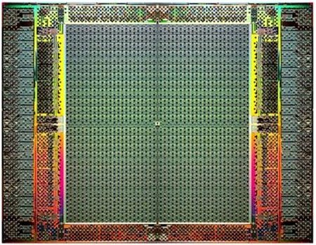

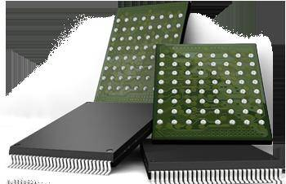
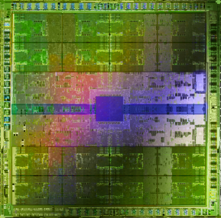
Pushing Towards New Architectures
Modern systems
?
FPGAs
Sequencing Machine
Hybrid Main Memory
Heterogeneous
Processors &
Accelerators
Persistent Memory/Storage
GPUs

Slide 9
Pushing Towards New Architectures
Modern systems
?
FPGAs
Sequencing Machine
Hybrid Main Memory
Heterogeneous
Processors &
Accelerators
Persistent Memory/Storage
GPUs

Slide 10
Algorithm-Architecture Co-design is Critical
Problem
Algorithm
Program/Language
System Software
Computer Architecture (expanded view)
SW/HW Interface
Micro-architecture
Logic
Devices
Electrons

Slide 11
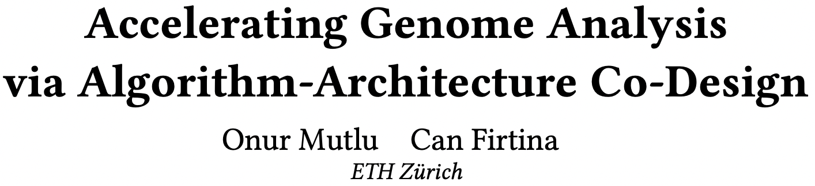
Accelerating Genome Analysis [DAC '23]
Onur Mutlu and Can Firtina,
"Accelerating Genome Analysis via Algorithm-Architecture Co-Design"
Invited Special Session Paper in Proceedings of the 60th Design Automation Conference (DAC), San Francisco, CA, USA, July 2023.
[Related Invited Paper]
[arXiv version]
[Slides (pptx) (pdf)]
[Talk Video at DAC 2023] (38 minutes, including Q&A)

Slide 12

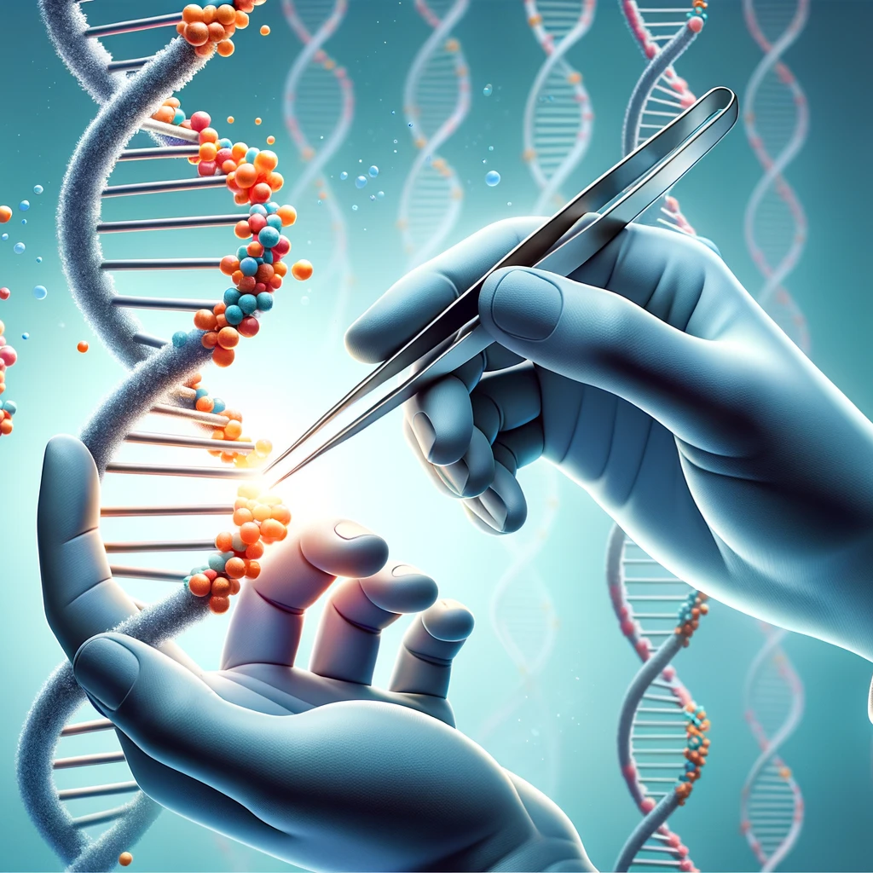


Analyzing Genomes Reveals Key Insights
Altering genomes to solve
fundamental challenges of life
Personalized Medicine
Detecting pathogens
in the environment
Rapid surveillance of
disease outbreaks

Slide 13
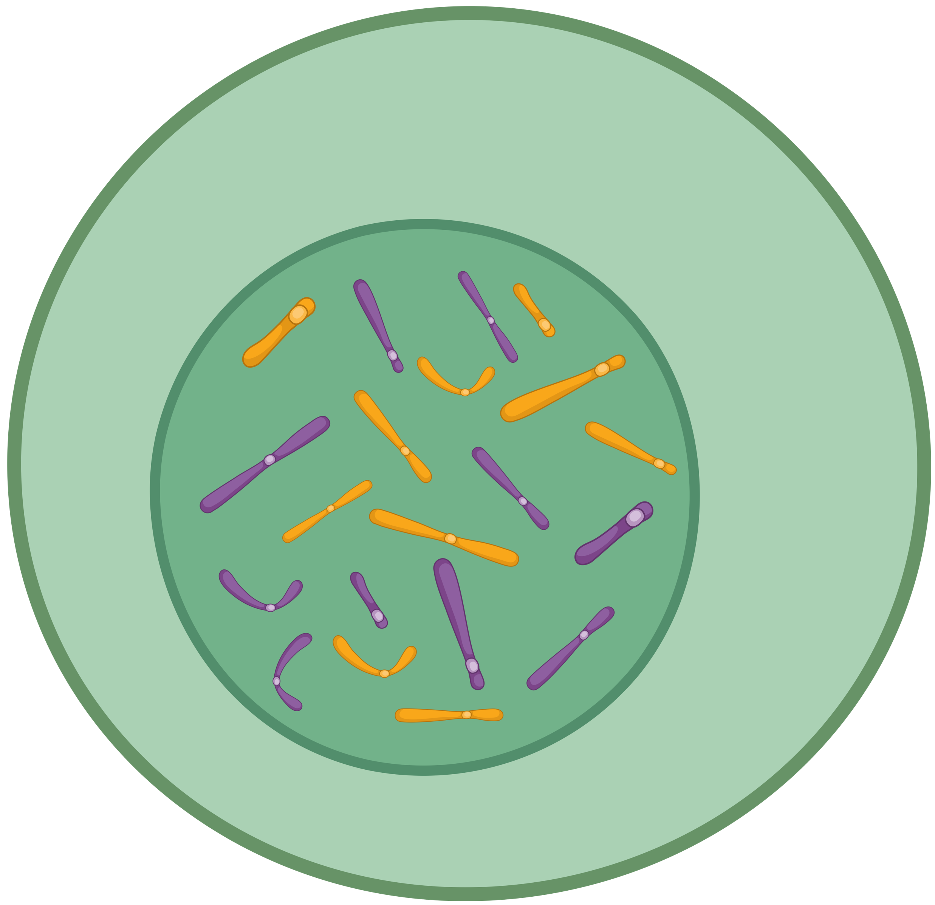
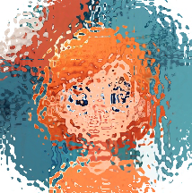
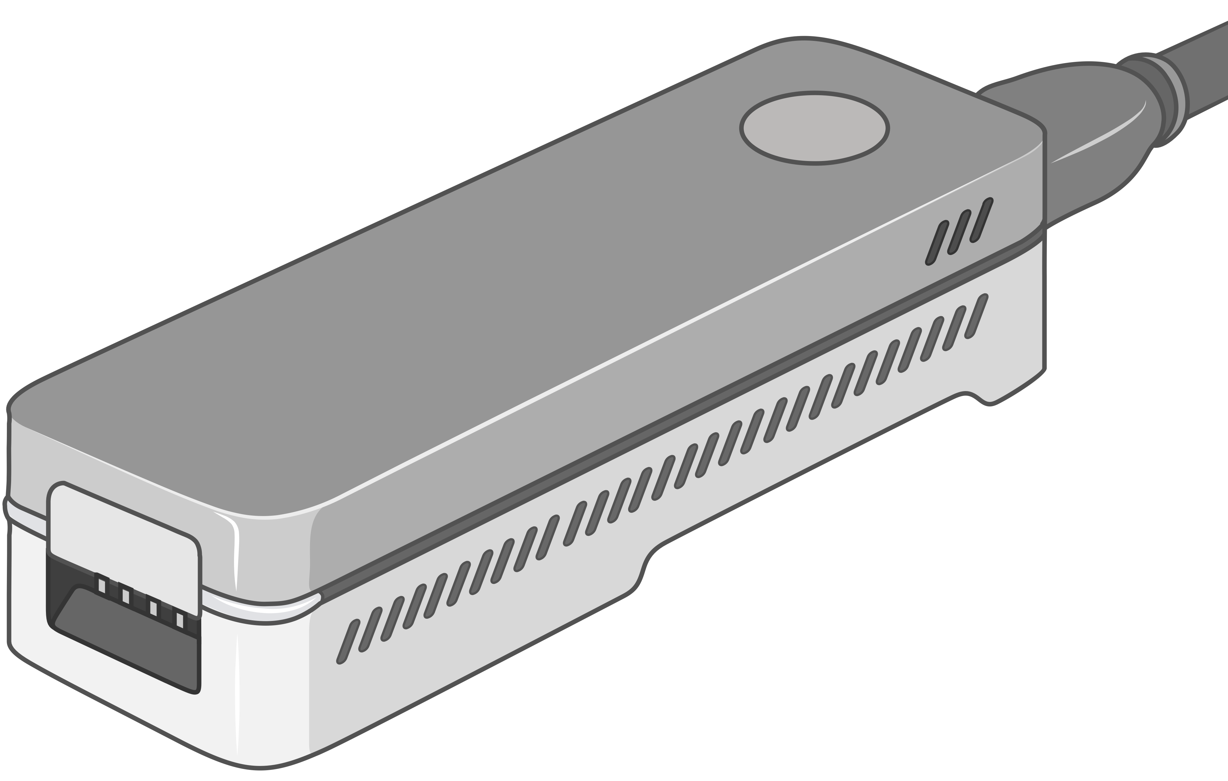
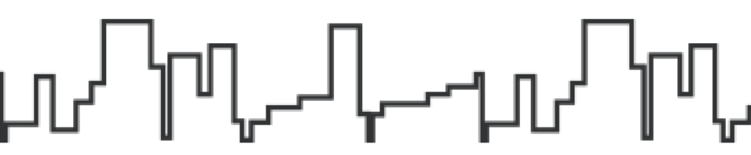
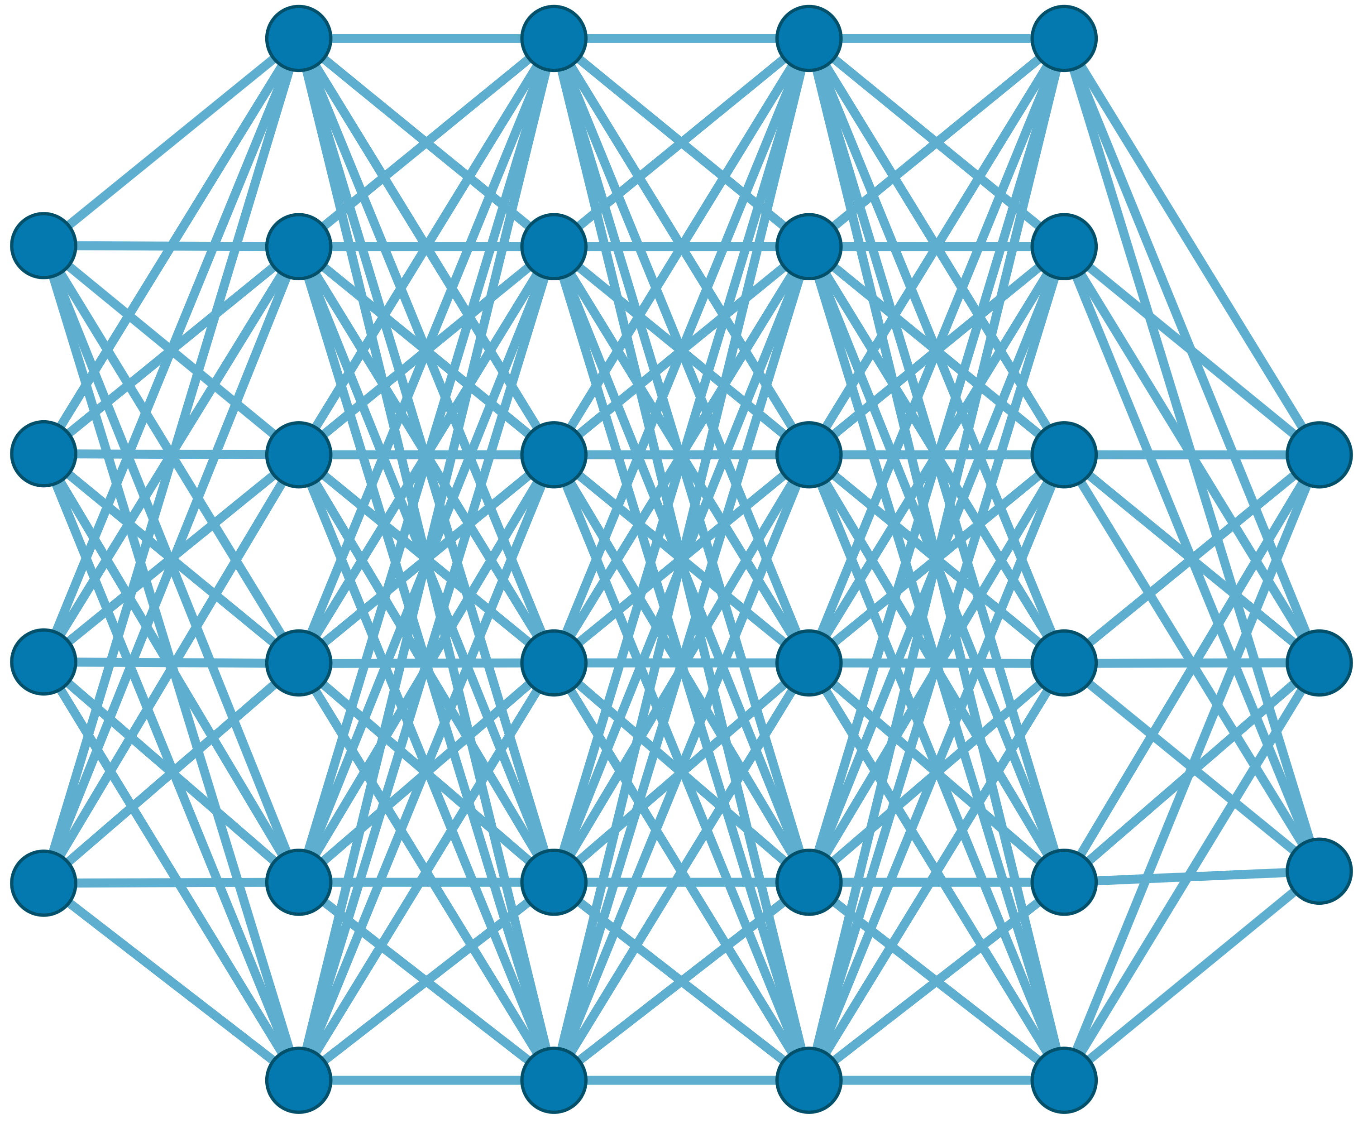

Generating the Entire Genomic Sequence
Whole Genome: 6.4B bps
(Non-human-readable)
Sequencing Device
Raw Genomic Data
(Human-readable?)
Translator (Basecalling)
AI
CGAAATGCC...AGATTAAACGCT...TGCCCTAA...GAATGGCGT
Whole Human Genome: 6.4B bps (Human-readable)

Slide 14



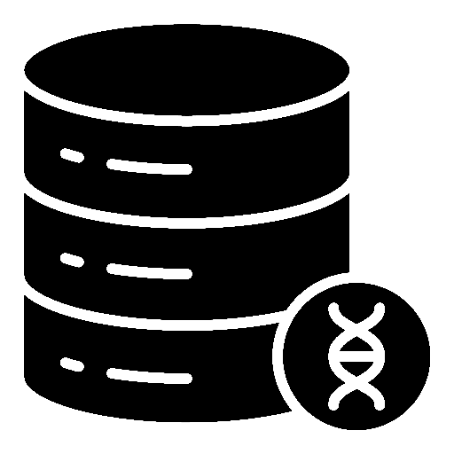





Genomic Data: Giant Jigsaw Puzzle to Solve
Human (Reference) Genome: 3.2 Billion bps (haploid)
CGAAATGCC...AGATTAAACGCT...TGCCCTAA...GAATGGCGT
?
Scale: ~$1/{10}^{8}$
AAATGG
CGAAATGCC...AGATTAAATGGT...TGCCCTAA...GAATGGCGT
Entire Genomic Sequence of an Organism
Read: ~100 – 100,000 bps
Small pieces (reads)
?
Unknown origins
Non-identical reference genome
Data Science for Massive Datasets
(TBs to PBs)
Large volume of data to analyze

Slide 15


A Common Genome Analysis Pipeline
Raw
Reads
Basecalling (Translator)
Basecalled
(Translated)
Reads
Read
Mapping
AAATGTGGTCCATTG
Assembly
Variant Calling
Metagenomics
Downstream Analysis

Slide 16
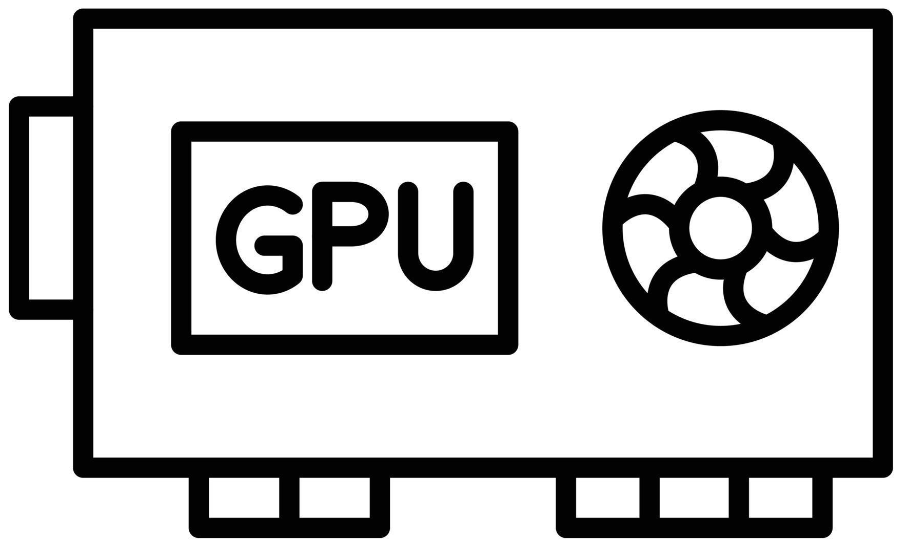

Genome Analysis is Energy Inefficient
Raw
Reads
Basecalling (Translator)
Basecalled
(Translated)
Reads
Read
Mapping
AAATGTGGTCCATTG
Power-Hungry Devices
Costly and large volumes
of data movement
Single memory request consumes >160$×$ - 800$×$ more energy compared to performing an addition operation
⁻ Boroumand et al., “Google Workloads for Consumer Devices: Mitigating Data Movement Bottlenecks,” ASPLOS 2018
⁻ Kestor et al., “Quantifying the Energy Cost of Data Movement in Scientific Applications,” IISWC 2013
⁻ Pandiyan and Wu, “Quantifying the energy cost of data movement for emerging smart phone workloads on mobile platforms,” IISWC 2014

Slide 17


Genome Analysis is Computationally Costly
Significant computation and energy overhead

Slide 18
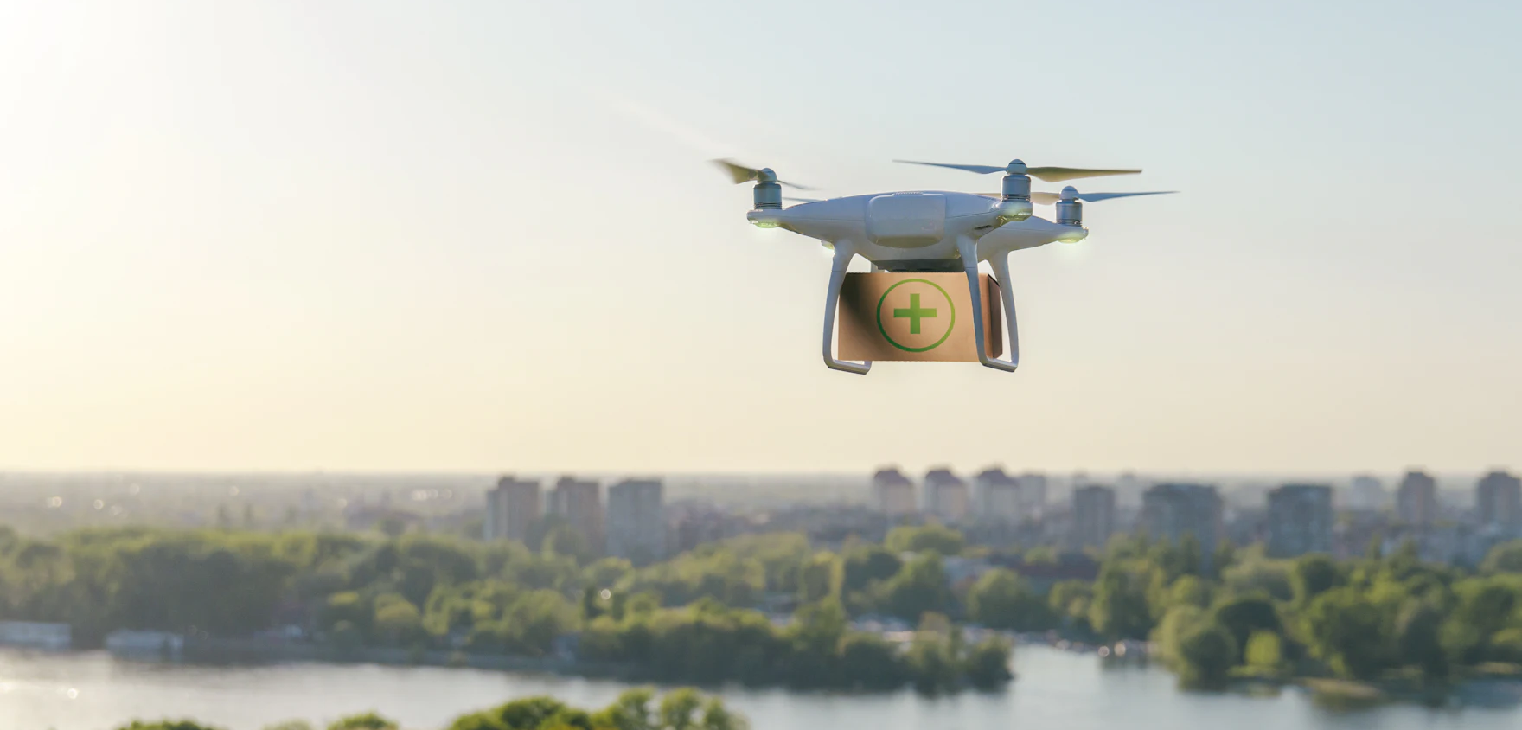

Limited Application Scope and Accuracy
Energy-efficient analysis for Resource-constrained devices
Urgent analysis within minutes
Large-scale analysis
without sacrificing accuracy
and performance

Slide 19
Enabling New Directions in
Genome Analysis via New Algorithms

Slide 20
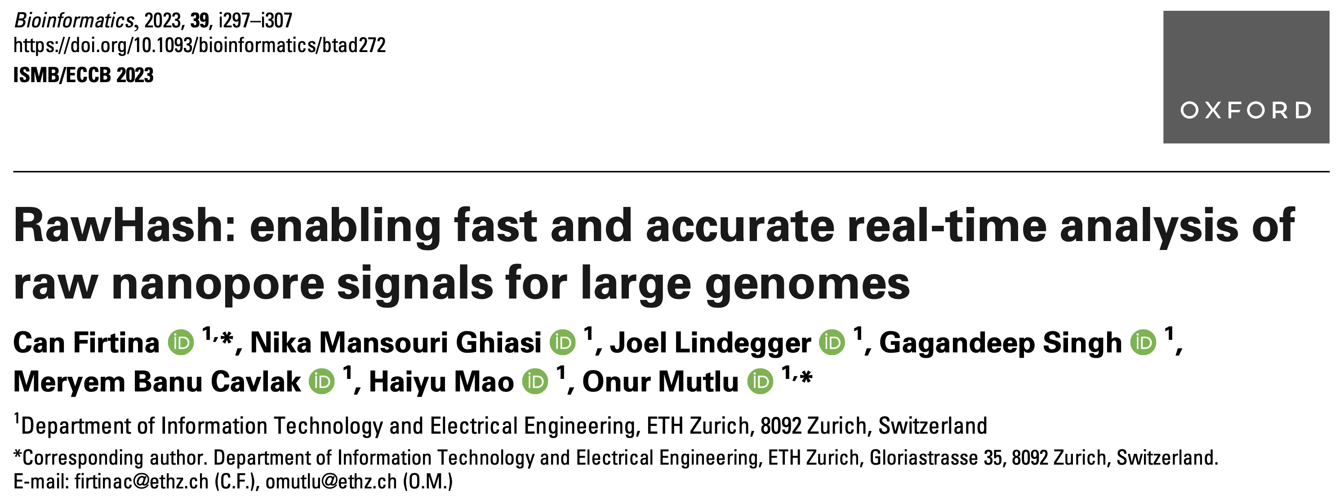
New Frontiers: Raw Signal Analysis [ISMB '23]
Can Firtina, Nika Mansouri Ghiasi, Joel Lindegger, Gagandeep Singh, Meryem Banu Cavlak,
Haiyu Mao, and Onur Mutlu,
"RawHash: Enabling Fast and Accurate Real-Time Analysis of Raw Nanopore Signals
for Large Genomes"
Proceedings of the 31st Annual Conference on Intelligent Systems for Molecular Biology (ISMB) and the 22nd European Conference on Computational Biology (ECCB), July 2023
[Online link at Bioinformatics Journal]
[arXiv version]
[Slides (pptx) (pdf)]
[Talk Video at ISMB/ECCB 2023] (19 minutes)
[RawHash Source Code]

Slide 21
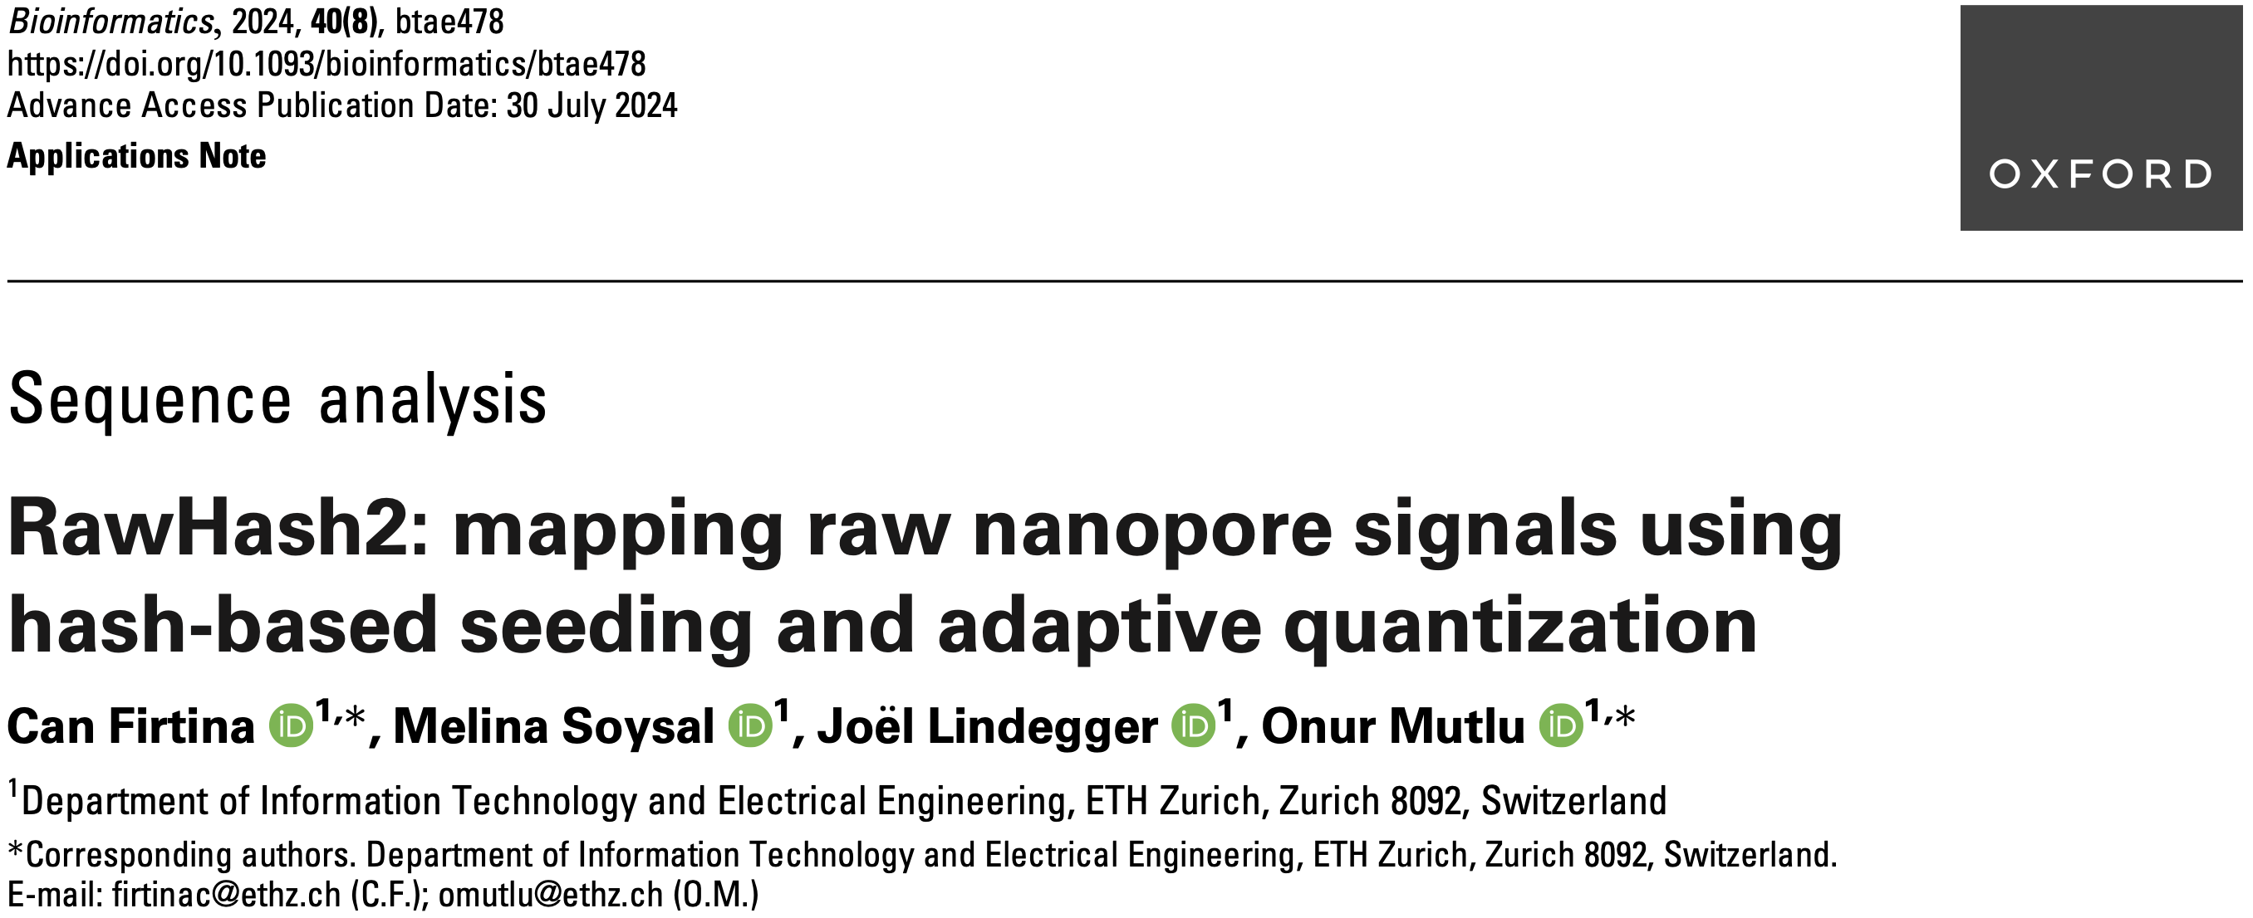
Real-Time Raw Signal Analysis [Bioinformatics '24]
Can Firtina, Melina Soysal, Joël Lindegger, and Onur Mutlu,
"RawHash2: Mapping Raw Nanopore Signals Using Hash-Based Seeding
and Adaptive Quantization"
Bioinformatics, July 2024.
[Online link at Bioinformatics Journal]
[arXiv version]
[RawHash Talk Video] (19 minutes)
[RawHash2 Source Code]

Slide 22
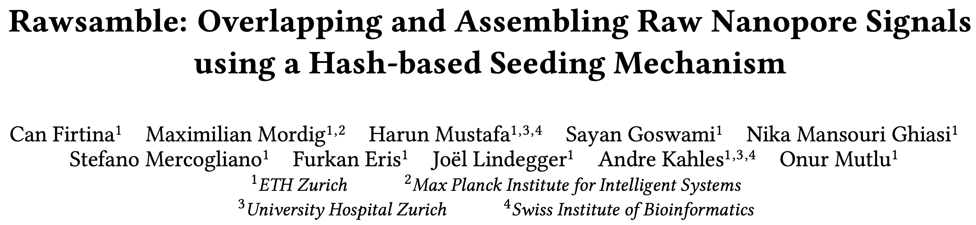
New Directions: Assembling Raw Signals
Can Firtina, Maximilian Mordig, Harun Mustafa, Sayan Goswami, Nika Mansouri Ghiasi,
Stefano Mercogliano, Furkan Eris, Joël Lindegger, Andre Kahles, and Onur Mutlu
"Rawsamble: Overlapping and Assembling Raw Nanopore Signals
using a Hash-based Seeding Mechanism"
arXiv, October 2024
[arXiv version]
[Talk Video at CSHL Data Science 2024] (16 minutes)
[Source Code]
arXiv
Source code

Slide 23
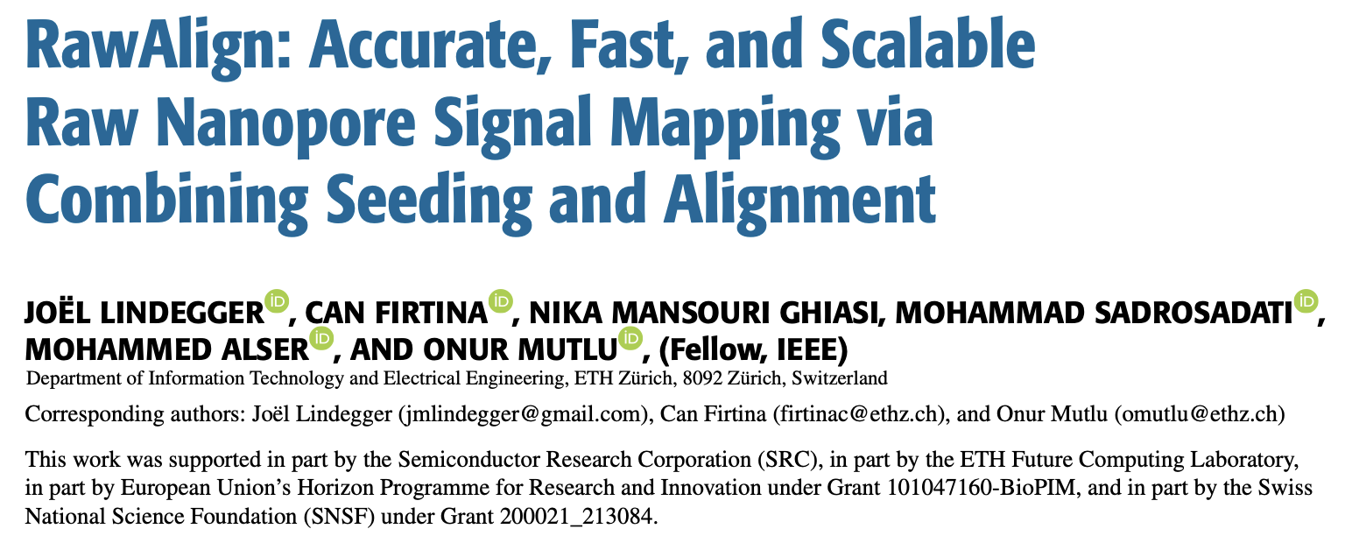
Quickly Aligning Raw Signals [IEEE Access '24]
Joel Lindegger, Can Firtina, Nika Mansouri Ghiasi, Mohammad Sadrosadati, Mohammed Alser,
and Onur Mutlu,
"RawAlign: Accurate, Fast, and Scalable Raw Nanopore Signal Mapping
via Combining Seeding and Alignment"
IEEE Access, December 2024.
[Online link at IEEE Access Journal]
[arXiv version]
[RawAlign Source Code]

Slide 24
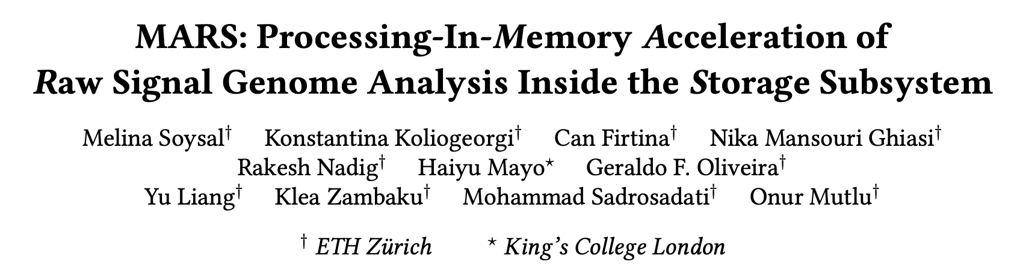
In-Storage Raw Signal Analysis [ICS '25]
Melina Soysal, Konstantina Koliogeorgi, Can Firtina, Nika Mansouri Ghiasi, Rakesh Nadig,
Haiyu Mao, Geraldo Francisco Oliveira Junior, Yu Liang, Klea Zambaku, Mohammad Sadrosadati, and Onur Mutlu
"MARS: Processing-In-Memory Acceleration of Raw Signal Genome Analysis
Inside the Storage Subsystem"
In 39th International Conference on Supercomputing (ICS), June 2025.
[arXiv version]

Slide 25
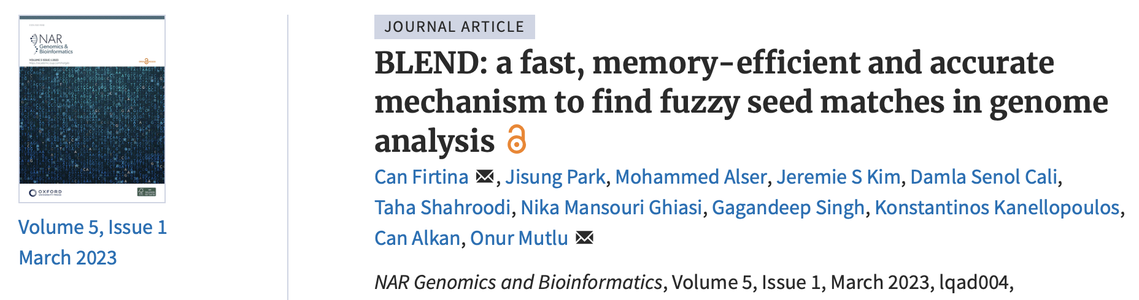
Tolerating Noise in String Matching [NARGAB '23]
Can Firtina, Jisung Park, Mohammed Alser, Jeremie S. Kim, Damla Senol Cali, Taha Shahroodi,
Nika Mansouri Ghiasi, Gagandeep Singh, Konstantinos Kanellopoulos, Can Alkan, Onur Mutlu,
"BLEND: A Fast, Memory-Efficient, and Accurate Mechanism
to Find Fuzzy Seed Matches in Genome Analysis"
NAR Genomics and Bioinformatics, March 2023.
[Online link at NAR Genomics and Bioinformatics Journal]
[arXiv version]
[bioRxiv version]
[Talk Video at RECOMB 2023] (23 minutes)
[BLEND Source Code]

Slide 26
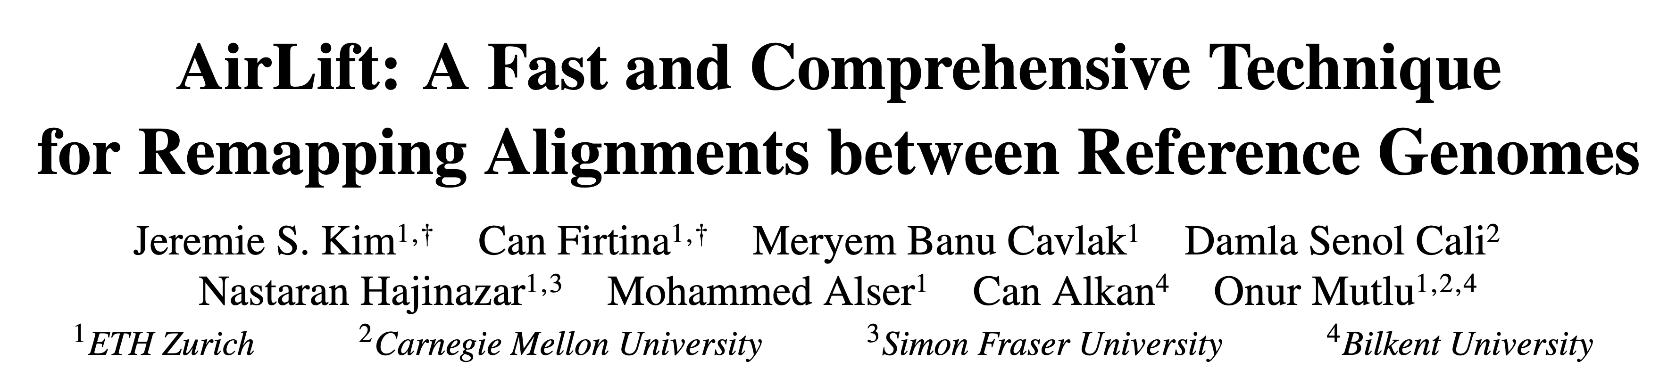
Mitigating Useless Computations [IEEE/ACM TCBB '24]
Jeremie S. Kim*, Can Firtina*, Meryem Banu Cavlak, Damla Senol Cali, Nastaran Hajinazar,
Mohammed Alser, Can Alkan, and Onur Mutlu,
"AirLift: A Fast and Comprehensive Technique for Remapping Alignments
between Reference Genomes"
IEEE/ACM TCBB, August 2024.
[Online link at IEEE/ACM TCBB Journal]
[arXiv version]
Presented at the 21st Asia Pacific Bioinformatics Conference (APBC),
Changsha, China, April 2023.
[Slides (pptx) (pdf)]
[Talk Video at BIO-Arch 2023 Workshop] (22 minutes)
[AirLift Source Code]
*Equal contribution

Slide 27
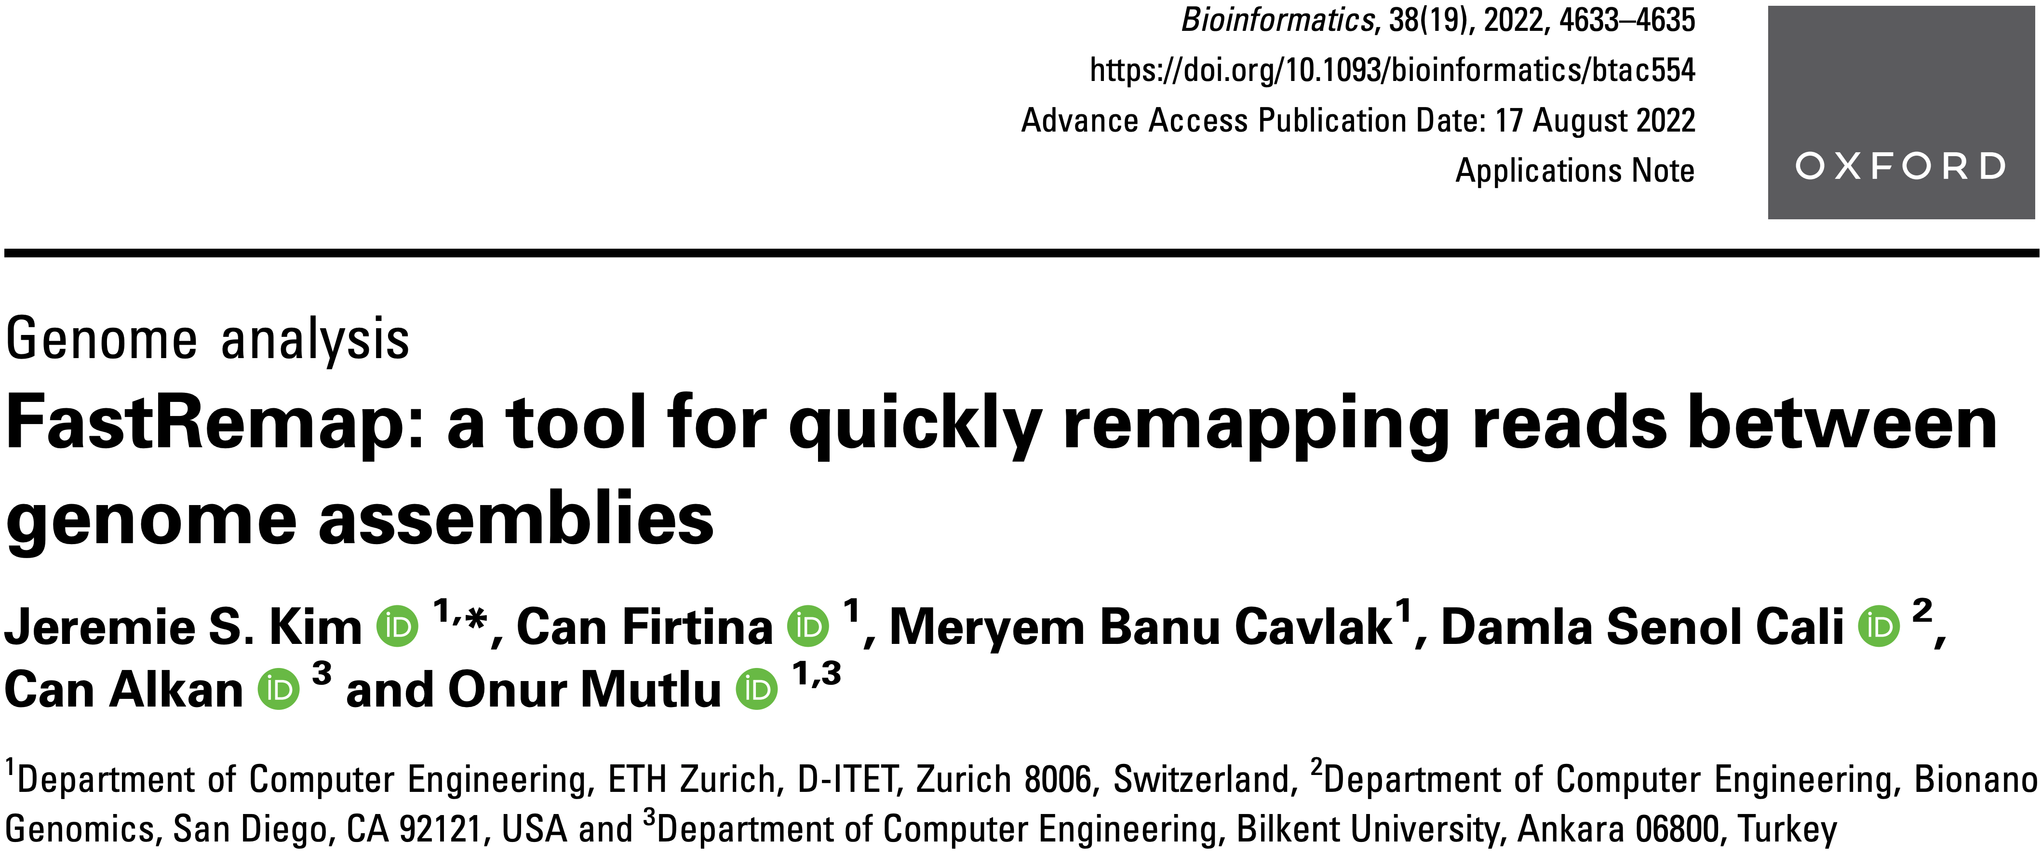
Mitigating Useless Computations [Bioinformatics '22]
Jeremie S. Kim, Can Firtina, Meryem Banu Cavlak, Damla Senol Cali, Can Alkan, and Onur Mutlu,
"FastRemap: A Tool for Quickly Remapping Reads between Genome Assemblies"
Bioinformatics, October 2022.
[Online link at Bioinformatics Journal]
[arXiv preprint]
[FastRemap Source Code]

Slide 28
Utilizing AI/ML in
Genome Analysis via New Algorithms and
Architectures

Slide 29
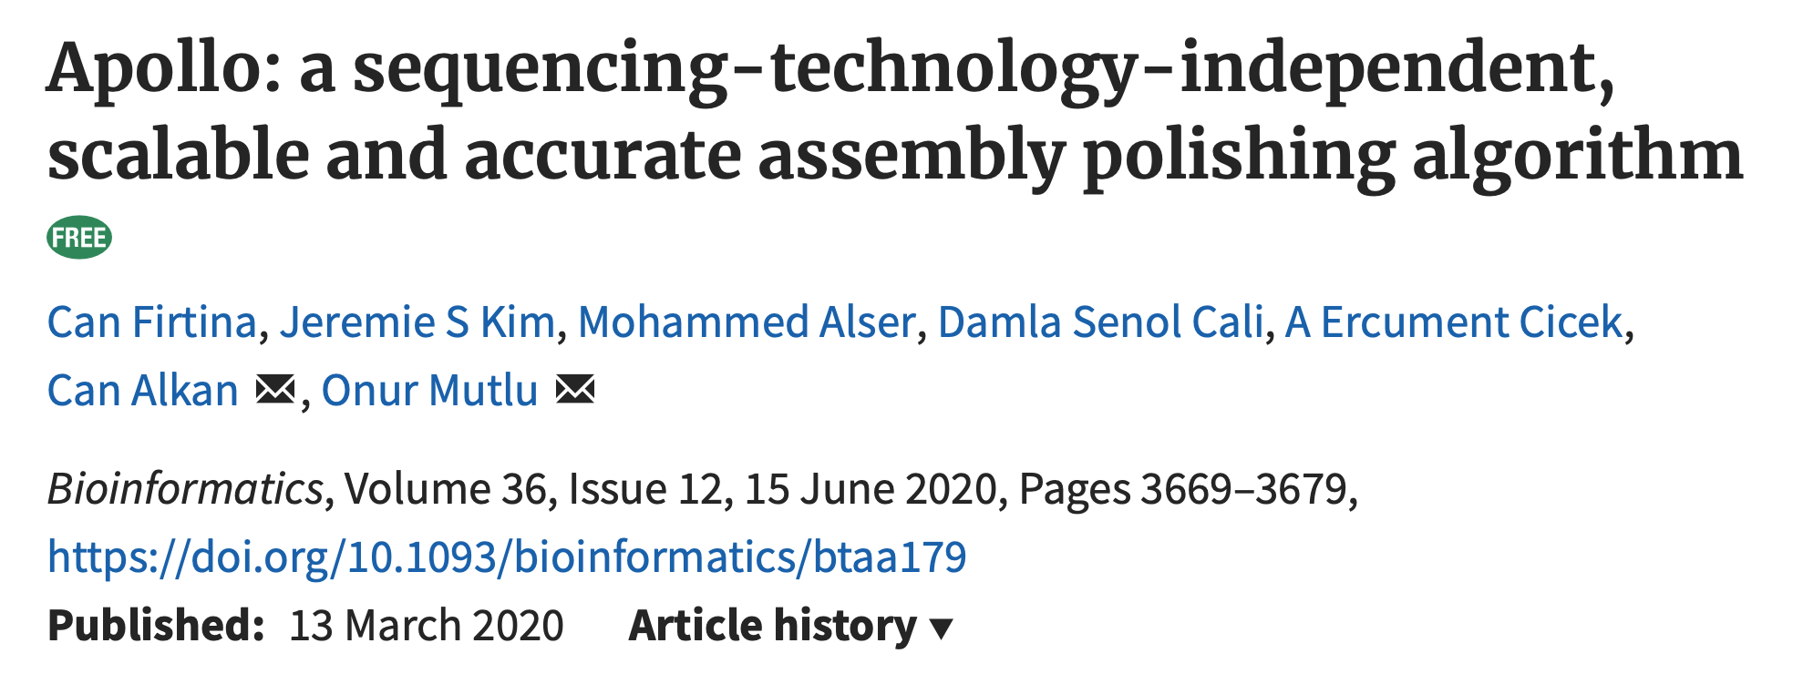
Error Correction using ML [Bioinformatics '20]
Can Firtina, Jeremie S. Kim, Mohammed Alser, Damla Senol Cali, A. Ercument Cicek, Can Alkan,
and Onur Mutlu,
"Apollo: A Sequencing-Technology-Independent, Scalable,
and Accurate Assembly Polishing Algorithm"
Bioinformatics, June 2020.
[Online link at Bioinformatics Journal]
[arXiv version]
[Slides (pptx)][(pdf)]
[Source Code]

Slide 30
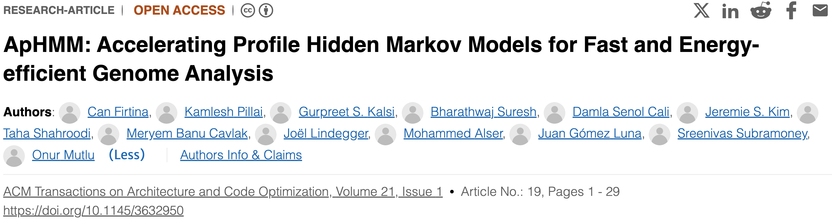
Accelerating ML & Genome Graphs [ACM TACO '24]
Can Firtina, Kamlesh Pillai, Gurpreet S. Kalsi, Bharathwaj Suresh, Damla Senol Cali, Jeremie S. Kim, Taha Shahroodi, Meryem Banu Cavlak, Joel Lindegger, Mohammed Alser, Juan Gomez Luna, Sreenivas Subramoney and Onur Mutlu,
"ApHMM: Accelerating Profile Hidden Markov Models for
Fast and Energy-efficient Genome Analysis"
ACM Transactions on Architecture and Code Optimization (TACO), Feb 2024.
[ACM Digital Library version]
[arXiv version]
Presented at the 19th HiPEAC Conference, Munich, Germany, January 2024.
[Slides (pptx) (pdf)]
[Talk Video HiPEAC 2024] (35 minutes)
[ApHMM Source Code]

Slide 31
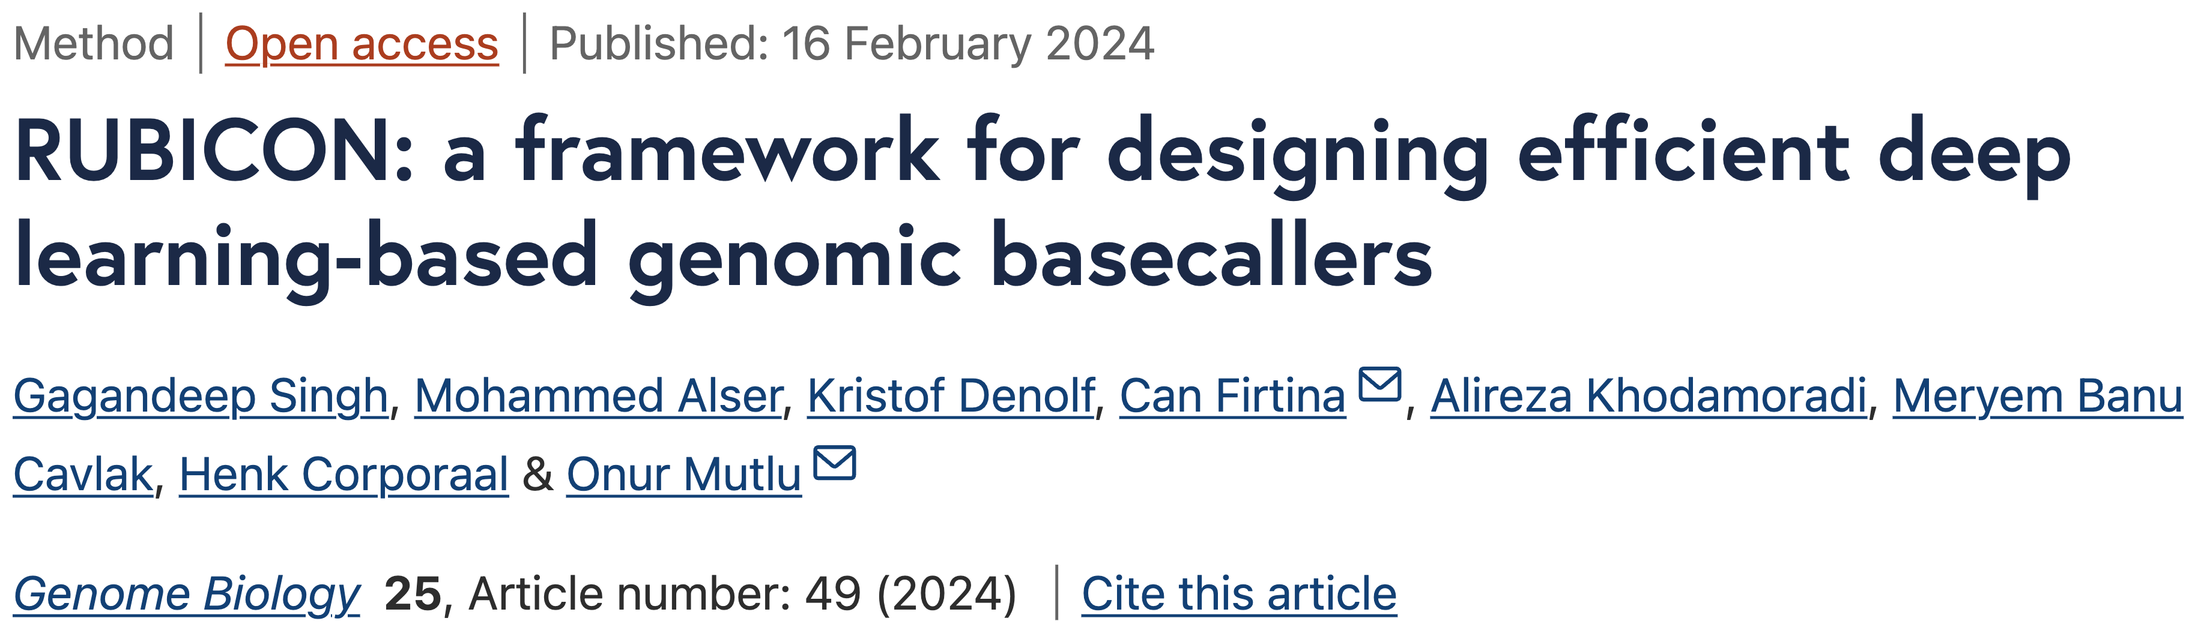
Translating Raw Signals using ML [Genome Biology '24]
Gagandeep Singh, Mohammed Alser, Kristof Denolf, Can Firtina, Alireza Khodamoradi,
Meryem Banu Cavlak, Henk Corporaal and Onur Mutlu,
"RUBICON: A Framework for Designing Efficient Deep Learning-Based Genomic Basecallers"
Genome Biology, February 2024.
[arXiv version]
[Online link at Genome Biology Journal]
[RUBICON Source Code]

Slide 32
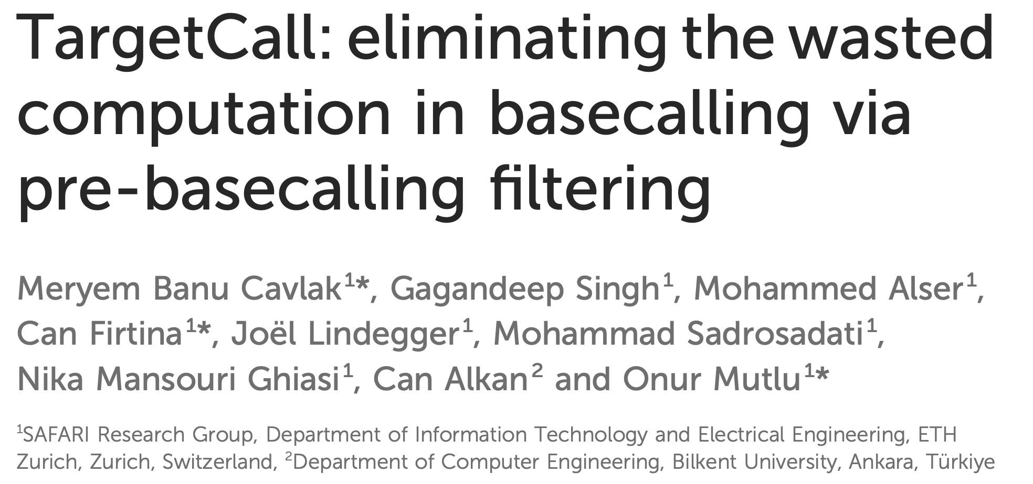
Eliminating Useless Basecalling [Frontiers In Genetics '24]
M. Banu Cavlak, Gagandeep Singh, Mohammed Alser, Can Firtina, Joel Lindegger, Mohammad Sadrosadati, Nika Mansouri Ghiasi, Can Alkan, and Onur Mutlu,
"TargetCall: Eliminating the Wasted Computation in Basecalling
via Pre-Basecalling Filtering"
Frontiers in Genetics, October 2024.
[Online link at Frontiers in Genetics Journal]
[arXiv Version]
[Talk Video at BIO-Arch 2023 Workshop]
[TargetCall Source Code]

Slide 33
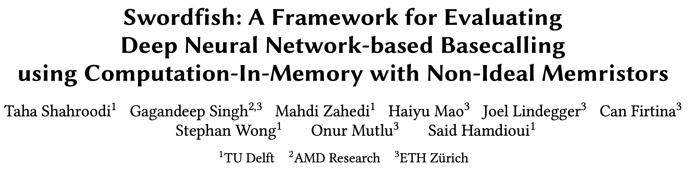
Basecalling using PIM [MICRO '23]
Taha Shahroodi, Gagandeep Singh, Mahdi Zahedi, Haiyu Mao, Joel Lindegger, Can Firtina,
Stephan Wong, Onur Mutlu, and Said Hamdioui,
"Swordfish: A Framework for Evaluating Deep Neural Network-based Basecalling
using Computation-In-Memory with Non-Ideal Memristors"
Proceedings of the 56th International Symposium on Microarchitecture (MICRO), Toronto, ON, Canada, November 2023.
[Slides (pptx) (pdf)]
[arXiv version]

Slide 34
DNN Hardware Acceleration
DNN execution is dominated by:
Vector-Matrix Multiplication (VMM)
Data movement between memory and accelerator
(e.g., GPU or TPU)
Memristor-based PIM for DNN Acceleration
Memristor-based crossbars support VMM
Processing in Memory (PIM) minimizes data movement
  [Ankit+, ASPLOS 2019], [Chi+, ISCA 2016], [Lou+, PACT2020], [Shafiee+, ISCA 2016]

Slide 35
VMM in Memristor-based Crossbars
Digital to Analog Converters
Analog to Digital Converters

Slide 36
Non-idealities in Memristor-based Crossbars
Variation in
Synaptic Conductance
Non-ideal DAC
Digital to Analog Converters
Wire Resistance
Analog to Digital Converters
Non-ideal ADC
Subpar utilization of trained models
due to non-idealities

Slide 37
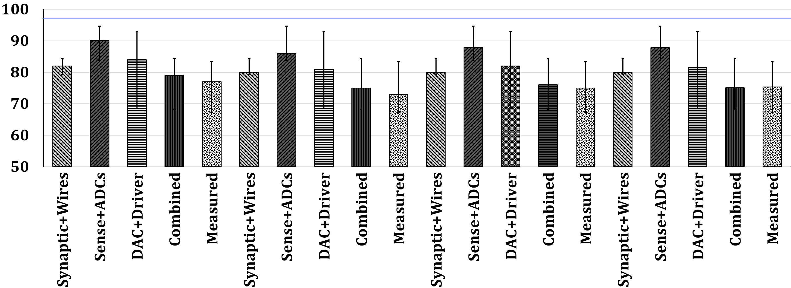
Accuracy: All Non-idealities without Mitigation
D1
Baseline
D2
Baseline
Accuracy (%)
Non-idealities
Combined non-idealities leads to significant accuracy loss (>18%)

Slide 38
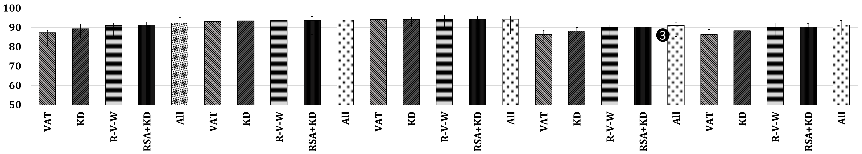
Accuracy: Enhancement Techniques on All Non-idealities
D1
Baseline
D3
Baseline
Accuracy (%)
Enhancement Technique
Accuracy loss drops to 6% from 18% after handling all non-idealities

Slide 39
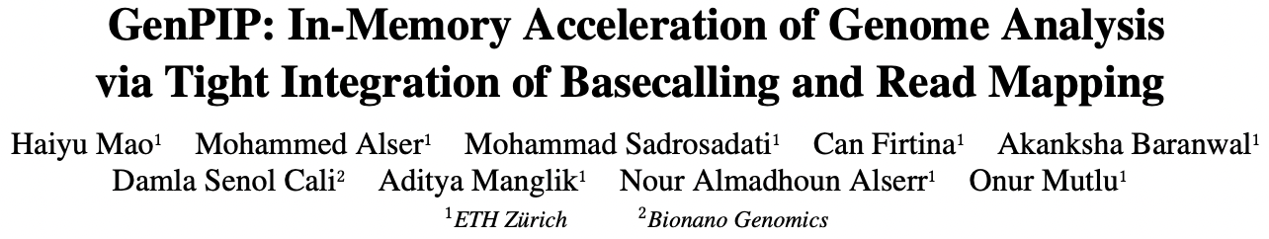
ML-based Genome Analysis via PIM [MICRO '22]
Haiyu Mao, Mohammed Alser, Mohammad Sadrosadati, Can Firtina, Akanksha Baranwal,
Damla Senol Cali, Aditya Manglik, Nour Almadhoun Alserr, and Onur Mutlu,
"GenPIP: In-Memory Acceleration of Genome Analysis via Tight Integration
of Basecalling and Read Mapping"
Proceedings of the 55th International Symposium on Microarchitecture (MICRO), Chicago, IL, USA, October 2022.
[Slides (pptx) (pdf)]
[Longer Lecture Slides (pptx) (pdf)]
[Lecture Video (25 minutes)]
[arXiv version]

Slide 40
Problem 1: Large Data Movement
Raw Signals
Basecalling
Reads
Read quality
control
High-quality
reads
Read
mapping
Mapped
reads
3913 GB
546 GB
437 GB
382 GB
Large data movement between genome analysis steps
[NC'19] Rory Bowden, Robert W Davies, Andreas Heger, Alistair T Pagnamenta, Mariateresa de Cesare, Laura E Oikkonen, Duncan Parkes, Colin Freeman, Fatima Dhalla, Smita Y Patel, et al. Sequencing of human genomes with nanopore technology. Nature Communications, 2019.

Slide 41
Problem 2: Wasted Computation
100%
79.5%
69.5%
Raw Signals
Basecalling
Reads
Read quality
control
High-quality
reads
Read
mapping
Mapped
reads
Low-quality
reads
Unmapped
reads
20.5%
10%
A considerable amount of computation on useless data due to
Low-quality reads
Unmapped reads

Slide 42
Goal and Opportunities
Goal: Efficiently accelerate the entire genome analysis pipeline while minimizing data movement and useless computation
We perform a study to quantify potential performance benefits
NVM-based PIM accelerators for separate basecalling and read mapping
no data movement
between the accelerators of analysis steps
no data movement
and
no useless reads
(ideal case)

Slide 43
GenPIP Overview
Raw signals from the sequencing machine
GenPIP
In-memory
Read Mapping
[PARC, ASPDAC’20]
+ Our design
In-memory
Basecaller
[Helix, PACT’20]
Signal
chunk
eDRAM
Basecalled
chunk
Chunk
Average Calculator
Read Mapping Controller
Base quality score
Chunk quality score
Quality score
PIM-CQS
PIM chunk quality score calculation
ER
Controller
Chunk mapping score
Read mapping result
To storage
Basecalling Module
ER
GenPIP Controller
ER
Read Mapping Module
https://arxiv.org/pdf/2209.08600.pdf

Slide 44
Fast, Accurate, and Efficient
Genome Analysis
via Algorithm-Architecture
co-design

Slide 45
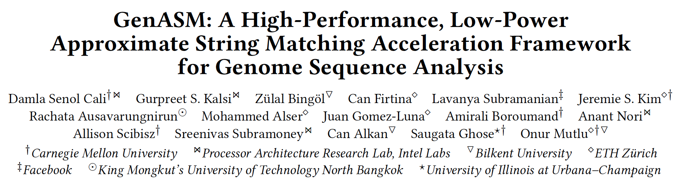
Accelerating String Matching [MICRO '20]
Damla Senol Cali, Gurpreet S. Kalsi, Zulal Bingol, Can Firtina, Lavanya Subramanian,
Jeremie S. Kim, Rachata Ausavarungnirun, Mohammed Alser, Juan Gomez-Luna,
Amirali Boroumand, Anant Nori, Allison Scibisz, Sreenivas Subramoney, Can Alkan,
Saugata Ghose, and Onur Mutlu,
"GenASM: A High-Performance, Low-Power Approximate String Matching Acceleration Framework for Genome Sequence Analysis"
Proceedings of the 53rd International Symposium on Microarchitecture (MICRO), Virtual, October 2020.
[Lightning Talk Video (1.5 minutes)]
[Lightning Talk Slides (pptx) (pdf)]
[Talk Video (18 minutes)]
[Slides (pptx) (pdf)]

Slide 46
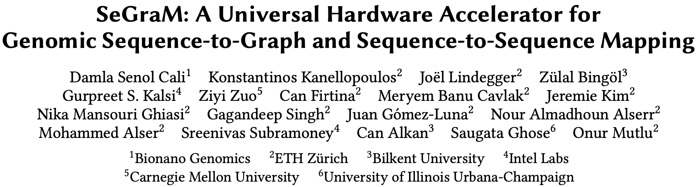
Accelerating Genome Graphs [ISCA '22]
Damla Senol Cali, Konstantinos Kanellopoulos, Joel Lindegger, Zulal Bingol, Gurpreet S. Kalsi,
Ziyi Zuo, Can Firtina, Meryem Banu Cavlak, Jeremie Kim, Nika Mansouri Ghiasi, Gagandeep Singh,
Juan Gomez-Luna, Nour Almadhoun Alserr, Mohammed Alser, Sreenivas Subramoney, Can Alkan,
Saugata Ghose, and Onur Mutlu,
"SeGraM: A Universal Hardware Accelerator for Genomic Sequence-to-Graph
and Sequence-to-Sequence Mapping"
Proceedings of the 49th International Symposium on Computer Architecture (ISCA), New York, June 2022.
[Slides (pptx) (pdf)]
[arXiv version]
[SeGraM Source Code and Datasets]
[Talk Video (22 minutes)]

Slide 47
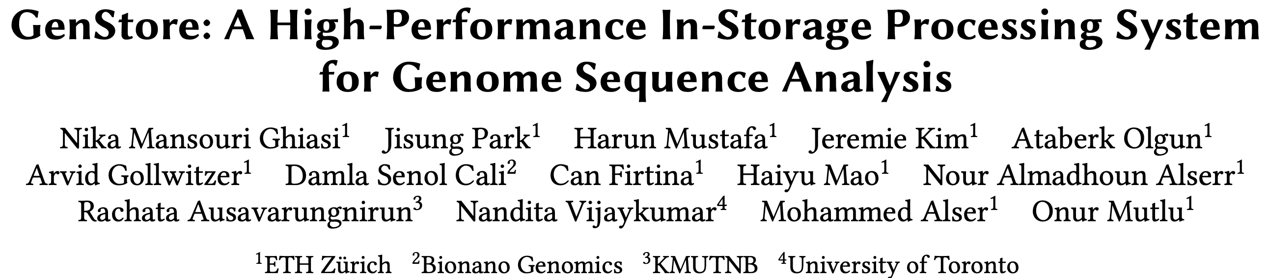
In-Storage Filtering for Genomics [ASPLOS '22]
Nika Mansouri Ghiasi, Jisung Park, Harun Mustafa, Jeremie Kim, Ataberk Olgun, Arvid Gollwitzer,
Damla Senol Cali, Can Firtina, Haiyu Mao, Nour Almadhoun Alserr, Rachata Ausavarungnirun,
Nandita Vijaykumar, Mohammed Alser, and Onur Mutlu,
"GenStore: A High-Performance and Energy-Efficient In-Storage Computing System
for Genome Sequence Analysis"
Proceedings of the 27th International Conference on Architectural Support for Programming Languages and Operating Systems (ASPLOS), Virtual, Feb 2022.
[Lightning Talk Slides (pptx) (pdf)]
[Lightning Talk Video (90 seconds)]

Slide 48
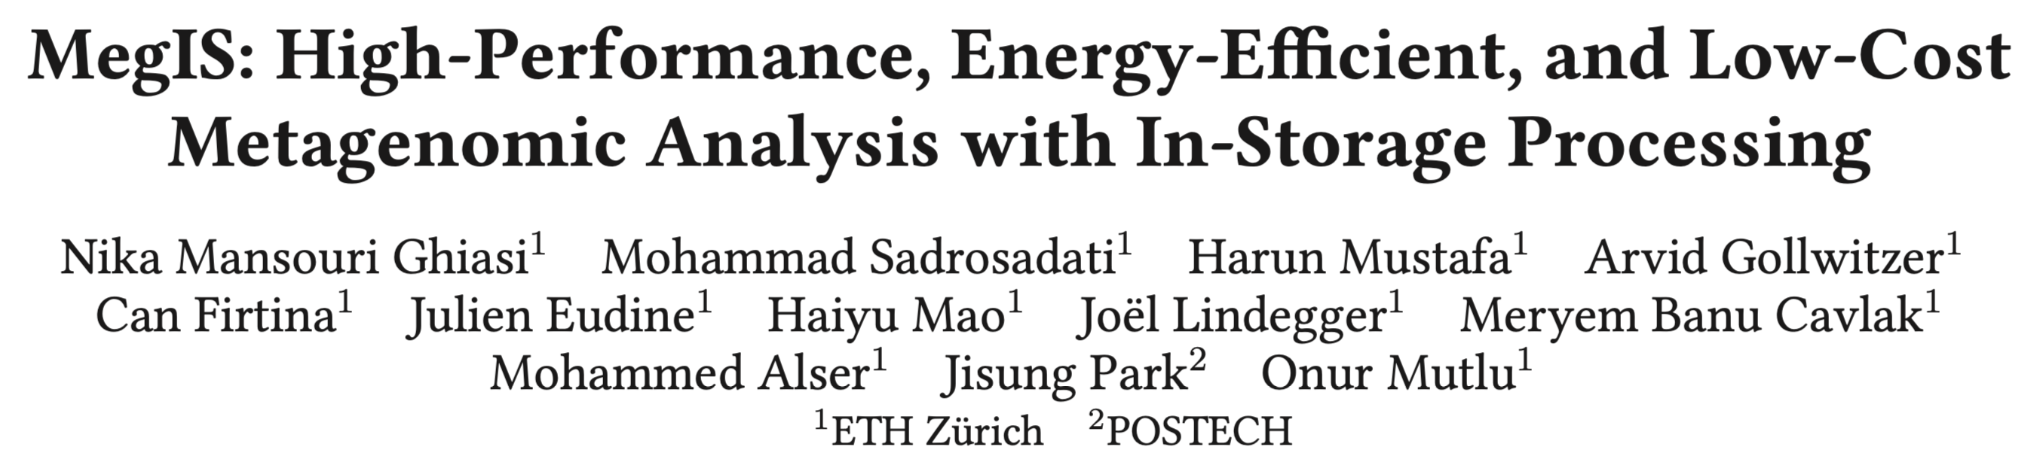
In-Storage Metagenomics [ISCA '24]
Nika Mansouri Ghiasi, Mohammad Sadrosadati, Harun Mustafa, Arvid Gollwitzer, Can Firtina,
Julien Eudine, Haiyu Mao, Joel Lindegger, Meryem Banu Cavlak, Mohammed Alser, Jisung Park,
and Onur Mutlu,
"MegIS: High-Performance and Low-Cost Metagenomic Analysis with In-Storage Processing"
Proceedings of the 51st Annual International Symposium on Computer Architecture (ISCA), Buenos Aires, Argentina, July 2024.
[Slides (pptx) (pdf)]
[arXiv version]

Slide 49
Accelerating Genome Analysis [DAC '23]
Onur Mutlu and Can Firtina,
"Accelerating Genome Analysis via Algorithm-Architecture Co-Design"
Invited Special Session Paper in Proceedings of the 60th Design Automation Conference (DAC), San Francisco, CA, USA, July 2023.
[Related Invited Paper]
[arXiv version]
[Slides (pptx) (pdf)]
[Talk Video at DAC 2023] (38 minutes, including Q&A)

Slide 50



Overview of Our Research Interests
Goal: Enable Fast, Energy-Efficient, Accurate, and Scalable Genome Analysis
by Designing Algorithms and Architectures
Today’s Talk
Real-Time and
Raw Sequencing Data Analysis
Accurate and Fast Algorithm Design
for Read Mapping
[Bioinformatics'22]
Data-Centric
Architectures for Genome Analysis
[ISMB/ECCB'23]
[Bioinformatics'24]
[NARGAB'23 & RECOMB'23]
[IEEE Access'24]
Algorithm & Hardware Design for AI
in Genome Analysis
Reviews
[CSBJ'22]
[DAC'23]
[Nature Protocols'24]
[arXiv'23]
[MICRO'20]
[arXiv'24 & HiTSeq'24]
[arXiv'23]
[MICRO'22]
[Bioinformatics'20]
[IEEE/ACM TCBB'24]
[ISCA'22]
[ACM TACO'24]
[ASPLOS'22]
[Genome Biology'24]
[IEEE Access'22]
[Front. in Genetics'24]
[MICRO'23]
[ISCA'24]

Slide 51


Today’s Talk
Significant computation and energy overhead
Limited accuracy and application scope
Algorithm & Hardware Design
for AI in Genome Analysis
ApHMM
(TACO'24 &
HiPEAC'24)
  Accelerating ML operations in Genome Graphs

Slide 52

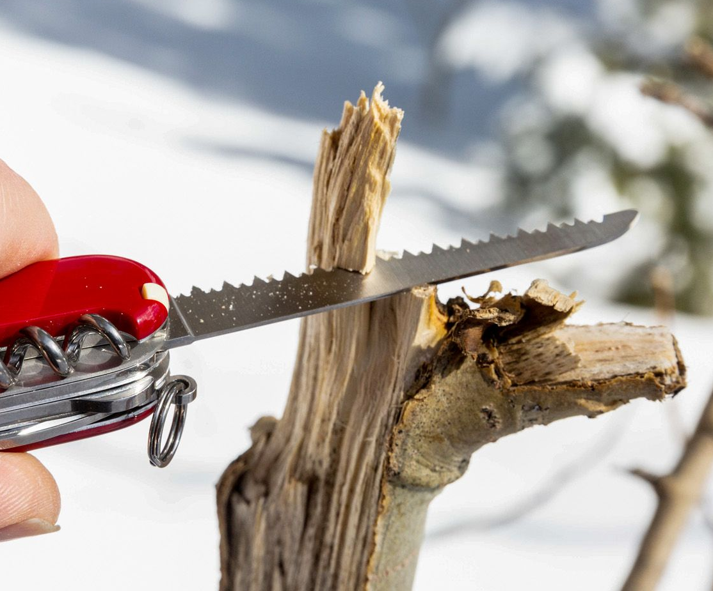
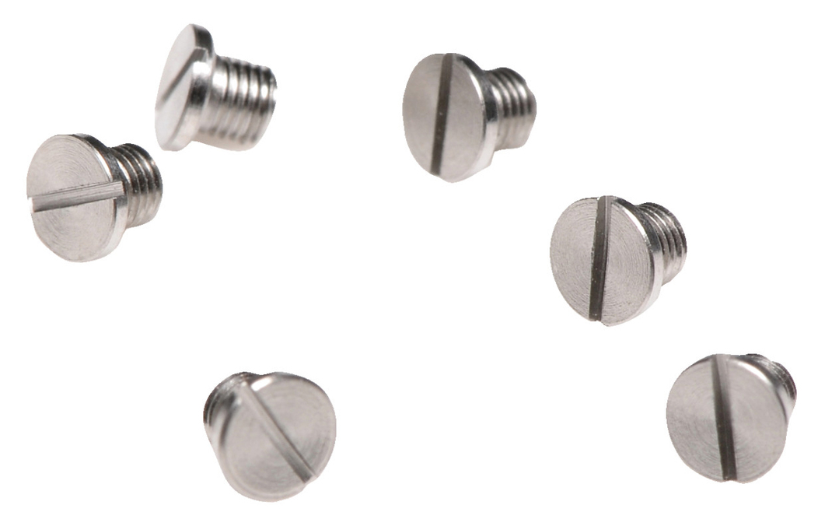

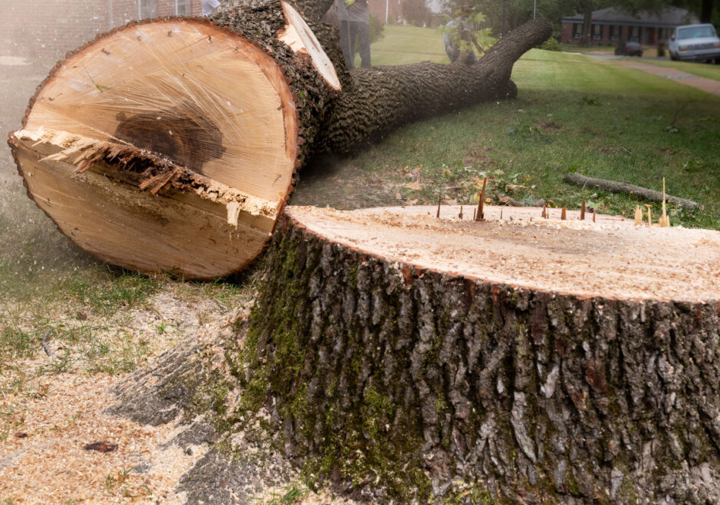
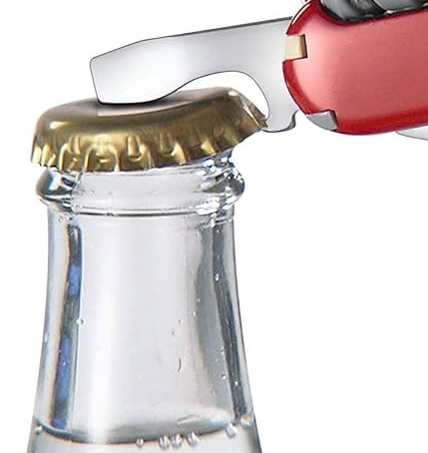
General-Purpose "Things"

Slide 53
Algorithm Design Demands General-Purpose Computing
Your Favorite
Algorithm
Function 1
Function 2
Function 4
Function 3
Your Favorite
Output
General-Purpose Systems
(e.g., CPUs)
Paid Costs for Generality:
Supporting unnecessary operations
Inefficient data and control flow
Limited parallelism & bandwidth
High latency &
Substantial energy

Slide 54
Great Algorithms Demand Specialization
Application-Specific Architecture
Everyone’s Favorite
Algorithm
Function 1
Function 1
Function 2
Function 2
Function 3
Function 3
Goal: Avoid wasting computation & energy
Opportunities:
Better data flow with minimal latency & power
Paid Costs for Specialization:
Poor programmability
High manufacturing and engineering costs
Efficient processors customized for the task
Better parallelism

Slide 55
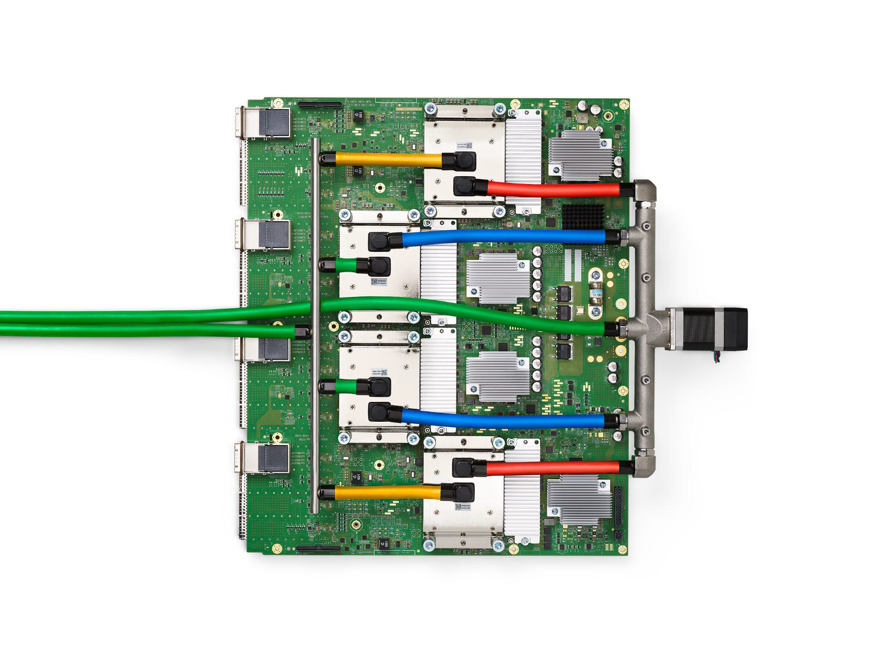
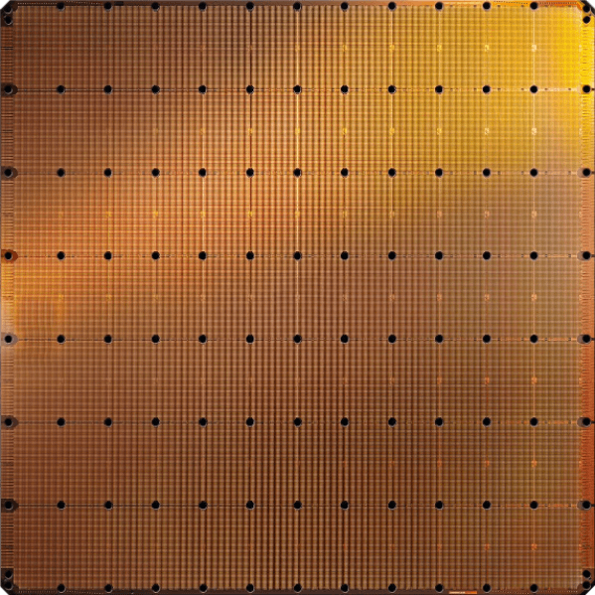
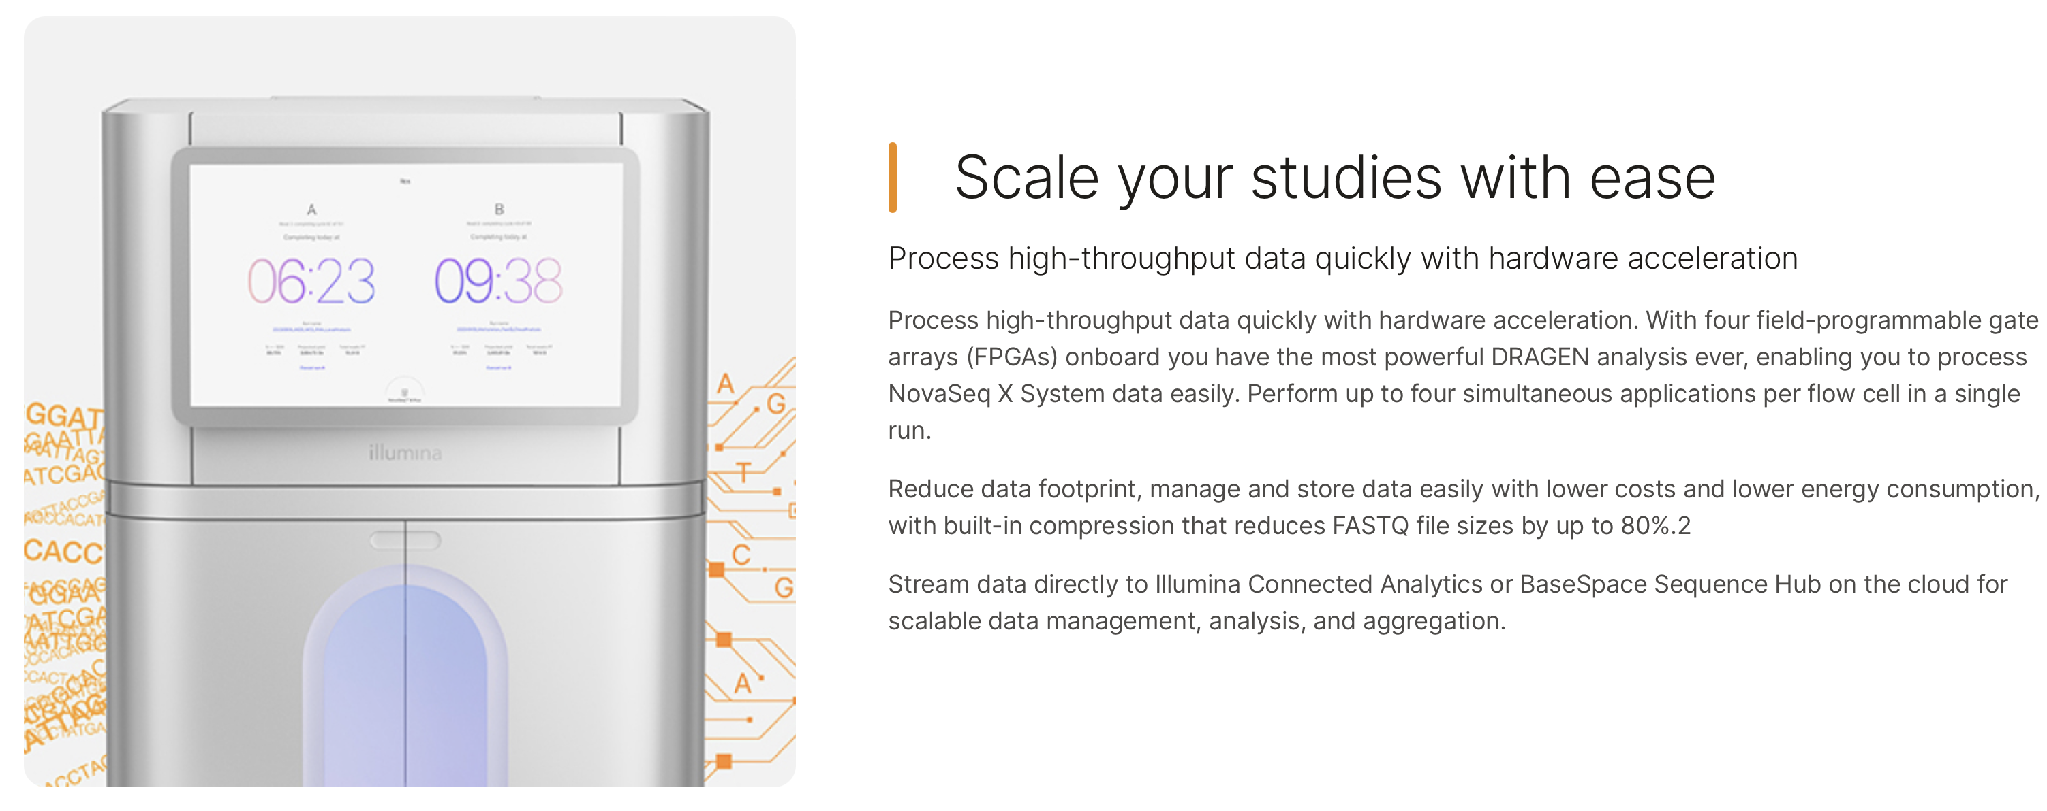
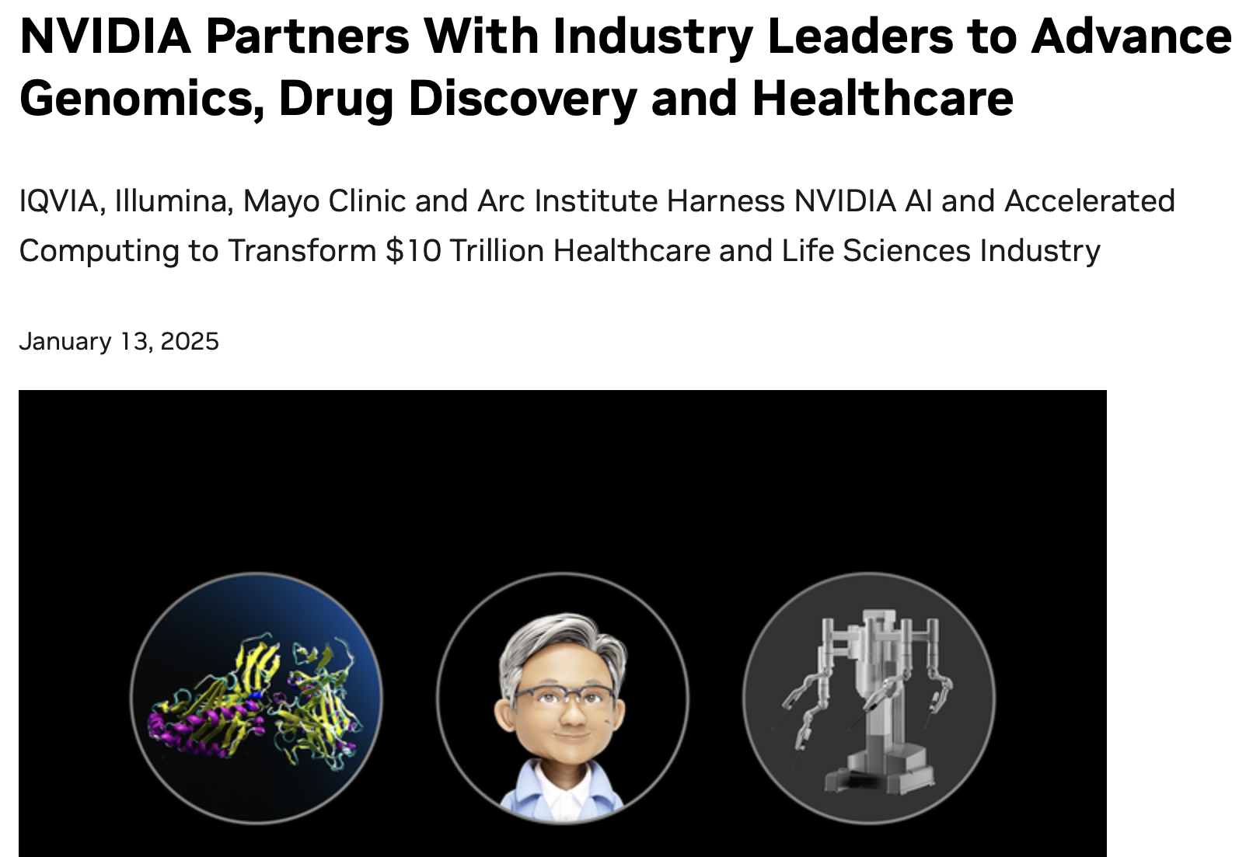
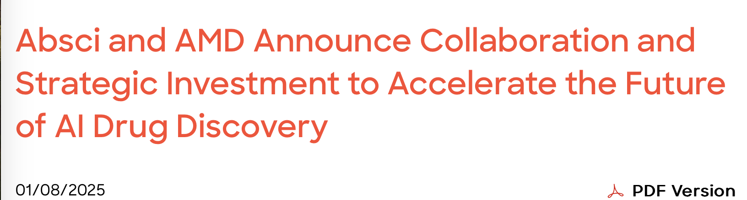
Acceleration Efforts for AI and Genomics
Cerebras WSE-3
The largest ML accelerator chip
Google’s TPUs:
NVIDIA H100

Slide 56
Important and
Commonly Used Applications
Demand Specialization

Slide 57




Probabilistic Graphs in Genomics
Probabilistic graphs are commonly used
to identify variations between sequences
To avoid redundant comparisons
and storage
To provide rich information
on expected variations
Reference Genome Graph

Slide 58
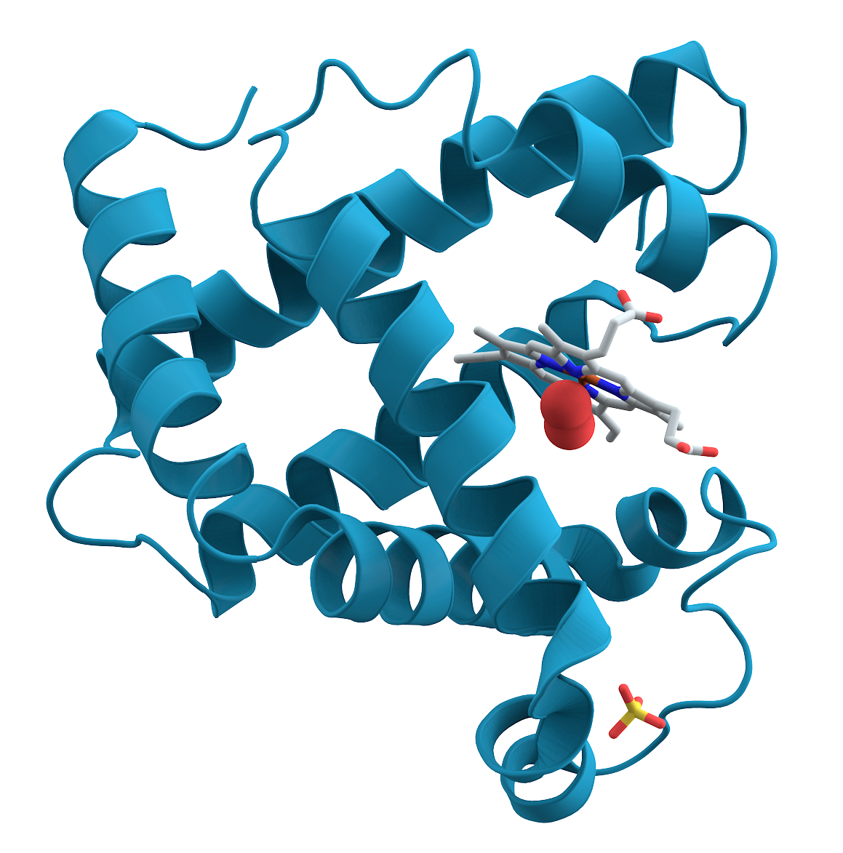
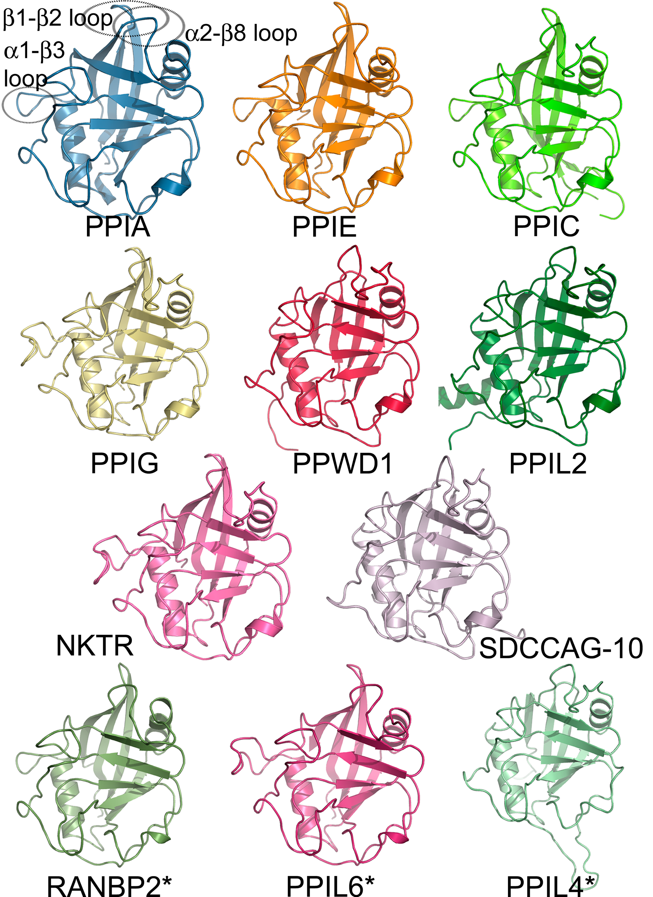
Graph-Based Applications in Genomics
Protein Family Search
with Graph Alignment
Error Correction
with Probabilistic Graphs
Multiple Sequence
Alignment
Protein
GCCC-TATGGTTAAGCTT
GCCCATATGGTTAAGCTT
GCCCATATGATTAAGCTT
CCCT
TGCT
GCTA
GCCCATATGGTTAAGCTT
CCTA
GCTT
GCCCGTATGGTT--GCTT
Protein
Family #1
Protein
Family #2
ATGC
AAGC
GCCCATATGCTTAAGCTT
GCCC---TGGTTAAGCT-
CCCT
GCTT
GCCCATATCCTTAAGCTT
GCCCTTATGCTTAAGCTA
GCCCATATGGTTAAGCTT

Slide 59
A Common Graph Structure in Genomics
Profile Hidden Markov Models (PHMMs):
A probabilistic graph structure
0.4
0.3
A: 0.1
T: 0.2
G: 0.6
C: 0.1
A: 0.2
T: 0.2
G: 0.2
C: 0.4
I
I
I
I
0.6
0.2
0.1
A
C
T
T
A: 0.9
T: 0.1
G: 0.0
C: 0.0
A: 0.1
T: 0.1
G: 0.1
C: 0.7
0.7
D
D
D

Slide 60
Underlying ML Technique in Genomic Graphs
Forward Calculations
Backward Calculations
Updating
Transition Probabilities
Updating
Emission Probabilities

Slide 61
Underlying ML Technique in Genomic Graphs
Forward Calculations
Backward Calculations
Function 1
Function 1
Function 2
Function 2
Updating
Transition Probabilities
Updating
Emission Probabilities
Function 3
Function 4

Slide 62
Costly Use of ML in Genomic Graphs
Cost of Using Machine Learning (ML) in pHMMs:
51.44%
45.76%
98.57%

Slide 63
Goal
Enable rapid and power-efficient
use of the underlying ML technique in genome graphs

Slide 64
Key Approach: HW-SW Co-Design
SW
Reduce redundant data storage by utilizing
the fixed data pattern
Reduce unnecessary computations with quick filtering
Avoid repeated operations by utilizing lookup tables
Reduce data movement by processing data where it makes sense
Flexible and efficient hardware design
HW

Slide 65





HW: Simple Data Pattern in DP Calculations
DP Operations
in pHMMs:
Dynamic Programming
(DP) Operations:
$$F_{t}\left(i\right)$$
$$i$$
$$i$$
A
I
D
C
I
D
T
I
D
$$t$$
$$t$$
A
T
G
T
Many Different Patterns
Simple Pattern
Frequent off-chip access
MUL
MUL
ADD
FP DIV
Fast On-chip Memory Access
DP Computation in pHMMs
Store and access data
where it makes sense

Slide 66




SW: Reducing Unnecessary Computations
Observation:
Calculating the entire DP
is not needed
$$F_{t}\left(i\right)$$
$$F_{t}\left(i\right)$$
$$i$$
A
I
D
C
I
D
T
I
D
$$i$$
A
I
D
C
I
D
T
I
D
$$t$$
$$t$$
A
Filter by sorting
A
T
T
G
G
T
T
Dense DP Calculations
Sparse (Filtered) DP Calculations
Challenge:
Sorting is costly in hardware

Slide 67

SW: Reducing Unnecessary Computations
Software co-design:
Replace sorting with a cheaper filtering
State IDs
Range
8, 9
1.00 – 0.94
10, 14
0.94 – 0.88
15, 16, 18
0.88 – 0.82
11, 20, 21, …
0.82 – 0.76
13, 17, 19, …
0.76 – 0.70
.
.
.
.
.
.
0.06 – 0.00
Histogram Filter

Slide 68
Putting the Optimizations Together
Effectively implementing the hardware and software optimizations
to improve performance and reduce power requirements

Slide 69
Integrating ApHMM in a Complete System
The specialized task can be offloaded
to an accelerator whenever needed

Slide 70
Key Results: Performance
Specialized design enables computation
up to two orders of magnitude faster:
Better data flow with reduced latency and improved parallelism

Slide 71
Key Results: Energy Consumption
…and a significant reduction in energy consumption
by up to three orders of magnitude:
simpler hardware with a minimized off-chip memory accesses and data movement

Slide 72
Specialization Provides
Significant Performance
and Energy Benefits

Slide 73
Today’s Talk
Significant computation and energy overhead
Limited accuracy and application scope
Algorithm & Hardware Design
for AI in Genome Analysis
ApHMM
(TACO'24 &
HiPEAC'24)
  Accelerating ML operations in Genome Graphs

Slide 74
Summary of Key Takeaways
There are many ways to utilize AI in genomics (and life sciences more broadly)
  We only scratched the surface of those applications today
It is critical to consider the requirements of your application
  Portable? Low latency? Highest accuracy?
It is critical to consider the limitations of your system
  And integrate these limitations in the analysis
Data movement will continue to be a major system bottleneck
  Generating biological data is getting faster and cheaper
Many future opportunities exists with emerging technologies

Slide 75











Acknowledgements
Collaborators:
Funding agencies and industry sponsors:
  BioPIM, SNSF, Intel, Google, Huawei, Microsoft, VMware, and SRC

Slide 76
Accelerating AI-Driven Genome Analysis
via Algorithm-Architecture Co-Design
Can Firtina | canfirtina@gmail.com
Senior Researcher and Lecturer at ETH Zurich
Incoming Assistant Professor of Computer Science at UMD
June 16, 2025
PASC25, Challenges in Systems Design for Omics, Switzerland

