Slide 1


Introduction to Real-Time
Raw Nanopore Signal Analysis:
RawHash and RawHash2
Can Firtina
canfirtina@gmail.com
18 March 2024
Sabanci University
BIO310 - Introduction to Bioinformatics

Slide 2

Brief Self Introduction
Can Firtina
  Ph.D. Candidate in SAFARI Research Group at ETH Zurich
Research interests: Bioinformatics & Computer Architecture
  Real-time genome analysis
  Similarity search in a large space of genomic data
  Hardware-Algorithm co-design to accelerate genome analysis
  Genome editing
  Error correction
Get to know our group and our research
  Group website: https://safari.ethz.ch/
  Contact me: canfirtina@gmail.com
  Website: https://cfirtina.com
  Twitter (aka X): https://twitter.com/FirtinaC

Slide 3
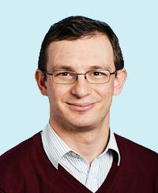
Professor Mutlu
Onur Mutlu
  Full Professor @ ETH Zurich ITET (INFK), since September 2015
  Strecker Professor @ Carnegie Mellon University ECE/CS, 2009-2016, 2016-…
  PhD from UT-Austin, worked at Google, VMware, Microsoft Research, Intel, AMD
  https://people.inf.ethz.ch/omutlu/
  omutlu@gmail.com (Best way to reach)
  https://people.inf.ethz.ch/omutlu/projects.htm
Research and Teaching in:
  Computer architecture, computer systems, hardware security, bioinformatics
  Memory and storage systems
  Hardware security, safety, predictability
  Fault tolerance
  Hardware/software cooperation
  Architectures for bioinformatics, health, medicine
  …

Slide 4
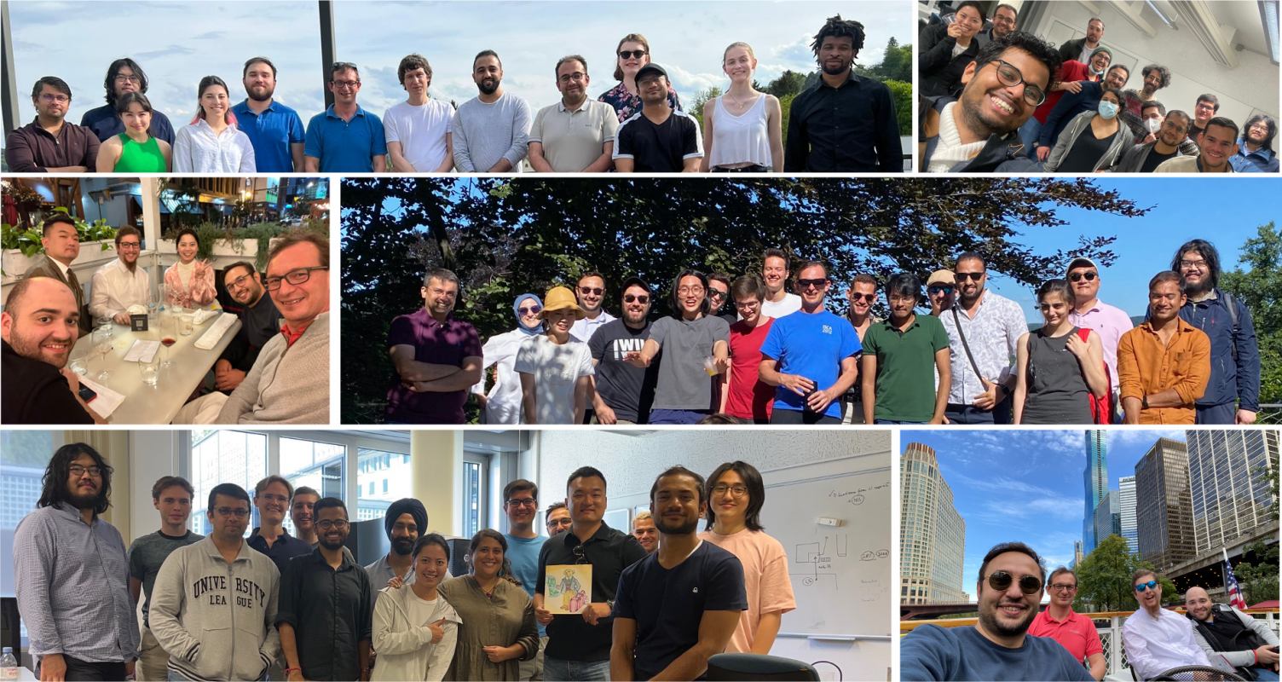

SAFARI Research Group
Computer architecture, HW/SW, systems, bioinformatics, security, memory
40+ Researchers
Think BIG, Aim HIGH!
https://safari.ethz.ch

Slide 5
Four Key Current Directions
Fundamentally Secure/Reliable/Safe Architectures
Fundamentally Energy-Efficient Architectures
  Memory-centric (Data-centric) Architectures
Fundamentally Low-Latency and Predictable Architectures
Algorithms & Architectures for AI/ML, Genomics, Medicine

Slide 6
Agenda for Today
Background
  Sequence analysis
  Raw nanopore signal analysis and real-time analysis
Enabling Fast and Accurate Real-time Analysis
  RawHash and RawHash2
Conclusion

Slide 7

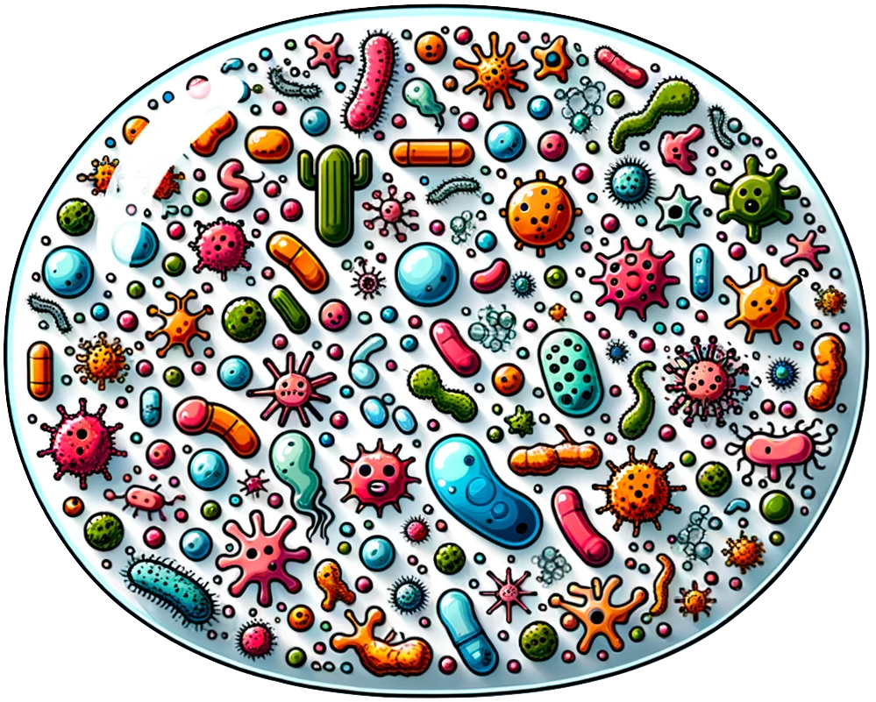


Sequence Analysis – Why?
Understanding genetic variations, species, and evolution
Predicting the presence of pathogens in an environment
Surveillance of disease outbreaks
Personalized medicine
And, many, many other applications …

Slide 8
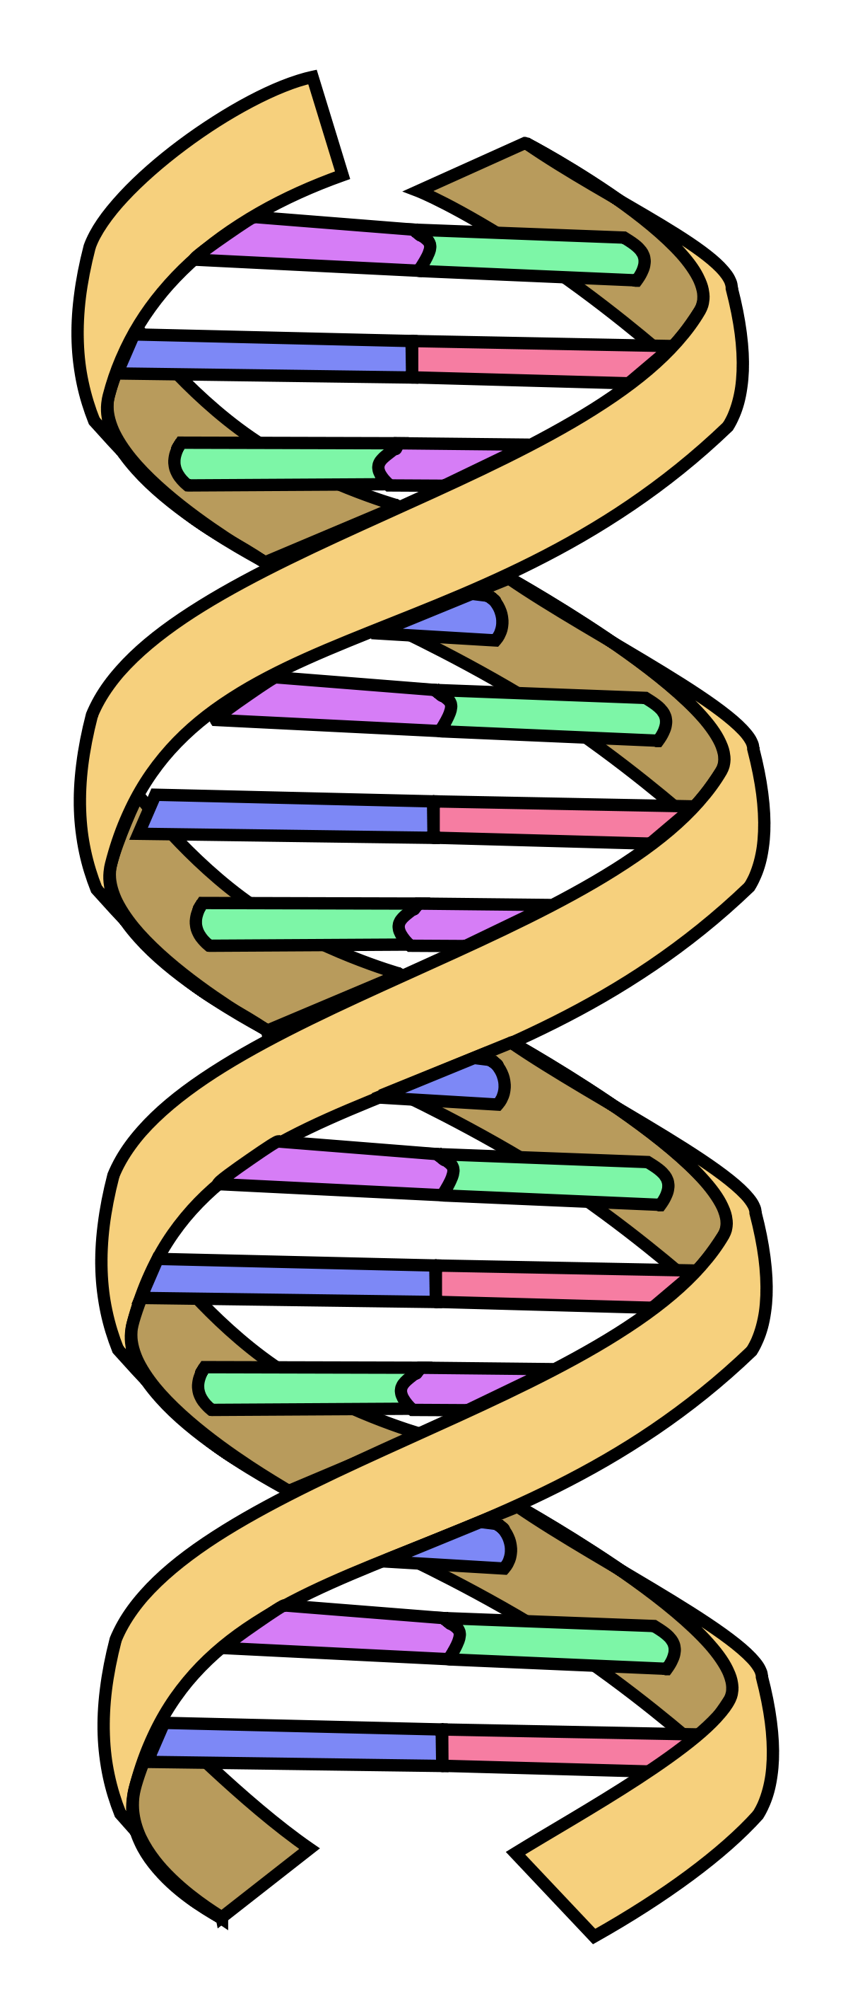
Sequence Analysis – How?
High throughput sequencing machines
  Quickly converts biological molecules into sequences of characters for analysis
AAGCTTCCATGG
AAATGGGCTTTC
GCTTCCAGAATG
Sequences from DNA (Reads)
GCCCAAATGGTT
Biological Molecule (e.g., DNA)

Slide 9

Sequence Comparison is Essential
Analyze sequences by accurately and quickly comparing
  To each other
  To a template sequence (e.g., a reference genome)
Essential to understand functionality of a sequence, mutations, diseases…
Biological Sequences
(e.g., DNA, proteins)

Slide 10
A Naïve Sequence Comparison Approach
Read mapping:
  Mapping: Identifies similar regions between a pair of sequences
  Alignment: Identifies exact differences within similar regions (costly!)
Reference
Read
Very expensive!
O(m²kn)
m: read length
k: no. of reads
n: reference genome length

Slide 11
A Practical Read Mapping
Seeds
> 3 billion characters
Reference
…CAATTTGCCCATATGGTTAAGCTTCCATGGAAATGGGCTTTCGCTTTG…
…
K-mers
Locations
Read
GCCCAAATGGTT
GCC | 7
CCC | 8
CAA | 1
AAA | 31 | 101
CCA | 25 | 230 | 400
… | … | … | …
K-mers
GCC
CCC
…
Index (Hash Table)
Indexing
Store certain k-mers with their positions for fast query
Seeding
Determine potential matching regions (seeds)
Seed Filtering
Prune uninformative/unreliable seeds
Alignment
Determine the exact differences

Slide 12

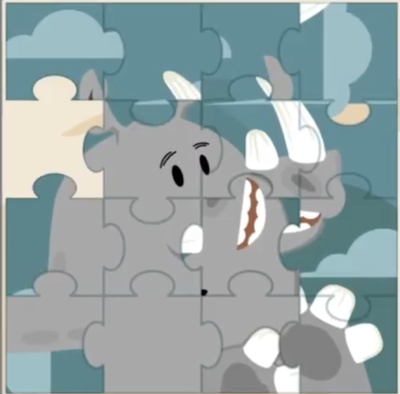
Sequencing Output and Challenges
Small pieces of a puzzle
short reads (Illumina)
Large pieces of a puzzle
long reads (Nanopore & PacBio)
Which sequencing technology is the best?
100-300 bp
low error rate (~0.1%)
500-2M bp
high error rate (~5%)
https://www.pacb.com/smrt-science/smrt-sequencing/hifi-reads-for-highly-accurate-long-read-sequencing/

Slide 13
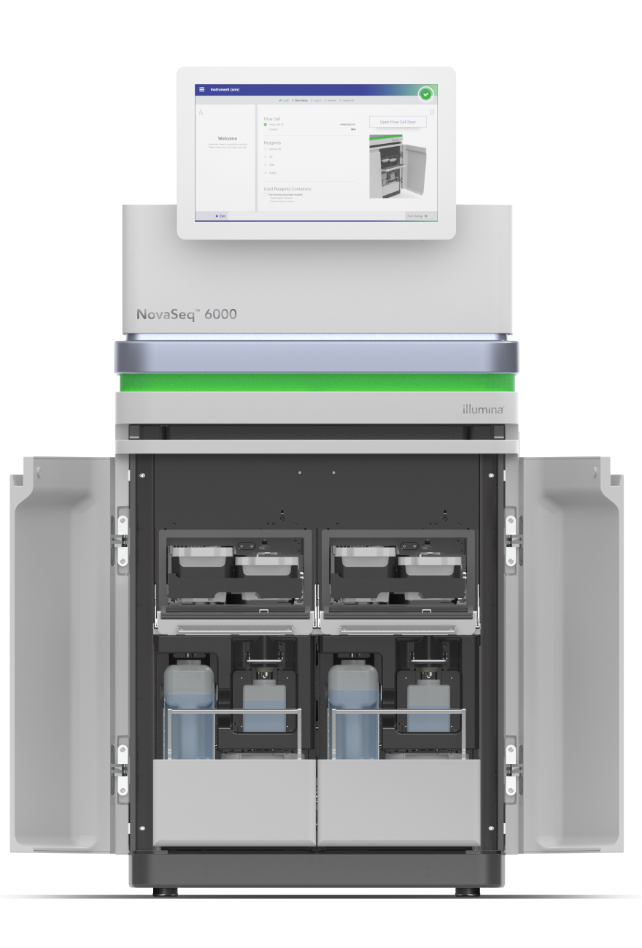
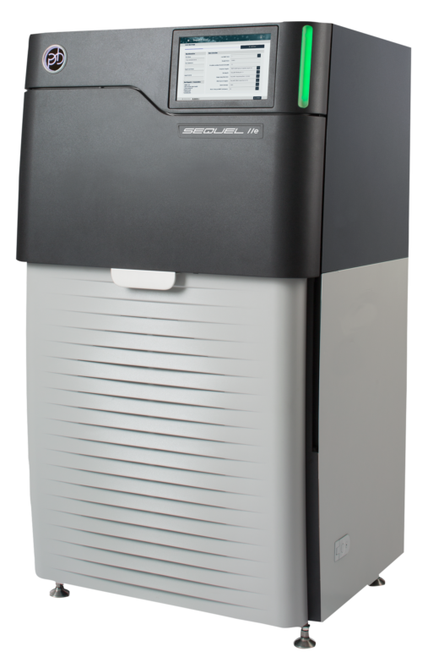
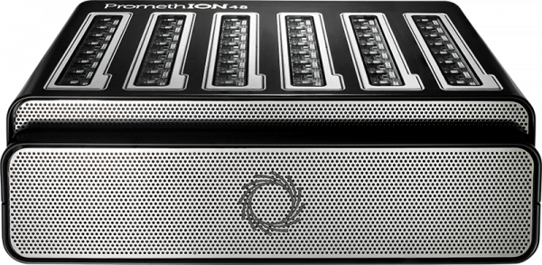
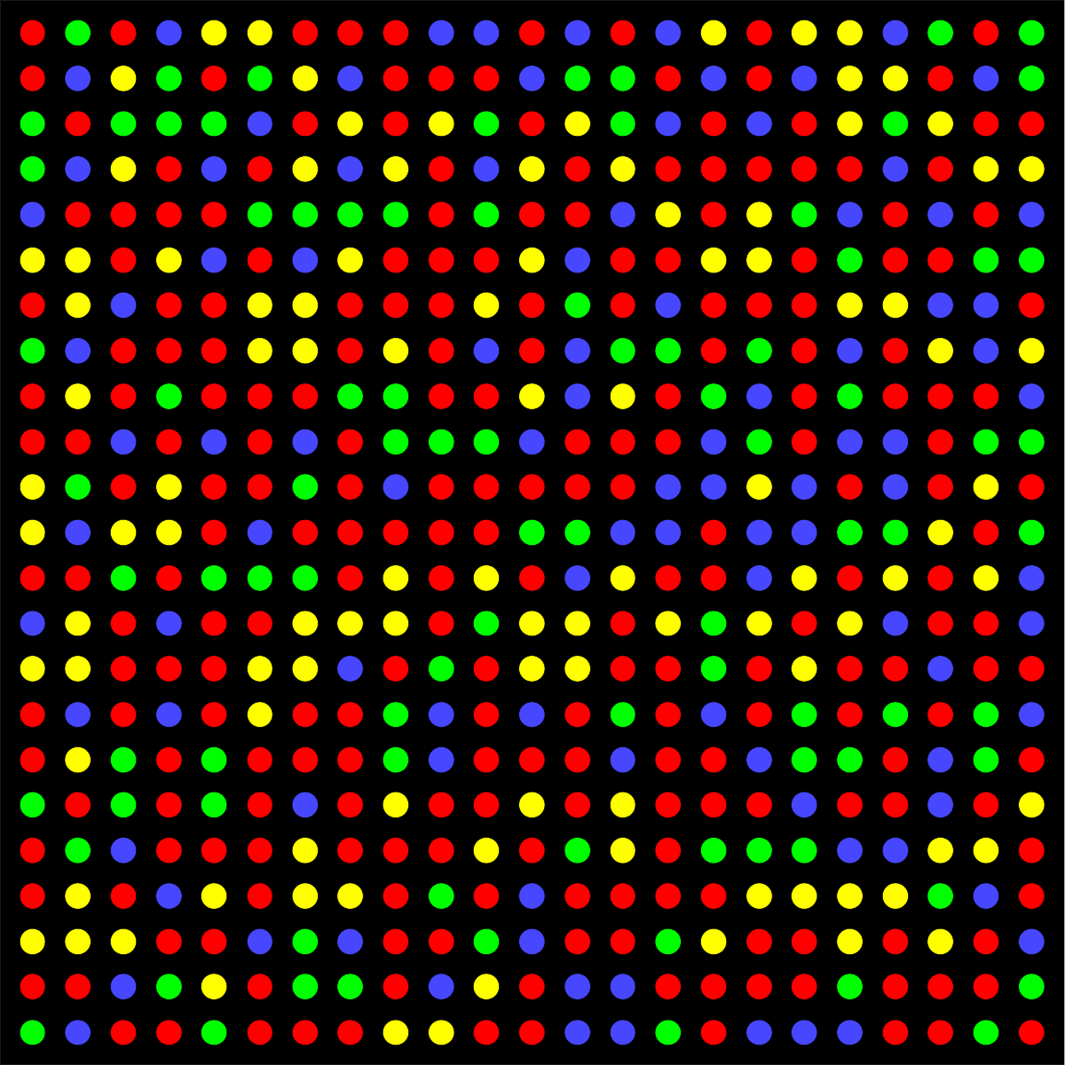


Different Raw Sequencing Data
Illumina
Nanopore
PacBio
Multiple images
Electrical Signal
30-hour movie
.BCL/.CBCL
.POD5
.BAM

Slide 14
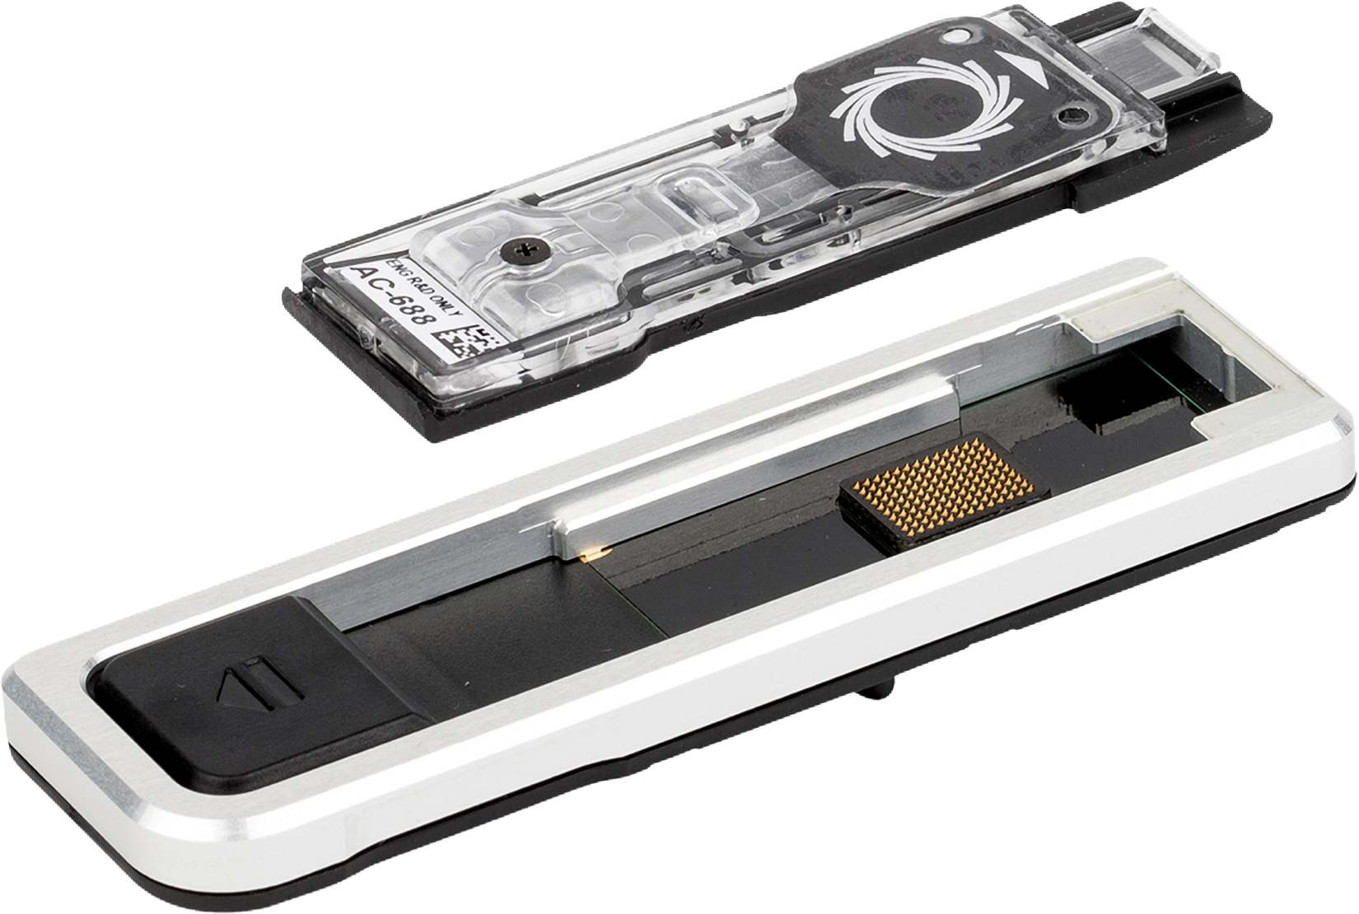

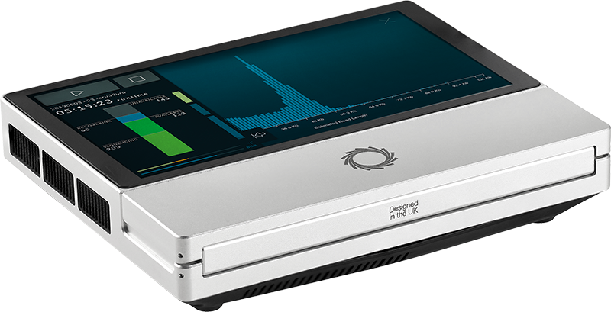
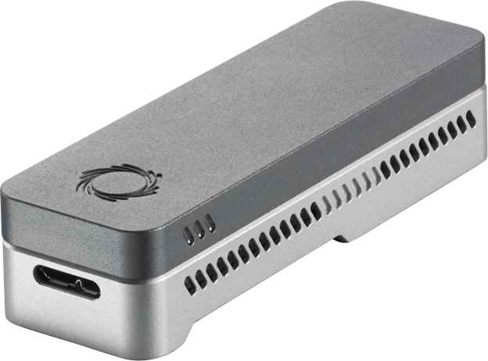
Nanopore Sequencing
Nanopore Sequencing: a widely used sequencing technology
  Long reads (up to >2 million nucleotides)
  Portable sequencing
  Cost-effective
  More unique features: real-time analysis

Slide 15


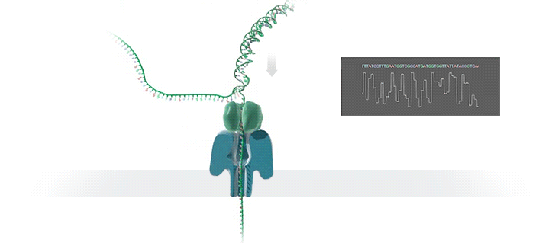



Nanopore Sequencing & Real-time Analysis
Nanopore Sequencing
Raw Electrical Signals
(Real-Time) Analysis
Basecalling:
CTAGATG…
Current
Basecalled Read
Raw Signals: Ionic current measurements generated as DNA passes through the nanopore at a certain speed
(Real-Time) Analysis: Translating to bases or directly analyzing raw signals
Real-Time Decisions: Stopping sequencing early based on real-time analysis

Slide 16

Benefits of Real-Time Analysis
Reducing latency by overlapping the sequencing and analysis steps
Time
Sequencing
Analysis
Reduced Latency
Sequencing & Real-Time Analysis
Reducing sequencing time and cost by stopping sequencing early
Completely Sequenced Read
Reduced Sequencing Time (and Cost)
Partially Sequenced Read
Sequencing is stopped early with a real-time decision

Slide 17




Challenges in Real-Time Analysis
Rapid analysis to match the nanopore sequencer throughput
Timely decisions to stop sequencing as early as possible
Accurate analysis from noisy raw signal data
Power-efficient computation for scalability and portability

Slide 18
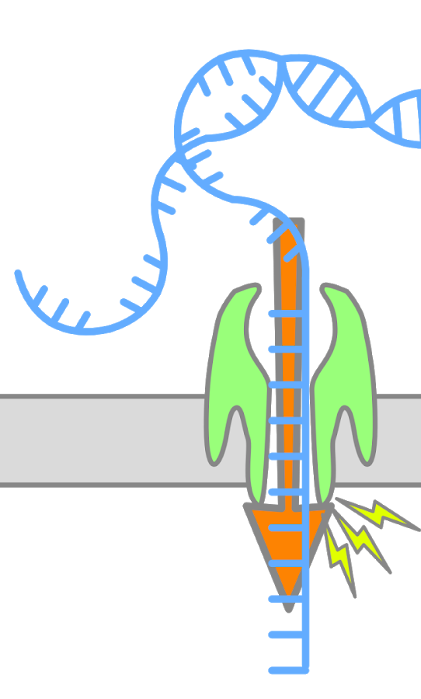
Enabling Analysis From Electrical Signals
K many nucleotides (k-mers) sequenced at a time
Event: A segment of the raw signal
  Corresponds to a particular k-mer
  Abrupt signal changes show sequencing of a new k-mer
  Statistical methods can find these abrupt changes
  Event value: average of signals within an event
Observation: Identical k-mers generate similar event values during sequencing
Event
ACTTGG
pAmpere
ACTTGG
k many nucleotides
105.71
Time (s)
Event Value (picoampere)

Slide 19
Agenda for Today
Background
  Sequence analysis
  Raw nanopore signal analysis and real-time analysis
Enabling Fast and Accurate Real-time Analysis
  RawHash and RawHash2
Conclusion

Slide 20

ISMB/ECCB 2023
RawHash
Enabling Fast and Accurate Real-Time Analysis
of Raw Nanopore Signals for Large Genomes
Can Firtina
Nika Mansouri Ghiasi |  | Joel Lindegger |  | Gagandeep Singh
Meryem Banu Cavlak |  | Haiyu Mao |  | Onur Mutlu
Paper
Code

Slide 21
Executive Summary
Problem: Real-time analysis of nanopore raw signals is inaccurate and inefficient for large genomes
Goal: Enable fast and accurate real-time analysis of raw signals for large genomes
Key Contributions:
1) The first hash-based mechanism that can quickly and accurately analyze raw nanopore signals for large genomes
2) The novel Sequence Until technique can accurately and dynamically stop
the entire sequencing of all reads at once if further sequencing is not necessary
Key Results: Across 3 use cases and 5 genomes of varying sizes, RawHash provides
  25.8$×$ and 3.4$×$ better average throughput compared to two state-of-the-art works
  1.14$×$ – 2.13$×$ more accurate mapping results for large genomes
  Sequence Until reduces the sequencing time and cost by 15$×$

Slide 22
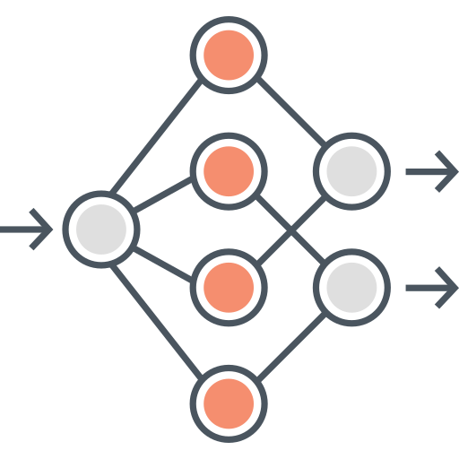

Existing Solutions
Deep neural networks (DNNs) for translating signals to bases
Mapping signals to reference genomes without basecalling
Real-Time Analysis
Real-Time Analysis
Basecalling
Read Mapping
Mapping Raw Signals
A
T
G
G
Less noisy analysis from basecalled sequences
Raw signals contain richer information than bases
Costly and power-hungry computational requirements
Efficient analysis with better scalability and portability

Slide 23
The Problem – Mapping Raw Signals
Raw Signal
Small Reference Genome
Large Reference Genome (Human)
Fewer candidate regions in small genomes
Substantially larger number of regions to check per read as the genome size increases
Problem: Probabilistic mechanisms
on many regions ➔ inaccurate mapping
Accurate mapping
Problem: Distance calculation
on many regions ➔ reduced throughput
High throughput

Slide 24
The Problem – Mapping Raw Signals
Raw Signal
Existing solutions are
inaccurate or inefficient
for large genomes
Small Reference Genome
Large Reference Genome (Human)
Fewer candidate regions in small genomes
Substantially larger number of regions to check per read as the genome size increases
Problem: Probabilistic mechanisms
on many regions ➔ inaccurate mapping
Accurate mapping
Problem: Distance calculation
on many regions ➔ reduced throughput
High throughput

Slide 25
Outline
Background
Motivation and Goal
Experimental Methodology
Temperature Analysis
Aggressor Row Active Time Analysis
Spatial Variation Analysis
Implications on Attacks and Defenses
Conclusions
RawHash
Evaluation
Conclusion

Slide 26
Goal
Enable fast and accurate real-time analysis
of raw nanopore signals for large genomes

Slide 27
RawHash
The first hash-based search mechanism
to quickly and accurately map raw nanopore signals
to reference genomes
Sequence Until can accurately and dynamically stop the entire sequencing run at once
if further sequencing is unnecessary

Slide 28
RawHash
The first hash-based search mechanism
to quickly and accurately map raw nanopore signals
to reference genomes
Sequence Until can accurately and dynamically stop the entire sequencing run at once
if further sequencing is unnecessary

Slide 29
RawHash – Key Idea
Key Observation: Identical nucleotides generate similar raw signals
Raw Signal #1
Distance Calculation
Raw Signal #2
Hash
Hash
Fast Match
0x01
0x01
Challenge #1: Generating the same hash value for similar enough signals
Challenge #2: Accurately finding as few similar regions as possible

Slide 30
RawHash Overview
Reference Genome
Raw Nanopore Signal
…GCTATTACCTTAATGTG…
Reference-to-Event Conversion
Signal-to-Event Conversion
2.21
-0.9
1.15
2.22
-0.91
1.18
Indexing (Offline)
Quantization
Quantization
Mapping (Real-Time)
28
6
18
28
6
18
Hashing
Hashing
Store
Hash Table
Query
0x01
0x01
Matching Regions
Chaining & Mapping
Mapping Positions

Slide 31
RawHash Overview
Reference Genome
Raw Nanopore Signal
…GCTATTACCTTAATGTG…
Reference-to-Event Conversion
Signal-to-Event Conversion
2.21
-0.9
1.15
2.22
-0.91
1.18

Slide 32
Reference-to-Event Conversion
K-mer model: Provides expected event values for each k-mer
  Preconstructed based on nanopore sequencer characteristics
Use the k-mer model to convert all k-mers
of a reference genome to their expected event values
Reference Genome
Expected Event Values
Normalized Event Values
..GCTATTACC..
GCTATT
K-mer Model
(Lookup Table)
105.757390
Normalize
2.21
CTATTA
81.740642
-0.09
k-mers ($k=6$)
TATTAC
103.170091
1.15
ATTACC
101.082485
1.11

Slide 33
Signal-to-Event Conversion
Event detection: Identifies signal regions corresponding to specific k-mers
  Uses statistical test (segmentation) to spot abrupt signal changes
Consecutive events ➔ consecutive k-mers
Raw Nanopore Signal
Event
Event Value
Normalize
2.21
Segment
Calculate
Means
105.71
0.08
1.18
1.14

Slide 34
Signal-to-Event Conversion
Event detection: Identifies signal regions corresponding to specific k-mers
  Uses statistical test (segmentation) to spot abrupt signal changes
Consecutive events ➔ consecutive k-mers
Can we directly match signals to each other?
Raw Nanopore Signal
Event
Event Value
Normalize
2.21
Segment
Calculate
Means
105.71
0.08
1.18
1.14

Slide 35
RawHash Overview
Reference Genome
Raw Nanopore Signal
…GCTATTACCTTAATGTG…
Reference-to-Event Conversion
Signal-to-Event Conversion
2.21
-0.9
1.15
2.22
-0.91
1.18
Quantization
Quantization
28
6
18
28
6
18

Slide 36
Quantizing the Event Values
Observation: Slight differences in raw signals from identical k-mers
  Challenge: Direct event value matching is not feasible and accurate
Key Idea: Quantize the event values
  Enables assigning identical quantized values to similar event values
Normalized event values from the same k-mer
Quantized event values (in binary)
-0.091
Quantize
1
1
0
0
1
-0.084
Quantize
1
1
0
0
1
CTATTA
-0.09
Quantize
1
1
0
0
1
-0.086
Quantize
1
1
0
0
1

Slide 37
RawHash Overview
Reference Genome
Nanopore Raw Signal
…GCTATTACCTTAATGTG…
Reference-to-Event Conversion
Signal-to-Event Conversion
2.21
-0.9
1.15
2.22
-0.91
1.18
Quantization
Quantization
28
6
18
28
6
18
Hashing
Hashing
Store
Hash Table
Query
0x01
0x01

Slide 38
Hashing for Fast Similarity Search
Each event usually represents a very small k-mer (6 to 9 characters)
  Challenge: Short k-mers are likely to appear in many locations
Key Idea: Create longer k-mers from many consecutive events
Key Benefit: Directly match hash values to quickly identify similarities
Consecutive k-mers
Consecutive events
CTATTA
-0.09
Quantize
1
1
0
0
1
TATTAC
1.15
Quantize
0
0
1
1
0
…
…
…
…
Pack
ATTACC
1.11
Quantize
0
0
1
0
1
1
1
0
0
1
0
0
1
1
0
…
0
1
0
0
1
Hash value of consecutive events
0x400D70A4
Hash

Slide 39
RawHash Overview
Reference Genome
Raw Nanopore Signal
…GCTATTACCTTAATGTG…
Reference-to-Event Conversion
Signal-to-Event Conversion
2.21
-0.9
1.15
2.22
-0.91
1.18
Indexing (Offline)
Quantization
Quantization
Mapping (Real-Time)
28
6
18
28
6
18
Hashing
Hashing
Store
Hash Table
Query
0x01
0x01
Matching Regions
Chaining & Mapping
Mapping Positions

Slide 40
Real-Time Mapping using Hash-based Indexing
Indexing (Offline)
Mapping (Real-time)
Reference Genome
Raw Nanopore Signal
…GCTATTACCTTAATGTG…
Reference-to-Event Conversion
Signal-to-Event Conversion
Quantization
Quantization
Hashing
Hashing
Store
Hash
Table
Query
0x01
0x01
Matching Positions
Chaining & Mapping
Yes: Process the next chunk
Read Until
or
Run Until
No: Stop mapping
Continue
Mapping?

Slide 41
RawHash
The first hash-based search mechanism
to quickly and accurately map raw nanopore signals
to reference genomes
Sequence Until can accurately and dynamically stop the entire sequencing run at once
if further sequencing is unnecessary

Slide 42
RawHash
The first hash-based search mechanism
to quickly and accurately map raw nanopore signals
to reference genomes
Sequence Until can accurately and dynamically stop the entire sequencing run at once
if further sequencing is unnecessary

Slide 43
The Sequence Until Mechanism
Problem:
  Unnecessary sequencing waste time, power and money
Key Idea:
  Dynamically decide if further sequencing of the entire sample is necessary to achieve high accuracy
  Stop sequencing early without sacrificing accuracy
Potential Benefits:
  Significant reduction in sequencing time and cost
Example real-time genome analysis use case:
  Relative abundance estimation

Slide 44
The Sequence Until Mechanism
Key Steps:
  Continuously generate relative abundance estimation after every $n$ reads
  Keep the last $t$ estimation results
  Detect outliers in the results via cross-correlation of the recent $t$ results
  Absence of outliers indicates consistent results
    Further sequencing is likely to generate consistent results ➔ Stop the sequencing
Relative Abundance Estimation
Keep Sequencing
$n$ Reads Sequenced
Estimation #1
Yes
Relative Abundance Estimation
$2n$ Reads Sequenced
Estimation #2
Outlier?
…
…
…
No
Relative Abundance Estimation
$t×n$ Reads Sequenced
Estimation #$t$
Stop Sequencing

Slide 45
Outline
Background
Motivation and Goal
Experimental Methodology
Temperature Analysis
Aggressor Row Active Time Analysis
Spatial Variation Analysis
Implications on Attacks and Defenses
Conclusions
RawHash
Evaluation
Conclusion

Slide 46
Evaluation Methodology
Compared to UNCALLED [Kovaka+, Nat. Biotech. 2021]
and Sigmap [Zhang+, ISMB/ECCB 2021]
  CPU baseline: AMD EPYC 7742 @2.26GHz
  32 threads for each tool
Use cases for real-time genome analysis:
  Read mapping
  Relative abundance estimation
    Benefits of Sequence Until
  Contamination analysis

Slide 47
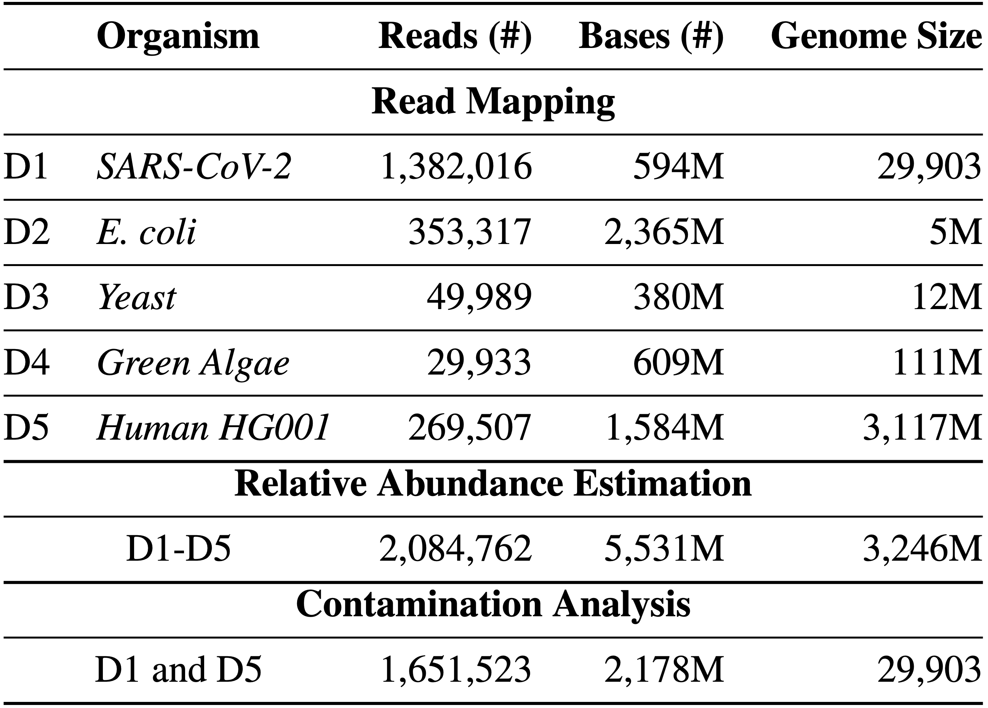
Evaluation Methodology
Evaluation metrics:
  Throughput (bases processed per second)
  Potential reduction in sequencing time and cost
  Accuracy
    Baseline: Mapping basecalled reads using minimap2
    Precision, recall, and F1 scores
    Relative abundance estimation distance to ground truth
Datasets:

Slide 48
Throughput
Real-time analysis requires faster throughput than sequencer
  Throughput of a nanopore sequencer: ~450 bp/sec (data generation speed)
Real-Time Analysis
No Real-Time
Analysis
25.8$×$ and 3.4$×$ better average throughput compared to
UNCALLED and Sigmap, respectively
Sigmap cannot perform real-time analysis for large genomes

Slide 49
Sequencing Time
Fewer bases to sequence ➔
  Reduction in sequencing time and cost
Lower is better
RawHash reduces sequencing time and cost
for large genomes up to 1.3$×$ compared to UNCALLED

Slide 50
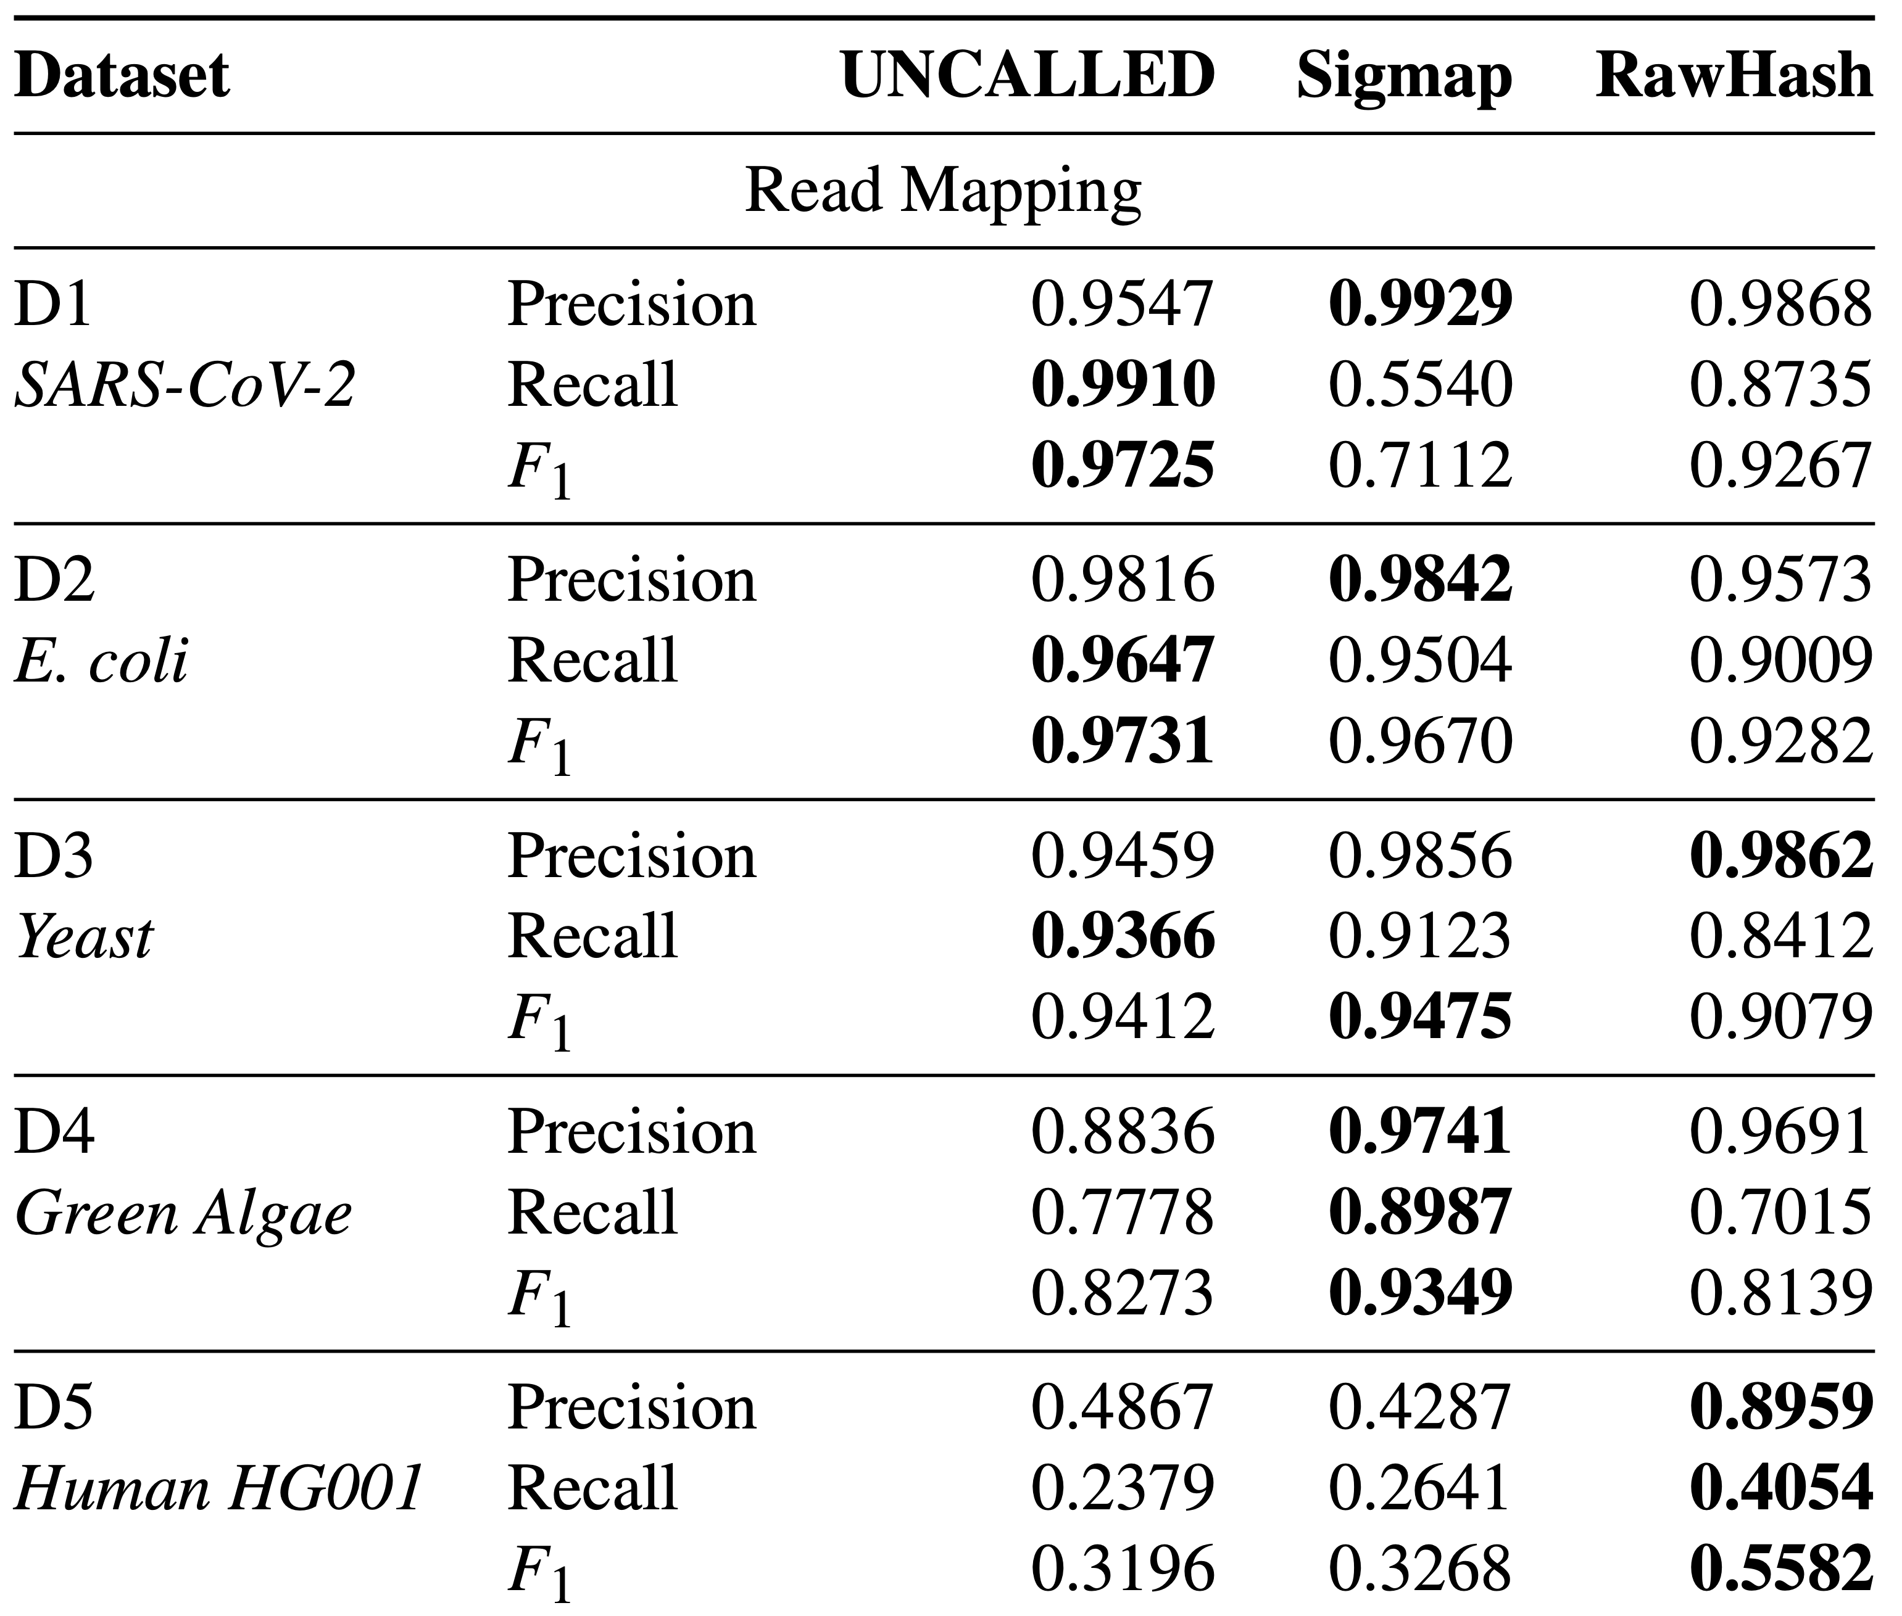
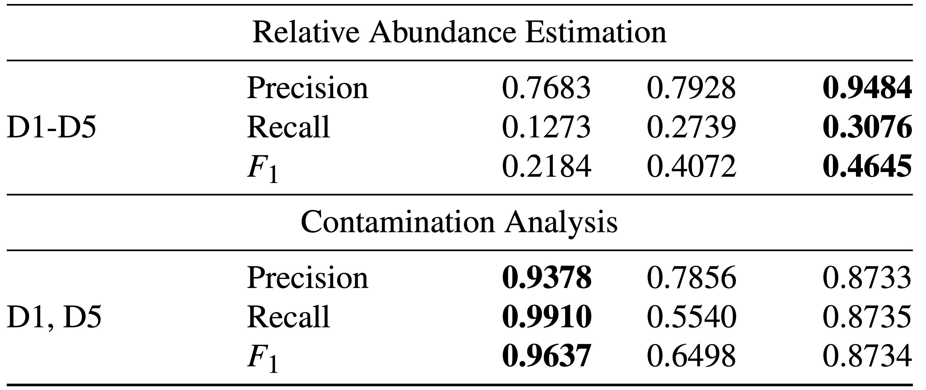
Mapping Accuracy
Read mapping accuracy of each tool and each use case
For Large Genomes: RawHash provides the best accuracy
in all metrics, resulting in 1.14$×$ - 2.13$×$ improvement in $F_{1}$ score

Slide 51
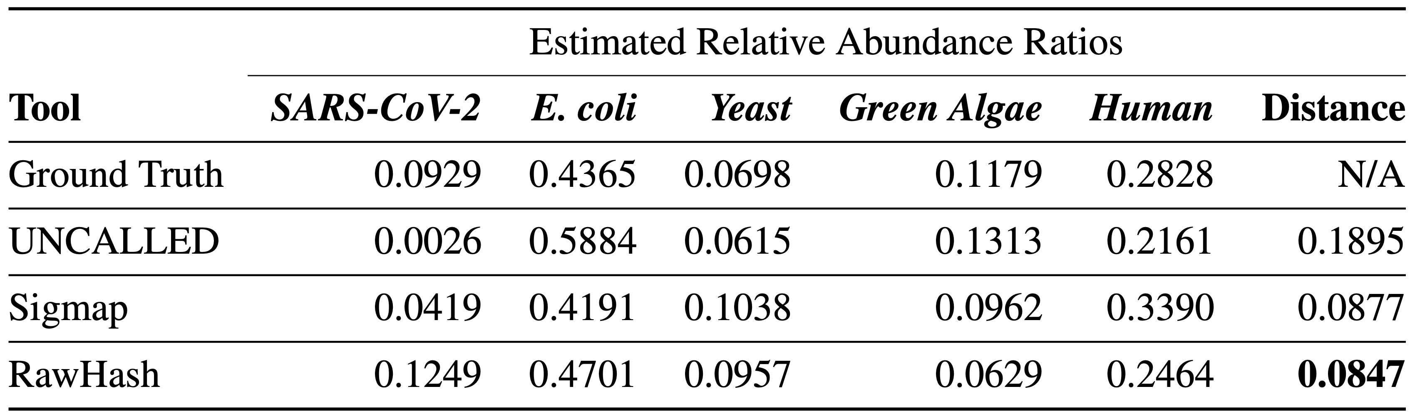
Relative Abundance Estimation Accuracy
Estimating the ratio of genomes in a sample in real-time
  Distance: Euclidean distance compared to the ground truth distance
  The dataset includes a large reference genome
RawHash provides the best relative abundance estimation
closest to the ground truth estimation

Slide 52
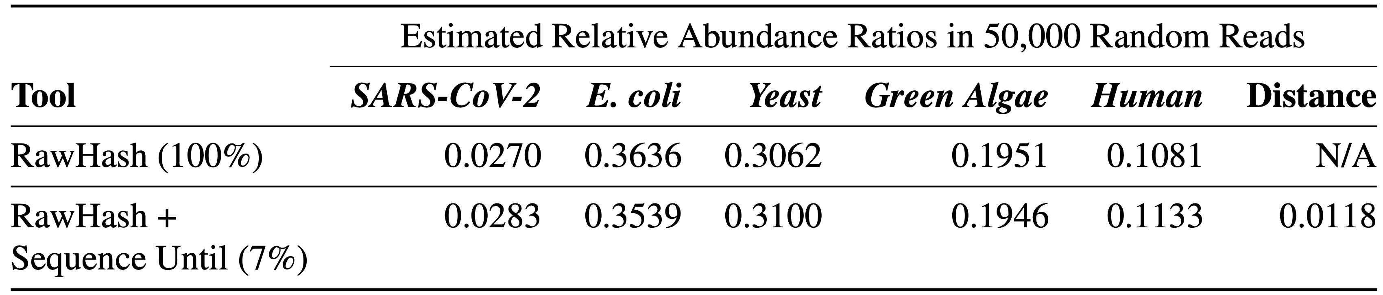
Real Implementation of Sequence Until
Running RawHash by using
  RawHash (100%): The entire sample without Sequence Until
  RawHash (7%): RawHash with Sequence Until where Sequence Until dynamically stops the entire sequencing after sequencing 7% of the sample
Sequence Until enables sequencing only 7% (~1/15)
of the entire sample with high accuracy

Slide 53
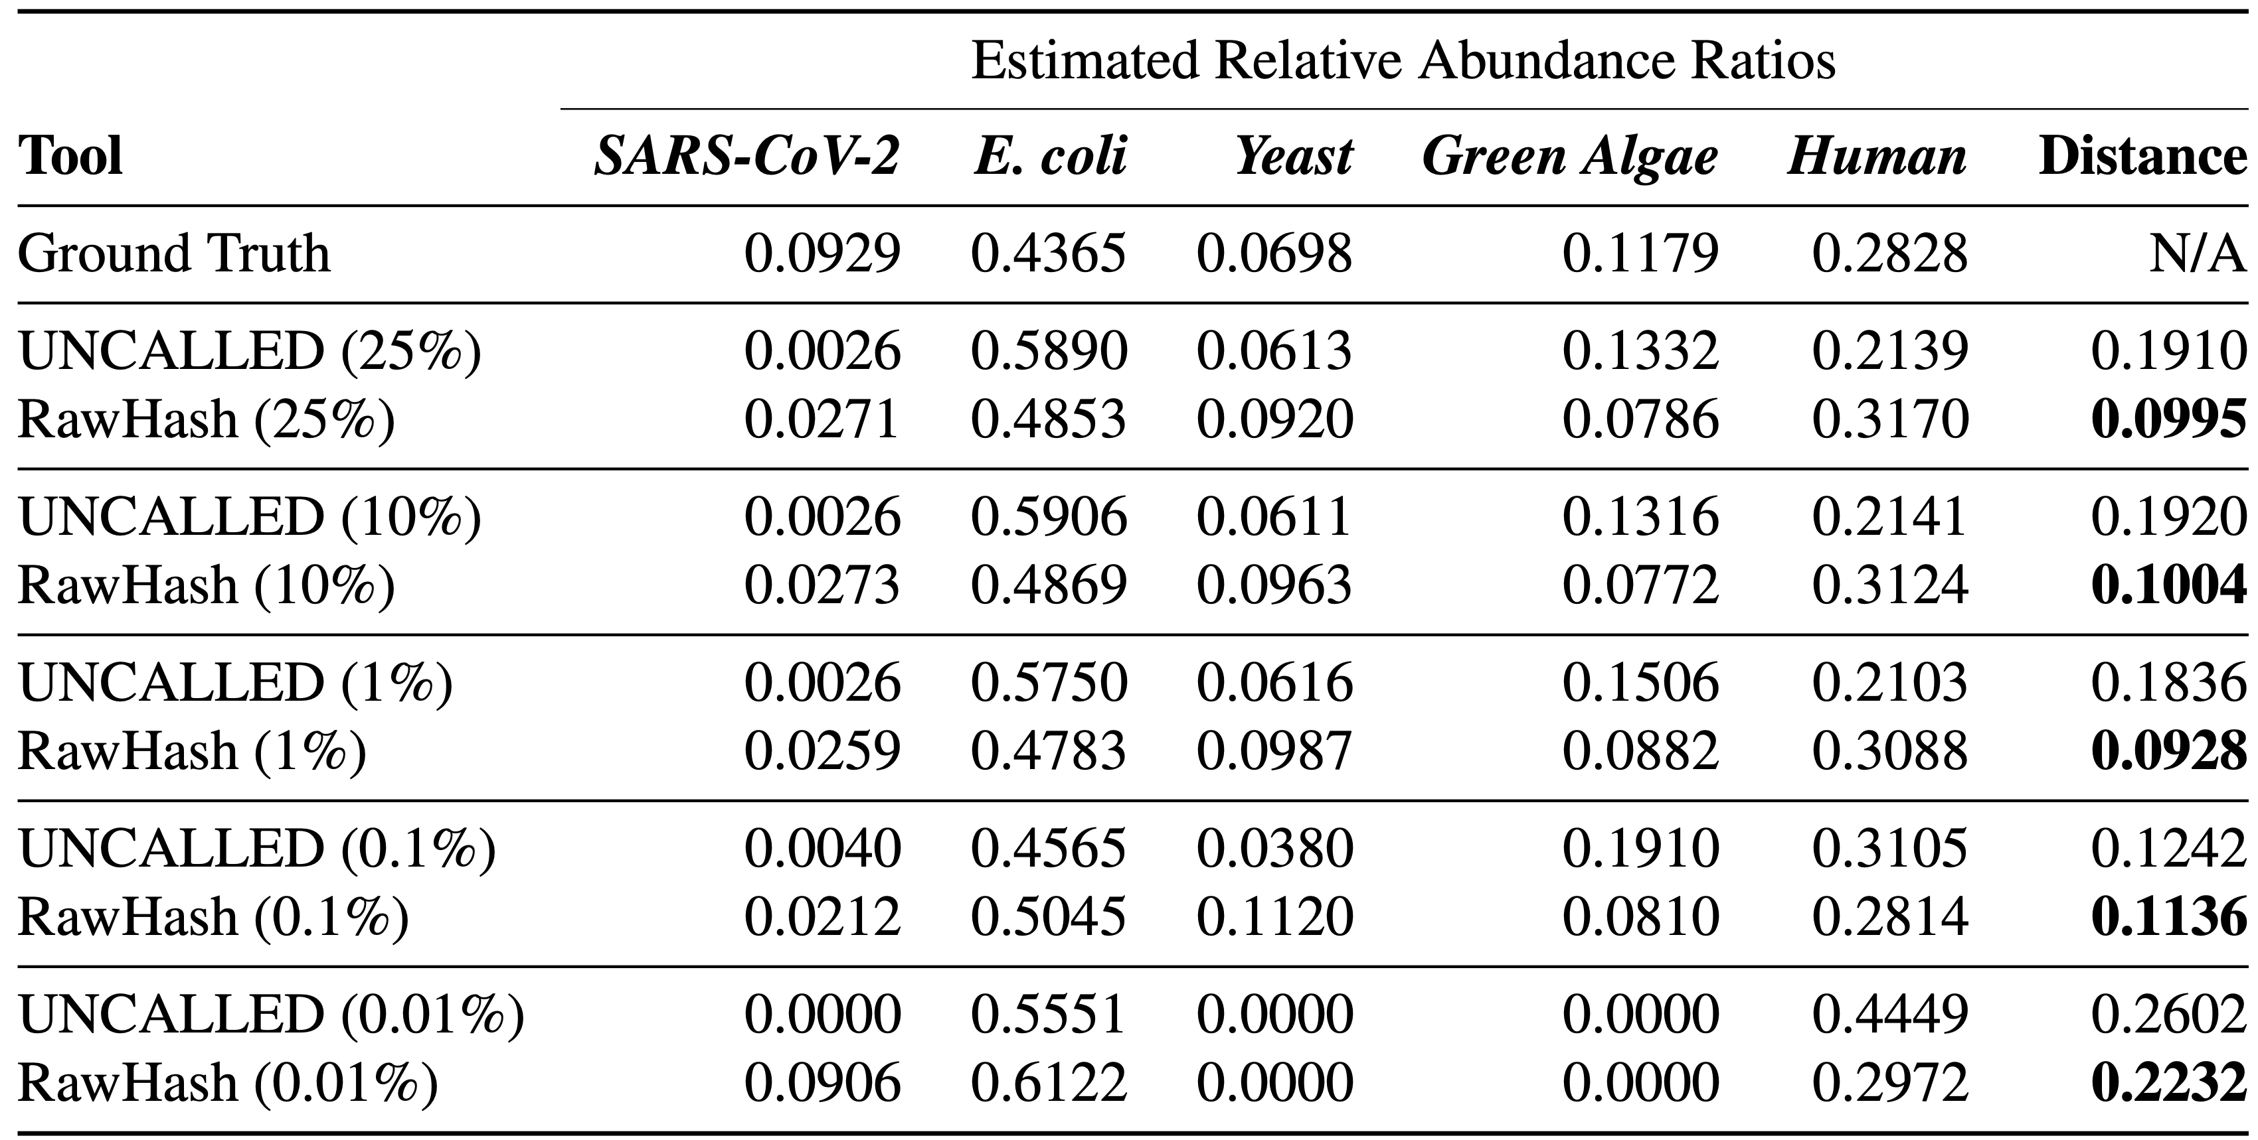
Simulating Sequence Until
Real relative abundance results using the entire set of reads
Simulating the benefits of Sequence Until by
  Using a random portion (25%, 10%, 1%, …) of the sample

Slide 54
Simulating Sequence Until
Real relative abundance results using the entire set of reads
Simulating the benefits of Sequence Until by
  Using a random portion (25%, 10%, 1%, …) of the sample
UNCALLED and RawHash benefit from Sequence Until significantly by up to 100$×$ reductions in
sequencing time and costs

Slide 55
More in the Paper
More Results
  Mapping time per read
  Overall computational resources required by each tool
    Peak memory usage, CPU time and real time in the indexing and mapping steps
  Performance breakdown of the steps in RawHash
Details of all mechanisms and configurations
  Details of the quantization and hashing mechanism
  Details of the parameter configurations
  Trade-offs between the DNN-based approaches and raw signal mapping approaches

Slide 56
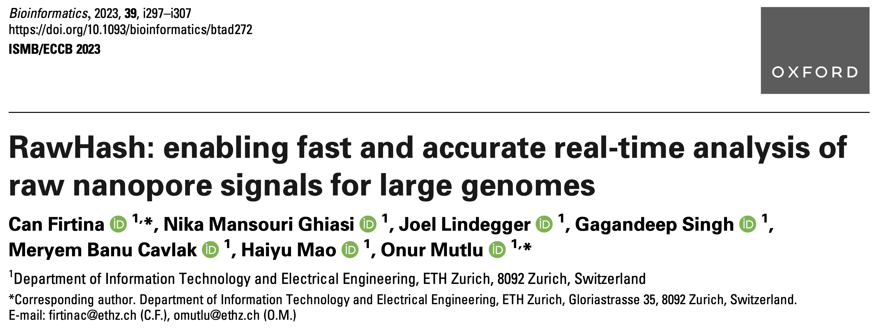
RawHash
Can Firtina, Nika Mansouri Ghiasi, Joel Lindegger, Gagandeep Singh,
Meryem Banu Cavlak, Haiyu Mao, and Onur Mutlu,
"RawHash: Enabling Fast and Accurate Real-Time Analysis of Raw Nanopore Signals for Large Genomes"
Proceedings of the 31st Annual Conference on Intelligent Systems for Molecular Biology (ISMB) and the 22nd European Conference on Computational Biology (ECCB), Jul 2023
[arXiv preprint]
[Source Code]

Slide 57
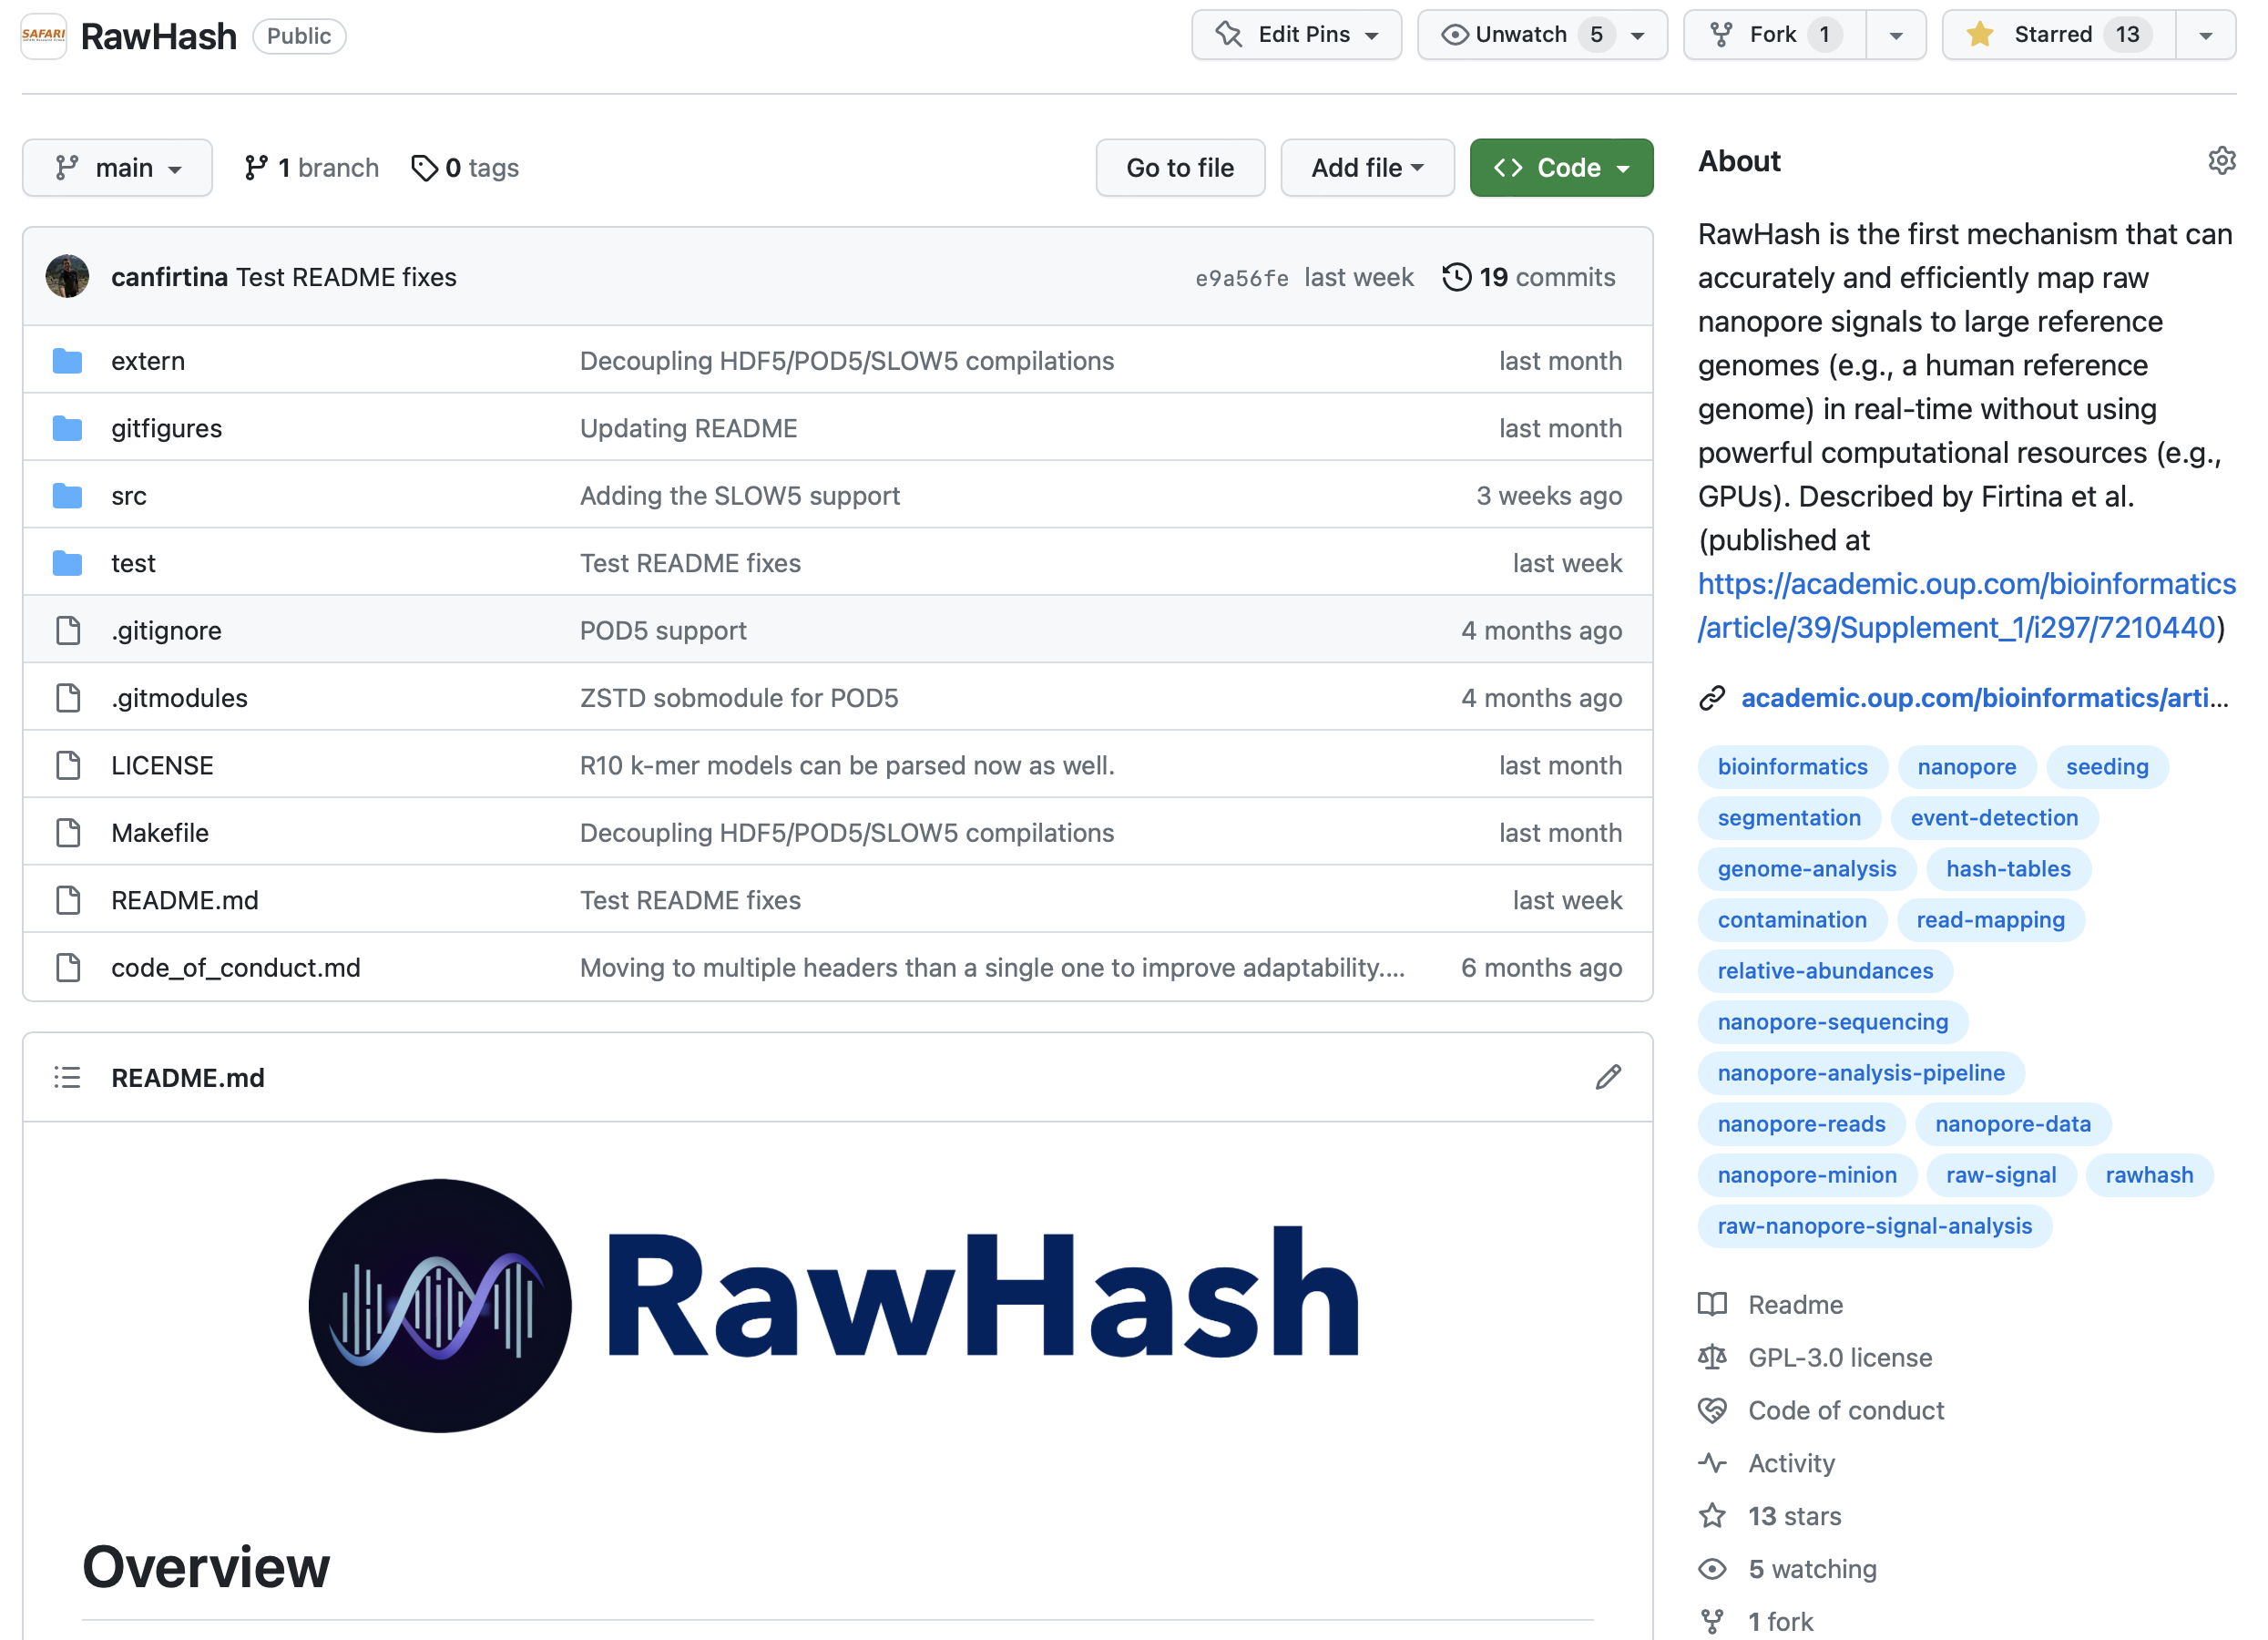
RawHash Source Code
Supports all major
raw signal file formats
and flow cell versions
  FAST5, POD5, S/BLOW5 file formats
Easy-to-use scripts
  To download all the datasets
  To reproduce all of our results
You can write your outlier function for Sequence Until
  Easily integrate Sequence Until
Upcoming Feature:
  Integrating the MinKNOW API
https://github.com/CMU-SAFARI/RawHash

Slide 58
Sketching with Hash-based Indexing
Indexing (Offline)
Mapping (Real-time)
Reference Genome
Raw Nanopore Signal
…GCTATTACCTTAATGTG…
Reference-to-Event Conversion
Signal-to-Event Conversion
Quantization
Quantization
Hashing
Hashing
All k-mers,
Minimizers,
Strobemers,
BLEND,
…
Sketch
Sketch
Store
Hash
Table
Query
0x01
0x01
Matching Positions
Chaining & Mapping
Yes: Process the next chunk
Read Until
or
Run Until
No: Stop mapping
Continue
Mapping?

Slide 59
Outline
Background
Motivation and Goal
Experimental Methodology
Temperature Analysis
Aggressor Row Active Time Analysis
Spatial Variation Analysis
Implications on Attacks and Defenses
Conclusions
RawHash
Evaluation
Conclusion

Slide 60
Conclusion
Key Contributions:
1) The first hash-based mechanism that can quickly and accurately analyze raw nanopore signals for large genomes
2) The novel Sequence Until technique can accurately and dynamically stop
the entire sequencing of all reads at once if further sequencing is not necessary
Key Results: Across 3 use cases and 5 genomes of varying sizes, RawHash provides
  25.8$×$ and 3.4$×$ better average throughput compared to two state-of-the-art works
  1.14$×$ – 2.13$×$ more accurate mapping results for large genomes
  Sequence Until reduces the sequencing time and cost by 15$×$
Many opportunities for analyzing raw nanopore signals in real-time:
  Many hash-based sketching techniques can now be used for raw signals
  Indexing is very cheap: Many future use cases with the on-the-fly index construction
  We should rethink the algorithms to perform downstream analysis fully using raw signals

Slide 61
ISMB/ECCB 2023
RawHash
Enabling Fast and Accurate Real-Time Analysis
of Raw Nanopore Signals for Large Genomes
Can Firtina
Nika Mansouri Ghiasi |  | Joel Lindegger |  | Gagandeep Singh
Meryem Banu Cavlak |  | Haiyu Mao |  | Onur Mutlu
Paper
Code

Slide 62
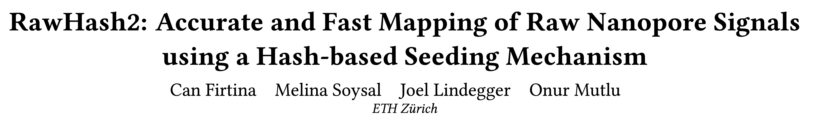
Fast and Accurate Real-Time Genome Analysis
Can Firtina, Melina Soysal, Joel Lindegger, and Onur Mutlu,
"RawHash2: Accurate and Fast Mapping of Raw Nanopore Signals using a Hash-based Seeding Mechanism"
Preprint on arxiv, September 2023.
[arXiv version]
[RawHash2 Source Code]

Slide 63
Optimizations in RawHash2 (1)
More sensitive chaining implementation with penalty scores
  Benefits: Enables filtering dissimilar regions quickly
  Downside: Additional computations with costly log operations
Weighted mapping decisions
  Benefit #1: ‘Learned’ mapping decisions based on the weights chosen from empirical analysis
  Benefit #2: Faster and more accurate decisions
Frequency filters
  Filters the seeds that frequently appear before chaining
  Benefits: Reduced workload on chaining without significantly affecting accuracy
  Downside: Less sensitive mapping due to removed seeds

Slide 64
Optimizations in RawHash2 (2)
New sketching techniques such as minimizers and BLEND
  Enables integration of widely studied sketching techniques
  Benefits: Can take advantage of these techniques (e.g., reduced storage requirements)
Support for the recent improvements in the technology
  Support for new data formats: POD5 and S/BLOW5
  Support for newer nanopore chemistry versions: R10.4

Slide 65
Results – Throughput
Real-time analysis requires faster throughput than sequencer
  Throughput of a nanopore sequencer: ~450 bp/sec (data generation speed)
2.3$×$ better average throughput RawHash

Slide 66
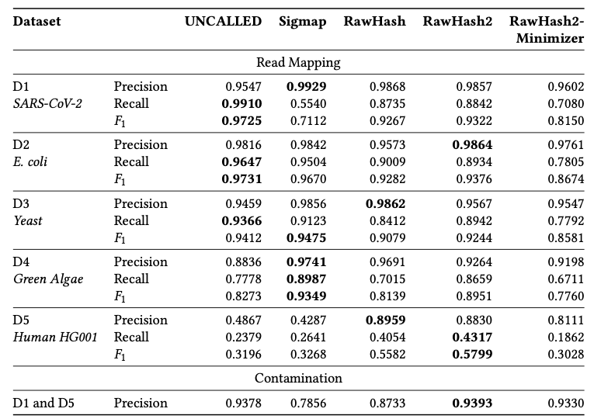
Results – Accuracy
RawHash2 is more accurate than RawHash in all cases

Slide 67
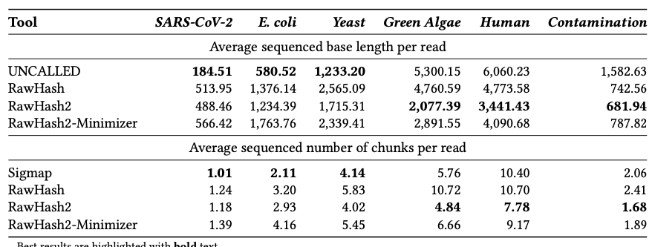
Results – Average Sequencing Length
RawHash2 uses fewer bases to sequence than RawHash in all cases
RawHash2 uses the smallest number of bases to sequence for larger genomes

Slide 68
Fast and Accurate Real-Time Genome Analysis
Can Firtina, Melina Soysal, Joel Lindegger, and Onur Mutlu,
"RawHash2: Accurate and Fast Mapping of Raw Nanopore Signals using a Hash-based Seeding Mechanism"
Preprint on arxiv, September 2023.
[arXiv version]
[RawHash2 Source Code]

Slide 69
Agenda for Today
Background
  Sequence analysis
  Raw nanopore signal analysis and real-time analysis
Enabling Fast and Accurate Real-time Analysis
  RawHash and RawHash2
Conclusion

Slide 70
The Future is Bright for Genome Analysis
We covered various recent ideas to
  Analyze genomes in ways that were not possible before
Enabling cost-effective, portable, fast, and accurate genome analysis has many implications
  What are the new applications to enable with these unique benefits?
Can we do even better?
  Understanding and modifying the sequencing process for analyzing other types of biological data
Many future opportunities exist
  Especially with new sequencing technologies
  Especially with new applications and use cases

Slide 71
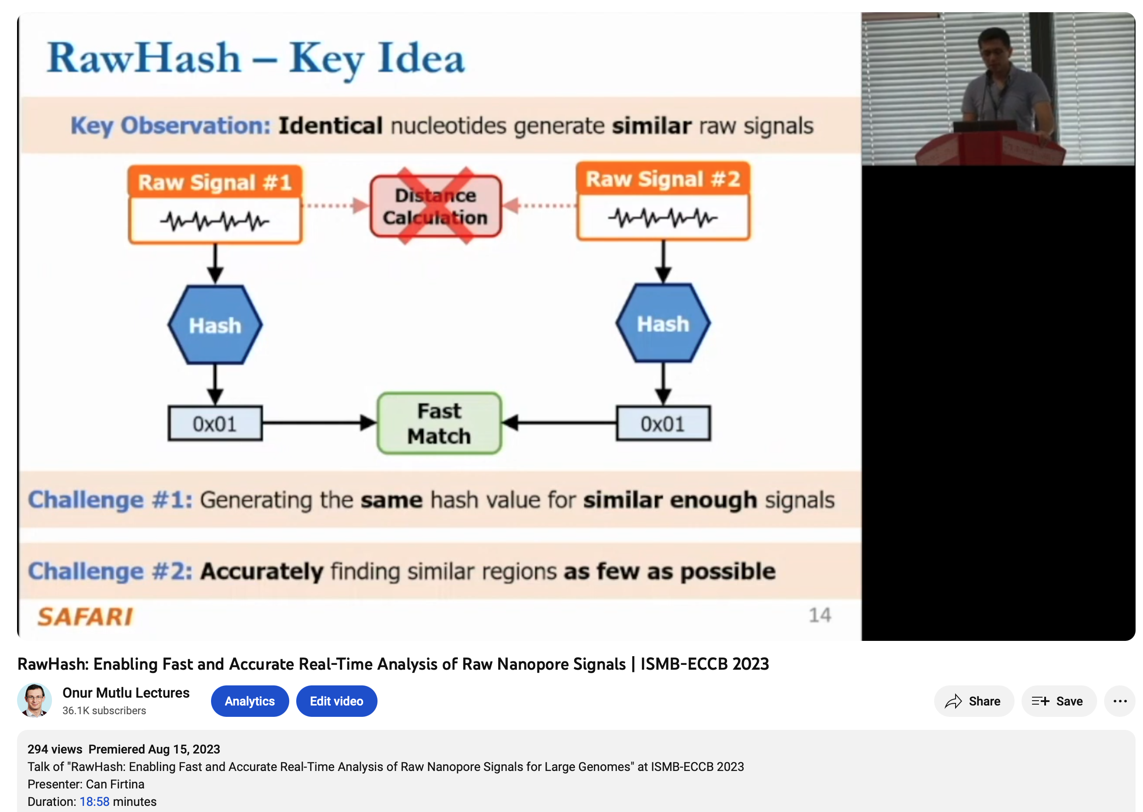
More on Real-Time Genome Analysis
Can Firtina,
"RawHash: Enabling Fast and Accurate Real-Time Analysis of Raw Nanopore Signals for Large Genomes"
Proceedings Talk at ISMB-ECCB, Lyon, France, 25 July 2023.
[Slides (pptx) (pdf)]
[Talk Video (18 minutes]

Slide 72
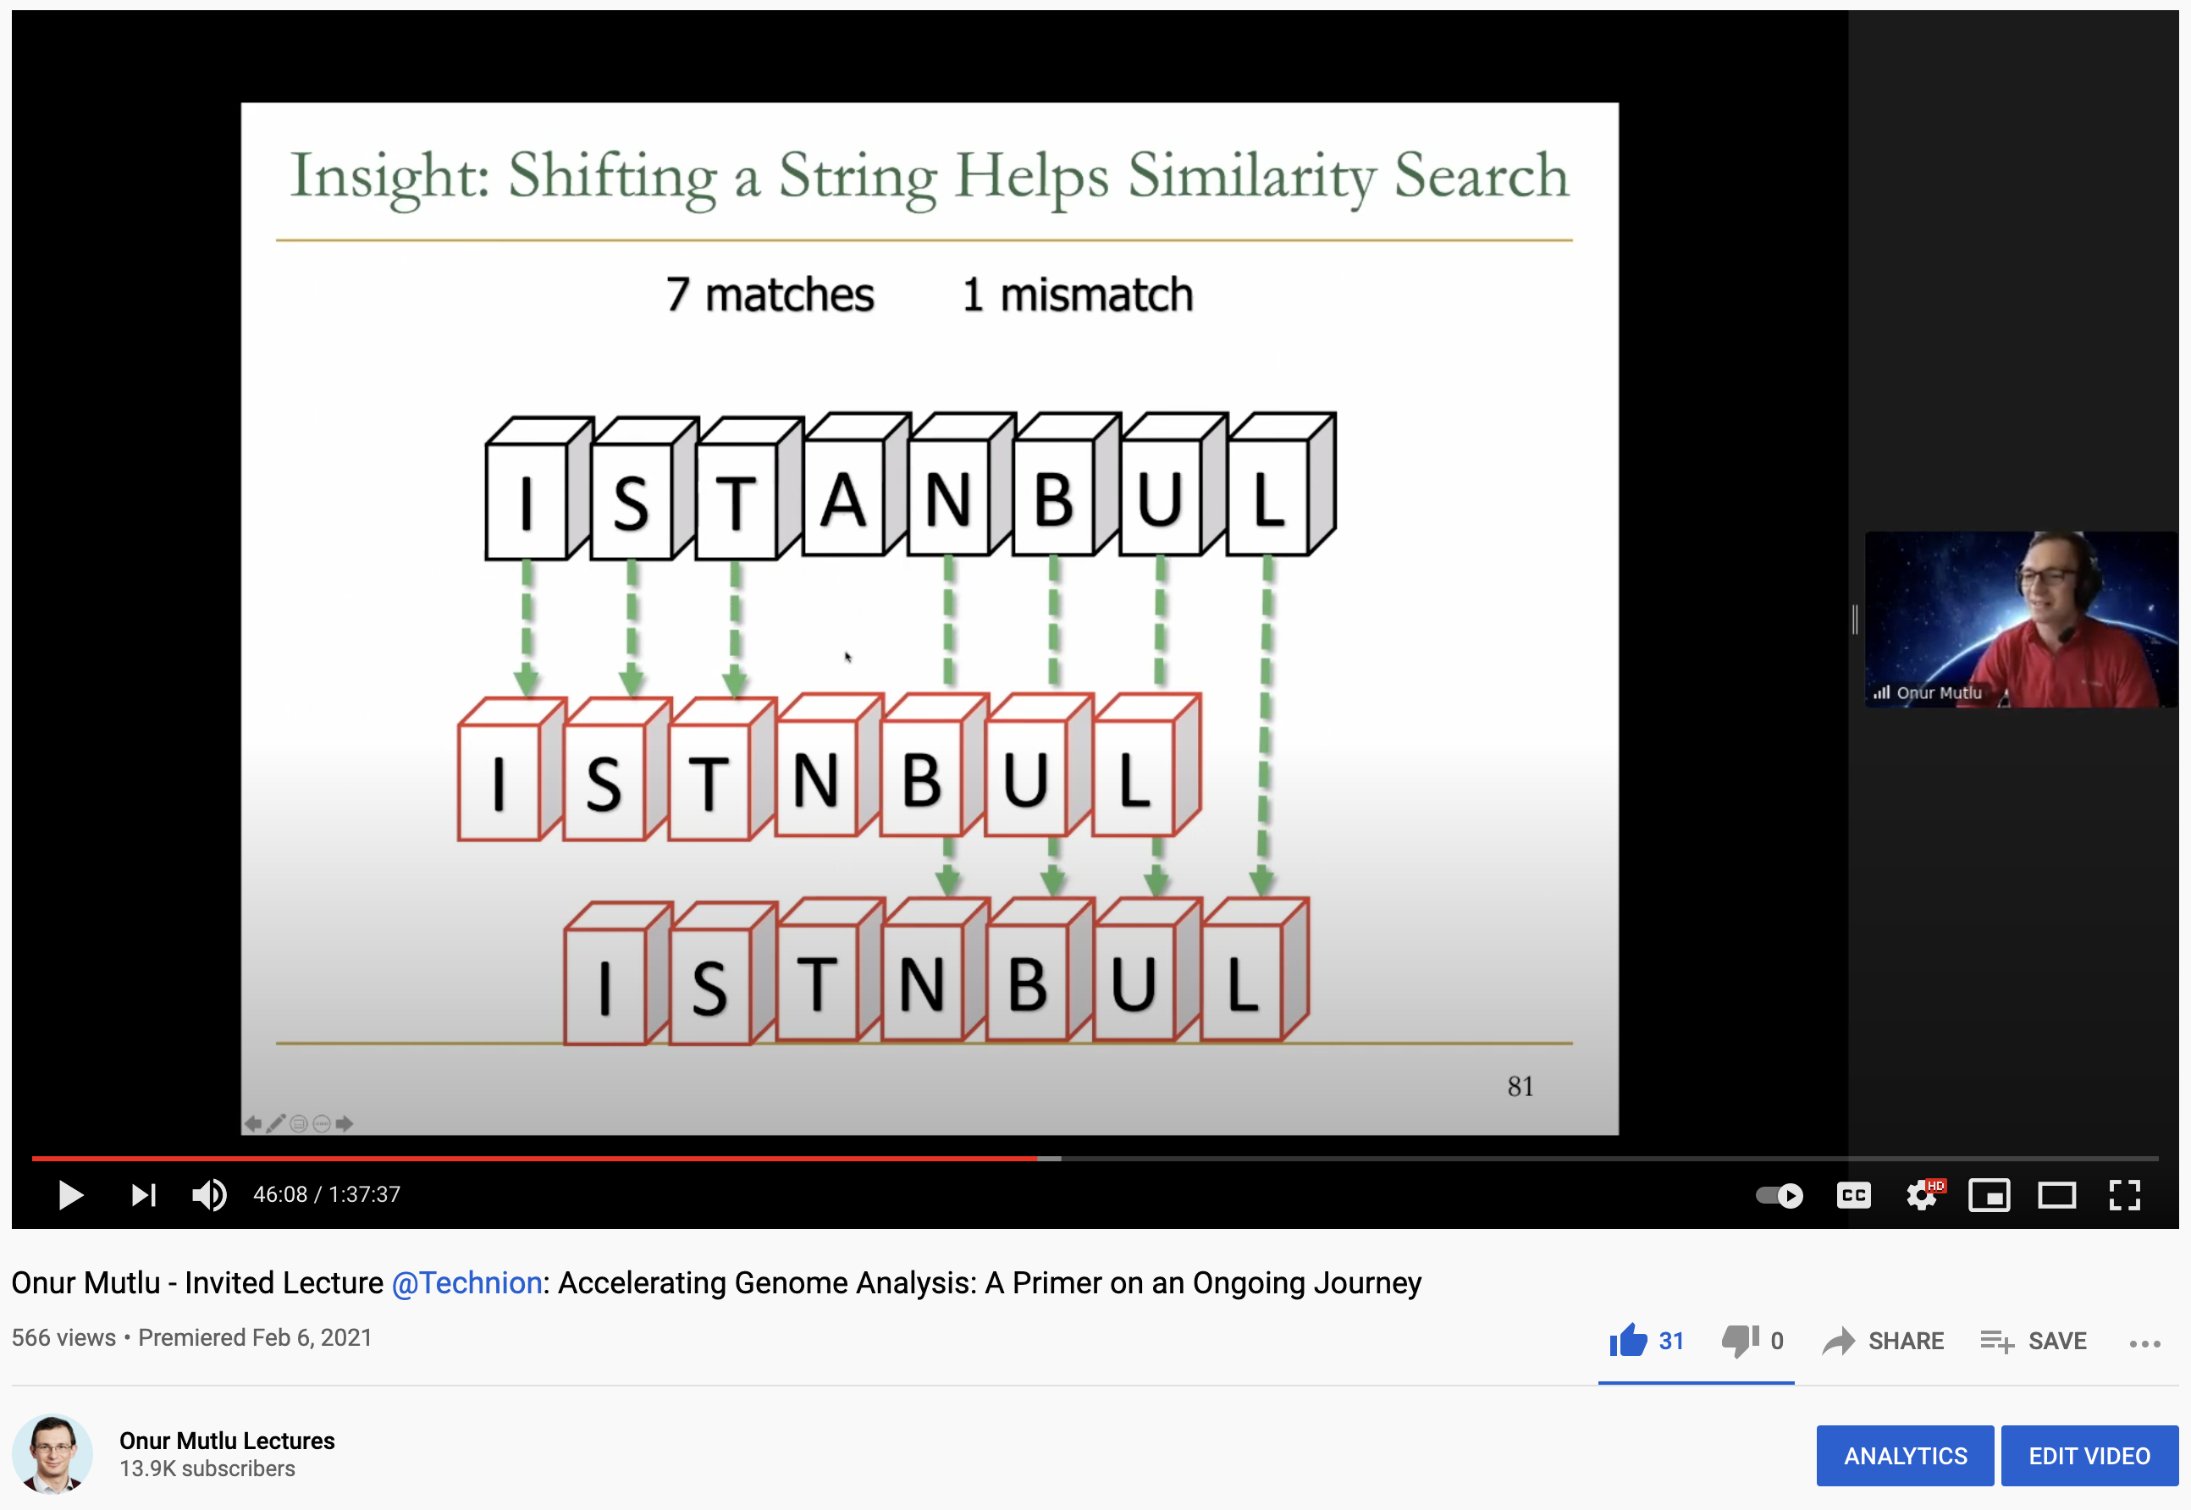
Fast Genome Analysis…
Onur Mutlu,
"Accelerating Genome Analysis: A Primer on an Ongoing Journey"
Invited Lecture at Technion, Virtual, 26 January 2021.
[Slides (pptx) (pdf)]
[Talk Video (1 hour 37 minutes, including Q&A)]
[Related Invited Paper (at IEEE Micro, 2020)]

Slide 73
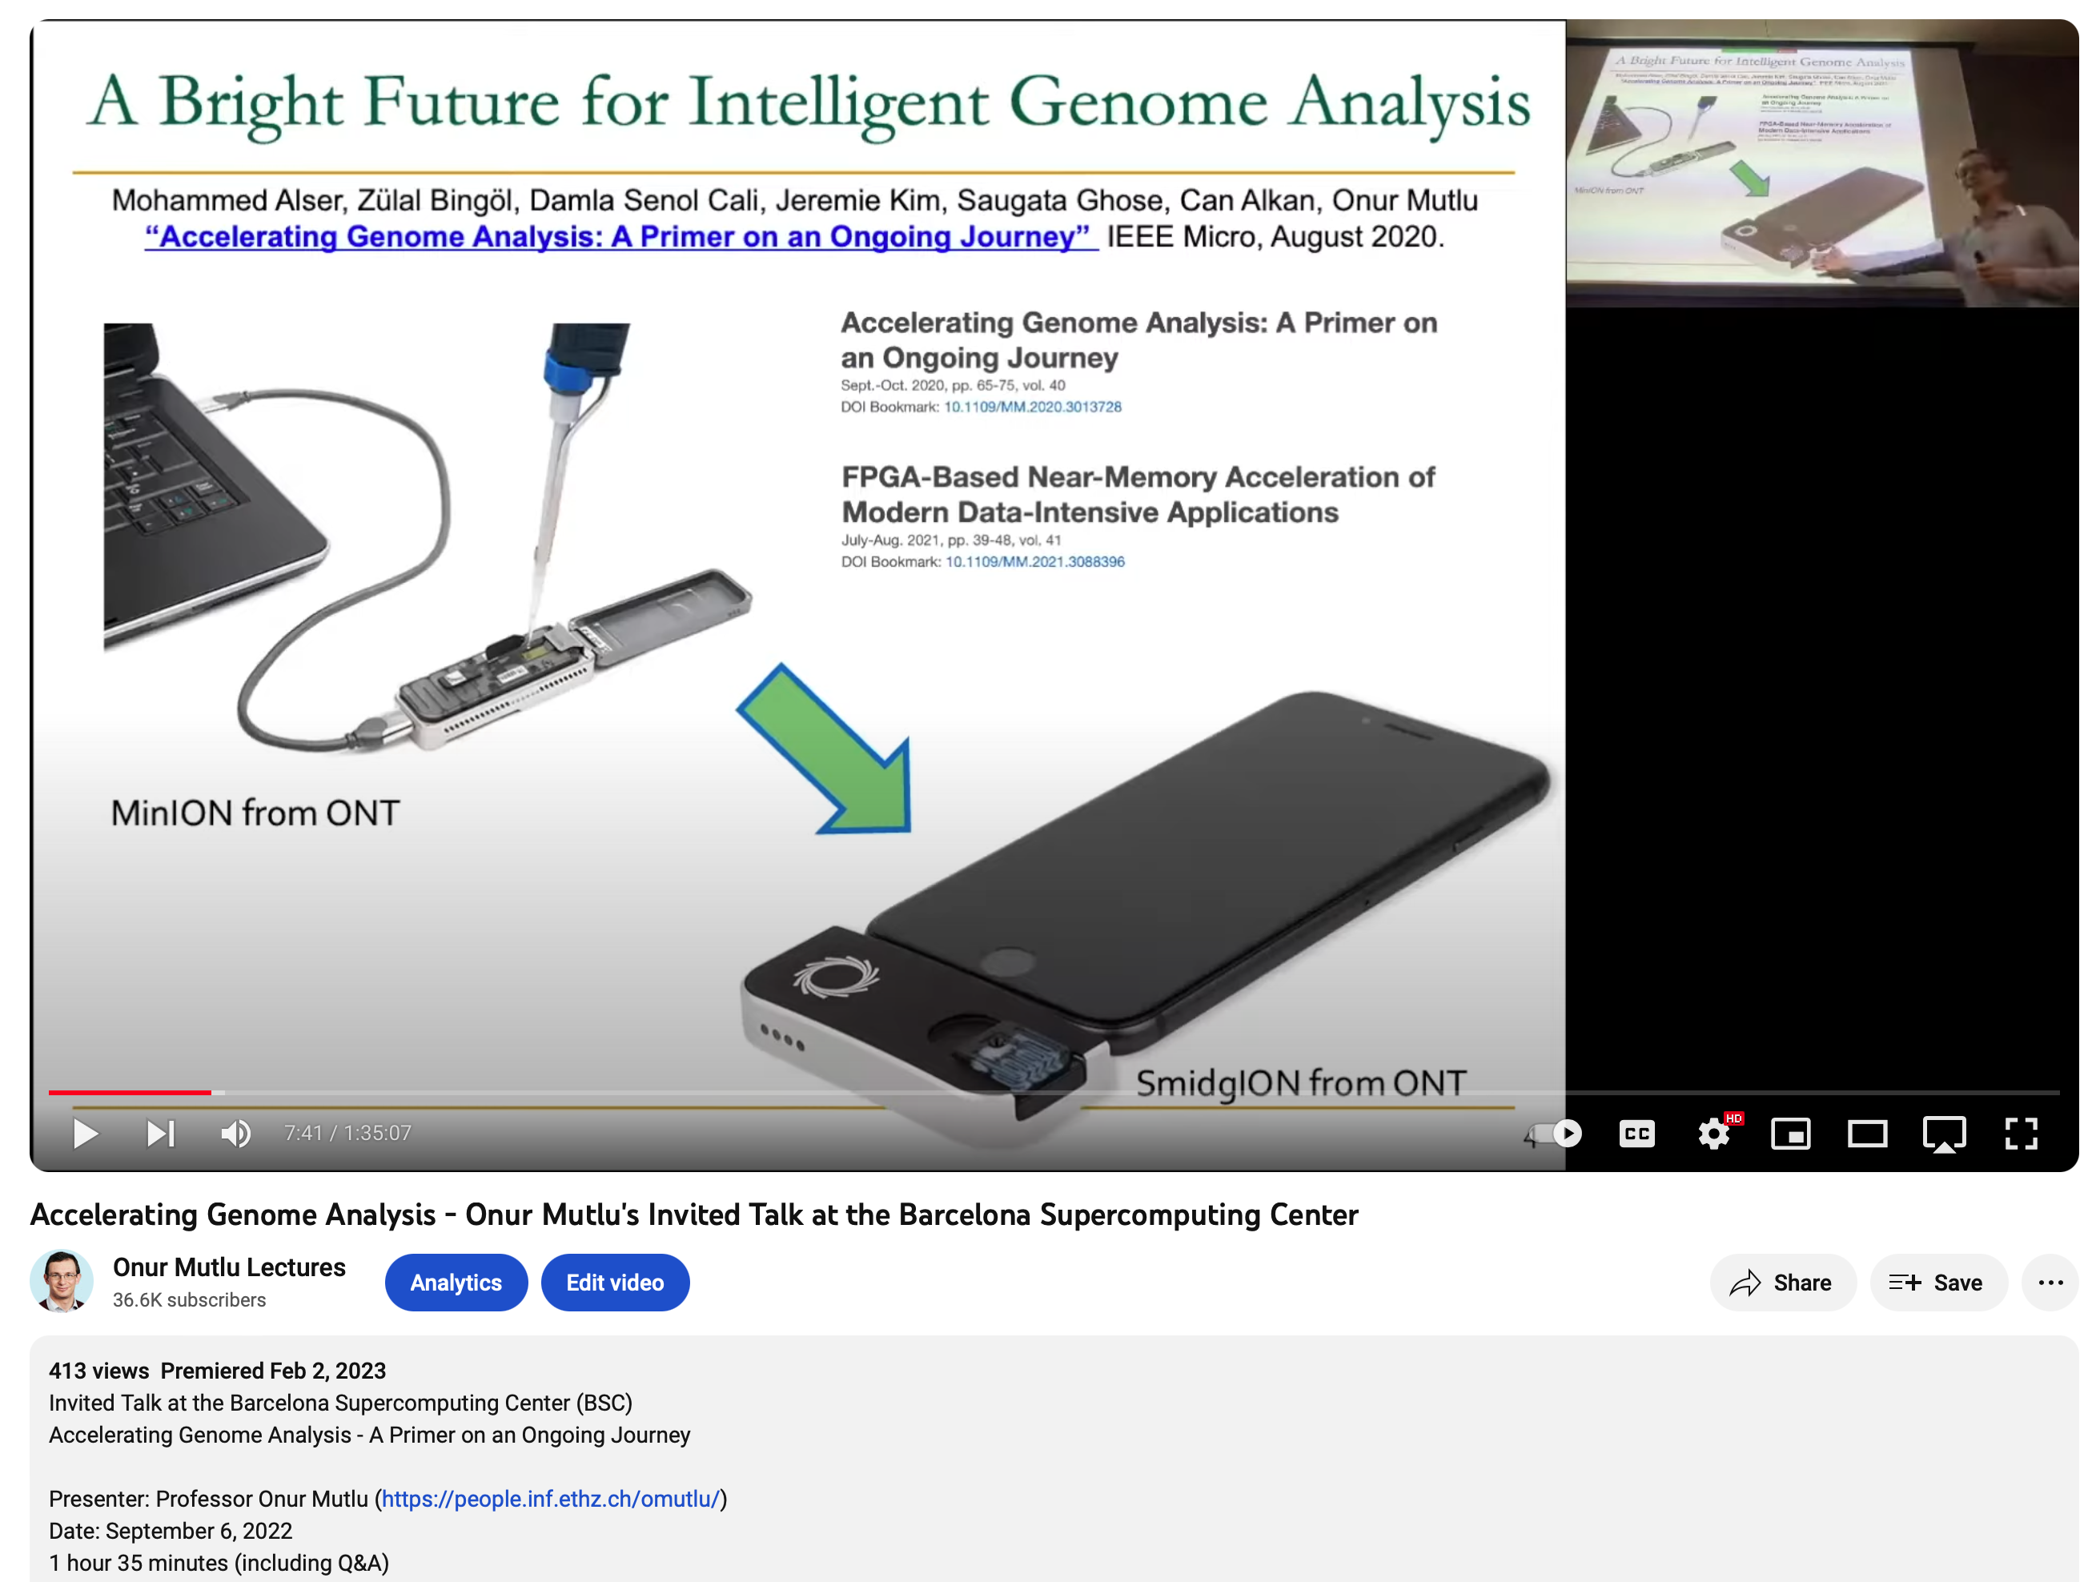
More on Fast Genome Analysis…
Onur Mutlu,
"Accelerating Genome Analysis"
Invited Talk at the Barcelona Supercomputing Center (BSC), Barcelona, Spain, 6 September 2022.
[Slides (pptx) (pdf)]
[Talk Video (1 hour 35 minutes, including Q&A)]
[Related Invited Paper (at IEEE Micro, 2020)]
[Related Invited Paper (at Computational and Structural Biology Journal, 2022)]

Slide 74
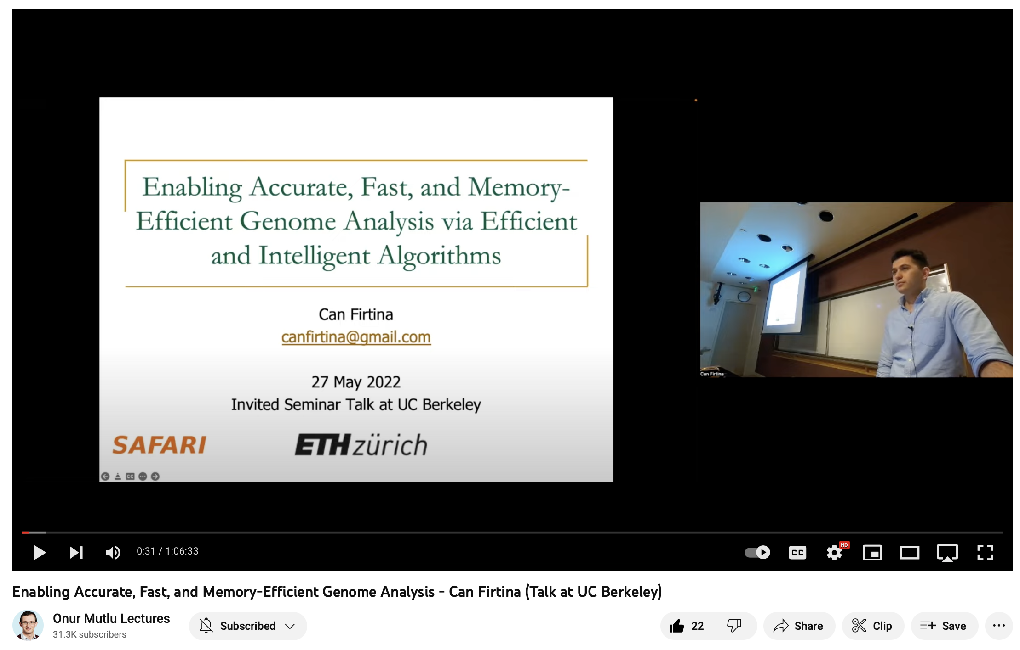
More on Accelerating Genome Analysis
Can Firtina,
"Enabling Accurate, Fast, and Memory-Efficient Genome Analysis via Efficient and Intelligent Algorithms"
Talk at UC Berkeley, Berkeley, CA, United States, May 27, 2022.
[Slides (pptx) (pdf)]
[Talk Video (1 hour 6 minutes)]

Slide 75
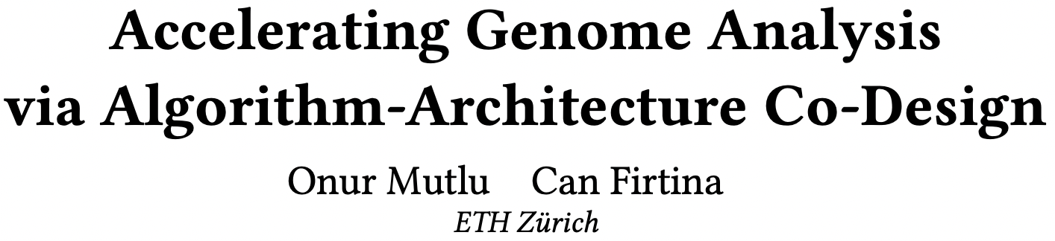
Accelerating Genome Analysis [DAC 2023]
Onur Mutlu and Can Firtina,
"Accelerating Genome Analysis via Algorithm-Architecture Co-Design"
Invited Special Session Paper in Proceedings of the 60th Design Automation Conference (DAC), San Francisco, CA, USA, July 2023.
[Slides (pptx) (pdf)]
[Talk Video (38 minutes, including Q&A)]
[Related Invited Paper]
[arXiv version]
https://ieeexplore.ieee.org/document/10247887

Slide 76
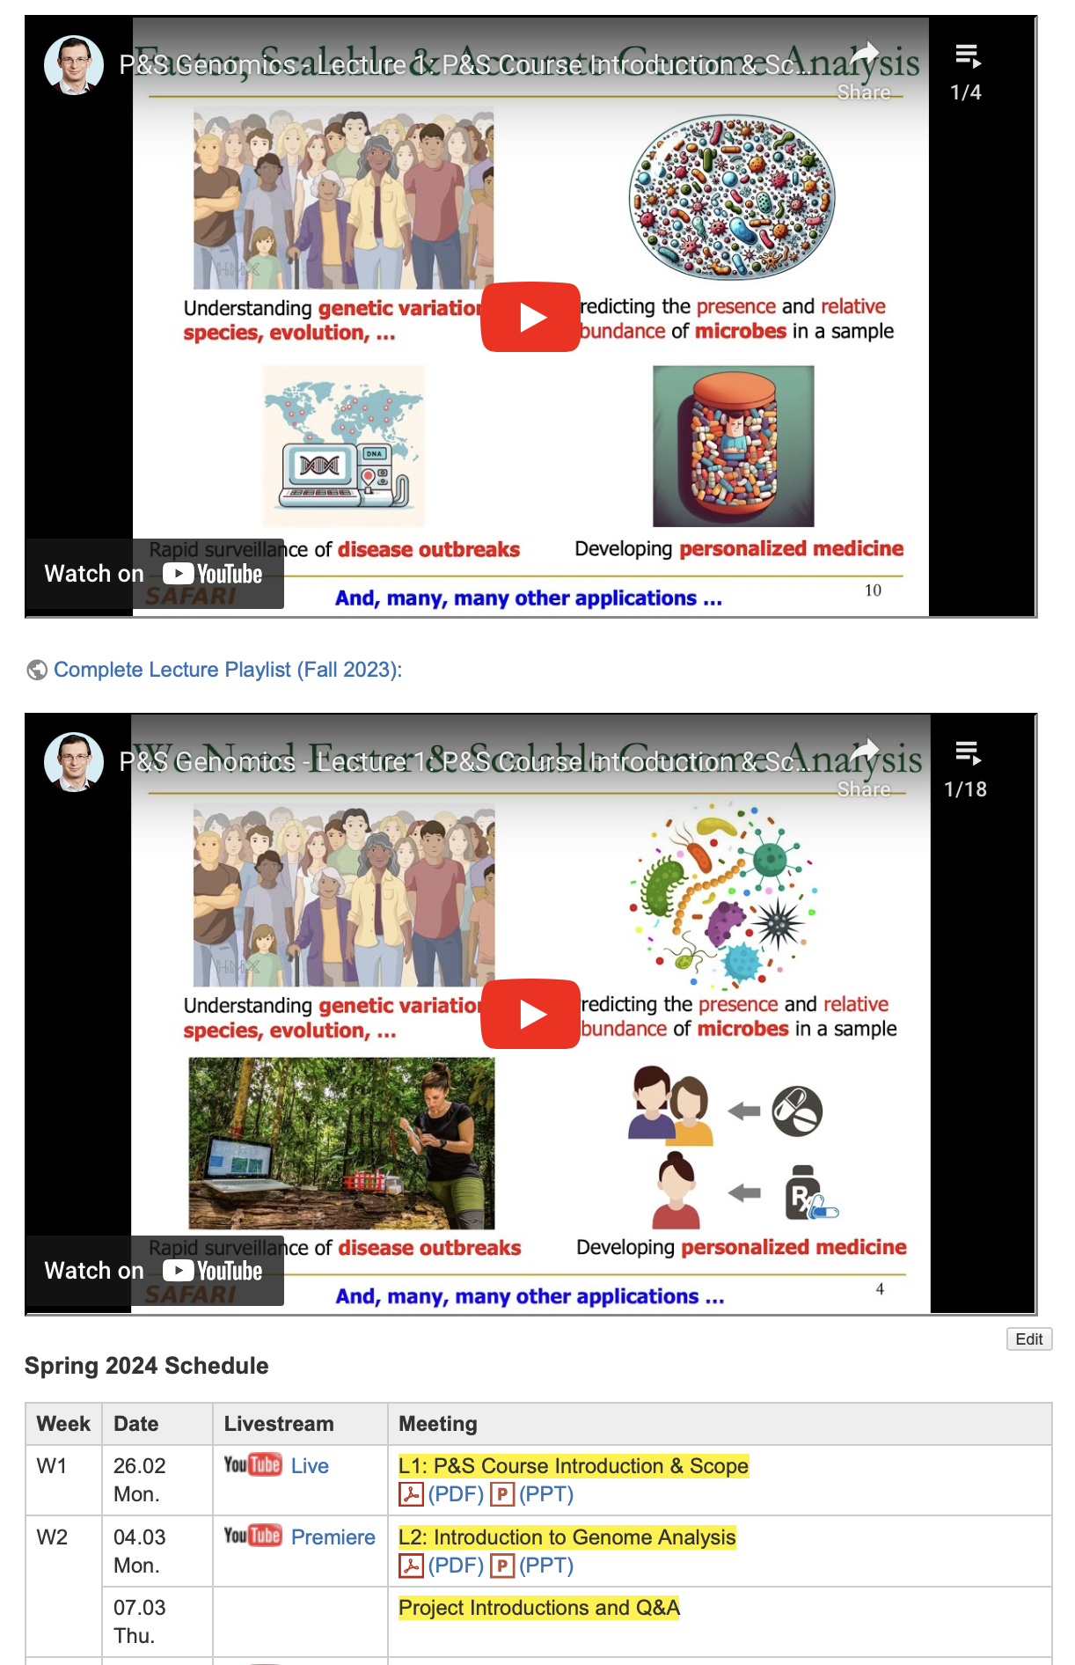
Genomics Course (Spring 2024)
Spring 2024 Edition:
  https://safari.ethz.ch/projects_and_seminars/spring2024/doku.php?id=bioinformatics
Fall 2023 Edition:
  https://safari.ethz.ch/projects_and_seminars/fall2023/doku.php?id=bioinformatics
Youtube Livestream (Spring 2024):
  https://youtube.com/playlist?list=PL5Q2soXY2Zi_UT4zTiLxRmK_zbgz6M93Z
Project course
  Taken by Bachelor’s/Master’s students
  Genomics lectures
  Hands-on research exploration
  Many research readings
https://www.youtube.com/onurmutlulectures

Slide 77
Introduction to Real-Time
Raw Nanopore Signal Analysis:
RawHash and RawHash2
Can Firtina
canfirtina@gmail.com
18 March 2024
Sabanci University
BIO310 - Introduction to Bioinformatics

Slide 78
Backup Slides

Slide 79
Challenges in Read Mapping
Need to find many mappings of each read
Need to tolerate variances/sequencing errors in each read
Need to map each read very fast (i.e., performance is important, life critical in some cases)
Need to map reads to both forward and reverse strands
https://www.bioinformaticsalgorithms.org/bioinformatics-chapter-1
Notes:
There are three main challenges.
First. The mapper needs to find many mappings for each read. Because the read is so short, they can map to multiple locations in the reference genome. How can we efficiently find all mappings of a read?
Second. The mapper needs to tolerate small variance or errors in each read. Since individuals are different, the subject’s DNA might slightly differs from the reference DNA, which can be mismatches, insertions or deletions of base pairs. How can we efficiently map each read with up to a number of e errors present?
Third. The mapper needs to map each read very fast. In another word, performance is important. Because the human DNA is 3.2 billion base-pairs long and each read is only hundreds of base-pairs long, there can be billions of reads subjected to mapping for an individual human. Current state of the art mappers take weeks to map a human’s DNA. So the question is, how can we design a much higher performance read mapper?

Slide 80
Analysis is Bottlenecked in Read Mapping!!
48
1
Human whole
genomes
GAGTCAGAATTTGAC
Human
GAGTCAGAATTTGAC
genome
GAGTCAGAATTTGAC
GAGTCAGAATTTGAC
GAGTCAGAATTTGAC
GAGTCAGAATTTGAC
GAGTCAGAATTTGAC
GAGTCAGAATTTGAC
GAGTCAGAATTTGAC
at 30× coverage
GAGTCAGAATTTGA
GAGTCAGAATTTGAC
GAGTCAGAATTTGAC
GAGTCAGAATTTGAC
32 CPU hours
GAGTCAGAATTTGAC
in about 2 days
GAGTCAGAATTTGAC
on a 48-core processor
Illumina NovaSeq 6000
Goyal+, "Ultra-fast next generation human genome sequencing data processing using DRAGENTM bio-IT processor for precision medicine”, Open Journal of Genetics, 2017.
Notes:
12.48
5.2 CPU hours
144x
60 CPU hours
BWA-MEM
25 minutes
Illumine HiSeq X10
25 minutes
Nanopore MinION
Short reads generated in a day using today’s HTS machines (e.g., Illumine HiSeq X10) can be mapped to the human reference genome using BWA-MEM [36], a popular and widely-used read mapper, in 12.5 CPU (central processing unit) days when running on a single core [66, 67]. BWA-MEM also takes about 2.5 CPU days to map long reads that are generated in 25 minutes using today’s Nanopore MinION sequencer [68]

Slide 81
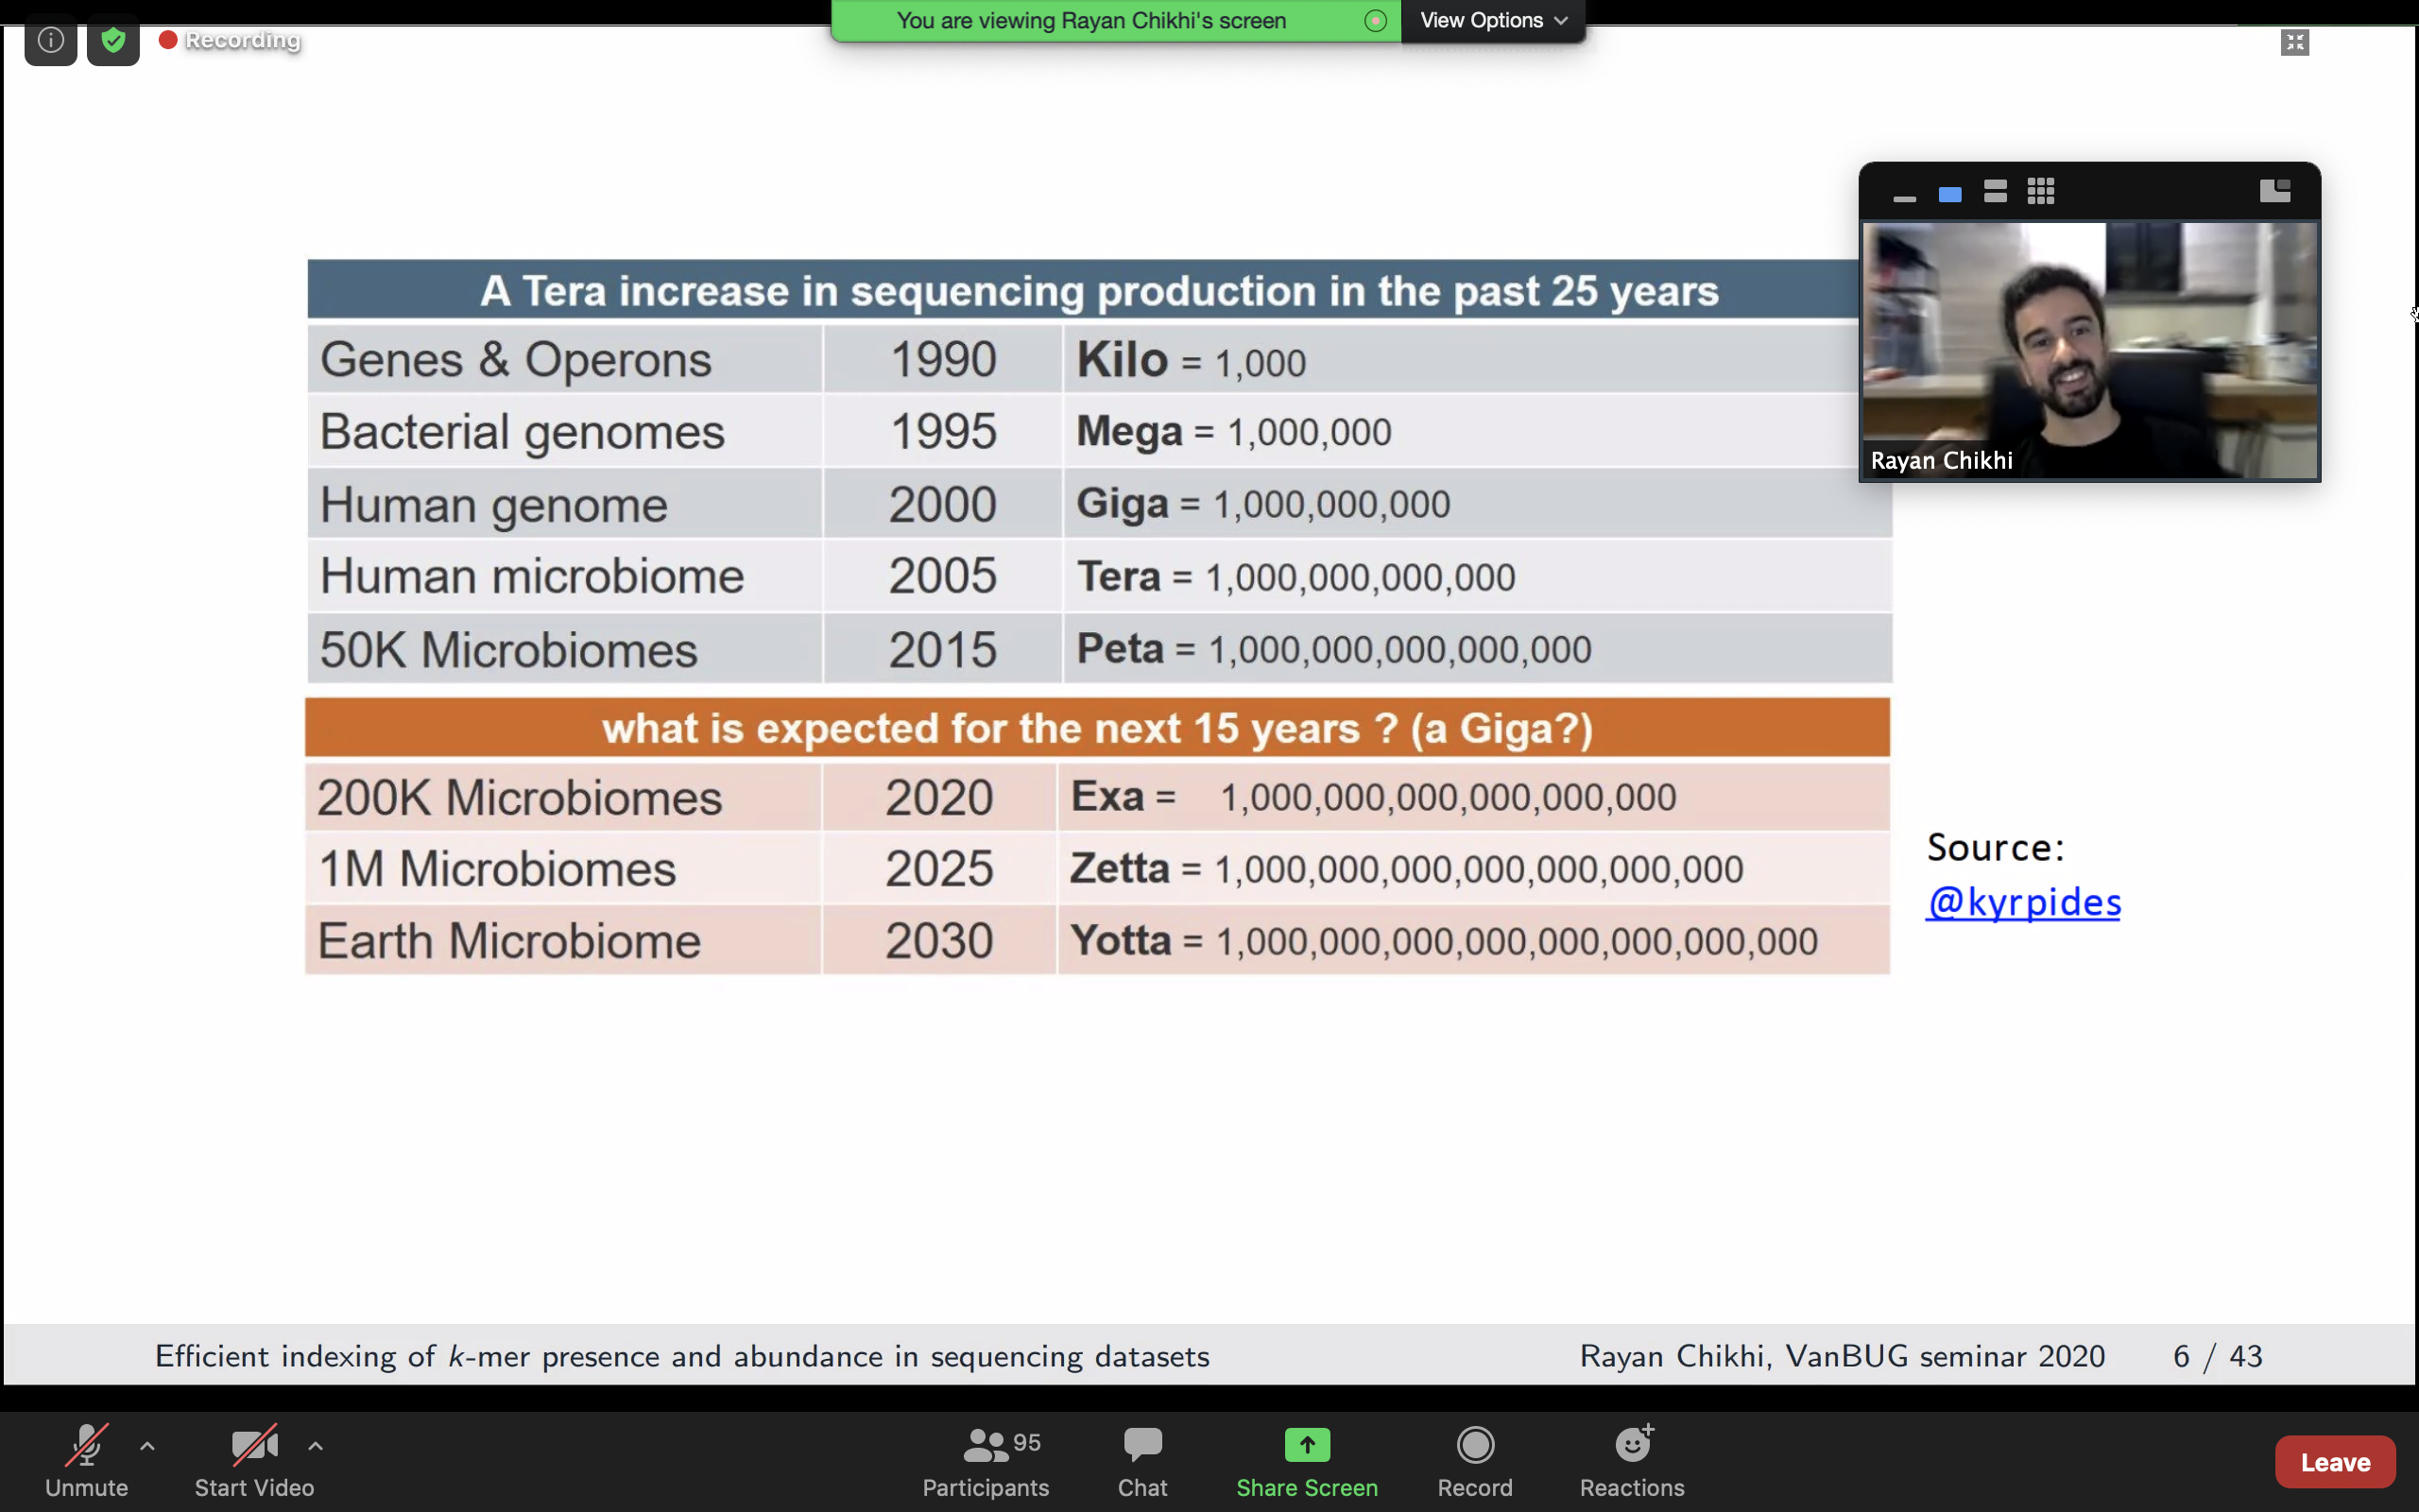
A Tsunami of Sequencing Data
A Tera-scale increase in sequencing production in the past 25 years

Slide 82

Solving the Puzzle
.FASTA file
.FASTQ file
Reference genome
Reads
https://www.pacb.com/smrt-science/smrt-sequencing/hifi-reads-for-highly-accurate-long-read-sequencing/
Notes:
Rhinoceros

Slide 83
Obtaining the Human Reference Genome
GRCh38.p13
Description: Genome Reference Consortium Human Build 38 patch release 13 (GRCh38.p13)
Organism name: Homo sapiens (human)
Date: 2019/02/28
3,099,706,404 bases
Compressed .fna file (964.9 MB)
https://www.ncbi.nlm.nih.gov/assembly/GCF_000001405.39
>NC_000001.11 Homo sapiens chromosome 1, GRCh38.p13 Primary Assembly NNNNNNNNNNNNNNNNNNNNNNNNNNNNNNNNNNNNNNNNNNNNNNNNNNNNNNNNNNNNNNNNNNNNNN
NNNNNNNNNNNNNNNNNNNNNNNNNNNNNNNNNNNNNNNNNNNNNNNNNNNNNNNNNNNNNNNNNNNNNN NNNNNNNNNNNNNNNNNNNNNNNNNNNNNNNNNNNNNNNNNNNNNNNNNNNNNNNNNNNNNNNNNNNNNN NNNNNNNNNNNNNNNNNNNNNNNNNNNNNNNNNNNNNNNNNNNNNNNNNNNNNNNNNNNNNNNNNNNNNN
….

Slide 84
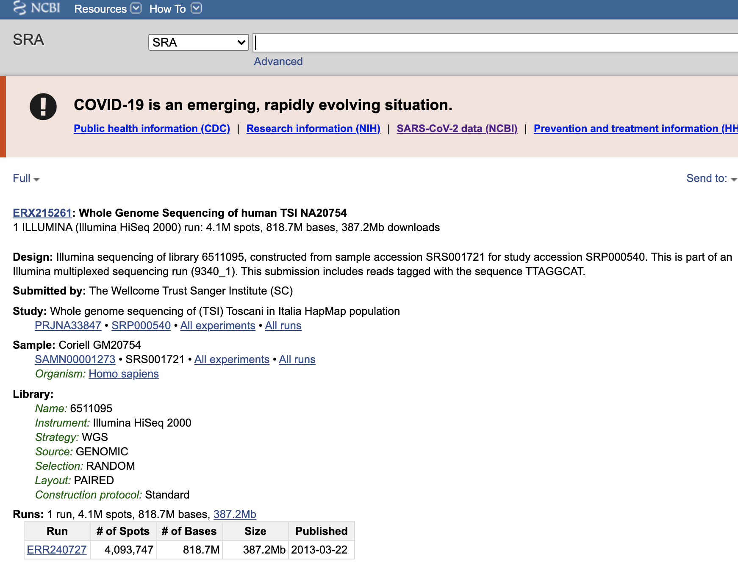
Obtaining .FASTQ Files
https://www.ncbi.nlm.nih.gov/sra/ERR240727

Slide 85
Read Mapping
Map reads to a known reference genome with some minor differences allowed
DNA Sample
“chemical format”
Reads
“text format”
Reference genome
Subject genome
“text format”
Notes:
Read mapping is a post processing procedure after DNA sequencing. It maps the data output from a DNA sequencer, which are many short DNA fragments, to a known reference genome, with some minor differences allowed.
To illustrate the problem better, let us take a closer look at the DNA itself. Logically, the DNA is a double stranded long string. In reality, within a cell they folded into a sphere in the nucleus like a ball of wool. Since it is very hard to disentangle the DNA at molecular level, to extract the information out, a sequencer cuts the mass into many short DNA pieces which are called reads.
A mapper’s job is to find where these DNA short reads are most likely to be originally placed so that later we can assemble them in the correct order to restore the original DNA.
Mapping these short reads, up to billions of them, with each one being 50 to 300 base-pairs long, to the reference genome is challenging.

Slide 86
Read Mapping Algorithms: Two Styles
Hash based seed-and-extend (hash table, suffix array, suffix tree)
  Index the “k-mers” in the genome into a hash table (pre-processing)
  When searching a read, find the location of a k-mer in the read; then extend through alignment
  More sensitive (can find all mapping locations), but slow
  Requires large memory; this can be reduced with cost to run time
Burrows-Wheeler Transform & Ferragina-Manzini Index based aligners
  BWT is a compression method used to compress the genome index
  Perfect matches can be found very quickly, memory lookup costs increase for imperfect matches
  Reduced sensitivity

Slide 87
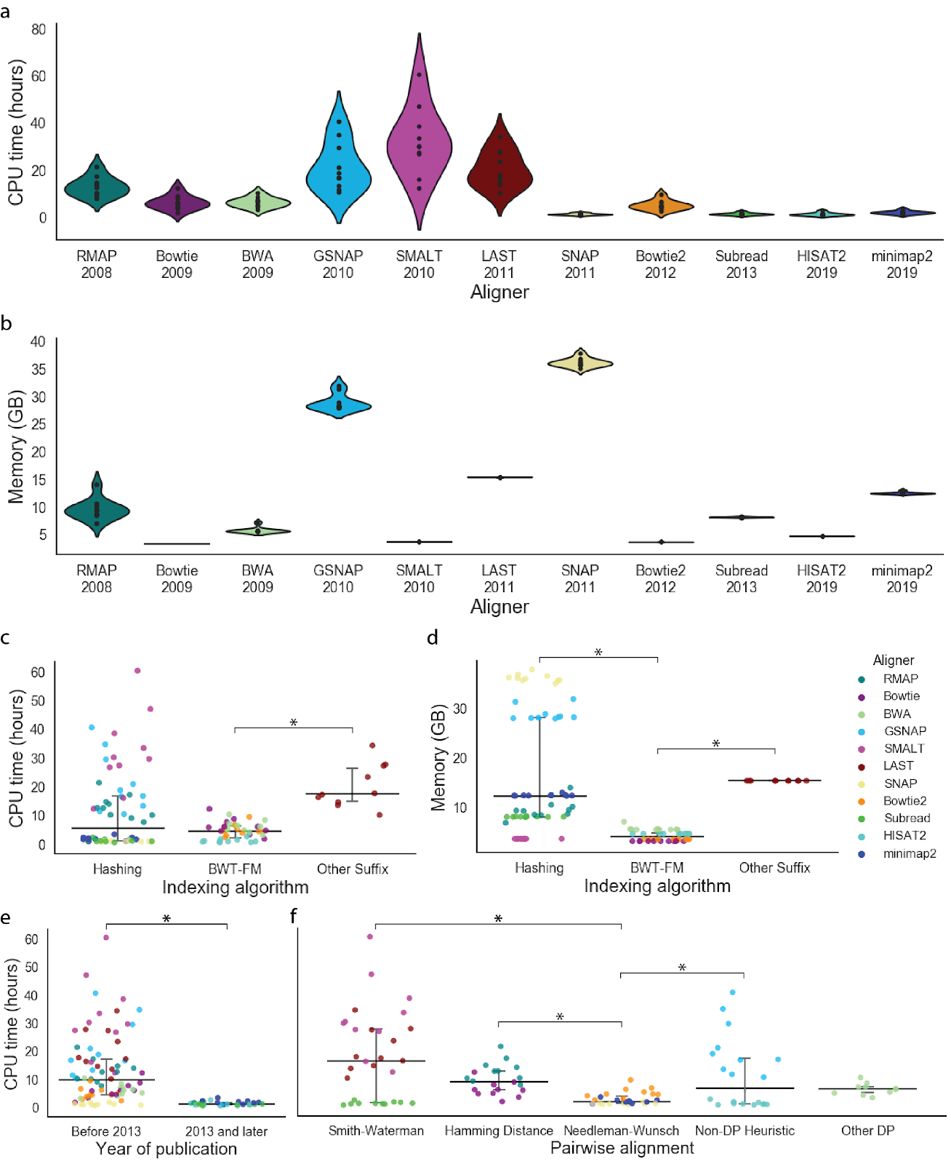
The Need for Speed
Did we realize the need for faster genome analysis?
Mapper
Alser+, "Technology dictates algorithms: Recent developments in read alignment", Genome Biology, 2021

Slide 88
Sequence Alignment in Unavoidable
Quadratic-time dynamic-programming algorithm
WHY?!
 |  | N | E | T | H | E | R | L | A | N | D | S
 | 0 | 1 | 2 | 3 | 4 | 5 | 6 | 7 | 8 | 9 | 10 | 11
S | 1 | 1 | 2 | 3 | 4 | 5 | 6 | 7 | 8 | 9 | 10 | 10
W | 2 | 2 | 2 | 3 | 4 | 5 | 6 | 7 | 8 | 9 | 10 | 11
I | 3 | 3 | 3 | 3 | 4 | 5 | 6 | 7 | 8 | 9 | 10 | 11
T | 4 | 4 | 4 | 3 | 4 | 5 | 6 | 7 | 8 | 9 | 10 | 11
Z | 5 | 5 | 5 | 4 | 4 | 5 | 6 | 7 | 8 | 9 | 10 | 11
E | 6 | 6 | 5 | 5 | 5 | 4 | 5 | 6 | 7 | 8 | 9 | 10
R | 7 | 7 | 6 | 6 | 6 | 5 | 4 | 5 | 6 | 7 | 8 | 9
L | 8 | 8 | 7 | 7 | 7 | 6 | 5 | 4 | 5 | 6 | 7 | 8
A | 9 | 9 | 8 | 8 | 8 | 7 | 6 | 5 | 4 | 5 | 6 | 7
N | 10 | 9 | 9 | 9 | 9 | 8 | 7 | 6 | 5 | 4 | 5 | 6
D | 11 | 10 | 10 | 10 | 10 | 9 | 8 | 7 | 6 | 5 | 4 | 5
Enumerating all possible prefixes
etc
etc
NETHERLANDS x SWITZERLAND
Data dependencies limit the computation parallelism
NETHERLANDS x S
NETHERLANDS x SW
NETHERLANDS x SWI
NETHERLANDS x SWIT
NETHERLANDS x SWITZ
NETHERLANDS x SWITZE
NETHERLANDS x SWITZER
NETHERLANDS x SWITZERL
NETHERLANDS x SWITZERLA
NETHERLANDS x SWITZERLAN
NETHERLANDS x SWITZERLAND
etc
Processing row (or column) after another
Notes:
1- Read alignment follows the basic dynamic-programming doctrine which runs in a quadratic time.
2- Data dependencies between the entries limits the parallelism. Each cell depends or three pre-computed cells (immediate left, upper, and upper-left cells). Thus, we can compute the vectors one after another but not in parallel. Left-to-right, or top-to-bottom, anti-diagonal.
3- We can solve a significant amount of time, If we can find a way to detect the incorrect mappings with cheap heuristics, much cheaper than computing the alignment.

Slide 89
Sequence Alignment in Unavoidable
Quadratic-time dynamic-programming algorithm
 |  | N | E | T | H | E | R | L | A | N | D | S
 | 0 | 1 | 2 | 3 | 4 | 5 | 6 | 7 | 8 | 9 | 10 | 11
S | 1 | 1 | 2 | 3 | 4 | 5 | 6 | 7 | 8 | 9 | 10 | 10
W | 2 | 2 | 2 | 3 | 4 | 5 | 6 | 7 | 8 | 9 | 10 | 11
I | 3 | 3 | 3 | 3 | 4 | 5 | 6 | 7 | 8 | 9 | 10 | 11
T | 4 | 4 | 4 | 3 | 4 | 5 | 6 | 7 | 8 | 9 | 10 | 11
Z | 5 | 5 | 5 | 4 | 4 | 5 | 6 | 7 | 8 | 9 | 10 | 11
E | 6 | 6 | 5 | 5 | 5 | 4 | 5 | 6 | 7 | 8 | 9 | 10
R | 7 | 7 | 6 | 6 | 6 | 5 | 4 | 5 | 6 | 7 | 8 | 9
L | 8 | 8 | 7 | 7 | 7 | 6 | 5 | 4 | 5 | 6 | 7 | 8
A | 9 | 9 | 8 | 8 | 8 | 7 | 6 | 5 | 4 | 5 | 6 | 7
N | 10 | 9 | 9 | 9 | 9 | 8 | 7 | 6 | 5 | 4 | 5 | 6
D | 11 | 10 | 10 | 10 | 10 | 9 | 8 | 7 | 6 | 5 | 4 | 5
Enumerating all possible prefixes
Data dependencies limit the computation parallelism
Processing row (or column) after another
Entire matrix is computed even though strings can be dissimilar.
Number of differences is computed only at the backtraking step.
Notes:
1- Read alignment follows the basic dynamic-programming doctrine which runs in a quadratic time.
2- Data dependencies between the entries limits the parallelism. Each cell depends or three pre-computed cells (immediate left, upper, and upper-left cells). Thus, we can compute the vectors one after another but not in parallel. Left-to-right, or top-to-bottom, anti-diagonal.
3- We can solve a significant amount of time, If we can find a way to detect the incorrect mappings with cheap heuristics, much cheaper than computing the alignment.

Slide 90
Metagenomics Analysis
Reads from different unknown donors at sequencing time are mapped to many known reference genomes
genetic material recovered directly from environmental samples
Reads
“text format”
Reference Database
Notes:
Read mapping is a post processing procedure after DNA sequencing. It maps the data output from a DNA sequencer, which are many short DNA fragments, to a known reference genome, with some minor differences allowed.
To illustrate the problem better, let us take a closer look at the DNA itself. Logically, the DNA is a double stranded long string. In reality, within a cell they folded into a sphere in the nucleus like a ball of wool. Since it is very hard to disentangle the DNA at molecular level, to extract the information out, a sequencer cuts the mass into many short DNA pieces which are called reads.
A mapper’s job is to find where these DNA short reads are most likely to be originally placed so that later we can assemble them in the correct order to restore the original DNA.
Mapping these short reads, up to billions of them, with each one being 50 to 300 base-pairs long, to the reference genome is challenging.

Slide 91
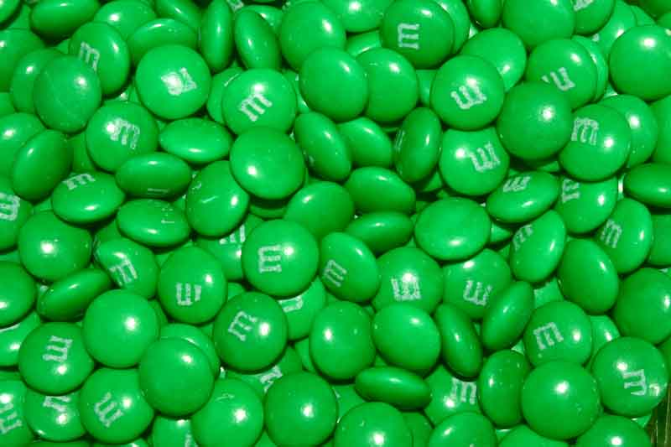

Genomics vs. Metagenomics
Genomics
Metagenomics

Slide 92
Existing Solutions – Real-time Basecalling
Deep neural networks (DNNs) for translating signals to bases
Nanopore sequencing
Raw Signal
Real-time Analysis
Basecalling
Read mapping
A
T
G
G
Current
DNNs provide less noisy analysis from basecalled sequences
Costly and power-hungry computational requirements

Slide 93
The Problem
The existing solutions are ineffective for large genomes
Real-time Analysis
Real-time Analysis
Basecalling
Read mapping
Signal mapping
A
T
G
G
Costly and energy-hungry computations to basecall each read:
Portable sequencing becomes challenging with
resource-constrained devices
Larger number of reference regions cannot be handled accurately or quickly, rendering existing solutions ineffective for large genomes

Slide 94
Applications of Read Until
Depletion: Reads mapping to a particular reference genome is ejected
Removing contaminated reads from a sample
Relative abundance estimation
Controlling low/high-abundance genomes in a sample
Controlling the sequencing of depth of a genome
Enrichment: Reads not mapping to a particular reference genome is ejected
Purifying the sample to ensure it contains only the selected genomes
Removing the host genome (e.g., human) in contamination analysis

Slide 95
Applications of Run Until and Sequence Until
Run Until: Stopping the sequencing without informative decision from analysis
Stopping when reads reach to a particular depth of coverage
Stopping when the abundance of all genomes reach a particular threshold
Sequence Until: Stopping the sequencing based on information decision
Stopping when relative abundance estimations do not change substantially (for high-abundance genomes)
Stopping when finding that the sample is contaminated with a particular set of genomes
…

Slide 96




Details: Quantizing the Event Values
Observation: Identical k-mers generate similar raw signals
  Challenge: Their corresponding event values can be slightly different
Key Idea: Quantize the event values
  To enable assigning the same quantized value to the similar event values
Slightly Different (Normalized) Event Values
-0.091 in binary:
-0.084 in binary:
1
0
1
1
1
1
0
1
1
0
1
1
…
1
0
1
1
1
1
0
1
1
0
1
0
…
Most significant $Q=9$ bits:
Most significant $Q=9$ bits:
1
0
1
1
1
1
0
1
1
1
0
1
1
1
1
0
1
1
Pruning $p=4$ bits:
Pruning $p=4$ bits:
Matching Quantized
Event Values
1
0
0
1
1
1
0
0
1
1

Slide 97
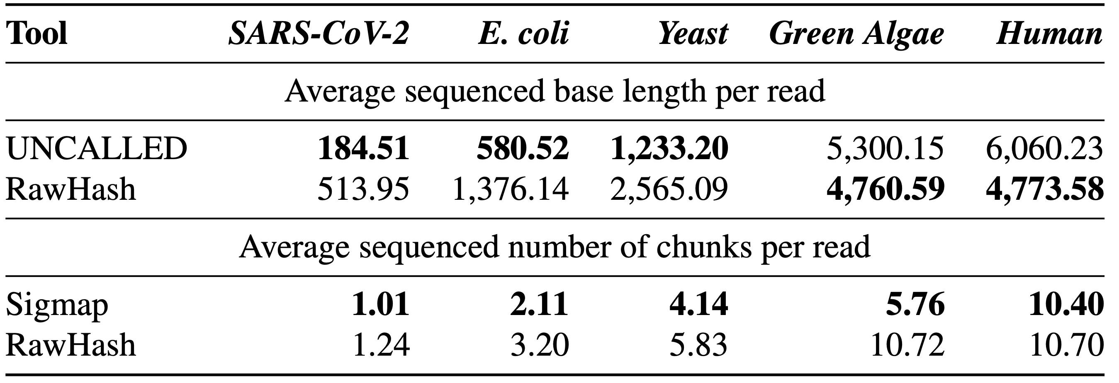
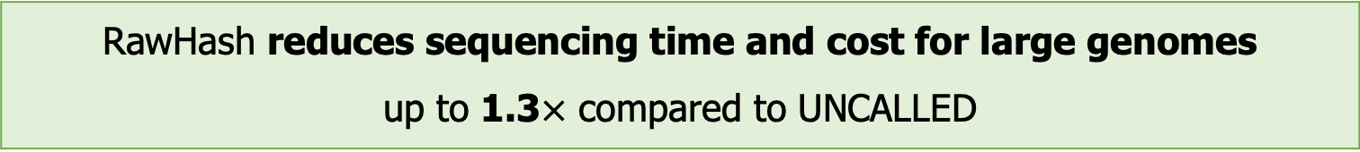
Average Sequenced Bases and Chunks
RawHash reduces sequencing time and cost for large genomes
up to 1.3$×$ compared to UNCALLED
Although Sigmap processes less number of chunks than RawHash, it fails to provide real-time analysis capabilities for large genomes

Slide 98
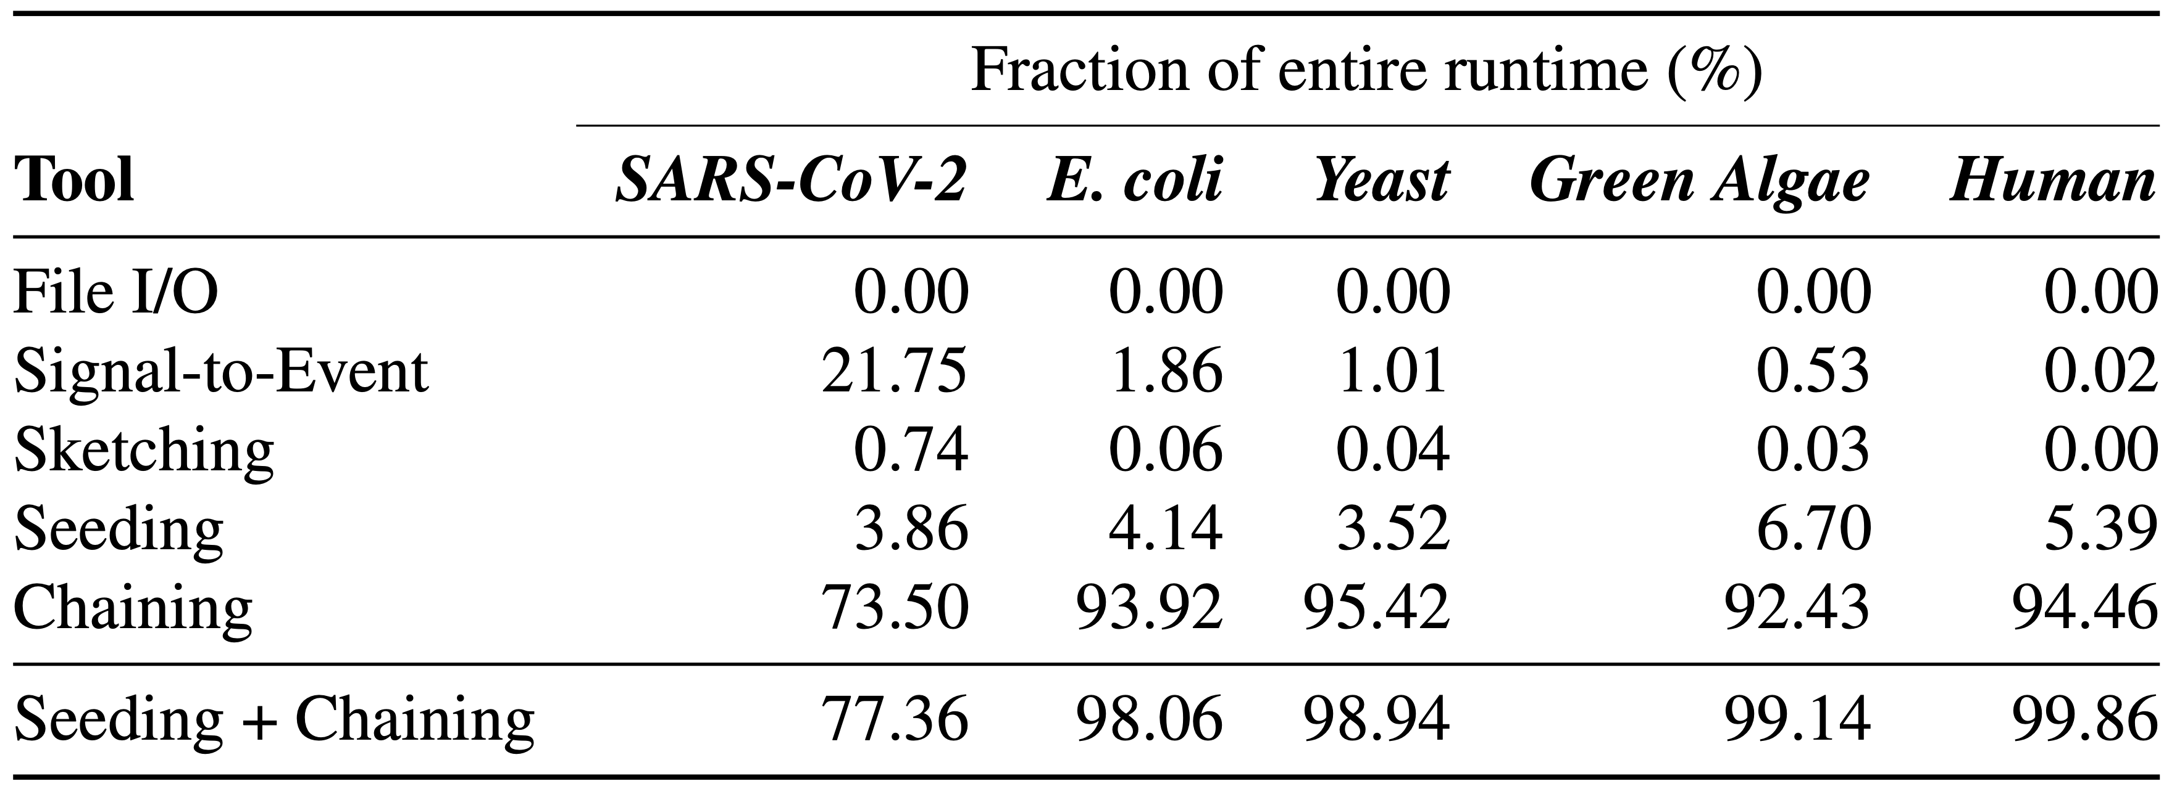
Breakdown Analysis of the RawHash Steps
The entire runtime is bottlenecked by the chaining step

Slide 99
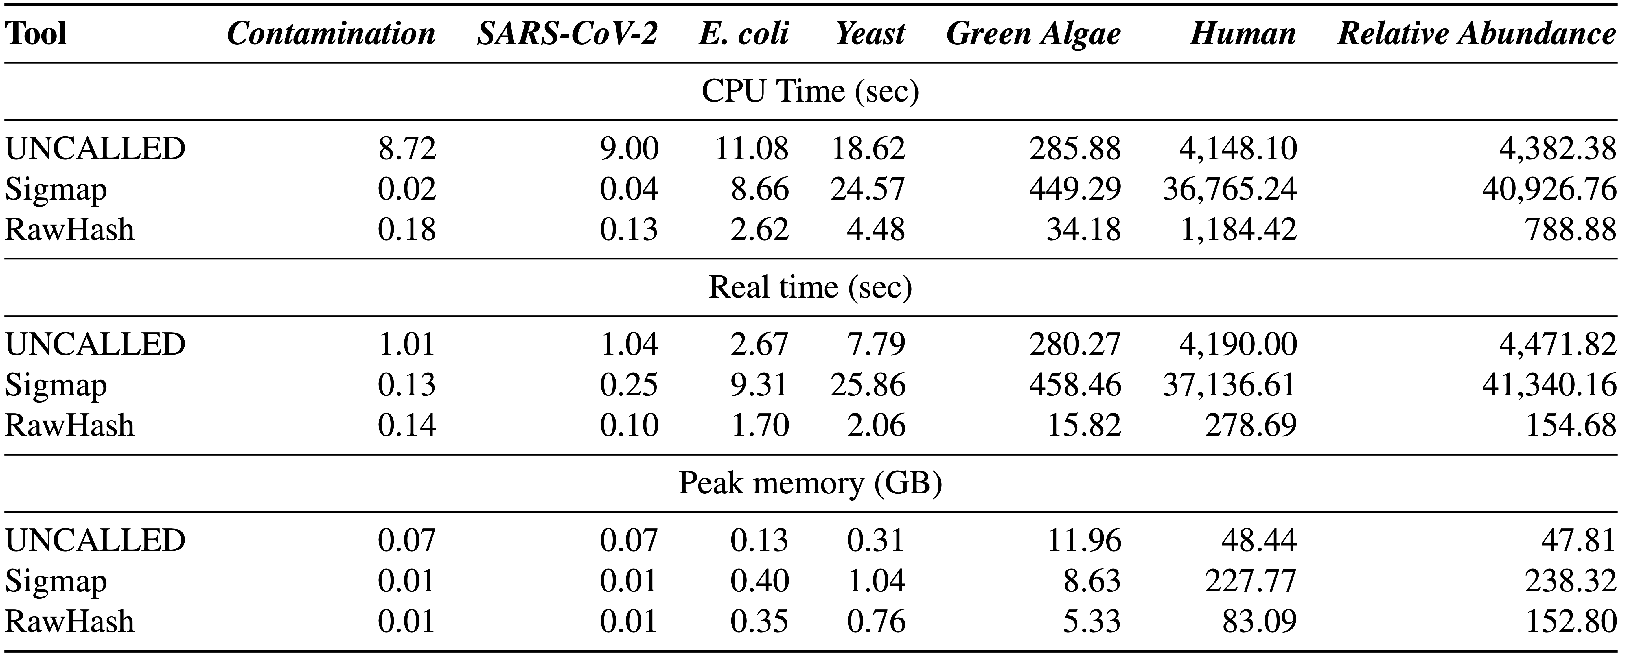
Required Computation Resources in Indexing
The indexing step of RawHash is orders of magnitude faster than
the indexing steps of UNCALLED and Sigmap, especially for large genomes
RawHash requires larger memory space than UNCALLED

Slide 100
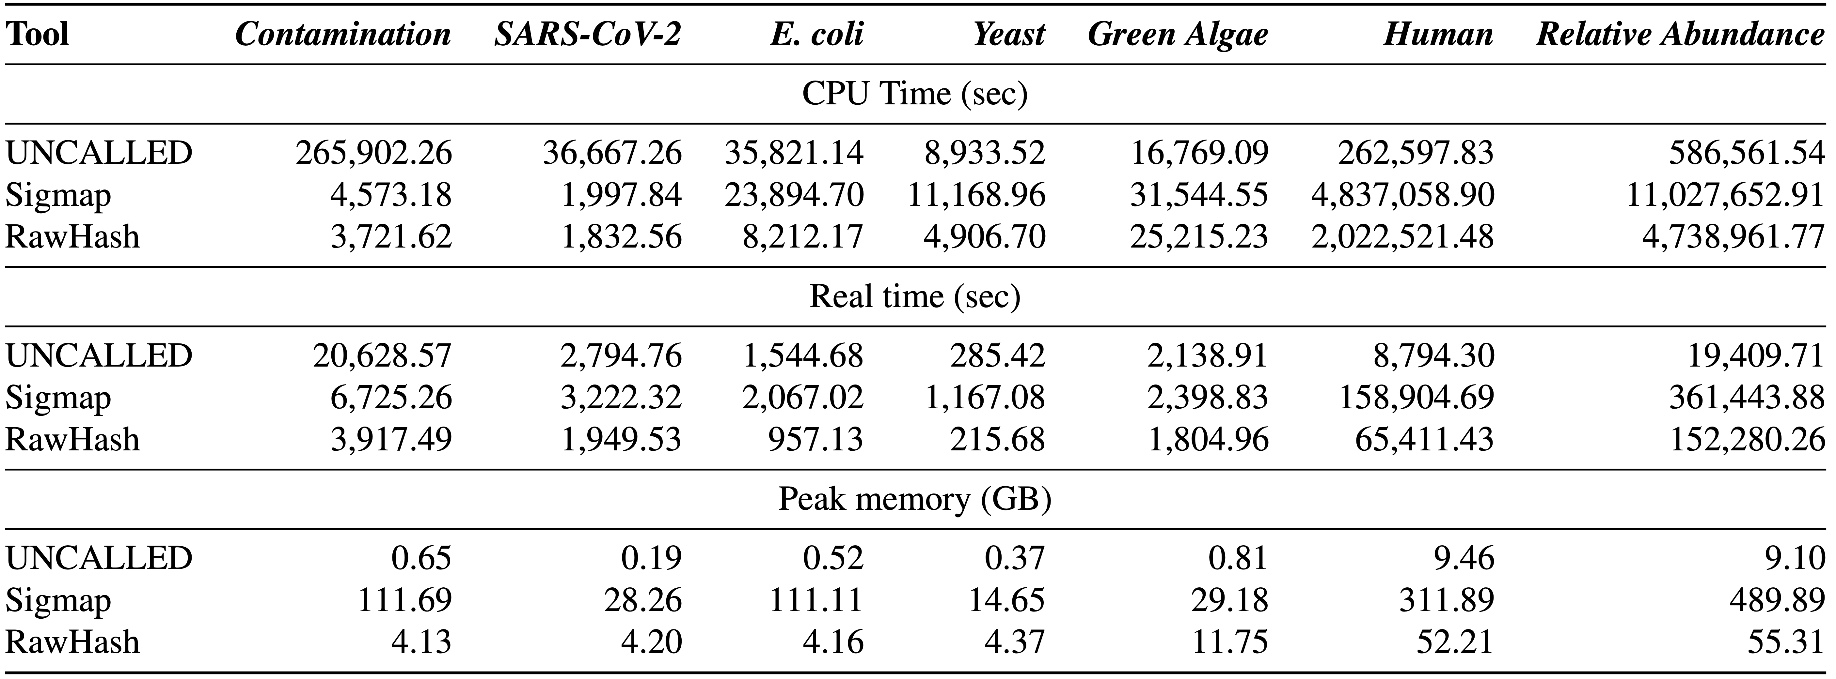
Required Computation Resources in Mapping
The mapping step of RawHash is significantly faster than Sigmap
for all genomes, and faster than UNCALLED for small genomes
RawHash requires larger memory space than UNCALLED

Slide 101
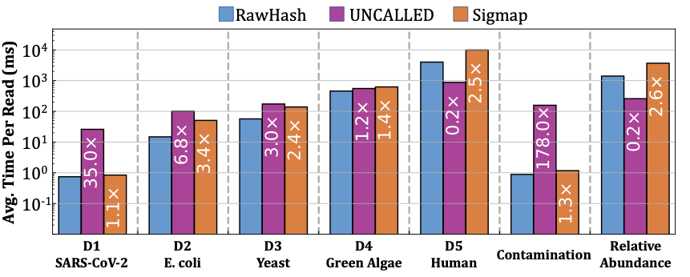
Average Mapping Time per Read
The mapping step of RawHash is significantly faster than Sigmap
for all genomes, and faster than UNCALLED for small genomes

Slide 102
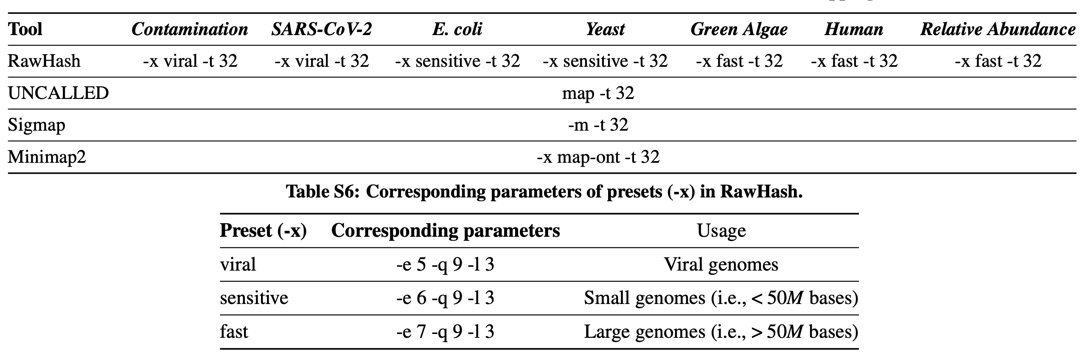
Parameter Configurations

Slide 103
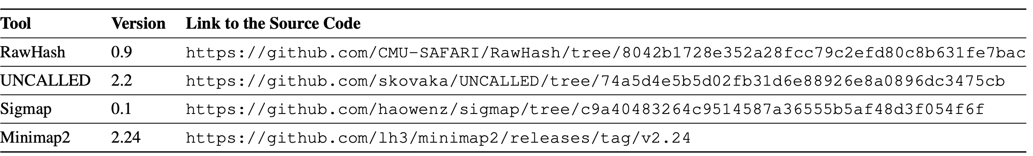
Versions

