Slide 1




HiPEAC 2024
ApHMM
Paper
Accelerating Profile Hidden Markov Models
for Fast and Energy-Efficient Genome Analysis
Can Firtina
canfirtina@gmail.com
https://cfirtina.com
Kamlesh Pillai, Gurpreet S. Kalsi, Bharathwaj Suresh, Damla Senol Cali,
Jeremie S. Kim, Taha Shahroodi, Meryem Banu Cavlak, Joël Lindegger,
Mohammed Alser, Juan Gómez Luna, Sreenivas Subramoney, Onur Mutlu

Slide 2
Executive Summary
Motivation: Graph structures such as profile Hidden Markov Models (pHMMs) are commonly used to accurately analyze biological sequences
Problem: The parameters used in pHMMs are mainly trained and used with a computationally intensive Baum-Welch algorithm, causing major performance and energy overhead for many genomics workloads
Goal: Enable rapid, power-efficient, and flexible use of pHMMs for genomics workloads
ApHMM: the first flexible and hardware-software accelerator for pHMMs that can
Substantially reduce unnecessary data storage, data movement, and computations by effectively co-designing hardware and software together
Provide a flexible design to support several genomics workloads that use pHMMs
Key Results: Our ASIC implementation compared to CPU, GPU, and FPGA baselines across 3 workloads
  15.55×–260.03×, 1.83×–5.34×, and 27.97× better performance
  Up to 2622.94× reduction in energy consumption
https://github.com/CMU-SAFARI/ApHMM-GPU

Slide 3
Outline
Background & Problem
Motivation and Goal
Experimental Methodology
Temperature Analysis
Aggressor Row Active Time Analysis
Spatial Variation Analysis
Implications on Attacks and Defenses
Conclusions
ApHMM
Evaluation
Conclusion

Slide 4




Genome Analysis – Why?
Fast and accurate genome analysis is important for:
Understanding genetic variations, species, and evolution
Predicting the presence of pathogens in an environment
Surveillance of disease outbreaks
Personalized medicine

Slide 5

Background: Genome Analysis – How?
Genome sequencing machines can quickly convert biological molecules
  Into sequences of characters for analysis
AAGCTTCCATGG
AAATGGGCTTTC
GCTTCCAGAATG
Sequences from DNA
GCCCAAATGGTT
Biological Molecule (e.g., DNA)

Slide 6

Sequence Comparison is Essential
Analyze sequences by accurately and quickly comparing them
  To each other
  To a template sequence representative of a species, a certain group…
Essential to understand functionality of a sequence, mutations, diseases…
Biological Sequences
(e.g., DNA, proteins)

Slide 7



Graphs for Sequence Comparisons
Graphs are commonly used in sequence comparisons
  Can avoid redundant comparisons and storage
  Provides rich information on expected variations between sequences
Biological Sequences
(e.g., DNA, proteins)

Slide 8
Profile Hidden Markov Models
Profile Hidden Markov Models (pHMMs) are powerful and common graph structures for sequence comparison
  Goal: Identify variations between sequences probabilistically
  Each state outputs a biological character (emission) when visited
  States are visited via transitions (edges) based on observed variations
  Variations: No variation
Expected sequence: ACTT
Observed Sequence #1: ACTT
(No variation)
A
C
T
T

Slide 9
Profile Hidden Markov Models
Profile Hidden Markov Models (pHMMs) are powerful and common graph structures for sequence comparison
  Goal: Identify variations between sequences probabilistically
  Each state outputs a biological character (emission) when visited
  States are visited via transitions (edges) based on observed variations
  Variations: No variation, Substitutions
Expected sequence: ACTT
Observed Sequence #2: ACTG
(Substitutions)
A
C
T
G

Slide 10

Profile Hidden Markov Models
Profile Hidden Markov Models (pHMMs) are powerful and common graph structures for sequence comparison
  Goal: Identify variations between sequences probabilistically
  Each state outputs a biological character (emission) when visited
  States are visited via transitions (edges) based on observed variations
  Variations: No variation, Substitutions, Insertions
$$3×$$
I
Expected sequence: ACTT
Observed Sequence #3: AGGGCTT
(I: Insertions)
A
C
T
T

Slide 11
Profile Hidden Markov Models
Profile Hidden Markov Models (pHMMs) are powerful and common graph structures for sequence comparison
  Goal: Identify variations between sequences probabilistically
  Each state outputs a biological character (emission) when visited
  States are visited via transitions (edges) based on observed variations
  Variations: No variation, Substitutions, Insertions, Deletions
Expected sequence: ACTT
Observed Sequence #4: ATT
(D: Deletions)
A
C
T
T
D

Slide 12
Profile Hidden Markov Models
Profile Hidden Markov Models (pHMMs) are powerful and common graph structures for sequence comparison
  Goal: Identify variations between sequences probabilistically
  Each state outputs a biological character (emission) when visited
  States are visited via transitions (edges) based on observed variations
  Variations: No variation, Substitutions, Insertions, Deletions
I
I
I
I
Observed Sequence #1: ACTT
Observed Sequence #2: ACTG
Observed Sequence #3: AGGGCTT
Observed Sequence #4: ATT
…
A
C
T
T
D
D
D

Slide 13
Probabilities in pHMMs
Profile Hidden Markov Models (pHMMs) are powerful and common graph structures for sequence comparison
  Goal: Identify variations between sequences probabilistically
0.4
0.3
A: 0.1
T: 0.2
G: 0.6
C: 0.1
A: 0.2
T: 0.2
G: 0.2
C: 0.4
I
I
I
I
0.6
0.2
0.1
A
C
T
T
A: 0.9
T: 0.1
G: 0.0
C: 0.0
A: 0.1
T: 0.1
G: 0.1
C: 0.7
0.7
D
D
D

Slide 14
Utilizing Probabilities in pHMMs
The Baum-Welch algorithm is commonly used with pHMMs
  For both inference and training by effectively utilizing the probabilities
Inference: Identifying the variations between sequences
Training: Maximizing parameters to observe certain variations
Forward Calculations
Backward Calculations
Updating
Transition Probabilities
Updating
Emission Probabilities

Slide 15
Utilizing Probabilities in pHMMs
The Baum-Welch algorithm is commonly used with pHMMs
  For both inference and training by effectively utilizing the probabilities
Inference: Identifying the variations between sequences
Training: Maximizing parameters to observe certain variations
Forward Calculations
Backward Calculations
Updating
Transition Probabilities
Updating
Emission Probabilities

Slide 16
Utilizing Probabilities in pHMMs
The Baum-Welch algorithm is commonly used with pHMMs
  For both inference and training by effectively utilizing the probabilities
Inference: Identifying the variations between sequences
Training: Maximizing parameters to observe certain variations
Forward Calculations
Backward Calculations
Training Step
Updating
Transition Probabilities
Updating
Emission Probabilities

Slide 17






Forward & Backward Calculations
A dynamic programming approach
  Calculate the ‘possibility’ of visiting each state in a pHMM
  Given an observed sequence (from both directions of the sequence)
Observed Sequence: ATGT
$$F_{t}\left(i\right)$$
$$B_{t}\left(i\right)$$
$$i$$
A
I
D
C
I
D
T
I
D
$$i$$
A
I
D
C
I
D
T
I
D
$$t$$
$$t$$
A
A
T
T
G
G
T
T
Forward Calculations
Backward Calculations

Slide 18




Inference using pHMMs
Goal: Identifying the variations between sequences
  Inference by using decoding algorithms (e.g., the Viterbi Algorithm)
Observed Sequence: ATGT
$$F_{t}\left(i\right)$$
$$B_{t}\left(i\right)$$
$$i$$
A
I
D
C
I
D
T
I
D
$$i$$
A
I
D
C
I
D
T
I
D
$$t$$
$$t$$
A
A
T
T
G
G
T
T
Forward Calculations
Backward Calculations
Inference:
G
A
C
T
T
D

Slide 19
Training using pHMMs
Goal: Maximizing parameters to observe certain variations
  Training using the parameter updating steps in the Baum-Welch algorithm
Observed Sequence: ATGT
$$F_{t}\left(i\right)$$
$$B_{t}\left(i\right)$$
$$i$$
A
I
D
C
I
D
T
I
D
$$i$$
A
I
D
C
I
D
T
I
D
$$t$$
$$t$$
A
A
T
T
G
G
T
T
Forward Calculations
Backward Calculations
Training

Slide 20

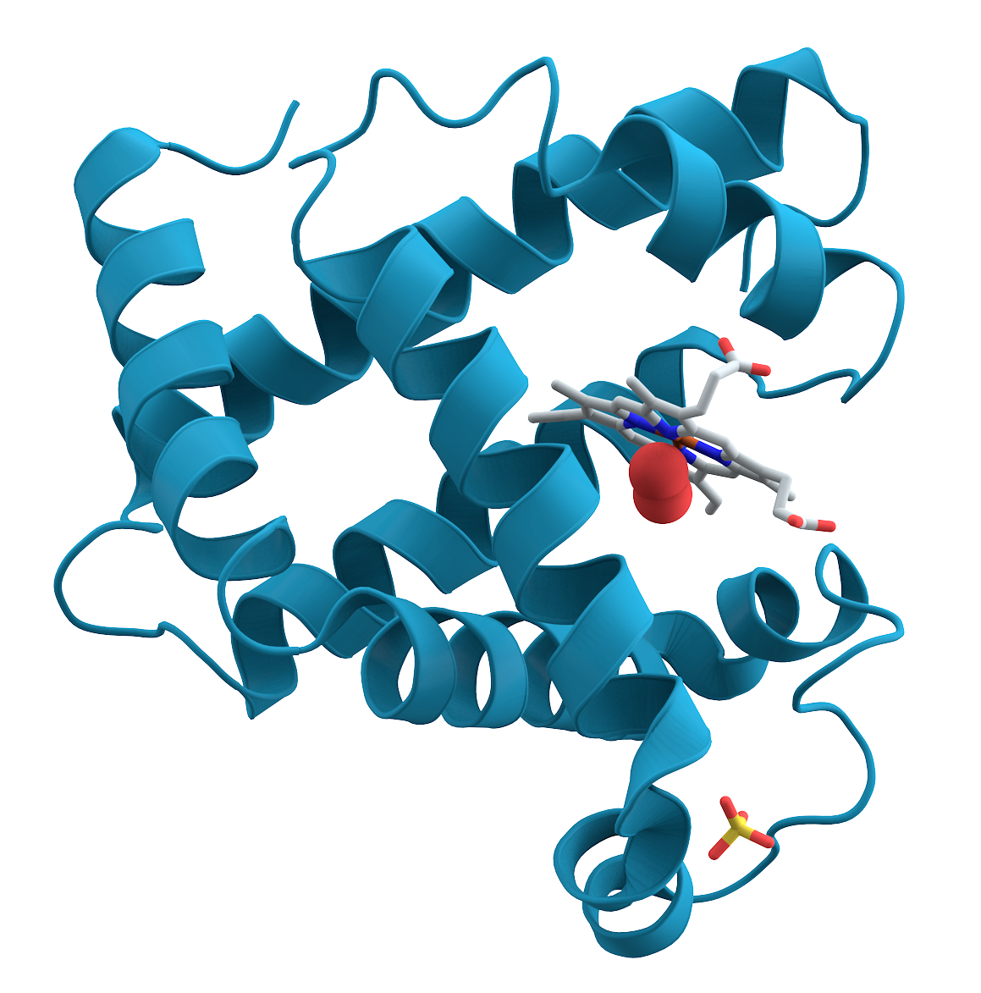
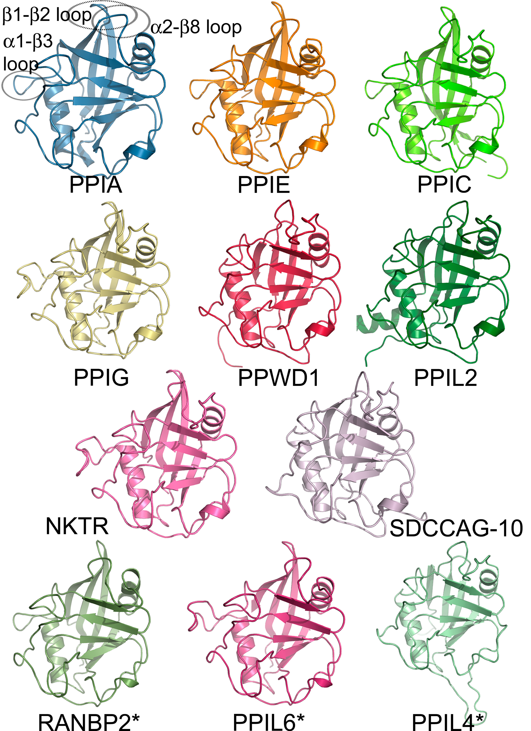
pHMMs in Genomics Workloads
pHMMs are commonly used in many genomics applications
1. Error
Correction
2. Protein Family
Search
3. Multiple Sequence Alignment
Protein
GCCC-TATGGTTAAGCTT
GCCCATATGGTTAAGCTT
GCCCATATGATTAAGCTT
CCCT
TGCT
GCTA
GCCCATATGGTTAAGCTT
CCTA
GCTT
GCCCGTATGGTT---GCTT
Protein
Family #1
Protein
Family #2
ATGC
AAGC
GCCCATATGCTTAAGCTT
CCCT
GCCC---TGGTTAAGCT--T
GCTT
GCCCATATCCTTAAGCTT
GCCCTTATGCTTAAGCTA
GCCCATATGGTTAAGCTT

Slide 21
The Baum-Welch Algorithm is Costly
The Baum-Welch algorithm causes a major
computational overhead in genomics workloads
  Taking up from 46% to 99% of the overall execution time
  Computationally complex dynamic programming calculations
  Compute intensive many floating-point operations
51.44%
45.76%
98.57%

Slide 22




Existing Solutions are Ineffective
pHMMs are specialized version of Hidden Markov Models (HMMs) with fixed patterns on states and transitions
$$F_{t}\left(i\right)$$
$$F_{t}\left(i\right)$$
$$i$$
A
I
D
C
I
D
T
I
D
$$i$$
A
I
D
C
I
D
T
I
D
$$t$$
$$t$$
A
A
T
T
G
G
T
T
Forward Calculations in pHMMs
Forward Calculations in HMMs
Generic HMM accelerators cannot exploit
the fixed data dependency pattern of pHMMs

Slide 23
Existing Solutions are Inflexible
pHMM requirements can change based on the application
  Different pHMM designs:
  Different alphabet sizes: DNA (4 letters), protein (20 letters)
I
I
I
I
I
I
I
I
A
C
T
T
A
C
T
T
D
D
D
Lack of flexible mechanisms
to handle different design choices

Slide 24
Existing Solutions are Inefficient
Suboptimal vectorization of SIMD-based solutions
on CPUs and GPUs
  High warp divergence, branching, low port utilization…
A significant portion of the floating-point operations in dynamic programming is redundant
  Same multiplications results can redundantly be computed during training
  Unnecessary data movements
Existing solutions provide suboptimal solutions due to
inefficient hardware or software design

Slide 25
The Problem
SIMD-based solutions on CPUs and GPUs provide suboptimal vectorization
  High warp divergence, branching, low port utilization…
A significant portion of the floating-point operations in DP is redundant
  Same multiplications appear repeatedly due to constant values during training
  Unnecessary data movements
The Baum-Welch algorithm causes
major performance overhead in
important genomics applications
Hardware- or software-only solutions
are not sufficient
for effectively accelerating pHMMs

Slide 26
Outline
Background & Problem
Motivation and Goal
Experimental Methodology
Temperature Analysis
Aggressor Row Active Time Analysis
Spatial Variation Analysis
Implications on Attacks and Defenses
Conclusions
ApHMM
Evaluation
Conclusion

Slide 27
Goal
Enable rapid, power-efficient, and flexible
use of pHMMs when using the Baum-Welch algorithm

Slide 28
ApHMM
The first flexible hardware-software co-designed acceleration framework that can significantly reduce
the computational overhead of the Baum-Welch algorithm for pHMMs
ApHMM-GPU: The first GPU implementation
of the Baum-Welch algorithm for pHMMs

Slide 29
Key Software & Hardware Optimizations
SW
Minimize redundant data storage by efficient pipelining
Reduce unnecessary computations with quick filtering
Avoid repeated operations by utilizing lookup tables
Reduce data movement by exploiting fixed data pattern
Flexible and efficient control logic and hardware design
HW

Slide 30
Key Software & Hardware Optimizations
SW
Minimize redundant data storage by efficient pipelining
Reduce unnecessary computations with quick filtering
Avoid repeated operations by utilizing lookup tables

Slide 31


SW: Minimizing Redundant Storage
Observation: Filling the entire Backward table is unnecessary
  Pipelining opportunities to directly consume a Backward value
Observed Sequence: ATGT
$$F_{t}\left(i\right)$$
$$B_{t}\left(i\right)$$
$$i$$
A
I
D
C
I
D
T
I
D
$$i$$
A
I
D
C
I
D
T
I
D
$$t$$
$$t$$
A
A
T
T
G
G
T
T
Forward Calculations
Backward Calculations
Training

Slide 32
SW: Minimizing Redundant Storage
Observation: Filling the entire Backward table is unnecessary
  Pipelining opportunities to directly consume a Backward value
Observed Sequence: ATGT
$$F_{t}\left(i\right)$$
$$B_{t}\left(i\right)$$
$$i$$
A
I
D
C
I
D
T
I
D
$$i$$
A
I
D
C
I
D
T
I
D
$$t$$
$$t$$
A
✓
Needed
A
No need
T
T
G
G
T
T
Forward Calculations
Backward Calculations
Training

Slide 33
SW: Minimizing Redundant Storage
Observation: Filling the entire Backward table is unnecessary
  Pipelining opportunities to directly consume a Backward value
  Partial compute approach: Only a single row should be fully stored
Observed Sequence: ATGT
$$F_{t}\left(i\right)$$
$$B_{t}\left(i\right)$$
$$i$$
A
I
D
C
I
D
T
I
D
$$i$$
A
I
D
C
I
D
T
I
D
$$t$$
$$t$$
A
A
T
T
G
G
T
T
Forward Calculations
Backward Calculations
Training

Slide 34
SW: Minimizing Redundant Storage
Observation: Filling the entire Backward table is unnecessary
  Pipelining opportunities to directly consume a Backward value
  Partial compute approach: Only a single row should be fully stored
Observed Sequence: ATGT
$$F_{t}\left(i\right)$$
$$B_{t}\left(i\right)$$
$$i$$
A
I
D
C
I
D
T
I
D
$$i$$
A
I
D
C
I
D
T
I
D
$$t$$
$$t$$
A
A
T
T
G
G
T
T
Forward Calculations
Backward Calculations
Training

Slide 35
SW: Minimizing Redundant Storage
Observation: Filling the entire Backward table is unnecessary
  Pipelining opportunities to directly consume a Backward value
  Partial compute approach: Only a single row should be fully stored
  Reduces the storage requirements during training
Observed Sequence: ATGT
$$F_{t}\left(i\right)$$
$$B_{t}\left(i\right)$$
$$i$$
A
I
D
C
I
D
T
I
D
$$i$$
A
I
D
C
I
D
T
I
D
$$t$$
$$t$$
A
A
T
T
G
G
T
T
Forward Calculations
Backward Calculations
Training

Slide 36


SW: Reducing Unnecessary Computations
Observation: ‘Negligible’ cells can be ignored
without significantly reducing overall accuracy
  Filtering: Non-negligible states are identified by sorting
  Sorting to find exactly $n$ states with largest Forward or Backward values
Sorting is complex to implement in hardware (and costly)
  Can we filter without sorting?
$$F_{t}\left(i\right)$$
$$F_{t}\left(i\right)$$
$$i$$
A
I
D
C
I
D
T
I
D
$$i$$
A
I
D
C
I
D
T
I
D
$$t$$
$$t$$
A
Filter by sorting
A
T
T
G
G
T
T
Forward Calculations
Filtered Forward Calculations

Slide 37


SW: Reducing Unnecessary Computations
Observation: ‘Negligible’ cells can be ignored
without significantly reducing overall accuracy
  Goal: Find at least $n$ states with largest Forward and Backward values
  Histogram-based filtering: Placing the states into buckets
  corresponding to a range of values
  Filter is full as soon we find at least $n$ states (e.g., $n = 10$)
States
Range
8, 9
1.00 – 0.94
Filter size = 2 < 10
10, 14
0.94 – 0.88
Filter size = 4 < 10
15, 16, 18
0.88 – 0.82
Filter size = 7 < 10
11, 20, 21, …
0.82 – 0.76
Filter is full
Filter size = 13 > 10
13, 17, 19, …
0.76 – 0.70
The rest is ignored
from further calculation
.
.
.
.
.
.
0.06 – 0.00
Histogram Filter

Slide 38

SW: Avoiding Repeated Operations
Observation: Same multiplications are redundantly performed
  Same default values are used for each possible connection in pHMMs
  Fixed connection patterns generate a fixed set of multiplication results
Goal: Avoid redundant computations
  By enabling efficient reuse of the common multiplications results
A: 0.1
T: 0.2
G: 0.3
C: 0.4
A: 0.1
T: 0.2
G: 0.3
C: 0.4
A: 0.1
T: 0.2
G: 0.3
C: 0.4
$$0.6 × 0.2$$
Costly FP Operations
…
…
0.6
0.6
0.6
Same output
A
T
T

Slide 39
SW: Avoiding Repeated Operations
Observation: Same multiplications are redundantly performed
  Same default values are used for each possible connection in pHMMs
  Fixed connection patterns generate a fixed set of multiplication results
Goal: Avoid redundant computations
  By enabling efficient reuse of the common multiplications results
  Lookup tables (LUTs) to efficiently store and use these common results
A: 0.1
T: 0.2
G: 0.3
C: 0.4
A: 0.1
T: 0.2
G: 0.3
C: 0.4
A: 0.1
T: 0.2
G: 0.3
C: 0.4
$$0.6 × 0.2$$
Cheap LUTs
…
…
0.6
0.6
0.6
Same output
A
T
T

Slide 40
Key Software & Hardware Optimizations
SW
Minimize redundant data storage by efficient pipelining
Reduce unnecessary computations with quick filtering
Avoid repeated operations by utilizing lookup tables
Reduce data movement by exploiting fixed data pattern
Flexible and efficient control logic and hardware design
HW

Slide 41
Overview of ApHMM Design
CPU
Memory (DRAM/L2/L1)
Parameters
Calculate Forward (Full)
Update Emission Probabilities
(Step-by-Step)
Data Control
Index Control
LUT
Update Transition Probabilities
(Step-by-Step)
Histogram
Filter
Calculate Backward (Step-by-Step)
Transition Scratchpad
Control Block
Compute Block
ApHMM Core
Flexible and efficient control logic and hardware design
enables opting out from heuristics and supporting different pHMM designs
✓

Slide 42






Computing the Baum-Welch in ApHMM
Index Control
PE Engine #1
PE Engine #1
PE Engine #1
PE #1
Previous Step Coefficients (L1):
$F_{t}\left(i\right)$ or $B_{t+1}(j)$ (Broadcasting)
$F_{t}\left(i\right)$ or $B_{t+1}(j)$
Dot Product Tree
Accumulator
PE Group
#1
Calculate Emission
Numerator
PE Group
#1
$$α_{ij}×e_{t+1}(j)$$
PE Group
#1
PE Group
#1
PE Group
#1
PE Group
#1
PE Group
#1
PE Group
#1
Forward/
Backward (PE)
LUT
Reduction Tree
Calculate Emission
Denominator
$F_{t}\left(i\right)$, $B_{t+1}\left(j\right)$
$$α_{ij}×e_{t+1}(j)$$
$F_{t+1}\left(j\right)$ or $B_{t}(i)$
Register
Register
Register
Register
Register
Register
Register
Register
TE MUL
MUL
ADD
FP DIV
Division & Update Emission
Write Selector
Previous Transition Numerator
8KB Transition Scratchpad
Update Emission (UE)
Update Transition (UT)
PE #1
PE Group #1
Compute Block
Calculate Forward/Backward & Update Transition
Efficiently exploiting data locality, broadcasting, memoization, streaming, and pipelining with our SW optimizations for an effective HW-SW co-design
✓

Slide 43
Outline
Background & Problem
Motivation and Goal
Experimental Methodology
Temperature Analysis
Aggressor Row Active Time Analysis
Spatial Variation Analysis
Implications on Attacks and Defenses
Conclusions
ApHMM
Evaluation
Conclusion

Slide 44
Evaluation Methodology
Performance, Area, and Power Analysis:
  Synthesized SystemVerilog Model in a 28nm process @1GHz
  CPU baseline: AMD EPYC 7742 @2.26GHz (1, 12, 32 threads)
  GPU baselines: Titan V & A100
  FPGA baseline: FPGA D&C
Use cases and their software baseline:
  Error Correction – Apollo
  Protein Family Search – HMMER
  Multiple Sequence Alignment – HMMER

Slide 45
Evaluation Methodology
Comparison Points
  CPU: Apollo, HMMER
  GPU: ApHMM-GPU, HMM_cuda
  FPGA: FPGA D&C
Datasets
  Error correction: Real 10,000 DNA sequences from Escherichia coli
  (E. coli) with average 5,128 read length
  Protein family search: Entire Pfam database (19,632 pHMMs) and
  real 214,393 protein sequences from Mitochondrial carrier
  Multiple sequence alignment: Aligning over ~1 million
  protein sequences from Pfam database

Slide 46
Performance: The Baum-Welch Algorithm
15.55×–260.03×, 1.83×–5.34×, and 27.97× faster than
the CPU, GPU, and FPGA implementations of the Baum-Welch algorithm
GPUs provide better performance for Forward calculations
due to frequent off-chip memory accesses in ApHMM during Forward calculation

Slide 47
Performance: Workload Acceleration
1.29×–59.94×, 1.03×–1.75×, and 1.03×–1.95× better performance
compared to the CPU, GPU, and FPGA baselines
Error correction benefits most from the acceleration
due to frequent and costly training

Slide 48
Energy: Overall Comparisons
For the Baum-Welch algorithm: 2474.09× and 896.70×–2622.94× reduction in energy consumption compared to CPU-1 and GPU implementations
For the workloads: 64.24×, 1.75×, and 1.96× reduction compared to CPU-1

Slide 49
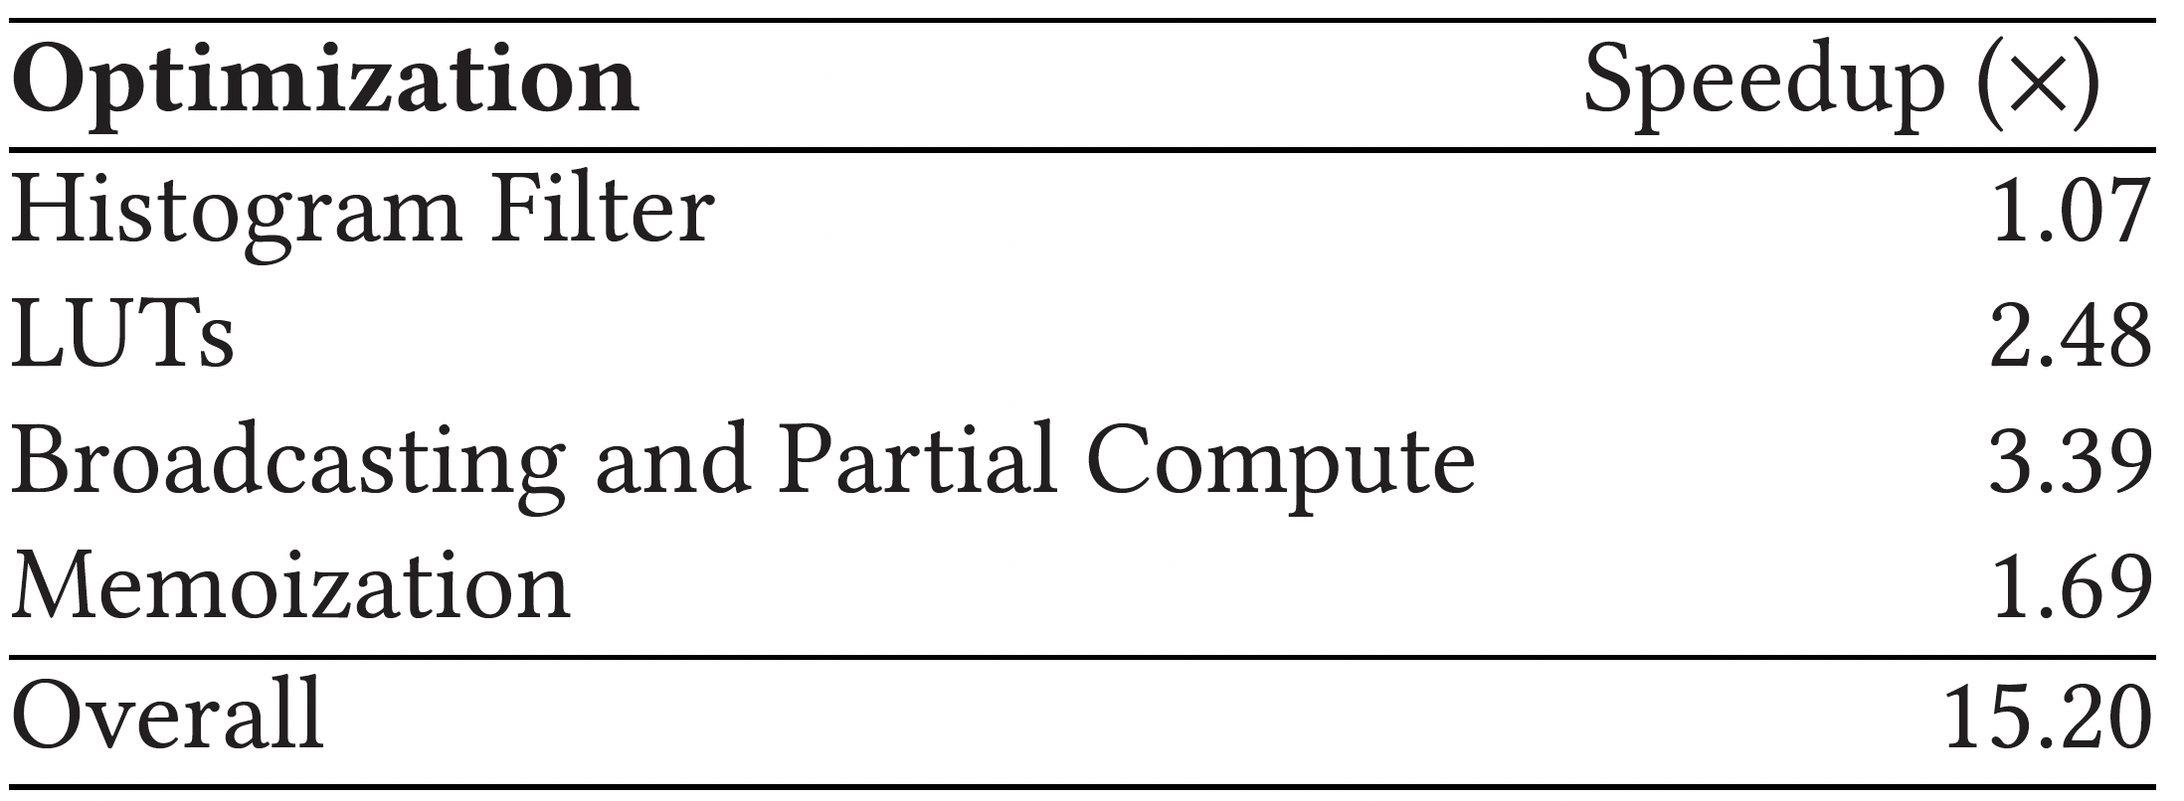
Speedup of Each Optimization
We analyze the speedup that each optimization provides over the CPU baseline
Broadcasting and partial compute together is only possible
with an efficient HW-SW co-design

Slide 50
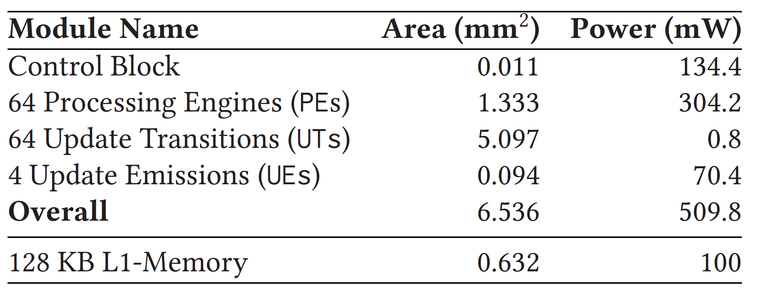
Area and Power
We analyze the area and power for ApHMM-4 using the Synopsys Design Compiler with a 28nm process @1GHz:
UTs require the largest area due to several complex units
such as multiplexer, division pipeline, and local memory
ApHMM can significantly accelerate pHMMs
with relatively small area and power requirements

Slide 51
More in the Paper
More Results
  Detailed discussion on the results generated per use case
  Justification of the dataset and baseline choices
Details of all mechanisms and configurations
  Details of our design space exploration
  Data distribution and memory layout
  Control and execution flow of ApHMM cores
  Related work discussion (e.g., Pair HMMs vs pHMMs)
  Detailed background on the equations and algorithms

Slide 52
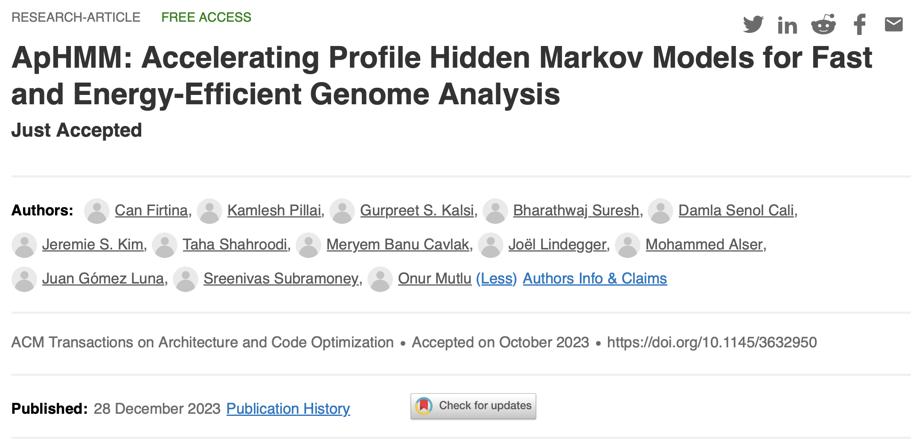
ApHMM
Can Firtina, Kamlesh Pillai, Gurpreet S. Kalsi, Bharathwaj Suresh,
Damla Senol Cali, Jeremie S. Kim, Taha Shahroodi, Meryem Banu Cavlak,
Joël Lindegger, Mohammed Alser, Juan Gómez Luna,
Sreenivas Subramoney, and Onur Mutlu,
"ApHMM: Accelerating Profile Hidden Markov Models for Fast and Energy-Efficient Genome Analysis”
ACM TACO, Dec 2023.
[Online link at ACM TACO]
[arXiv preprint]
[ApHMM Source Code]

Slide 53
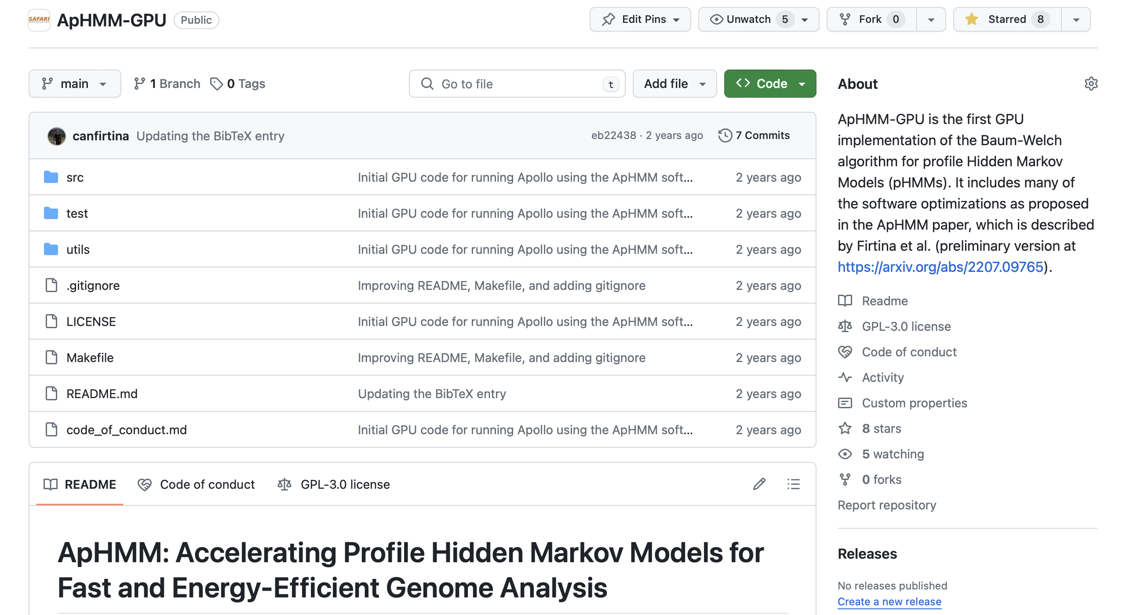
ApHMM-GPU Source Code
https://github.com/CMU-SAFARI/ApHMM-GPU

Slide 54
Outline
Background & Problem
Motivation and Goal
Experimental Methodology
Temperature Analysis
Aggressor Row Active Time Analysis
Spatial Variation Analysis
Implications on Attacks and Defenses
Conclusions
ApHMM
Evaluation
Conclusion

Slide 55
Conclusion
Goal: Enable rapid, power-efficient, and flexible use of pHMMs for genomics workloads
ApHMM: the first flexible and hardware-software accelerator for pHMMs that can
Substantially reduce unnecessary data storage, data movement, and computations by effectively co-designing hardware and software together
Provide a flexible design to support several genomics workloads that use pHMMs
Key Results: Our ASIC implementation compared to CPU, GPU, and FPGA baselines across 3 workloads
  15.55×–260.03×, 1.83×–5.34×, and 27.97× better performance
  Up to 2622.94× reduction in energy consumption
https://github.com/CMU-SAFARI/ApHMM-GPU

Slide 56
HiPEAC 2024
ApHMM
Paper
Accelerating Profile Hidden Markov Models
for Fast and Energy-Efficient Genome Analysis
Can Firtina
canfirtina@gmail.com
https://cfirtina.com
Kamlesh Pillai, Gurpreet S. Kalsi, Bharathwaj Suresh, Damla Senol Cali,
Jeremie S. Kim, Taha Shahroodi, Meryem Banu Cavlak, Joël Lindegger,
Mohammed Alser, Juan Gómez Luna, Sreenivas Subramoney, Onur Mutlu

Slide 57
Motivation and Goal
Experimental Methodology
Temperature Analysis
Aggressor Row Active Time Analysis
Spatial Variation Analysis
Implications on Attacks and Defenses
Conclusions
Backup Slides

Slide 58
Why Graphs are Useful
Accurate comparison requires identifying changes (insertions, deletions, substitutions) between sequences due to
  Variations between individuals and template sequences
  Errors in sequences
How to avoid unnecessary (and costly) comparisons?
Variants?
Errors?
Erroneous analysis?
Which variant?

Slide 59
Filtering – Performance Benefits
Filtering heuristics aim to reduce unnecessary computations
Motivational Study: ~2.5x performance improvements with filtering

Slide 60
Filtering – Accurate but Costly Sorting
Software-based filtering heuristics aim to reduce unnecessary computations
  High-accuracy can be achieved with filtering with correct setting
Filtering takes up ~8.5% of the overall execution time
due to sorting

Slide 61
Choosing the Right Amount of Cores
We analyze maximum number of cores that ApHMM can utilize
  Before it is bottlenecked by memory bandwidth for genomics applications
ApHMM with 4 cores (ApHMM-4) provides the best overall speedup

Slide 62
HiPEAC 2024
ApHMM
Paper
Accelerating Profile Hidden Markov Models
for Fast and Energy-Efficient Genome Analysis
Can Firtina
canfirtina@gmail.com
https://cfirtina.com
Kamlesh Pillai, Gurpreet S. Kalsi, Bharathwaj Suresh, Damla Senol Cali,
Jeremie S. Kim, Taha Shahroodi, Meryem Banu Cavlak, Joël Lindegger,
Mohammed Alser, Juan Gómez Luna, Sreenivas Subramoney, Onur Mutlu

