Slide 1



RawHash
Enabling Fast and Accurate Real-Time Analysis of Raw Nanopore Signals for Large Genomes
To appear in the proceedings of ISMB/ECCB 2023
Can Firtina, Nika Mansouri Ghiasi, Joel Lindegger, Gagandeep Singh,
Meryem Banu Cavlak, Haiyu Mao, Onur Mutlu
Preprint
Source Code

Slide 2
Executive Summary
Problem | Performing real-time genome analysis is inaccurate and inefficient for large genomes, causing serious barriers in fully exploiting the opportunities in real-time genome analysis
Goal | Enable efficient and accurate analysis for large genomes while the raw sequencing data is generated in real-time
RawHash | Encodes the raw sequencing data into hash values to accurately and efficiently identify similarities by matching their hash values Makes real-time decisions that can stop sequencing a DNA molecule without fully sequencing it Proposes Sequence Until that can accurately and dynamically stop the entire sequencing of all DNA molecules at once
Key Results | Up to 2x more accurate mapping results compared to the state-of-the-art works 25.8x and 3.4x better average throughput compared to UNCALLED and Sigmap, respectively The Sequence Until techniques enables reducing the sequencing time and cost by 15x
Notes:
We can analyze genomes in real-time while the raw sequencing data is generated from sequencing devices.

Slide 3
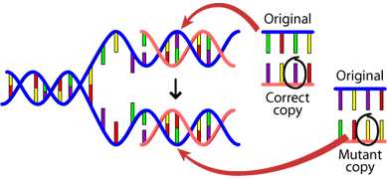
Genome Analysis
Genome Sequencing: Enables us to determine the order of the DNA sequence in an organism’s genome
  Plays a pivotal role in:
    Precision medicine
    Outbreak tracing
    Understanding of evolution
Nanopore Sequencing: a widely used sequencing technology
  Can sequence large fragments of DNA (i.e., 10Kbp - 2Mbp)
  Has high throughput
  Low cost
  Provides unique features
Notes:
I will give a brief background on genome sequencing

Slide 4
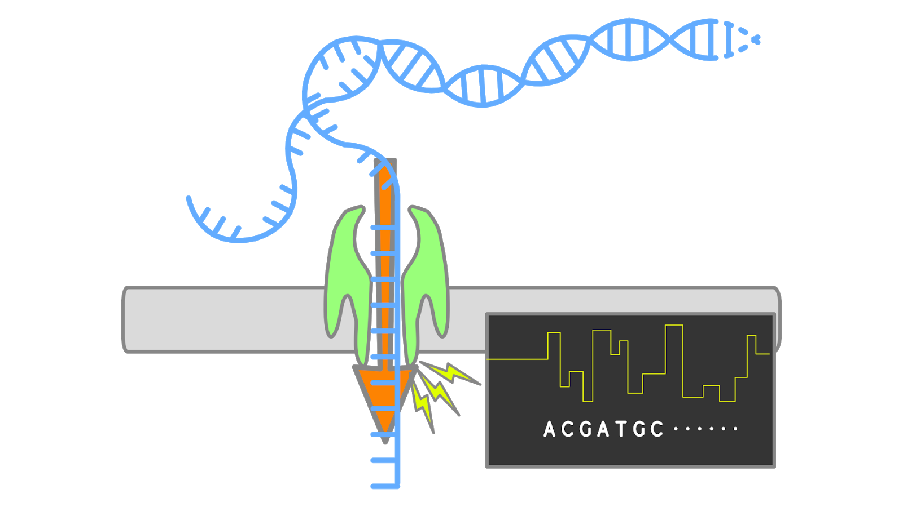


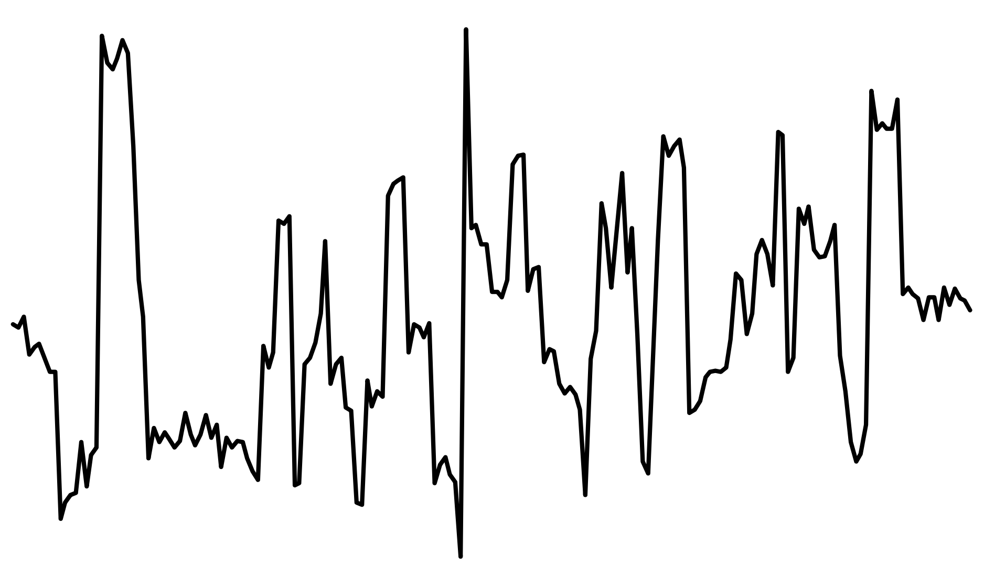


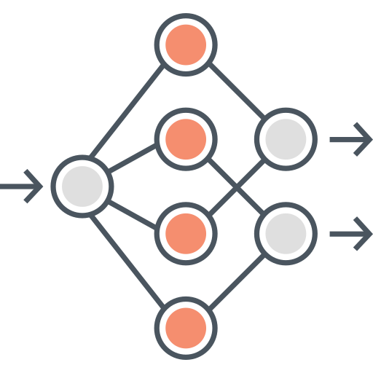
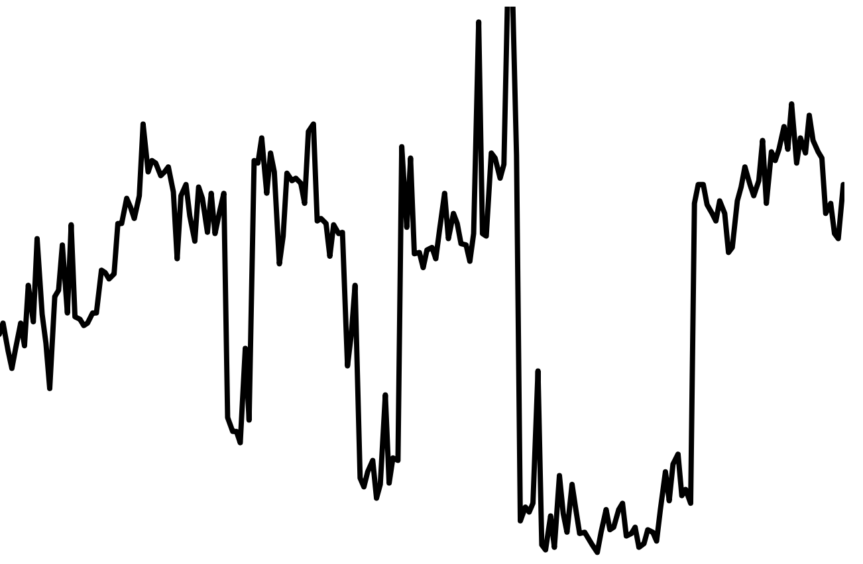
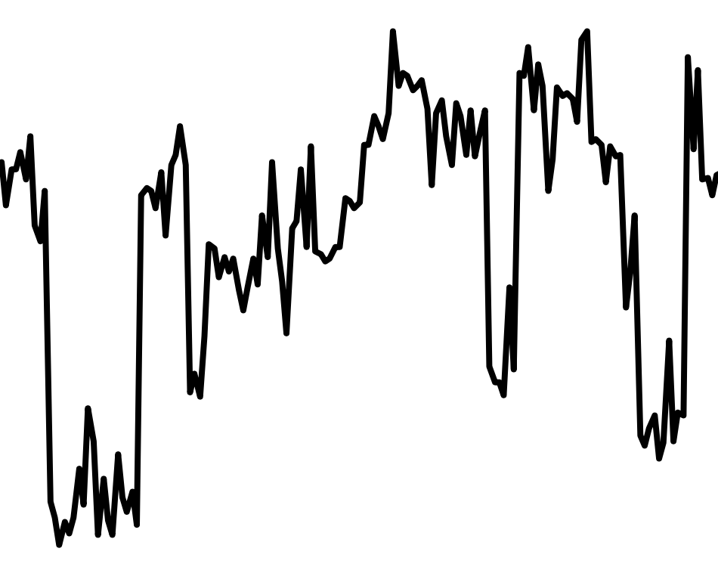
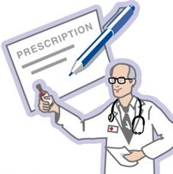
Traditional Genome Analysis Pipeline
Genome sequencing
Raw Signal
Basecalling
Reads
A
T
G
G
A
C
G
G
A
C
A
T
G
G
C
C
G
G
T
T
T
T
C
C
T
C
A
A
A
G
Read Mapping
Reference genome
Further
Genome Analysis
T
A
T
G
G
C
C
T
T
T
A
G
C
A
T
A
C
Mapped
Unmapped
Scientific Discovery
Notes:
I will show how nanopore sequencing is used in a traditional genome analysis pipeline.
Here a DNA or RNA molecule is sequenced while it goes through a tiny pore, called nanopores. These nanopores sample the current readings while the nucleic acids move through nanopores, which is provided as electrical signals.
[CLICK] Here the idea is whenever a new nucleic acid moves into a nanopore, and it creates abrupt changes in the current reading such that these abrupt changes can be used to identify the nucleic acid from electrical signal readings
[CLICK] And these signals are called raw signals
[CLICK] The next step is usually to translate these raw signals into their corresponding sequences, known as basecalling.
[CLICK] To do so, basecalling tools take the chunks of signals and convert them to their corresponding sequences.
[SOME CLICKS]
[CLICK] And these sequences are called reads. The next step is usually to identify the origin of these reads in their corresponding genome.
[CLICK] To achieve these, sequences are mapped to reference genomes. ...

Slide 5
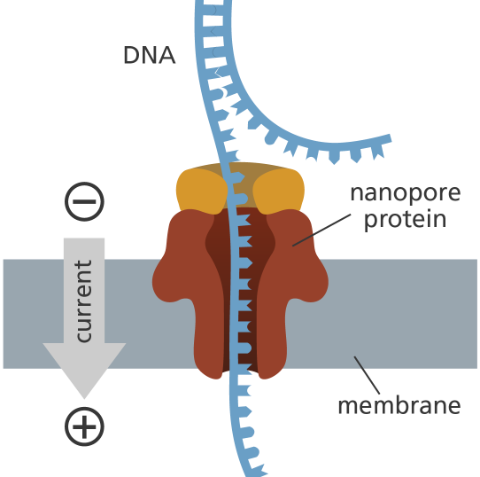


Real-Time Genome Analysis
1. Genome Sequencing
2. Raw Signal
No?: Reverse the polarity of electrical field to eject the read
3. Real-Time Analysis
4. Adaptive Sampling
Keep Sequencing?
Notes:
Nanopore sequencing provides a unique feature where we can analyze the sequencing data in real-time and make some decisions based on this analysis.
[CLICK] As DNA moves through nanopores, it provides the raw signal data in real-time at a certain throughput
[CLICK] So we can analyze these signals using efficient computational tools that are at least as fast as the nanopore sequencing
[CLICK] While analyzing, we can make some decisions while the read is being sequenced. For example, if we are trying to map the reads to a certain reference genome and if we identify that the read being sequenced won't be mapped to that particular reference genome, we can stop sequencing that read

Slide 6




Objectives in Real-Time Genome Analysis
Fast analysis that can match the throughput of sequencer
Fast decision to reduce the sequencing time and cost with effective use of adaptive sampling
Accurate analysis from noisy raw signal data
Low-power to enable portable sequencing and better scalability

Slide 7

Solutions for Real-Time Analysis
Using deep neural networks (DNNs) to basecall and map reads
1. Genome Sequencing
2. Raw Nanopore Signal
Costly and energy-hungry
computational resources are required
3. Real-Time Analysis
Basecalling
Read Mapping
G
A
G
T
4. Adaptive Sampling
Keep Sequencing?

Slide 8


Solutions for Real-Time Analysis
Mapping signals without basecalling
1. Genome Sequencing
2. Raw Nanopore Signal
Low-throughput or
Inaccurate analysis for large genomes
3. Real-Time Analysis
Signal Mapping
4. Adaptive Sampling
Keep Sequencing?

Slide 9
Outline
Background
Motivation and Goal
Experimental Methodology
Temperature Analysis
Aggressor Row Active Time Analysis
Spatial Variation Analysis
Implications on Attacks and Defenses
Conclusions
Goal and Key Ideas
RawHash
Evaluation
Conclusions

Slide 10




Goal
Fast analysis that can scale to large genomes
Fast decisions for adaptive sampling to reduce sequencing time and cost
Accurate analysis for large genomes
Low-power analysis that can be used with portable devices

Slide 11
RawHash
The first mechanism that can efficiently and accurately map raw signals to large genomes using an efficient hash-based search
Proposes Sequence Until, a novel mechanism that can decide in runtime if further sequencing of reads is needed to
stop the entire sequencing process

Slide 12
Outline
Background
Motivation and Goal
Experimental Methodology
Temperature Analysis
Aggressor Row Active Time Analysis
Spatial Variation Analysis
Implications on Attacks and Defenses
Conclusions
Goal and Key Ideas
RawHash
Evaluation
Conclusions

Slide 13
RawHash Overview
Indexing (offline):
  Convert the reference genome to its signal representation
  Generate hash values from signals
  Store hash values and their positions in a hash table
Mapping (real-time):
  Generate hash values from raw nanopore signals
  Use the hash table to find matching hash values between a reference genome and the nanopore raw signal
  Mapping regions: Regions with a certain number of hash value matches

Slide 14

Converting the Reference Sequences to Signals
To offload the translation costs to the offline indexing step
To enable utilizing the rich information in raw nanopore signals
Key Steps:
  K-mer model: Expected current readings after sequencing a fixed k number of nucleic acids (k-mers)
  Utilize the lookup table to convert all k-mers of a reference genome to their expected values (events)
Reference Genome
Expected Event Values
Normalized Event Values
…GCTATTACC…
GCTATT
K-mer Model
(Lookup Table)
105.757390
Norm.
2.21
CTATTA
81.740642
-0.9
k-mers ($k=6$)
TATTAC
103.170091
1.15
ATTACC
101.082485
1.11

Slide 15
Events in Raw Nanopore Signals
Event: Series of current readings
  Generated when sequencing a particular k-mer
  Next event: DNA molecule is shifted by one nucleic acid, creating the next k-mer
Event detection identifies regions of signals corresponding to the sequencing of certain k-mers in the DNA molecule
  Next event: Abrupt signal changes between two consecutive k-mers
Event
k-many nucleic acids

Slide 16
Event Detection in Raw Nanopore Signals
Event detection identifies regions of signals corresponding to the sequencing of certain k-mers in the DNA molecule
  By performing a statistical test (segmentation) to identify the abrupt changes in the signal generated as molecules move through nanopores
Observation: Nanopore sequencers do not generate exactly the same signals when sequencing the same k-mer
  However, the signals are still slightly similar to each other
  How can we leverage this?
Nanopore Raw Signal
Event
Mean Value of an Event
Norm.
2.21
Segment
Calculate
Means
105.71
-0.91
1.18
1.14

Slide 17
Quantizing the Event Values
Goal: Assign the same bucket (i.e., quantized values) to the similar event values
Key Steps:
Use the binary representations of event values (floating-point)
Take the most significant Q bits (to quantize)
Ignore the p bits in the middle (does not add much value)

Slide 18
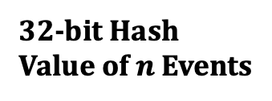
Hashing for Efficient Search
Goal: Enable finding efficient similarity detection by accurately matching hash values between signals
Pack the quantized values of some consecutive k-mers
Hash the packed value to generate a hash value
Use efficient data structures (e.g., hash tables) to identify regions with the similar event values by matching their hash values
Quantized Values (in binary) of $n$ Consecutive Events:
…
1
1
0
0
1
0
0
1
1
0
…
0
1
0
0
1
…
Pack
1
1
0
0
1
0
0
1
1
0
…
0
1
0
0
1
Hash
0x400D70A4
32-bit Hash Value of $n$ Events

Slide 19
Outline
Background
Motivation and Goal
Experimental Methodology
Temperature Analysis
Aggressor Row Active Time Analysis
Spatial Variation Analysis
Implications on Attacks and Defenses
Conclusions
Goal and Key Ideas
RawHash
Evaluation
Conclusions

Slide 20
Evaluation Methodology
Datasets from very small (viral) to large genomes (human and metagenomics)
Compared with UNCALLED and Sigmap
  RawHash, UNCALLED, and Sigmap do not require powerful computational resources (e.g., GPUs) to achieve efficient and portable genome analysis
Use cases
  Read mapping
  Relative abundance estimation
  Contamination analysis
Benefits of Sequence Until

Slide 21
Performance
Throughput (bases per second)
  Throughput of a nanopore sequencer: 450 bp/sec
Fast Analysis: Both RawHash and UNCALLED can match the throughput of nanopore
Sigmap falls behind the throughput of nanopores for larger genomes

Slide 22
Sequencing Time and Cost
Number of bases that needs to be sequenced before making a decision to eject the read
  Lower is better (cheaper and faster sequencing)
Fast Decision: RawHash reduces the sequencing time and cost for large genomes than UNCALLED

Slide 23
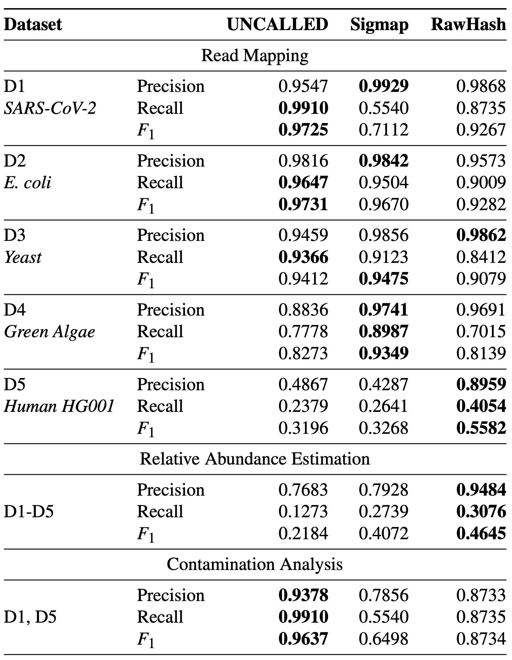
Accuracy of Mapping
Accuracy of genome analysis when mapping reads for three use cases
Accurate Analysis: RawHash provides the best accuracy for large genomes

Slide 24
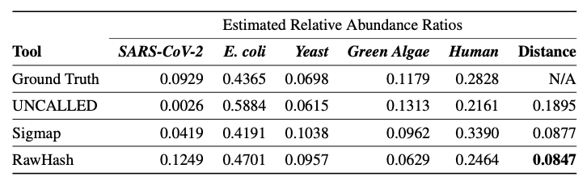
Relative Abundance Estimations
Estimating the relative abundance of each genome compared to the baseline as generated by minimap2
  Distance: Euclidean distance (L2-norm) compared to the ground truth distance
Accurate Analysis: RawHash provides the relative abundance estimations closest to the ground truth

Slide 25
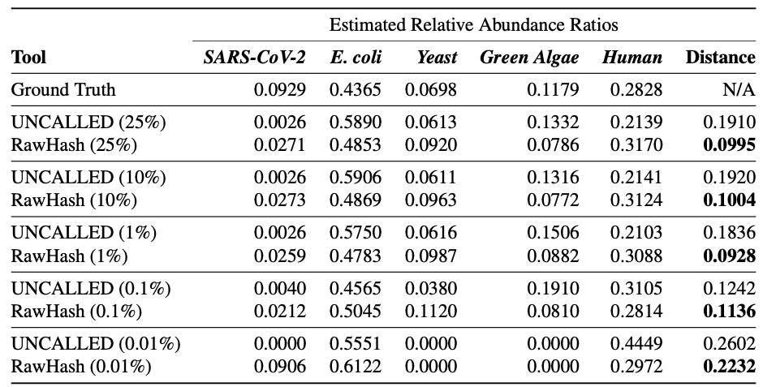
The Sequence Until Mechanism
Key Insight: Do we need to keep sequencing the entire sample for all applications in genome analysis?
Use case example: Can we predict the relative abundance estimation by sequencing only a portion of the sample and still provide accurate results?
Potential Benefits: Reduced sequencing time and costs by avoiding full sequencing

Slide 26
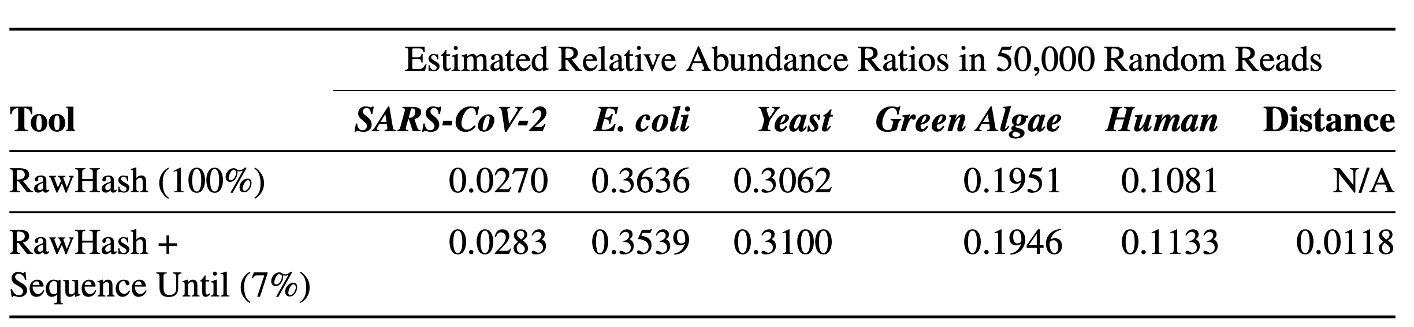
Benefits of Sequence Until
Sequence Until mechanism dynamically analyzes the results of a genome analysis use case to find outliers in the analysis
If no outlier in the previous estimations
  Further sequencing is unlikely to change the analysis significantly
  Stop the entire sequencing: Significant reduction in sequencing time and cost
Sequence Until dynamically stops the entire sequencing after sequencing only 7% of the entire sample while providing high accuracy
Sequencing only a portion of the sample significantly reduces sequencing time and cost (~15x reduction)

Slide 27
Outline
Background
Motivation and Goal
Experimental Methodology
Temperature Analysis
Aggressor Row Active Time Analysis
Spatial Variation Analysis
Implications on Attacks and Defenses
Conclusions
Goal and Key Ideas
RawHash
Evaluation
Conclusions

Slide 28
RawHash Summary
Problem | Performing real-time genome analysis is inaccurate and inefficient for large genomes, causing serious barriers in fully exploiting the opportunities in real-time genome analysis
Goal | Enable efficient and accurate similarity identification between raw signals
RawHash | Encodes the similar signal values into the same quantized value to alleviate the noise issues in raw signals Generates hash values from quantized values to efficiently identify similarities between signals based on hash value matches Proposes Sequence Until that can accurately and dynamically stop the entire sequencing
Key Results | Up to 2x more accurate mapping results 25.8x and 3.4x better average throughput compared to UNCALLED and Sigmap, respectively The Sequence Until techniques enables reducing the sequencing time and cost by 15x

Slide 29
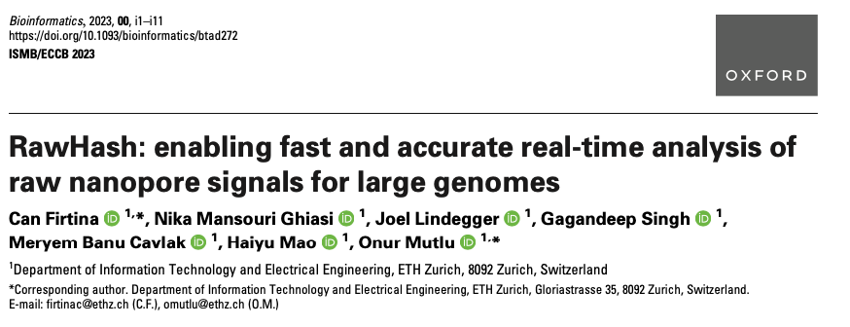
RawHash
To appear in the proceedings of ISMB/ECCB 2023
Can Firtina, Nika Mansouri Ghiasi, Joel Lindegger, Gagandeep Singh, Meryem Banu Cavlak, Haiyu Mao, and Onur Mutlu,
"RawHash: Enabling Fast and Accurate Real-Time Analysis of Raw Nanopore Signals for Large Genomes"
Proceedings of the 31st Annual Conference on Intelligent Systems for Molecular Biology (ISMB) and the 22nd European Conference on Computational Biology (ECCB), Jul 2023
[arXiv preprint]
[Source Code]

Slide 30
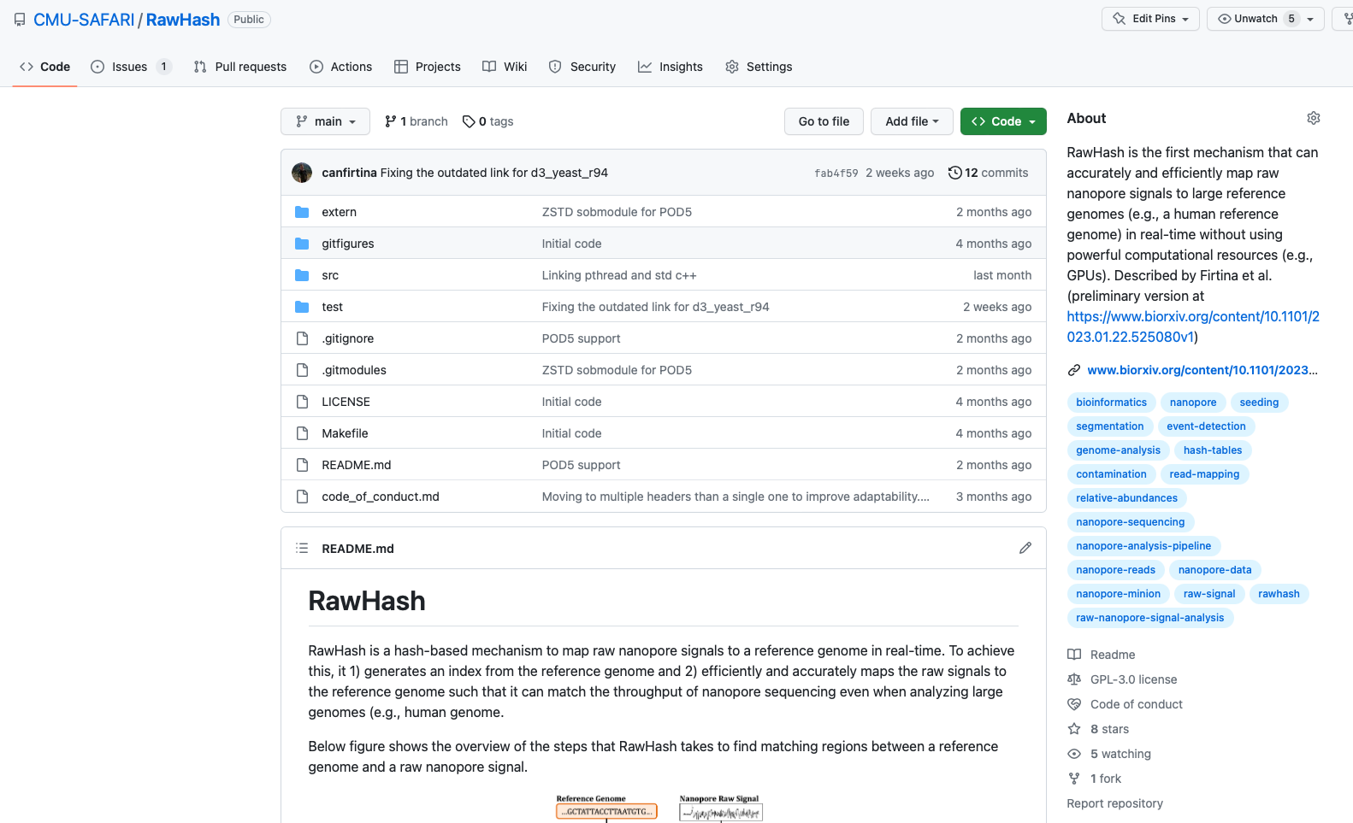
RawHash Source Code
https://github.com/CMU-SAFARI/RawHash

Slide 31
RawHash
Enabling Fast and Accurate Real-Time Analysis of Raw Nanopore Signals for Large Genomes
Can Firtina, Nika Mansouri Ghiasi, Joel Lindegger, Gagandeep Singh,
Meryem Banu Cavlak, Haiyu Mao, Onur Mutlu
Preprint
Source Code

Slide 32
Motivation and Goal
Experimental Methodology
Temperature Analysis
Aggressor Row Active Time Analysis
Spatial Variation Analysis
Implications on Attacks and Defenses
Conclusions
Backup Slides

Slide 33
Practical Similarity Identification
Seeds
> 3 billion characters
Reference
…CAATTTGCCCATATGGTTAAGCTTCCATGGAAATGGGCTTTCGCTTTG…
…
K-mers
Locations
Read
GCCCAAATGGTT
GCC | 7
CCC | 8
CAA | 1
AAA | 31 | 101
CCA | 25 | 230 | 400
… | … | … | …
K-mers
GCC
CCC
…
Index (Hash Table)
Seeding
Determine potential matching regions (seeds) in the reference genome
Seed Filtering
(e.g., Chaining)
Prune some seeds in the reference genome
Alignment
Determine the exact differences between the read and the reference genome

Slide 34
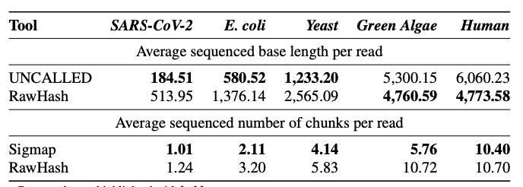
Sequencing Time and Cost Reductions

Slide 35
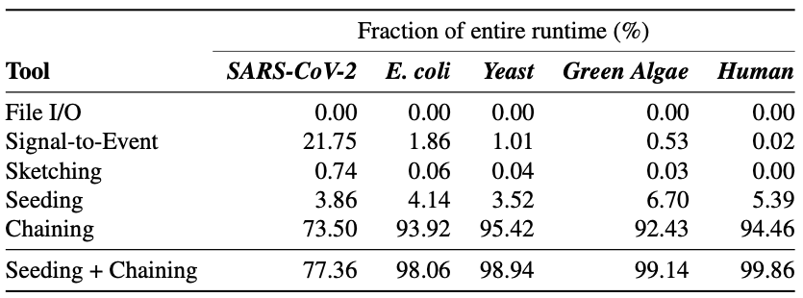
Profiling the RawHash Steps

Slide 36
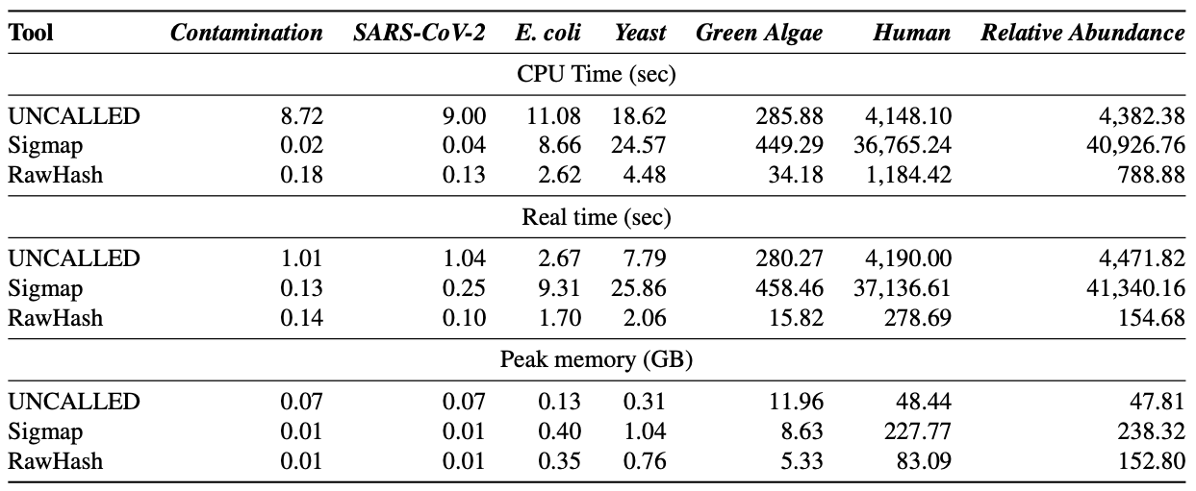
Required Computation Resources in Indexing

Slide 37
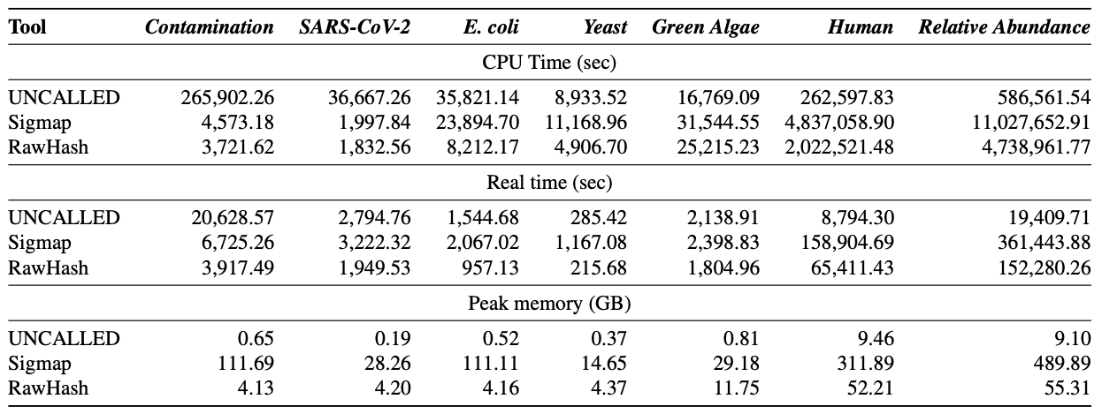
Required Computation Resources in Mapping

Slide 38
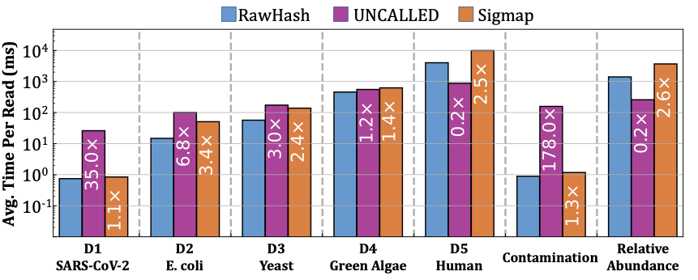
Average Mapping Time per Read

