Slide 1
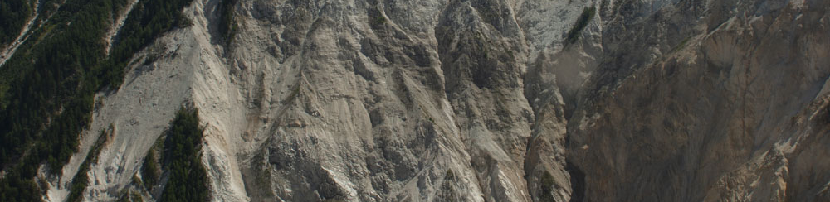

A data platform for monitoring hazardous mass movements in Alpine terrain
Elias Hodel, VAW / ETH Zurich
F.Walter, M. Wenner, E. Marchetti, M. Fengler, D. Farinotti
Swiss Geoscience Meeting, Fribourg
23.11.2019
Notes:
Welcome everybody to my presentation.
My name is Elias and I m happy to give you some insights into our data platform for monitoring hazardous mass movements in alpine terrain.
Let me first give you some background informatin about the investigation site, the Illgraben catchment in the Wallis.

Slide 2
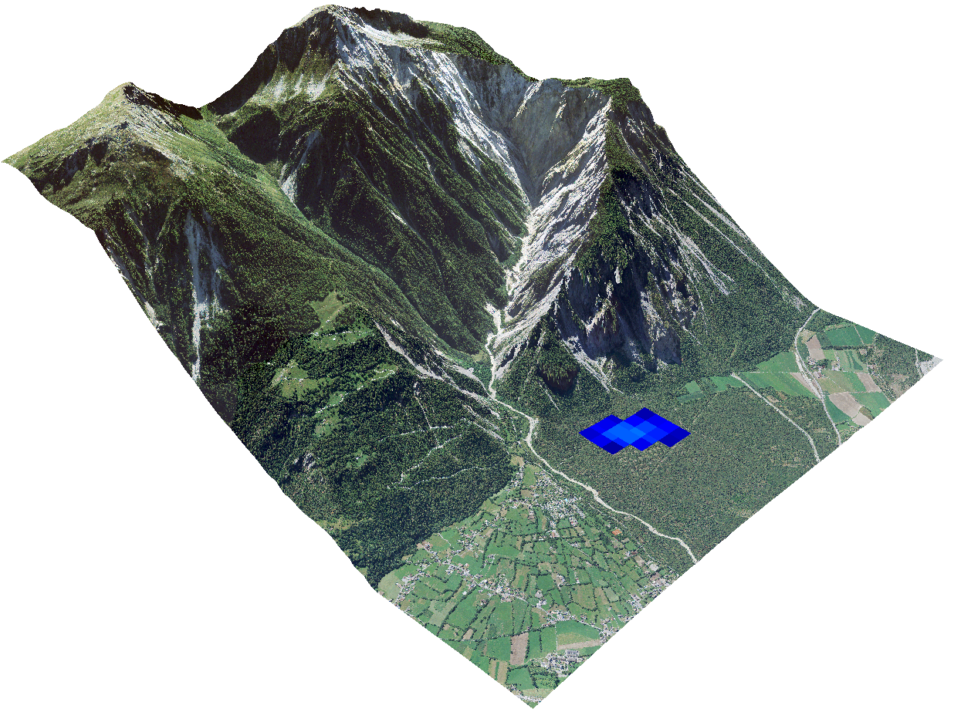
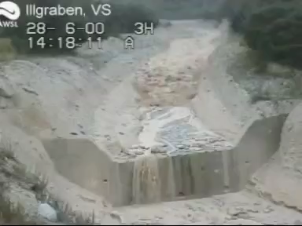
Investigation site: Illgraben (Valais, CH)
Illhorn
Slope erosion / Rock falls
(Quarzit and Limestone)
Highly active area: up to 5 (!) debris flows
Threatening the commune of Susten/Leuk
Example of debris flow at Illgraben: 28.6.2000
Susten/Leuk
(Rhone Valley)
2m
Debris flows during
heavy precipitation
Notes:
The Illgraben catchment is a geomorphological very active area.
Slope erosion and rock falls from the steep flanks of the Illhorn feed debris flows which occur during heavy rainfalls up to 5 times a year.
This debris flows threaten the commune of Susten and Leuk.
Due to the high number of debris flow occurrence this site is very interesting to study the phenomena and also to install a monitoring system.
In this video you see such a debris flow from the year 2000.

Slide 3

Operational in-torrent instrumentation
Illhorn
Ongoing research since 2000
Operational early warning system for the commune of Susten/Leuk
Flow depth
(WSL)
Infrasound
(E. Marchetti)
Susten/Leuk
(Rhone Valley)
Geophones
(WSL)
Notes:
Since 2000 there have been many research projects in the Illgraben catchment and there are still ongoing investigations.
The Swiss Federal Institute for Forest, Snow and Landscape Research WSL installed Geophones and Flow depth measurements,
Emmanuel Marchetti from Unversity of Firenze installed a Infrasound experiment, just to name few.
Together with the early warning system their main focus is on the lower part of the Illgraben.

Slide 4
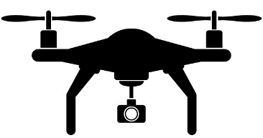
Critical area: Upper part of Illgraben
Illhorn
Poorly accessible, no instrumentation
Origin of debris flows, potential danger
Increase the time for early warning
Autonomous monitoring system using
Seismometers and
an autonomous flying UAV (drone)
6
4
8
2
Susten/Leuk
(Rhone Valley)
Notes:
The more critical area of the Illgraben is the upper part, where lose material is deposited and the debris flows starts.
Unfortunately this area is very dangerous and therefore poorly accessible. That’s also why there is no instrumentation yet.
But to get more insights in the origin of debris flows, the potential danger and to increase the time for early warning we need to monitor exactly this area.
Our idea: Setup of an autonomous monitoring system using seismometers for signal detection and an autonomous flying drone which gets triggered by them.

Slide 5
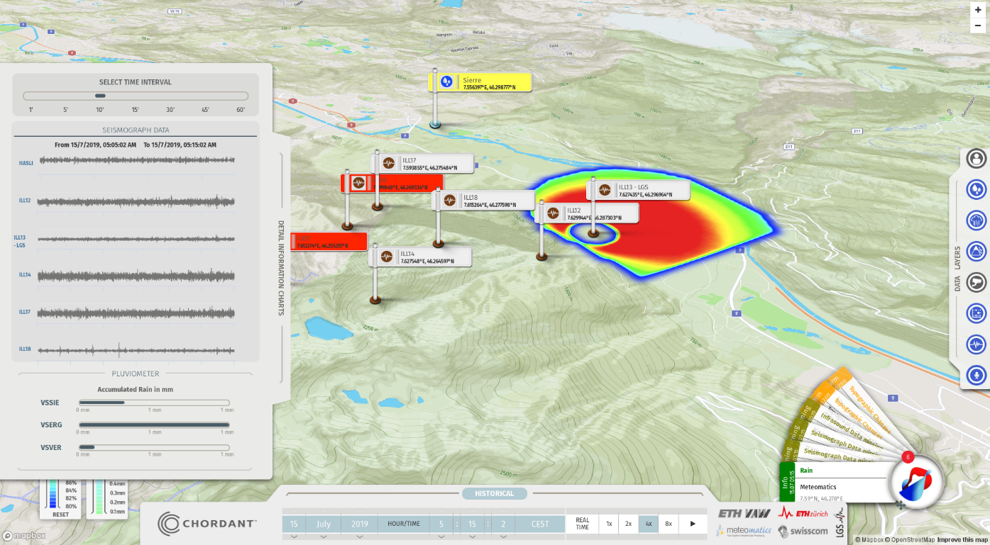

Towards autonomous monitoring of alpine mass movements
Autonomous
drone
DEM
DEM Differences
Orthophotos
Trigger
Position
(video live stream)
real-time
Seismic
data
IoT data platform
Swisscom Broadcast
(Prototype)
Terrestrial
photographs/video
Stationary and gridded
meteorological data
Other auxiliary
data…
Infrasound data
Notes:
Together with Swisscom Broadcast we developed an Internet of things platform.
We feed this platform with real-time data from various sources such as meteorological, analyzed seismic and infrasound data.
With the help of this platform we record measured events and combine the different datasets.
Besides this we additionally focused on the development of an autonomous drone and the seismic detector that should trigger its start. About this I will talk next before I come back to the IoT platform.

Slide 6
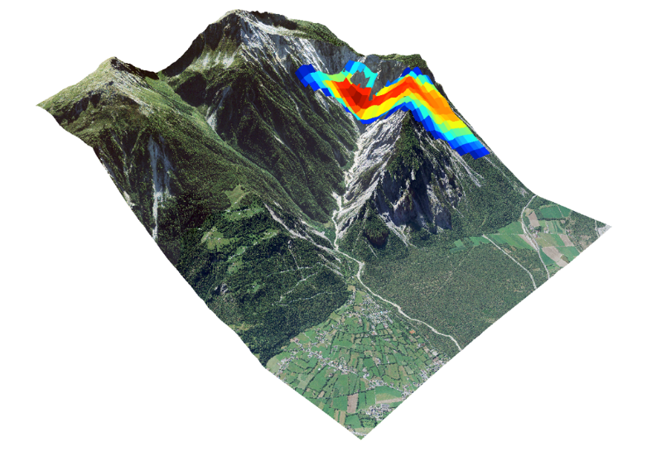
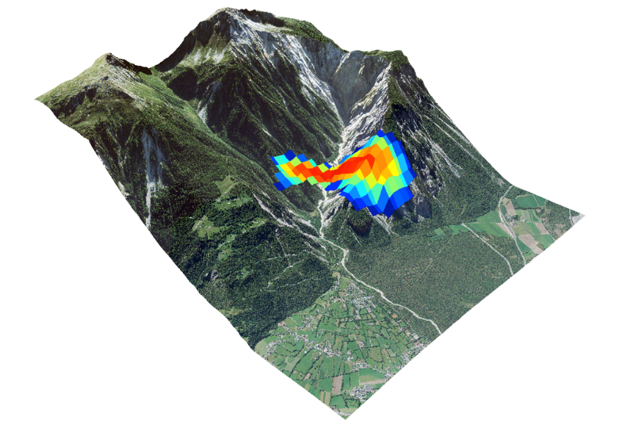
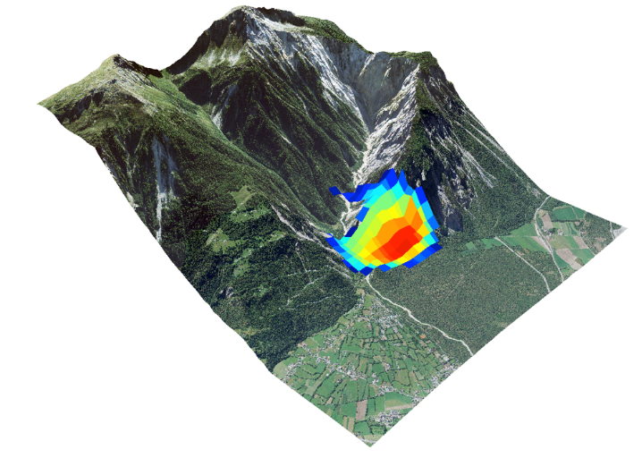
Trigger: Amplitude Source Location by Seismometer
Preliminary study showed that we can detect debris flow movement in the upper part of Illgraben
(Walter et al., 2017)
Increase of early warning time by ~20 min (!)
Method is suitable to be used as trigger for the autonomous drone system
Ongoing challenge: too many false detection
Time (s)
17:31:42
17:40:02
17:58:22
Notes:
A preliminary study showed that we can detect debris flow movements in the upper part of Illgraben using Amplitude Source Location by Seismometer.
Without going into detail, we basically detect the amplitude of the incoming seismic signal at several locations in order to derive the probable origin of a seismic signal.
The example here shows how we could detect the front of a debris flow. The different colors represent the probabilities whereas red corresponds with the highest one.
It also reveals that the detection of debris flow movement in the upper part of Illgraben could increase the early warning time by more than 20 minutes.
A similar method is meant to be used as a trigger for the autonomous drone. But this is an ongoing challenge, we still have too many false detections.

Slide 7
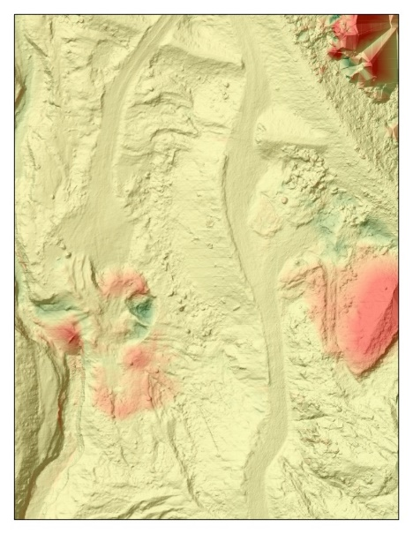
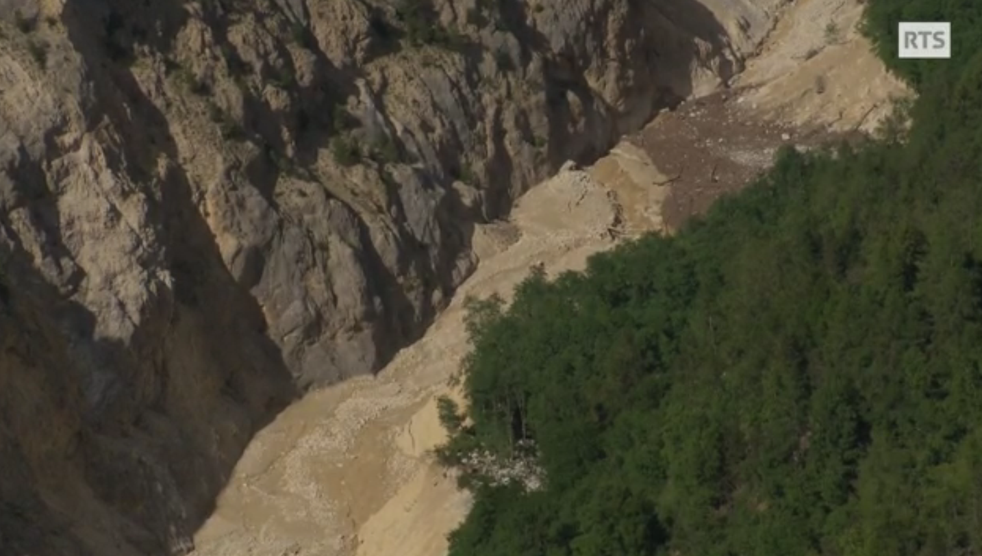
Trigger: Monitoring hazardous potential
Terrain Changes
Debris flow 15. July 2019
vegetation
‘noise’
erosion
-2m
flow direction
deposition
+6m
flow direction
10 m
Notes:
Here I would also like to mention that we do not intent to capture debris flows only. Moreover, we are also interested in detecting other mass movements that do not lead directly to debris flows. But they increase the availability of loose material and therefore also the hazardous potential. For example as you can see here the blocking of the main channel by a debris flow from the side. Changes in the topography like areas of erosion and deposition are for this reasons important to detect too as we can see here.

Slide 8
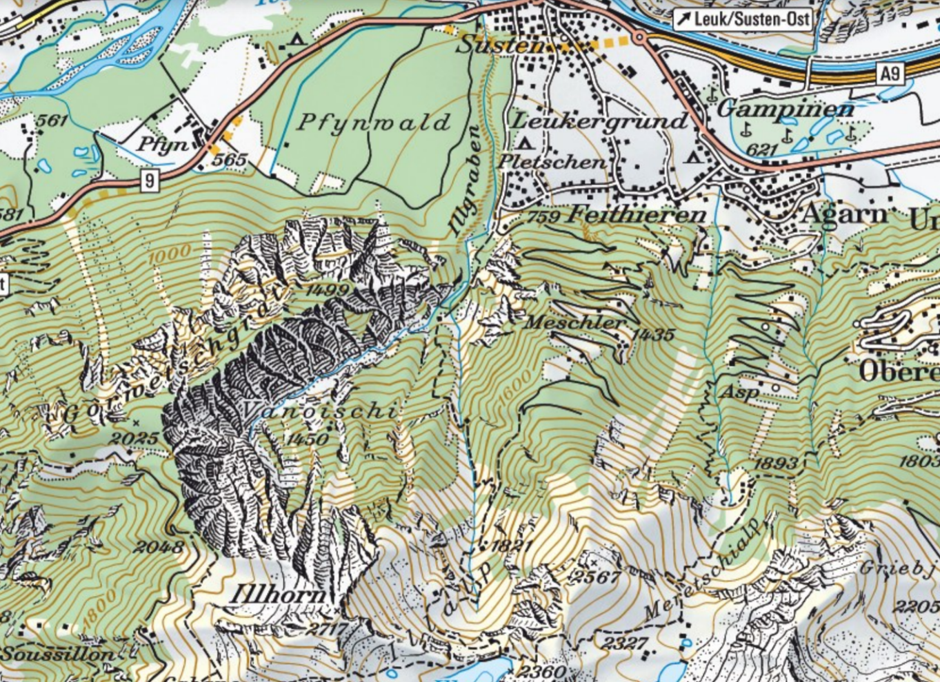
Autonomous drone system
High requirements on drone system
Robust, resistant and weatherproof
Secured and self-charging
Enough Power:
  flight length (~ 10km)
  elevation differences (> 1000m)
Uplink for data upload
Legal requirements (support by SBB)
Permission for BVLOS (Beyond visual line of sight)
SORA (Specific Operations Risk Assessment) Process
10 km
Notes:
By using an autonomous drone system we intend to capture these changes in the poorly accessible upper part of the Illgraben.
The requirements for such a system are quite high. The drone must be for instance weatherproof, very powerful, self charging and able to upload the recorded data immediately.
Additionally, such a system needs special permissions and a specific operation risk assessment. Here we could count on the help of our partner SBB.

Slide 9
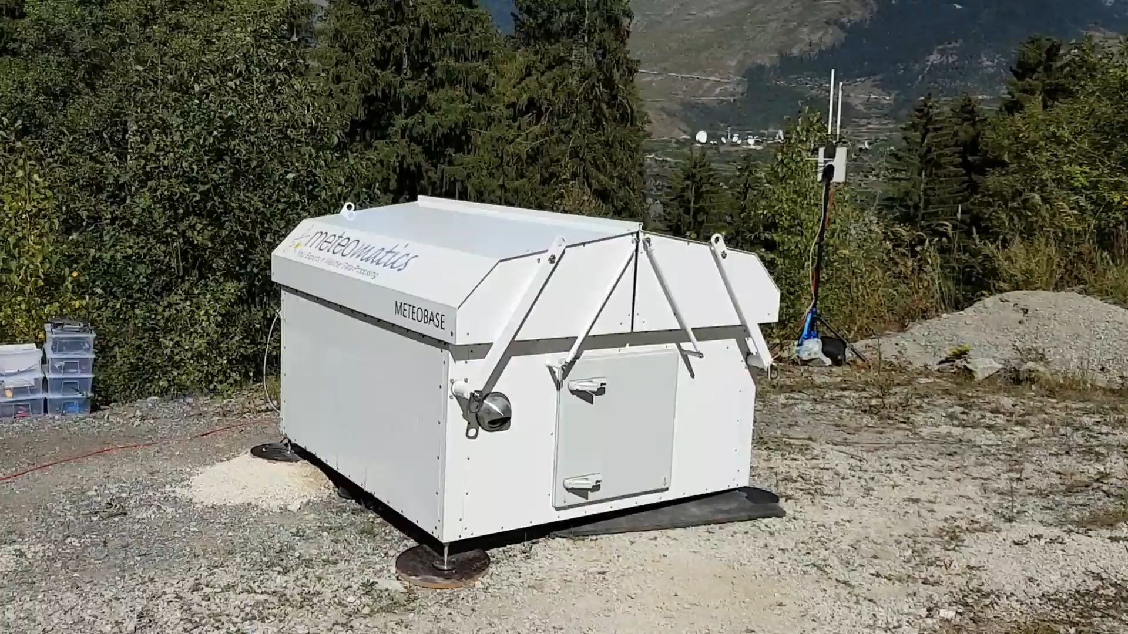
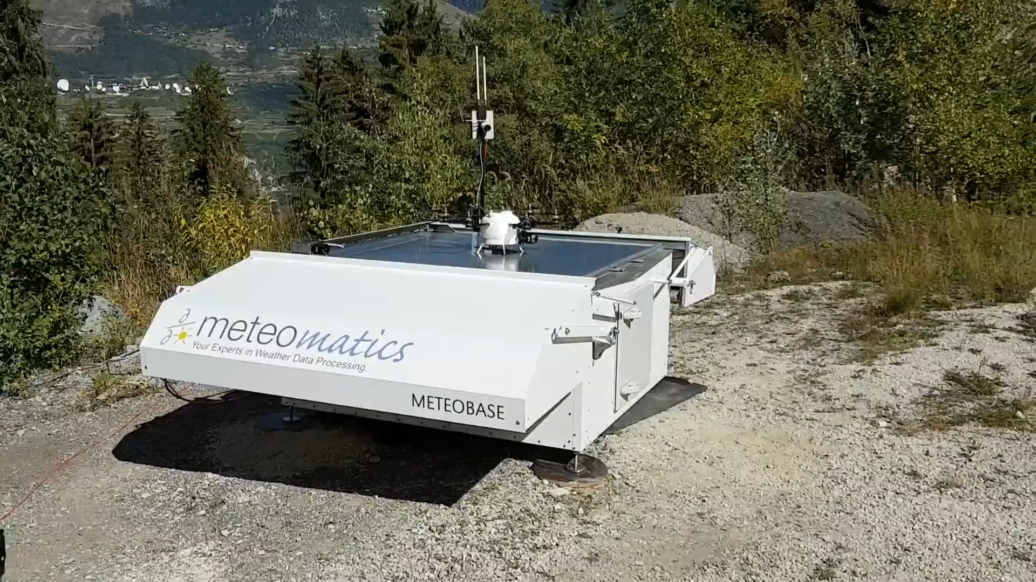
Autonomous drone system
Meteomatics Meteobase
First autonomous take-off and landing:
September 2019
Step by step improvements
  autonomous take-off, landing, charging
  increasing elevation heights
  increasing distances
  finding optimal flight route
  image recording and uploading
Daily and triggered autonomous flights planned for summer 2020
Notes:
Meteomatics, another partner of the project, developed based on these requirements an autonomous drone system called Meteobase.
The first autonomous take-off and landing happened early September this year.
Since than we made step by step improvements.
We increased flight distances and optimized the route for example.
Daily and triggered autonomous flights are planned for summer 2020.

Slide 10
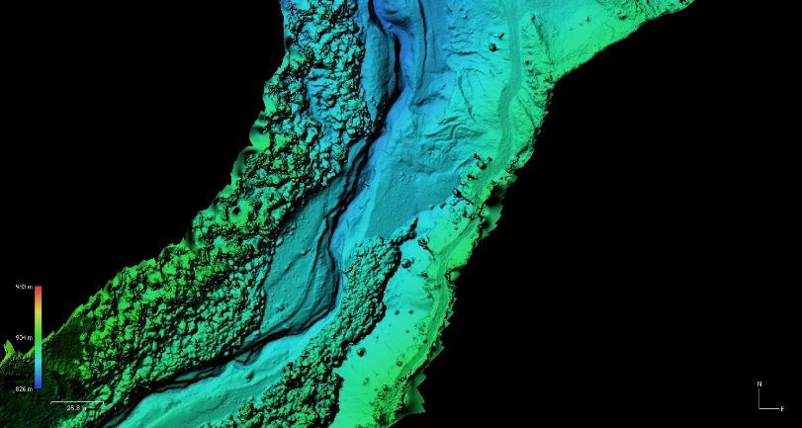
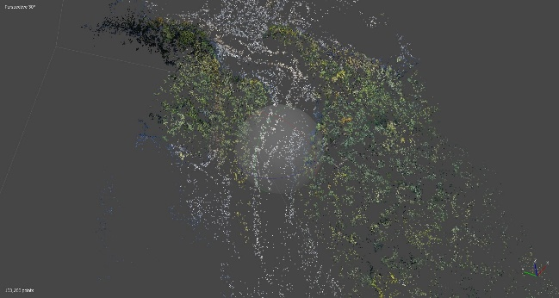
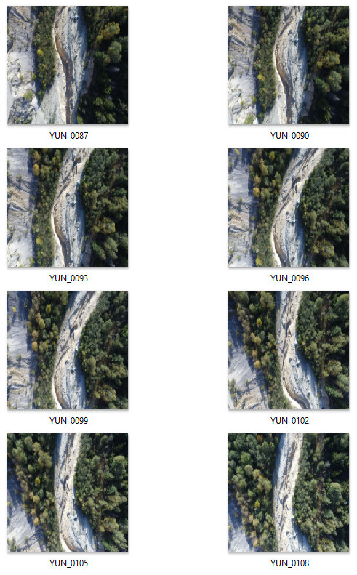
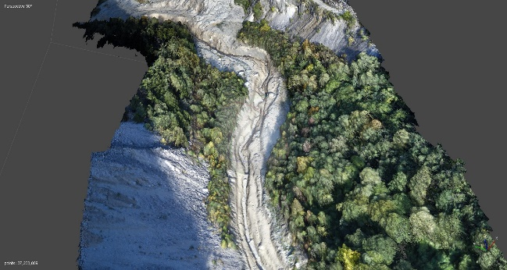
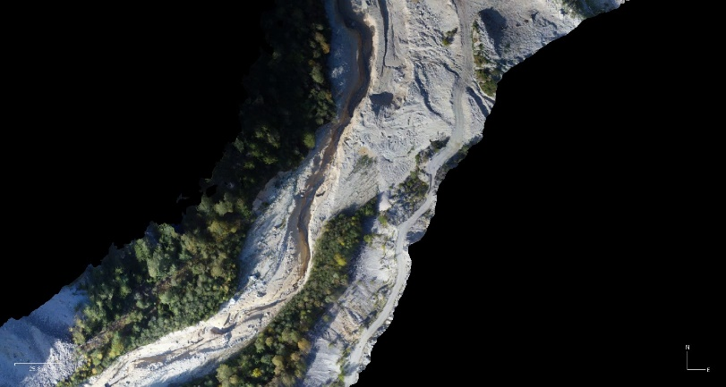
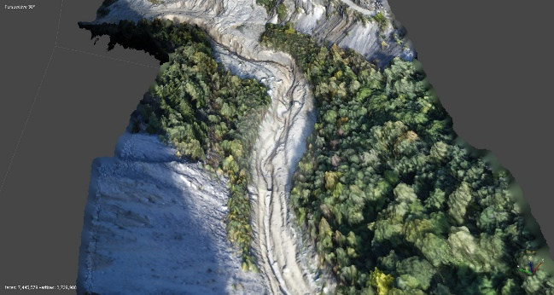
Photogrammetric analysis (Agisoft Metashape) from manual to automated processing
Differences and change detection
DEM - Digital Elevation Model
Tie Points
DOP - Digital Orthophoto
Dense point cloud
3D Model
Notes:
Once the Meteobase drone returned and uploaded the data it is planned that the images are processed automatically. The workflow from single images to digital elevation models and orthophotos is nowadays more or less simple and will be implemented in the next months. The calculation of DEM differences and the detection of changes should be integrated as well. The results will be integrated into our IoT platform.

Slide 11

Prototyp: IoT platform by Swisscom Broadcast
Heatmap:
Seismic source
Stationary data:
Seismic
Infrasound
Weather API
Precipitation nowcasting
Detailed Information, time slider, data layers
Notes:
If I have time I like to explain the IoT prototype platform of Swisscom broadcast.

Slide 12
Achievements and outlook
Achievements
Development of automatic seismic detector
Legal permission (BVLOS, SORA)
First autonomous drone flights
Real-time integration of already available data streams into IoT platform:
  Meteo data (Meteomatics Weather API)
  Seismic data (data network)
  Infrasound data (data network)
Outlook
Use ‘winter break’ for improvements of each component:
Implement machine learning algorithms to catch false alarms
Prepare for daily and triggered flights in summer 2020
Automate photogrammetric processing
Extend IoT platform with other data sources
Back to Illgraben: spring 2020 ☺
Notes:
Finally let me summarize some points. We are not yet there where we want to be, but we made some big steps forward.
We are using the winter break for further improvements and the preparation of the next ‘fieldseason’ starting spring 2020!

Slide 13
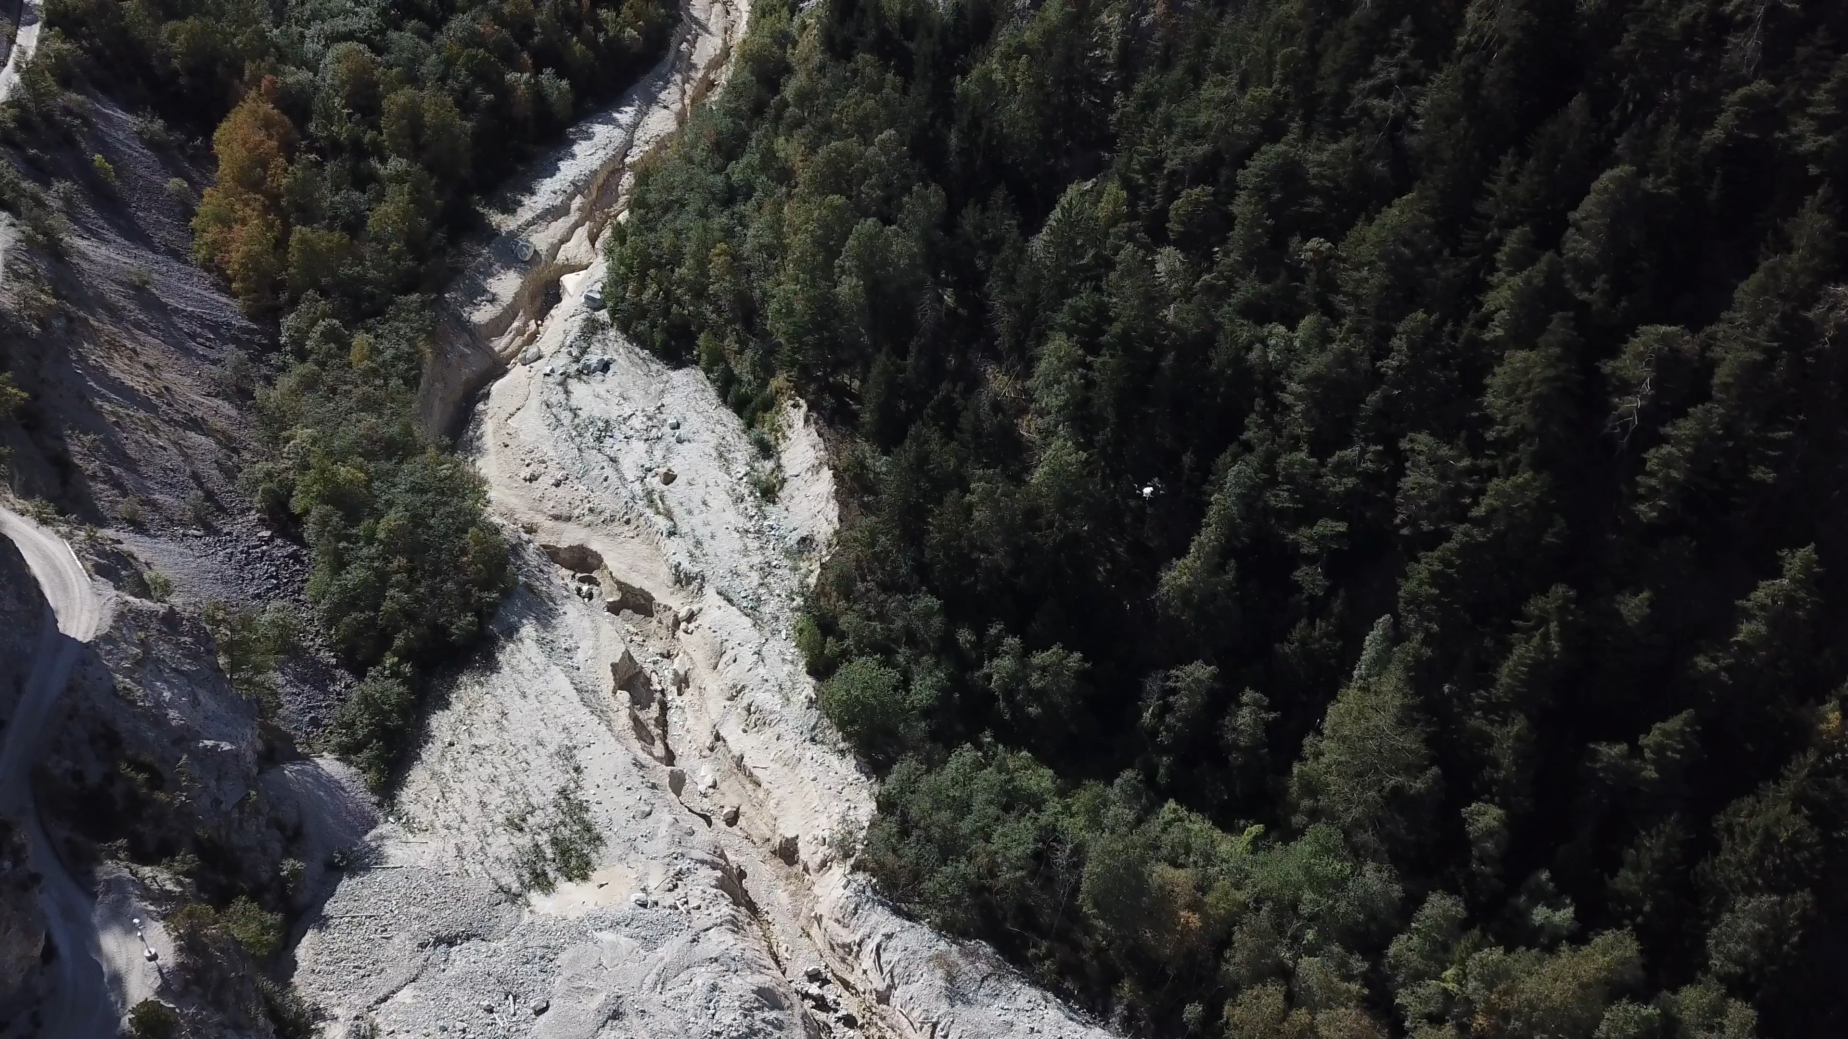
Thank you
Prof. Dr. Fabian Walter
walter@vaw.baug.ethz.ch
Elias Hodel
hodel@vaw.baug.ethz.ch
www.ethz.ch
www.vaw.ethz.ch
Notes:
Thank you very much for listening.
If there is still some time, I m open for questions,
otherwise you can always get in touch with us by the corresponding eMail-addresses.

Slide 14


Slide 15
Amplitude Source Location Challenges
BUT:
without additional post-processing many false detections
Problems if certain stations are down
NEEDED:
→ Additional integration of
  Seismic feature detection
  Machine learning and
  Random forest algorithm
→ Increasing reliability of station
Notes:
But, the real time analysis of the seismic data in 2018 revealed us two additional challenges.
First that there is a very high false detection rate without any post-processing of the seismic data and
second that the system is weak if certain stations are down or not sending proper data.
The first challenges we try to answer with the integration of additional seismic feature detection as well as machine learning and random forest algorithm.

