Slide 1
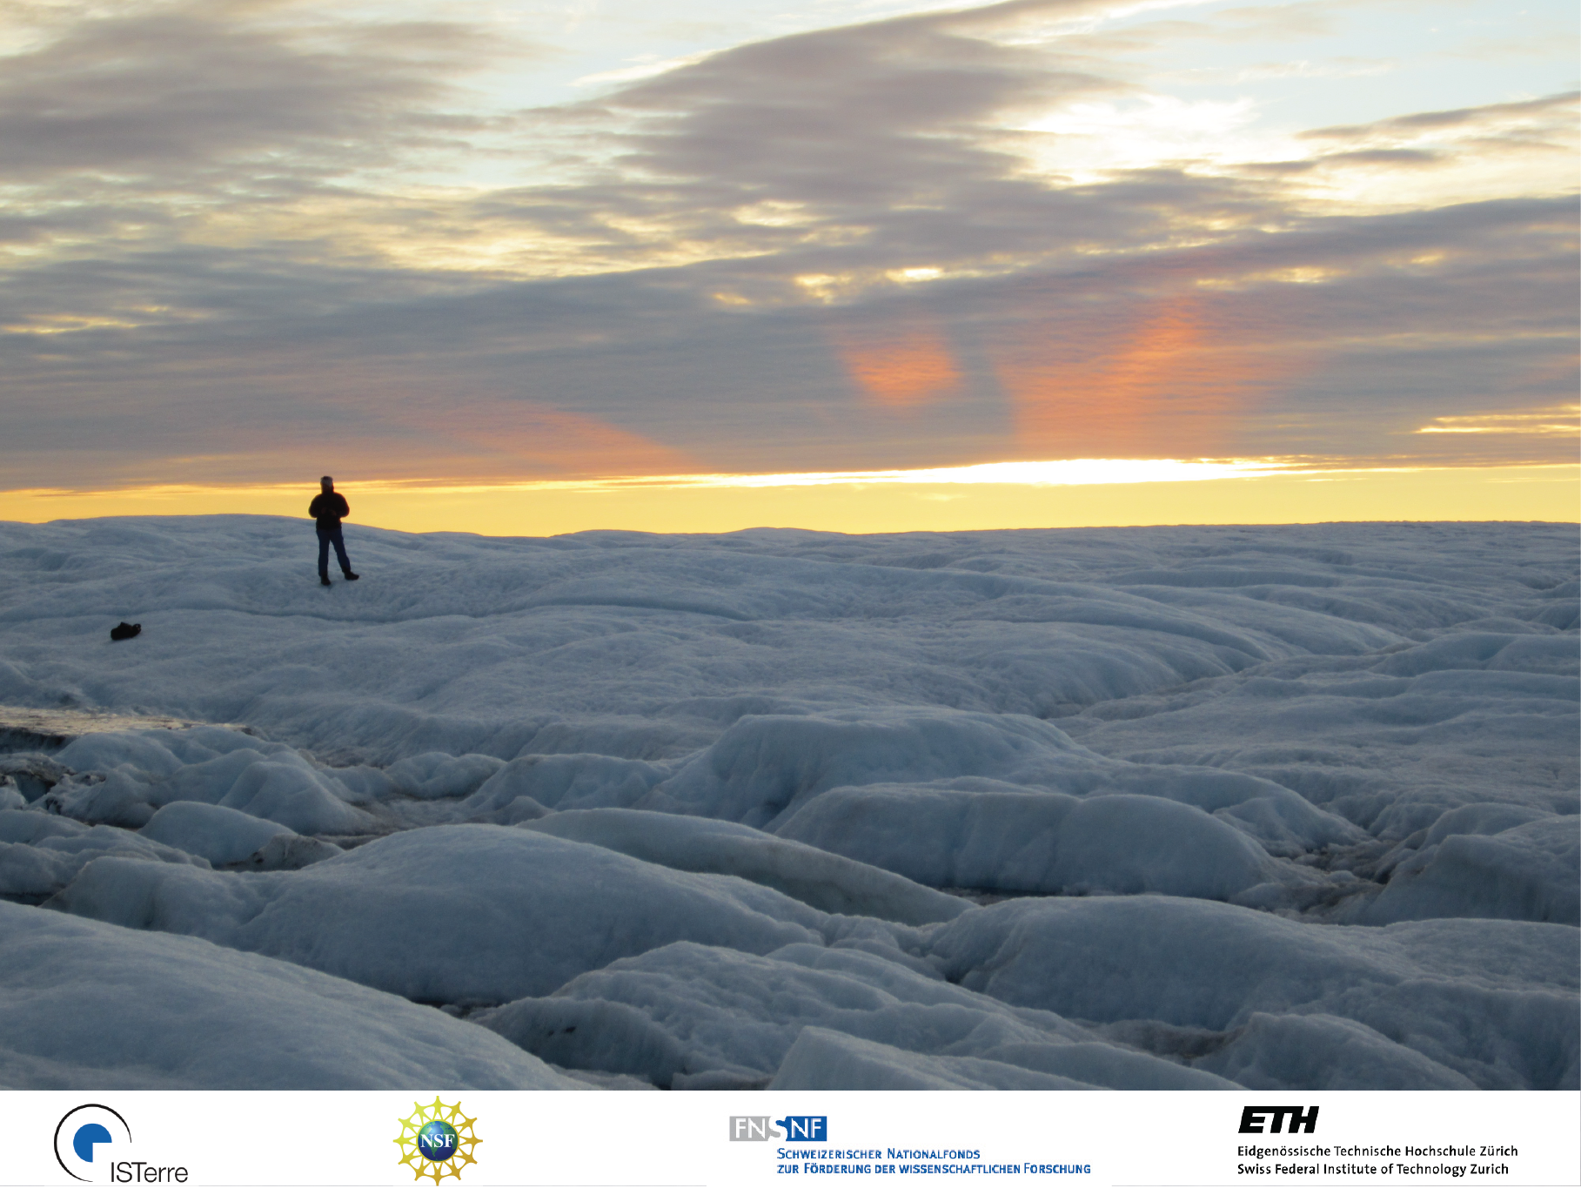
Characterizing Seismic Noise Sources in the Ablation Zone of the Greenland Ice Sheet
Fabian Walter¹, Philippe Roux¹, Claudia Röösli²
¹Institute des Sciences de la Terre, UJF-Grenoble
²Swiss Seismological Service, ETH Zürich
Stephan Husen, Edi Kissling, Claudia Ryser, Martin Lüthi, Martin Funk, Ginny Catania, Lauren Andrews, Katrin Plenkers

Slide 2
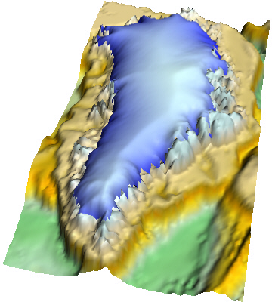
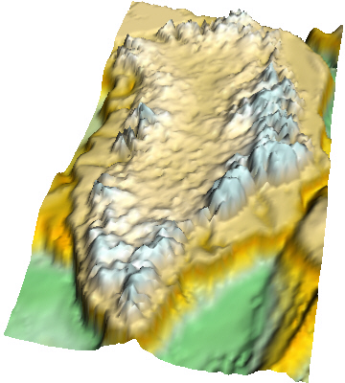
Greenland’s Contribution to Global Sea Level Rise
Complete Melt → 7 m sea level rise
Recent Mass
Loss:
1990-2000:
~100 Gt/a
~0.3 mm/a
Since 2006:
~200 Gt/a
~0.6 mm/a

Slide 3
Mass Loss of the
Greenland Ice Sheet
Mass loss: ~50 % surface, ~50 % discharge
Relationship?
Feedback?
Adaptability?
Time scales?

Slide 4
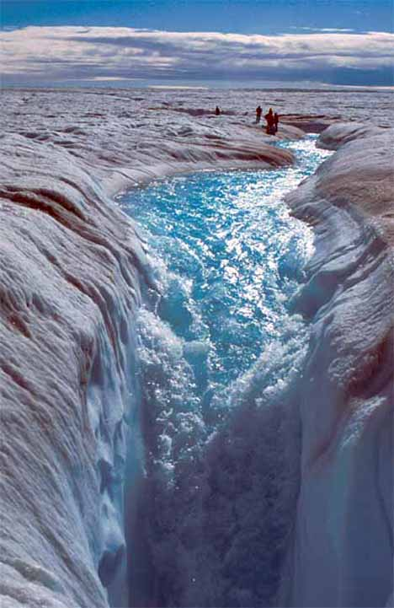
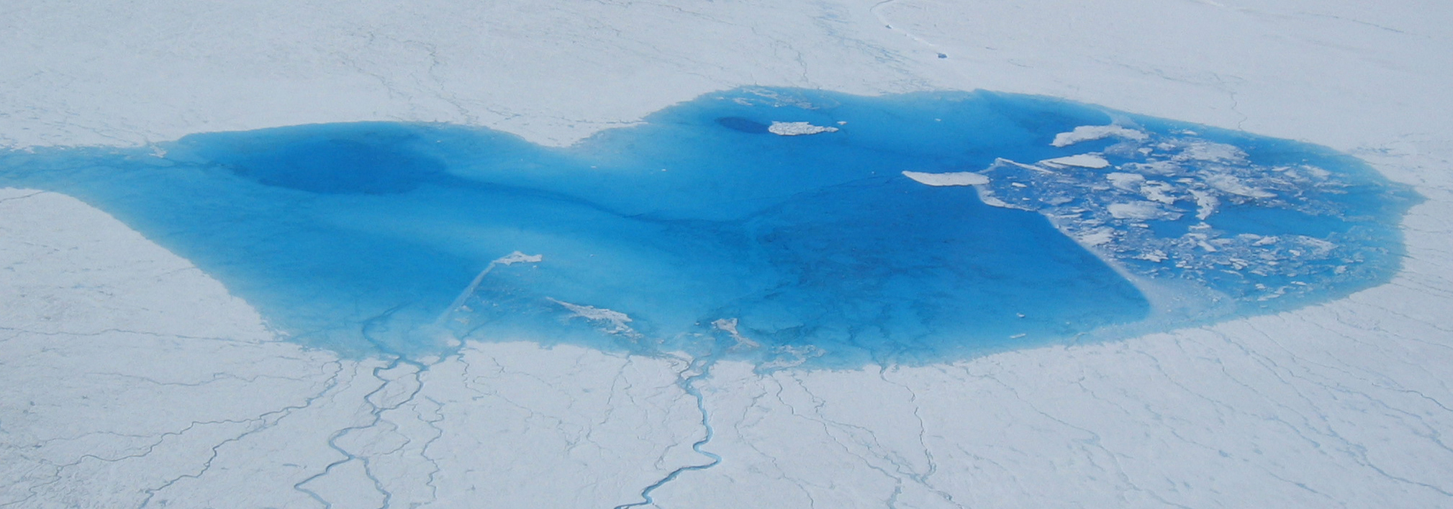
Melt in Greenland’s Ablation Zone
kilometer scale
Supraglacial lakes/streams
Connection with glacier bed
  Moulins
  Hydrofracturing

Slide 5
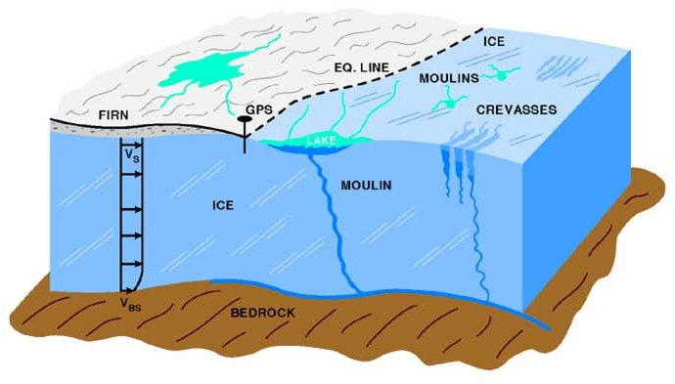
Ice Sheet Dynamics vs. Surface Melt
Accumulation zone
Ablation zone
?
Zwally et al., 2002

Slide 6

Real-Time Observations of Greenland’s Under-Ice Environment
ROGUE PROJECT
Moulin water
level
Melt
Seismometers
In-situ monitoring
Deep drilling 2011
  Subglacial water pressure
  Borehole deformation,
  temperature
Moulin water pressure
Surface melt, stream evolution
GPS
Seismic monitoring
Zwally et al., 2002; shuttershock.com

Slide 7
Overview
Seismological Experiment
Moulin tremor (Röösli et al., in preparation)
Investigating coherent seismic noise
  Matched filter processing
  Noise source identification and characterization
Scientific scope of future research

Slide 8
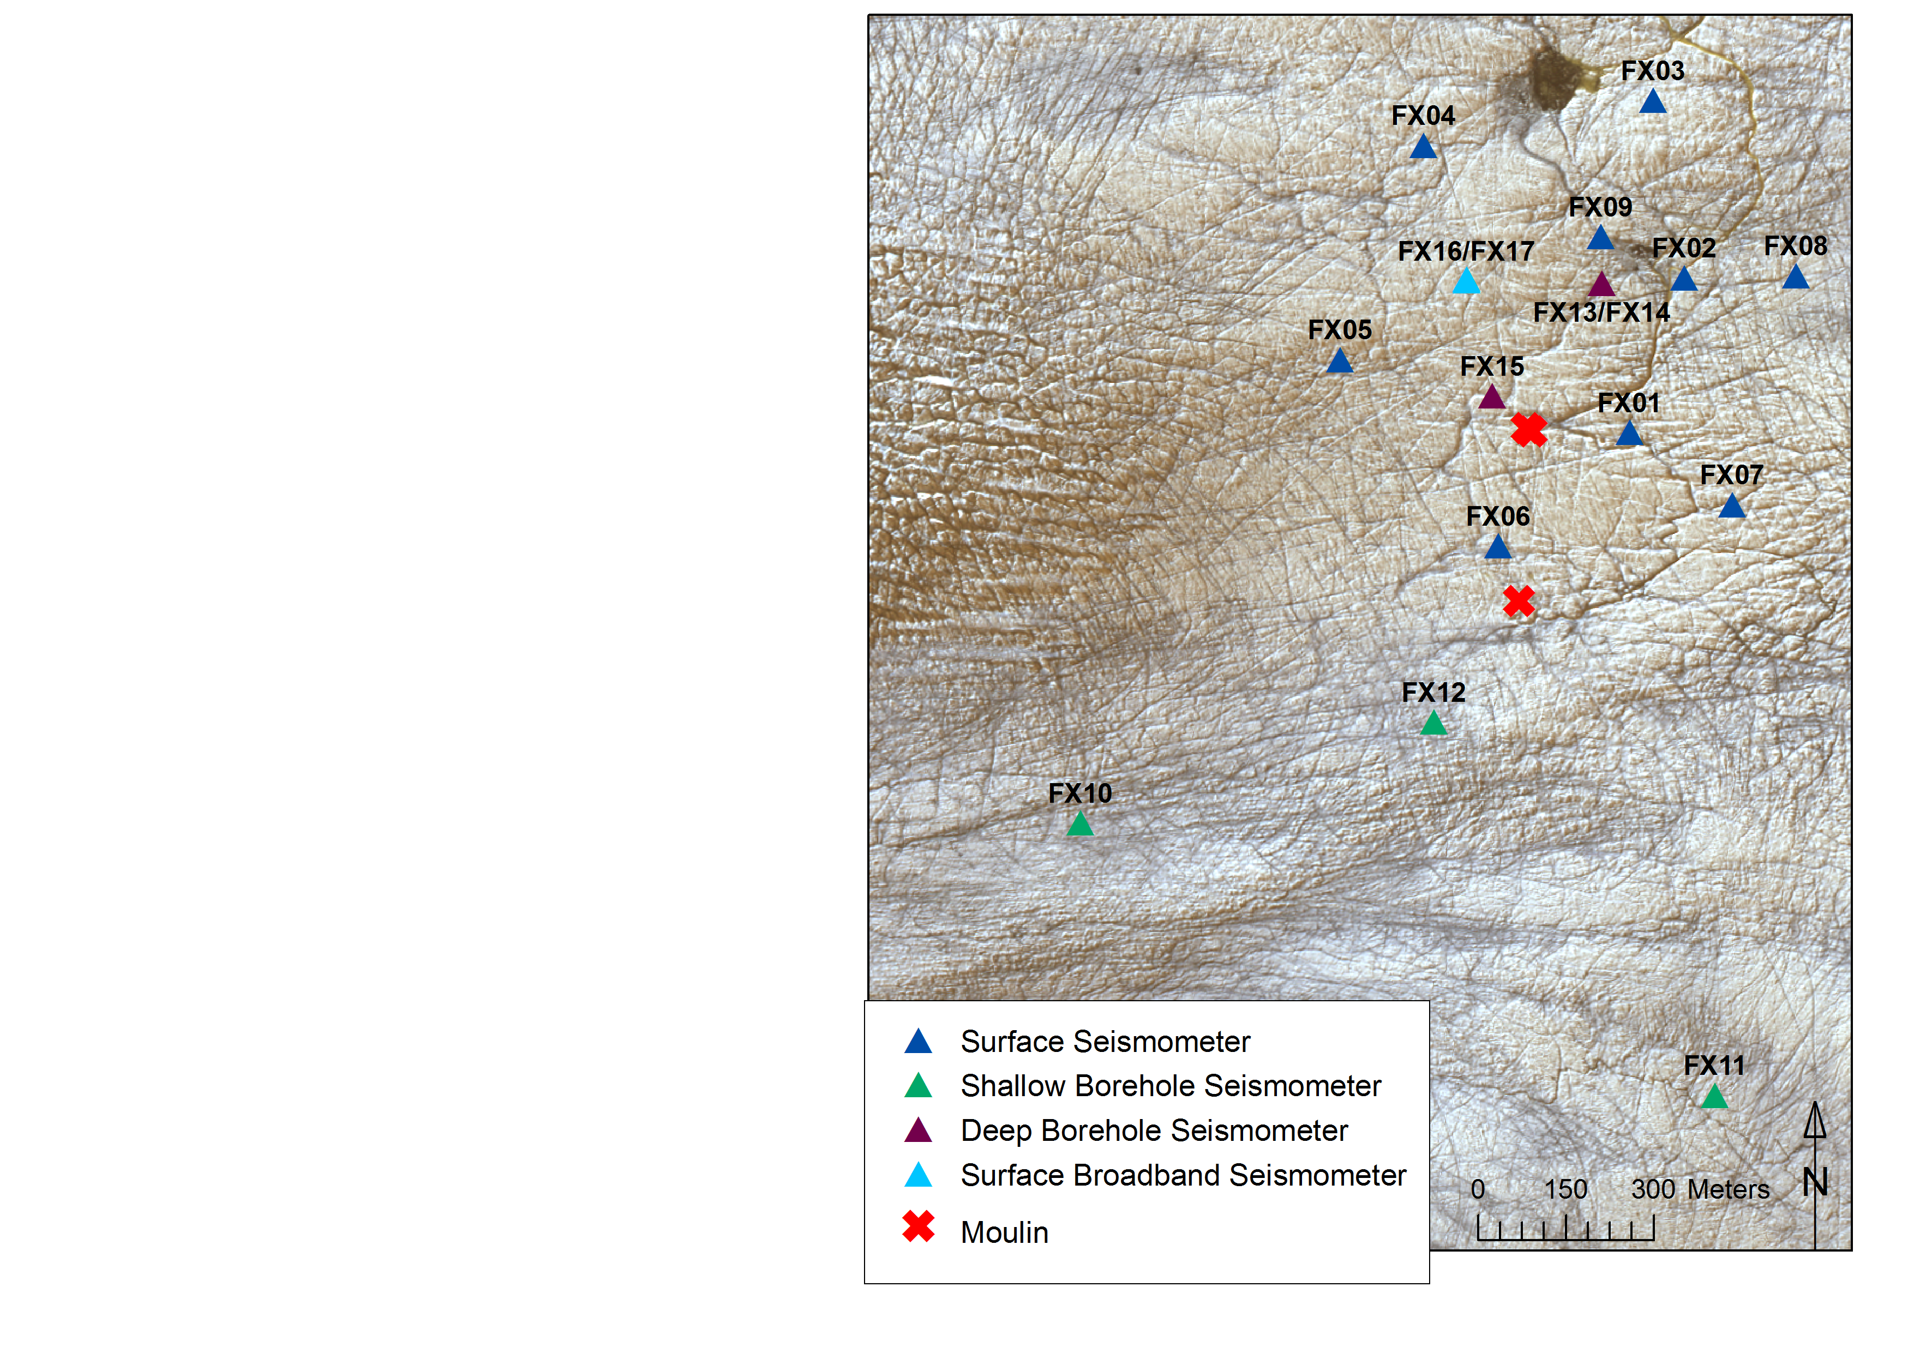
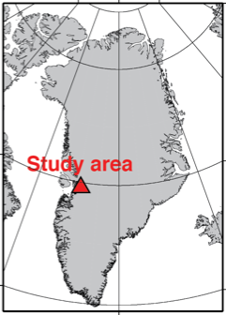
Seismic Monitoring
GOALS
Investigate hydraulic
processes
Supplement to glaciological
point-measurements
Techniques
  Event-based monitoring
    Stick-slip
    Hydrofracturing
  Noise-based monitoring
    Englacial water flow
    Tomography
IMPLEMENTATION
Seismic network in 2011
1.5 months
17 seismometer network
12 near-surface 1Hz seism.
3 borehole seism. (150-250m)
2 co-located broadband seism.

Slide 9
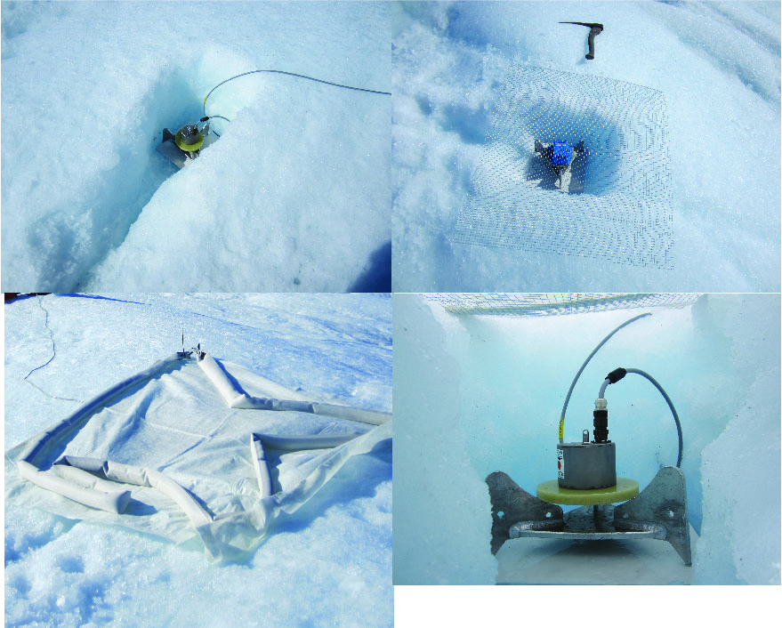

Slide 10
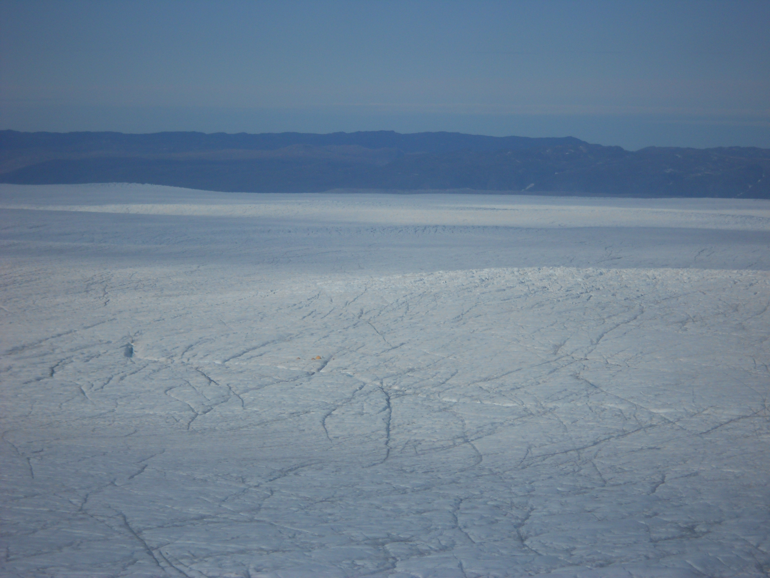

Slide 11
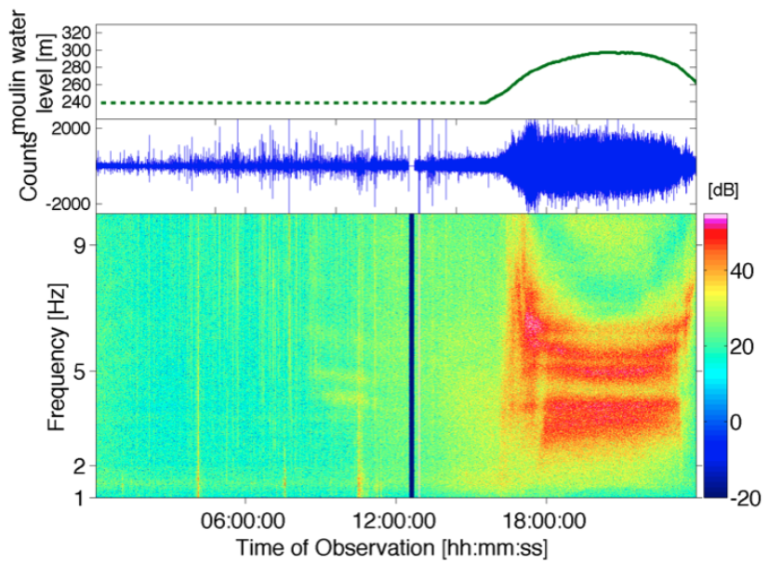
Seismic events: Moulin tremors

Slide 12
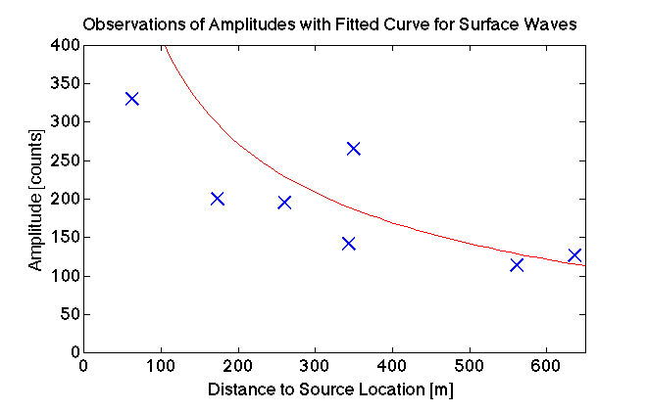
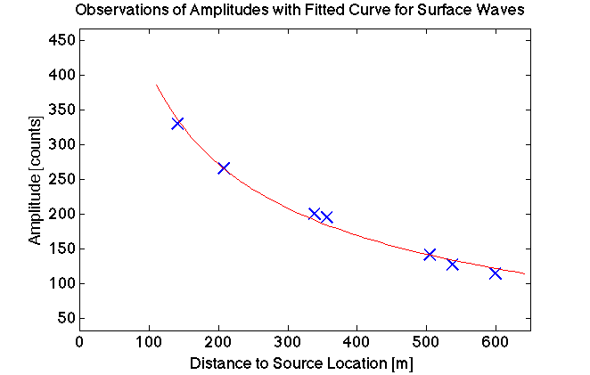
Röösli et al. in preparation

Slide 13
Examples of Seismic Noise Sources in Glaciers
Water
  Moulin, surface streams
  Englacial/subglacial water flow
Ice Deformation
  Crack penetration, iceberg calving
  Basal motion

Slide 14
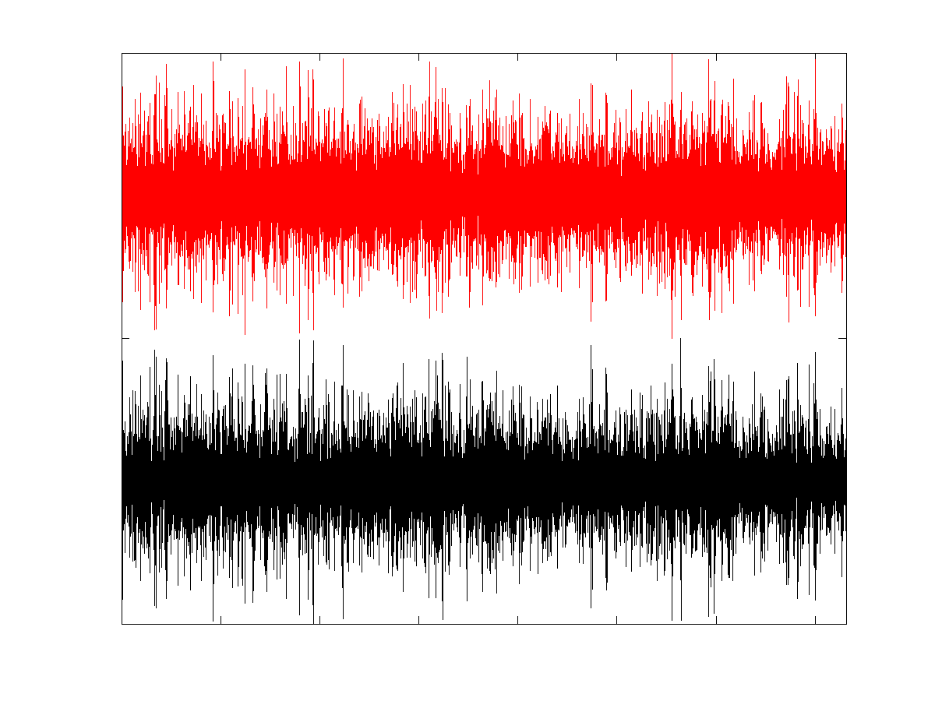
Seismic Noise (3-7Hz): Sustained Seismic Sources Within the Ice Sheet
Focus on coherent signals throughout network
Detect noise via stacking or cross-correlation of longer data sets
  Elucidate sustained coherent signals, even if weak
  Suppress transient icequake signals, even if strong
Vertical Velocity Seismograms
Station 2
24 minutes
Station 1

Slide 15
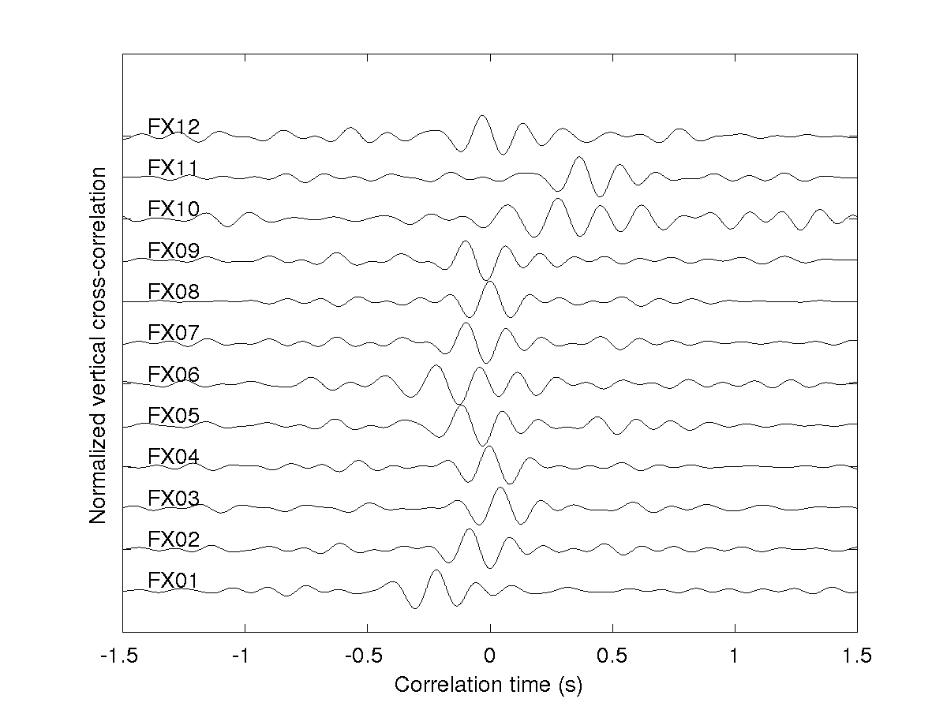
Cross-Correlation with Station FX08
SNR of cross-correlation:
  → Coherence of continuous signal
Zero-lag
  → Travel-time difference from noise source

Slide 16
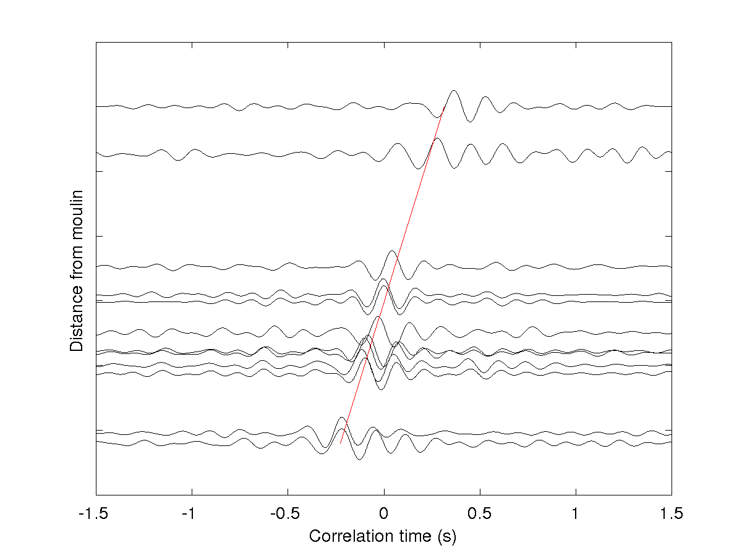
Cross-Correlation with Station FX08

Slide 17
Location of Noise Sources:
Matched Filter Processing
Data
N Stations
Discrete Fourier
Transform
using a grid search, match via inner product
→ combine signal amplitude and coherence
Replica
Surface wave emitted at location a_{j} with velocity c.

Slide 18
Location of Noise Sources:
Matched Filter Processing
Data
N Stations
Discrete Fourier
Transform
N x N ‘Cross-Spectral Density Matrix’
from ensemble averaging
Bartlett Processor (‘linear beamformer’)

Slide 19
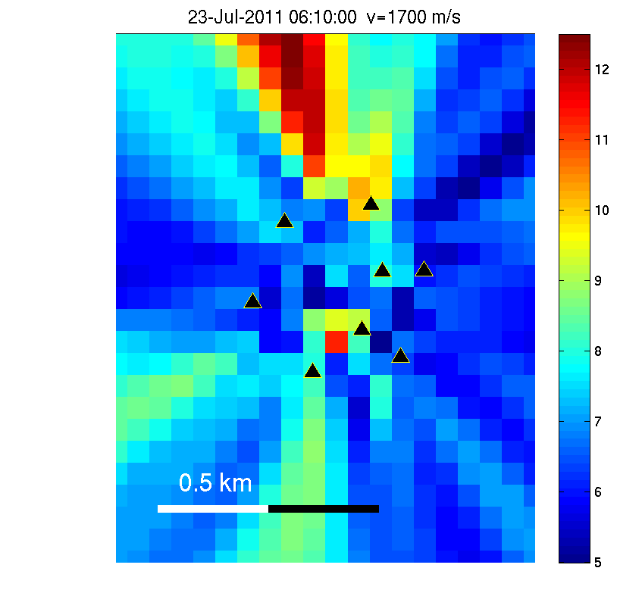
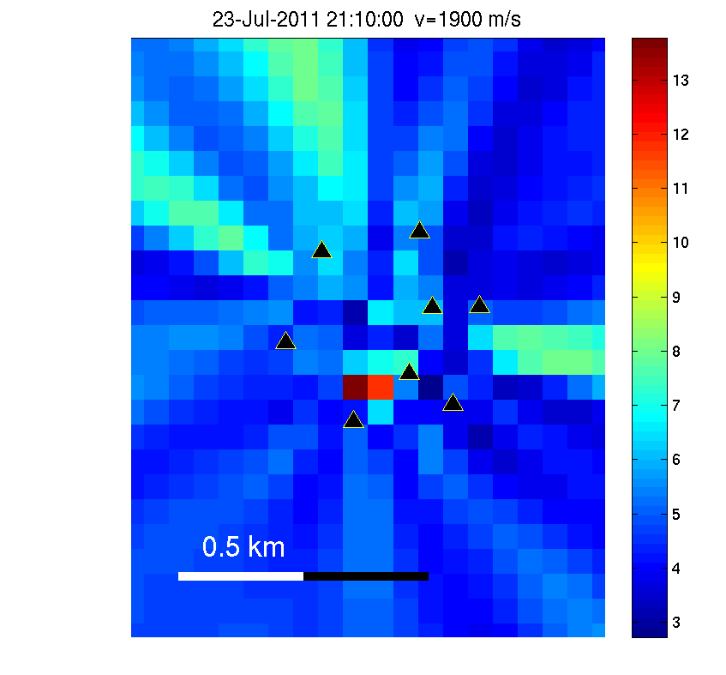
Noise Source Location: 3-7 Hz
Before Tremor
During Tremor
Beam Amplitude (arb. u.)
Beam Amplitude (arb. u.)
Two separate sources
Moulin inside network
Moulin north of network?

Slide 20
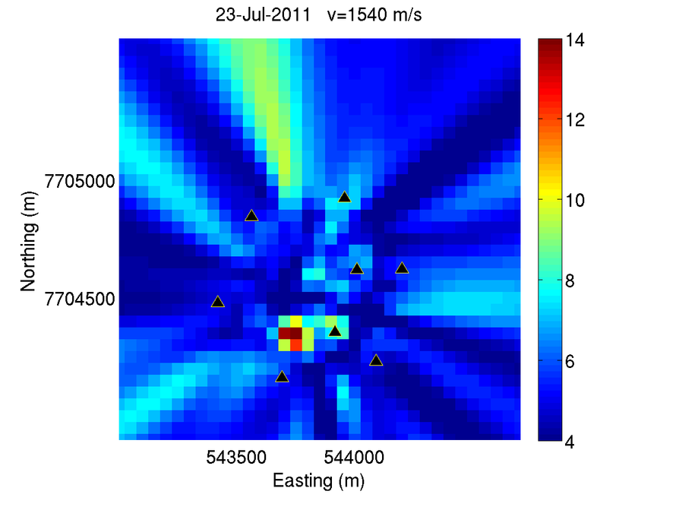
Beamforming for July 23

Slide 21

Now that we found two noise sources, what can we say about them?
www.toonpool.com

Slide 22
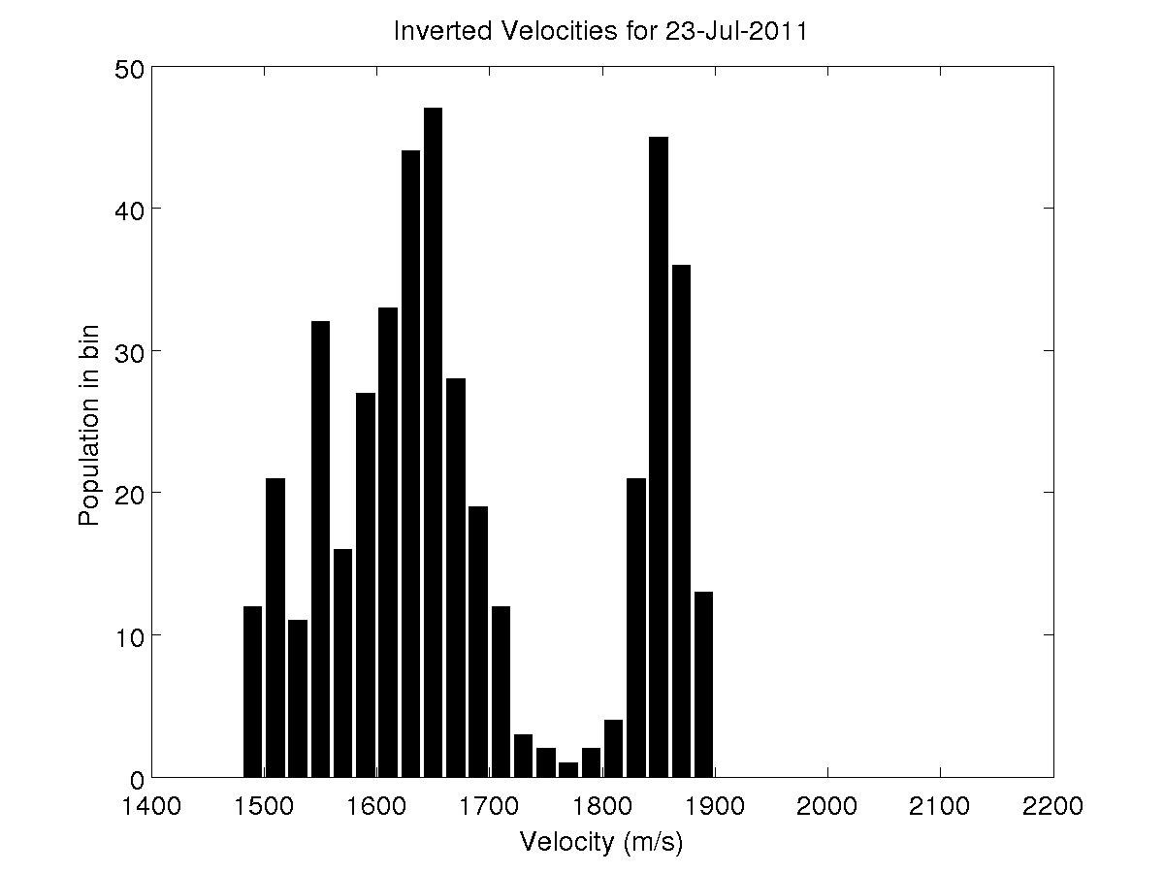
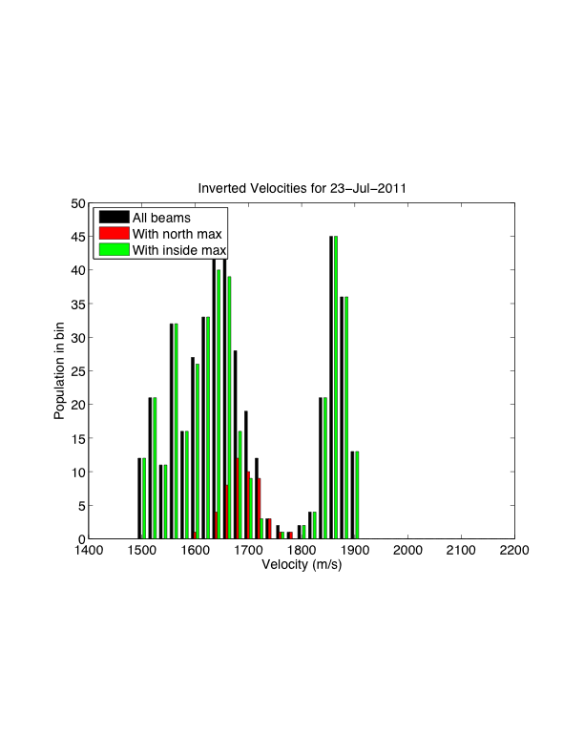
Seicmic Velocity Distribution

Slide 23
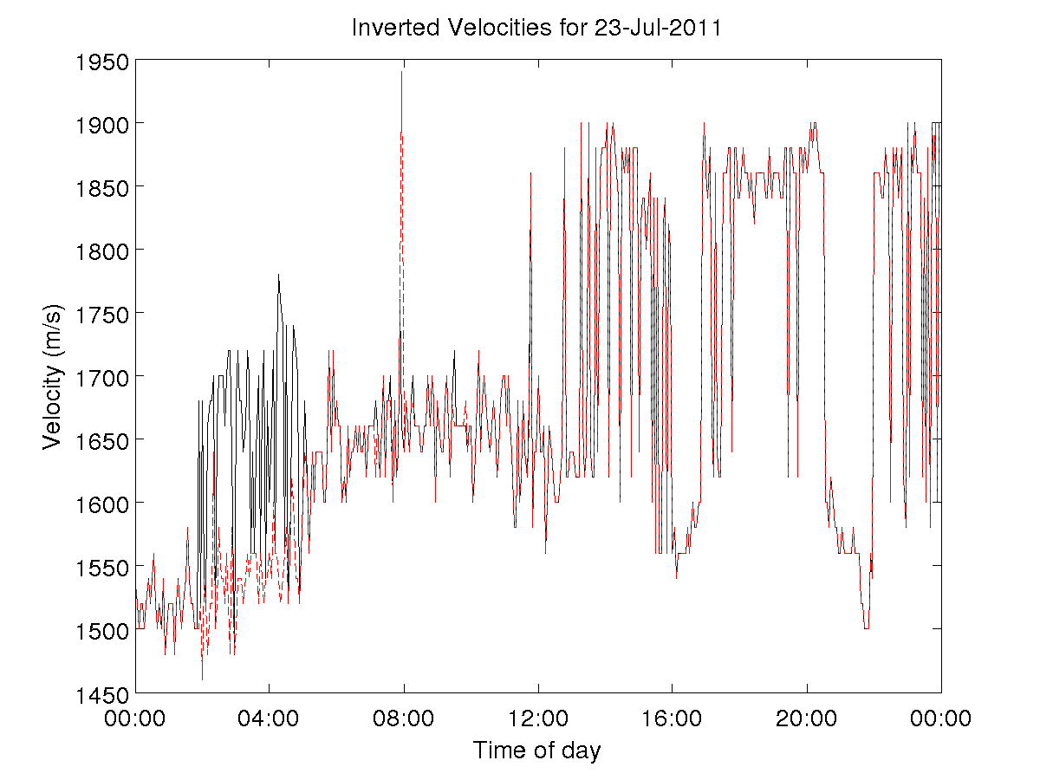
Seismic Velocity Fluctuations

Slide 24
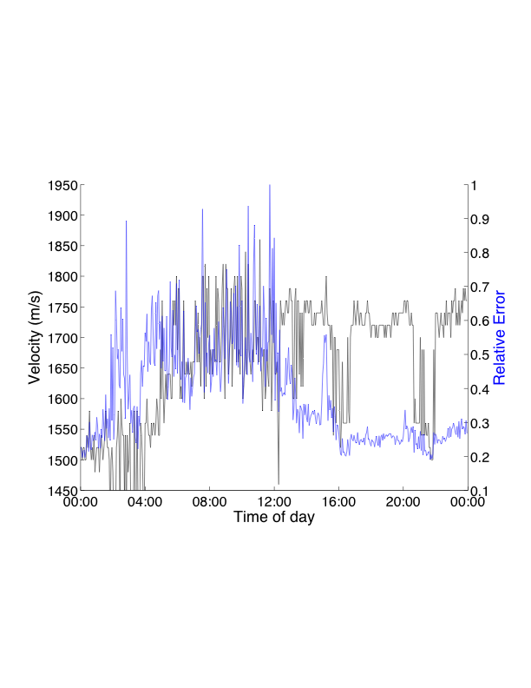
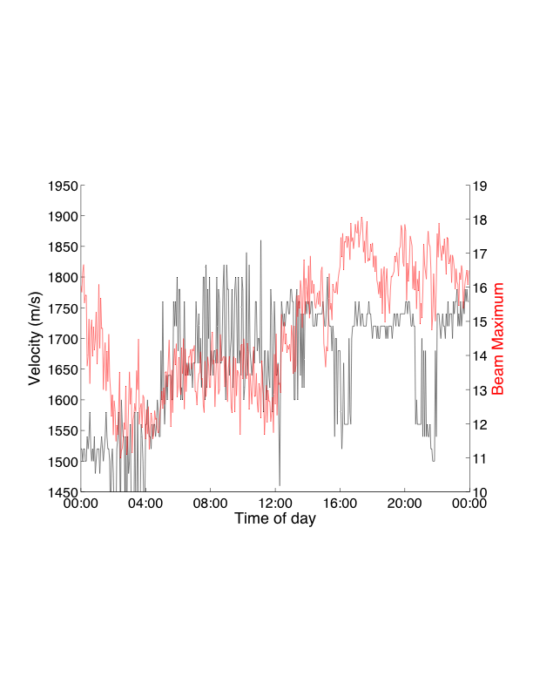
Seismic Velocity Fluctuations
Beam maximum → coherence
Area of beam maximum → resolution
no obvious relationship between inversion quality and velocity fluctuations

Slide 25
Source Discrimination:
Singular Value Decomposition
Singular Value Decomposition
Separate eigenvalues ⬅➔ separate noise sources

Slide 26
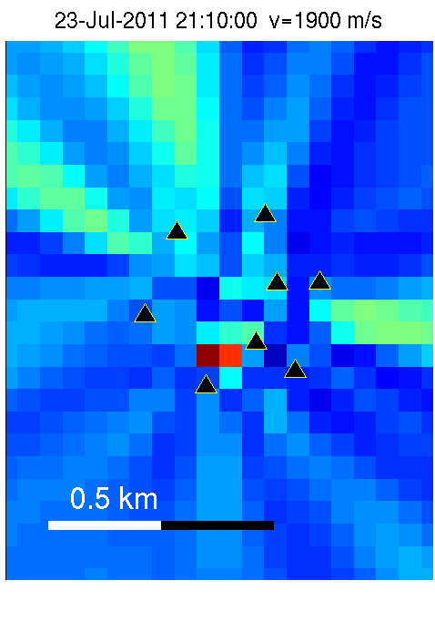
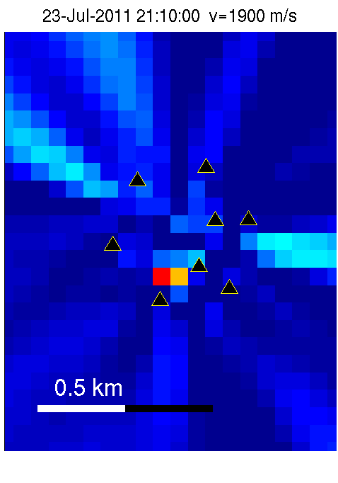
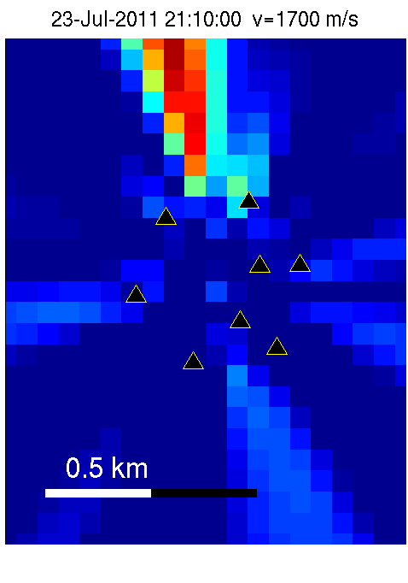
Location Results with Specific Eigenvalues
All Eigenvalues
1st Eigenvalue, only
2nd Eigenvalue, only
3
2
Beam Amplitude (arb. u.)
4
6
8
10
12

Slide 27
Summary: Technical
Noise in the 3-7 Hz range
Coherent noise during all day times
Location via match-filter processing possible
Noise source discrimination via SVD

Slide 28
Summary: Scientific
Confirm tremor results of Claudia Röösli
Moulin emits noise at other times, too
Presence of another persistent noise source north of network
Seismic velocity fluctuations associated with noise sources

Slide 29
Outlook
Uncertainty estimation in location and velocity
Add third dimension in location
Process entire 1.5 month long continuous record; compare with glaciological observations
??? Can we detect changes in noise sources ???
  Changes in englacial water flow
Tomography
  Complications
    Directional noise field
    Little scattering
  Possible via correlation of ‘beams’ rather than seismograms
  Filling/emptying of englacial void spaces

Slide 30
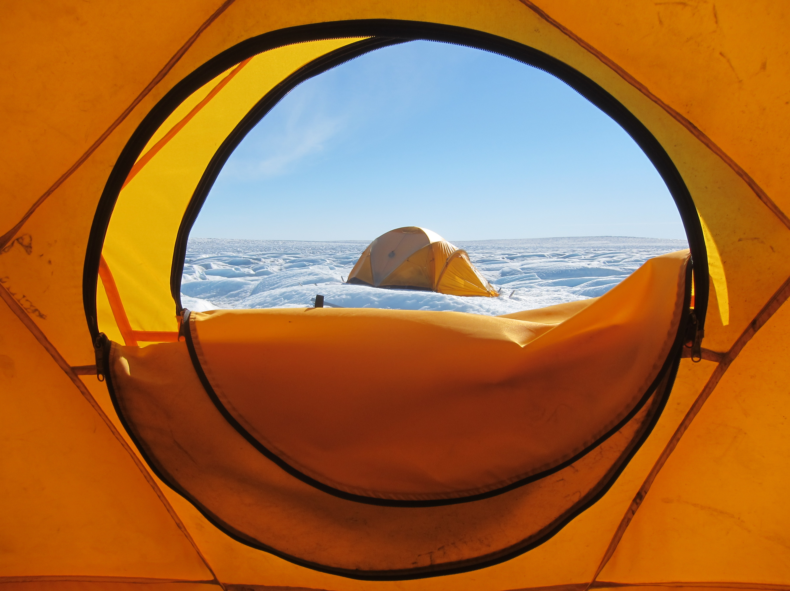
Thank you for your attention!

Slide 31
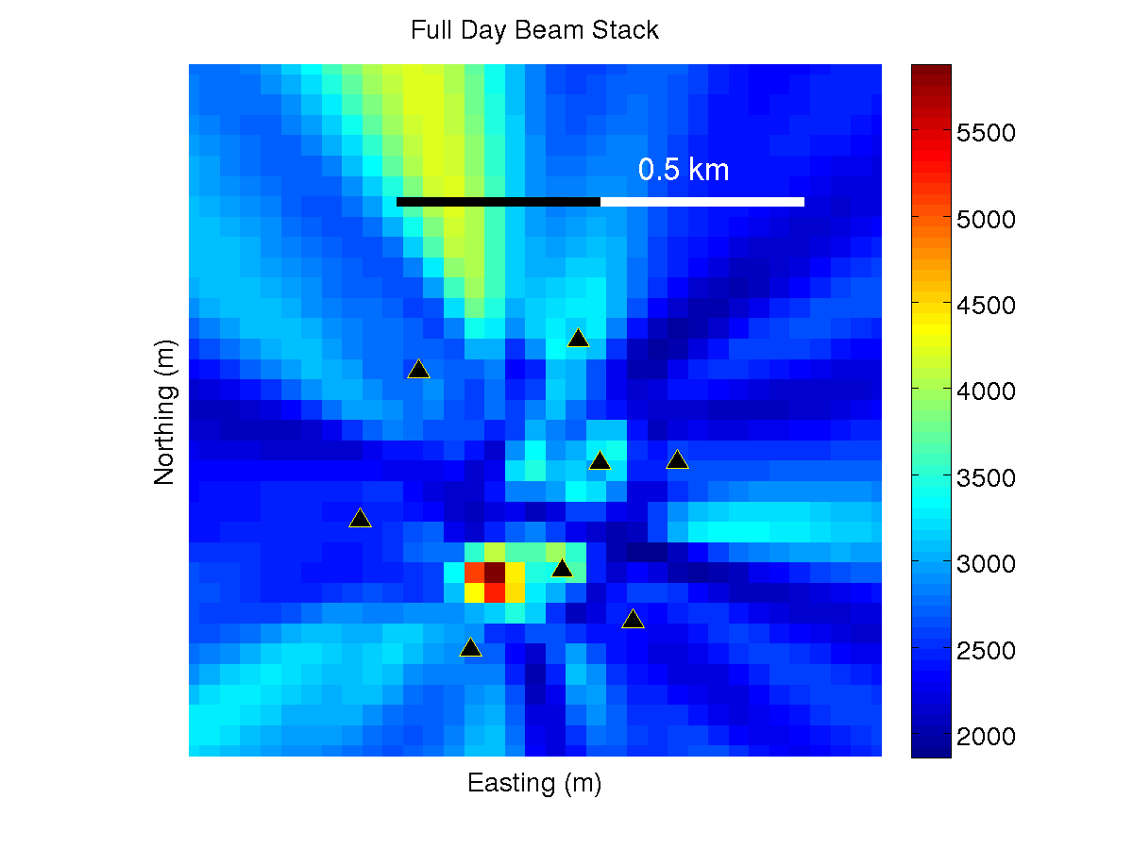
Stack of all beams from July 23
Two dominant noise sources
Velocity (m/s)

Slide 32
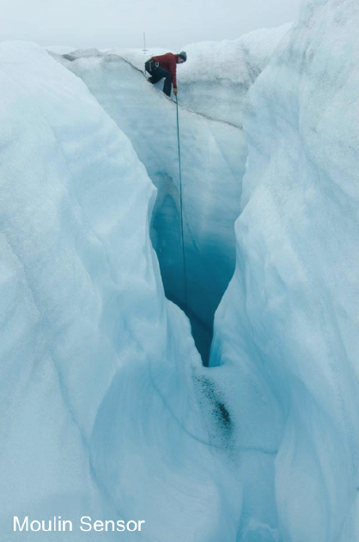
Measurement of water
level inside moulin.

Slide 33
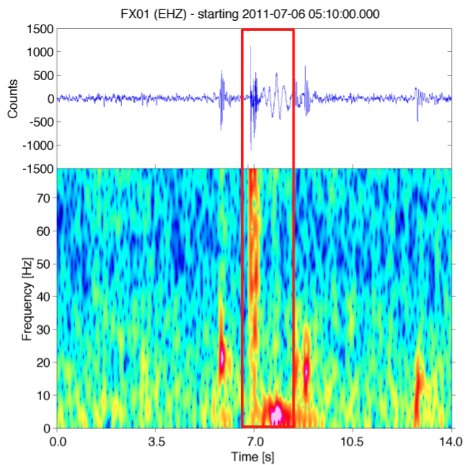
Seismic events: Icequakes
Brief (<0.1 seconds),
impulsive transients
Easily detectable
Englacial fracturing
More than 6,000 events/day
Shallow seismicity
Deep (100 m) icequake with
low-frequency coda
→ Water resonance?

Slide 34
Technical Questions
Normalize beam
Detect seismic velocity changes?

Slide 35
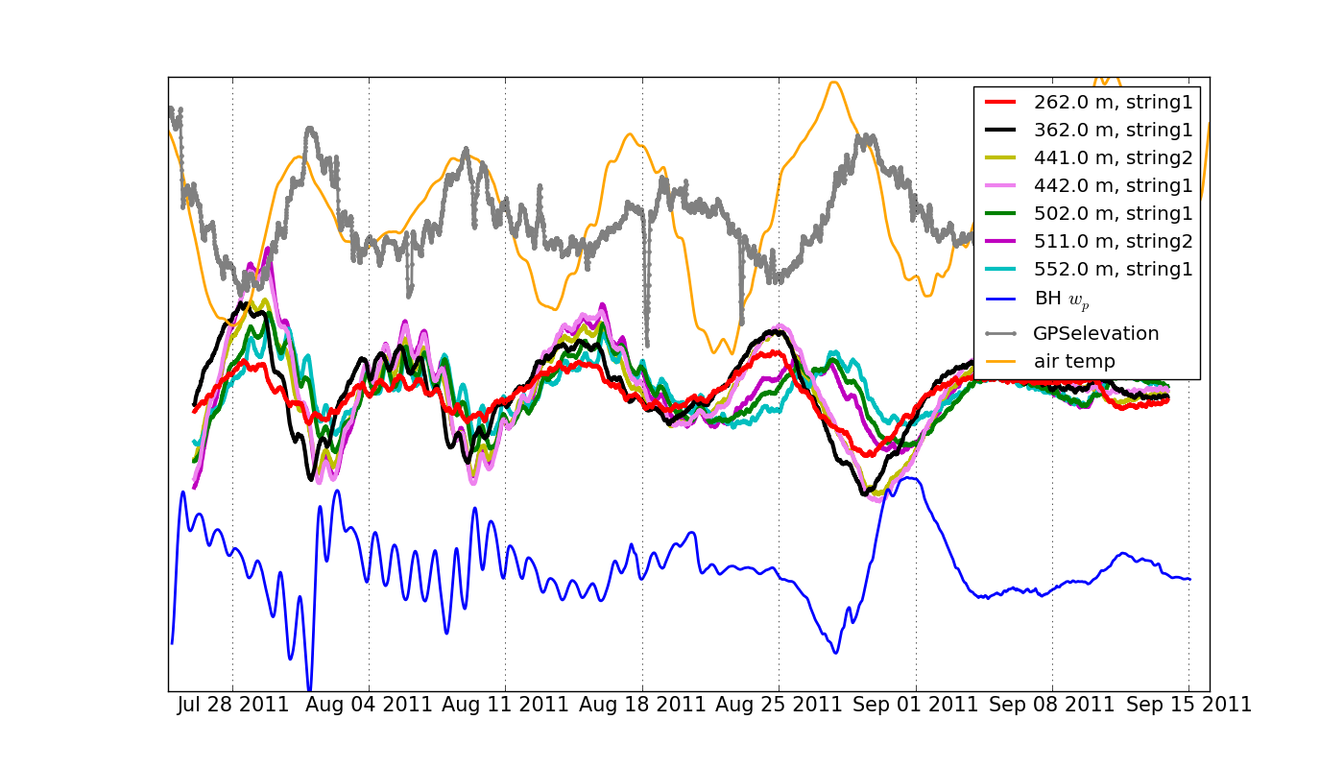
≈1 Week Fluctuations in
Air Temperature, Basal Water Pressure and Ice Deformation
1 week

Slide 36
Geometrical Interpretation of
Matched Filter Processing
Transformed Wavefield
d₂
Ignore phase:
Find location via
noise amplitudes modeling
d₁

Slide 37
Geometrical Interpretation of
Matched Filter Processing
Transformed Wavefield
Ignore amplitude:
Find location via
phase match

Slide 38
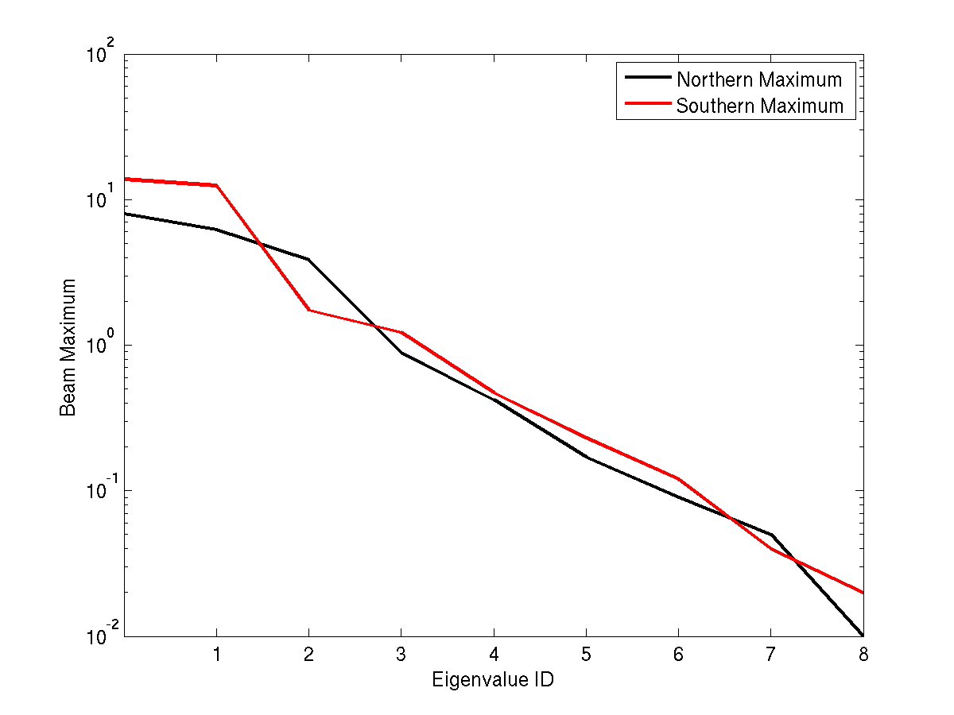
Influence of Eigenvalues on
Local Beam Maxima
ALL
EIGENVALUES

Slide 39
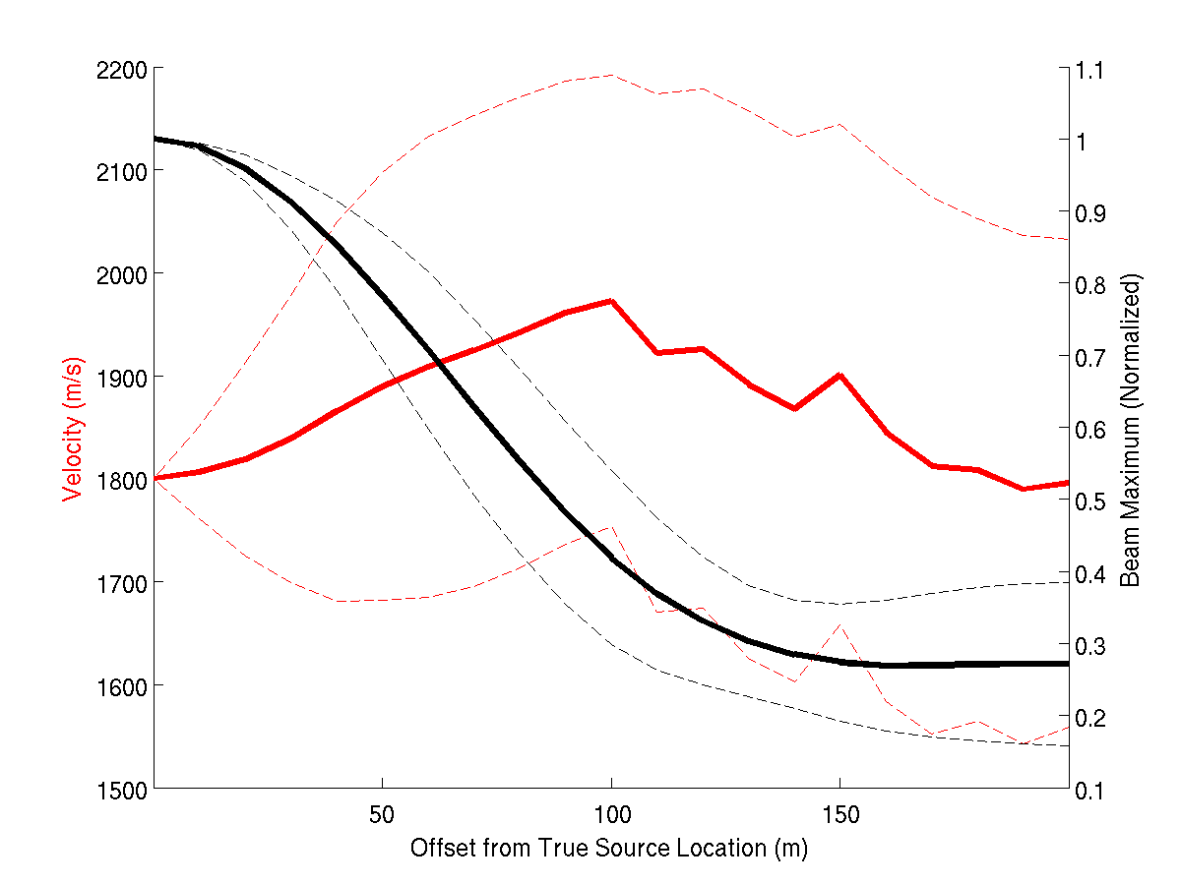
Uncertainty in Inverted Velocity

Slide 40
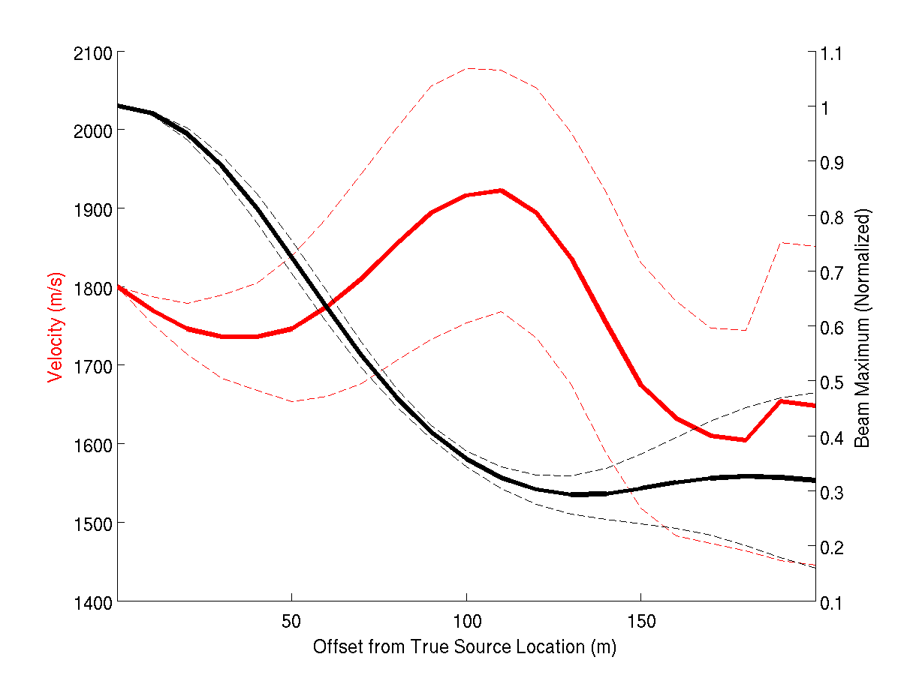
Uncertainty in Inverted Velocity

Slide 41
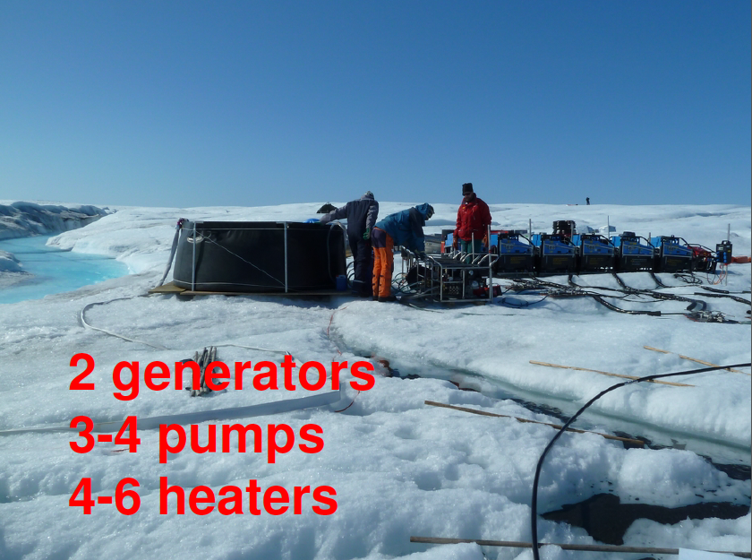

Slide 42
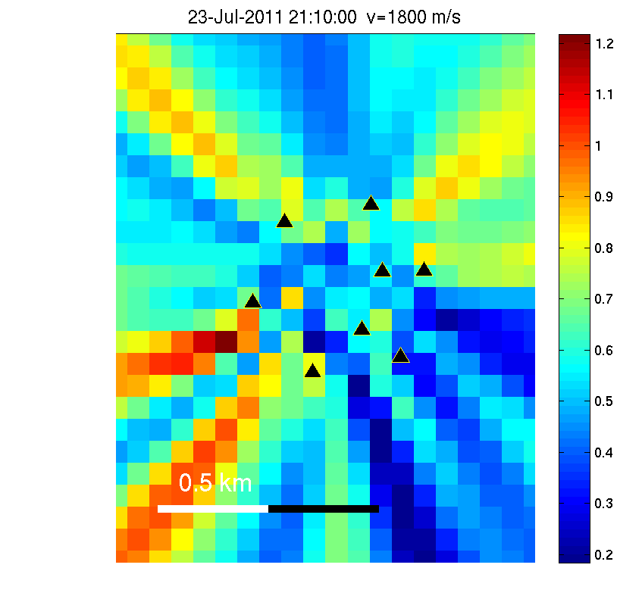
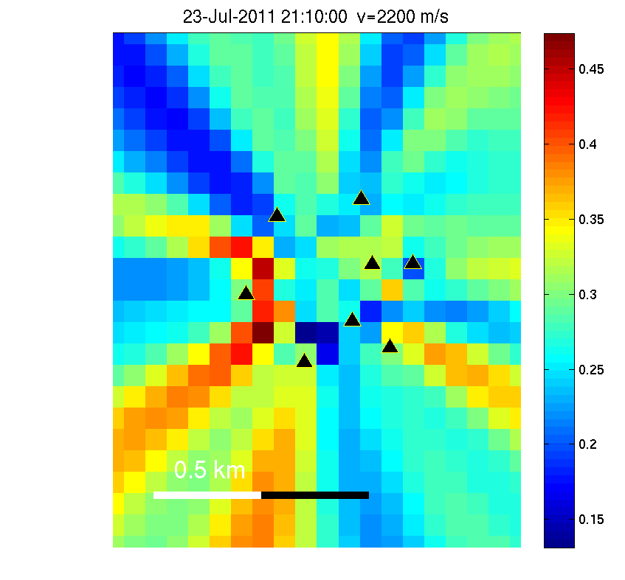
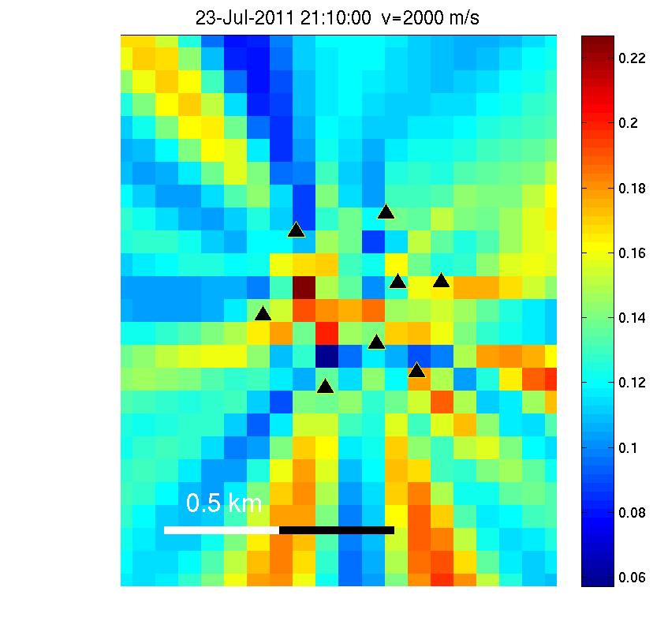
Location Results with Specific Eigenvalues
3rd Eigenvalue
4th Eigenvalue
5th Eigenvalue

Slide 43
Singular Value Decomposition
Singular Value Decomposition
Separate eigenvalues ⬅➔ separate noise sources

Slide 44
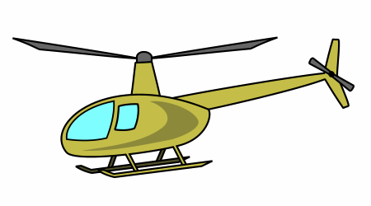

Coherent vs. Incoherent Noise
www.picideas.net
www.how-to-draw-funny-cartoons.com

