Slide 1
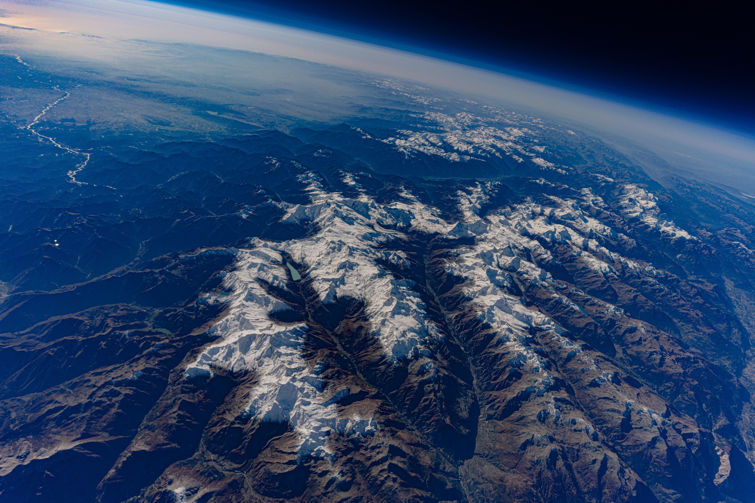

Debris Flow Monitoring with
Distributed Acoustic Sensing (ESR12)
Host: Swiss Federal Institute for Forest,
Snow and Landscape Research WSL
Presented by: Małgorzata Chmiel (WSL)
Project supervisor(s) at host institute: Fabian Walter (PI), Stuart Lane (UNIL) Project supervisor at secondment: Lina Polvi-Sjöberg (UmU, Sweden)
Fabian Walter
22.09.2020
1
Foto: Marc Funk
Notes:
1

Slide 2
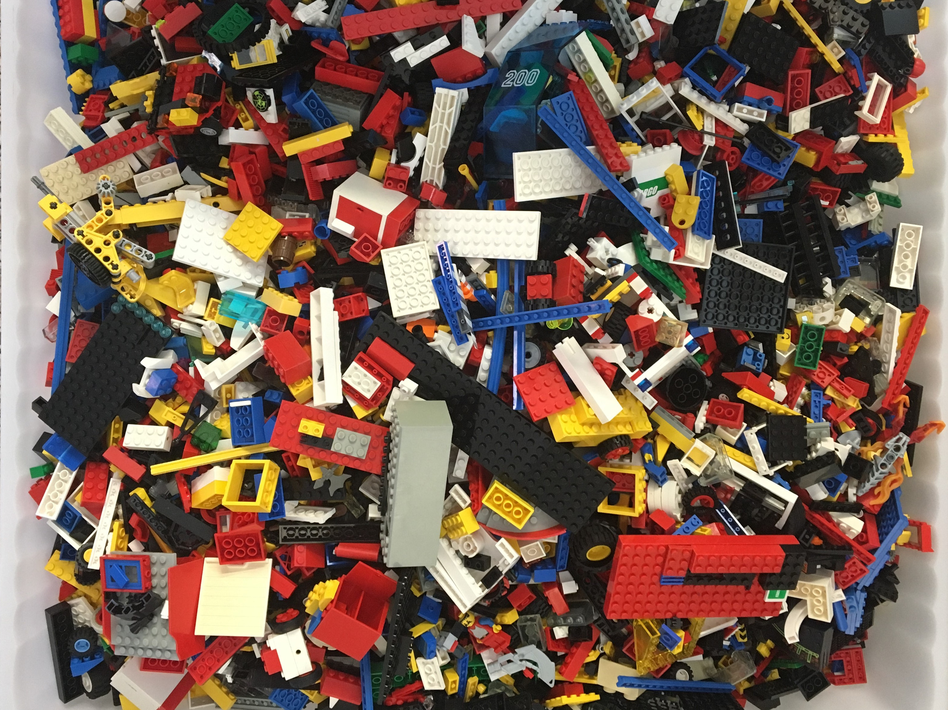
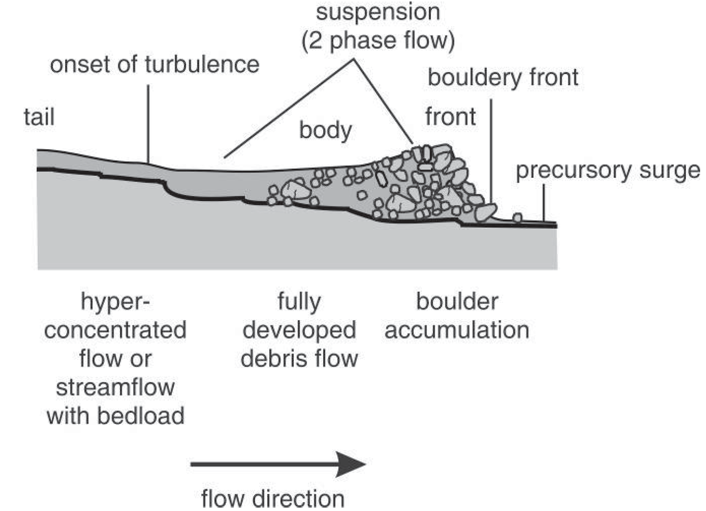
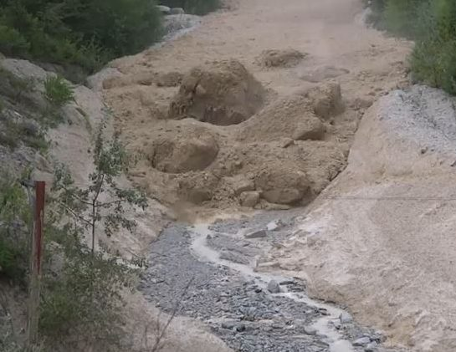
Murgangfront: Fliessband und
Dominante Seismische Quelle
Seismically “loud”
steinchenwelt.net
Hübl et al., 2009, International Symposium on Water Management and Hydraulic Engineering
Notes:
A few words about debris flows and the idea of particle impacts as a generator for high-frequency seismic signals.
The front is the „loudest“ portion as the largest grains accumulate here as a result of particle segregation (analogy: small LEGO pieces are always at the bottom).
2

Slide 3
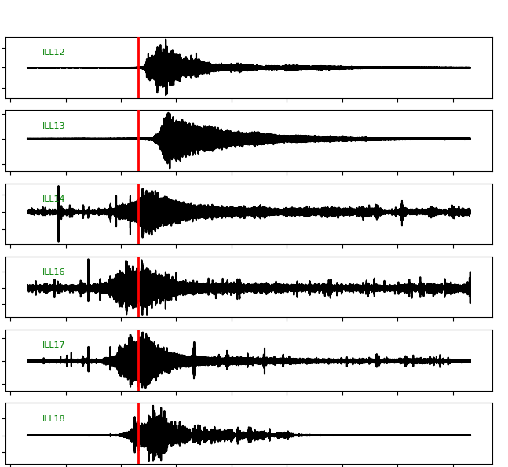
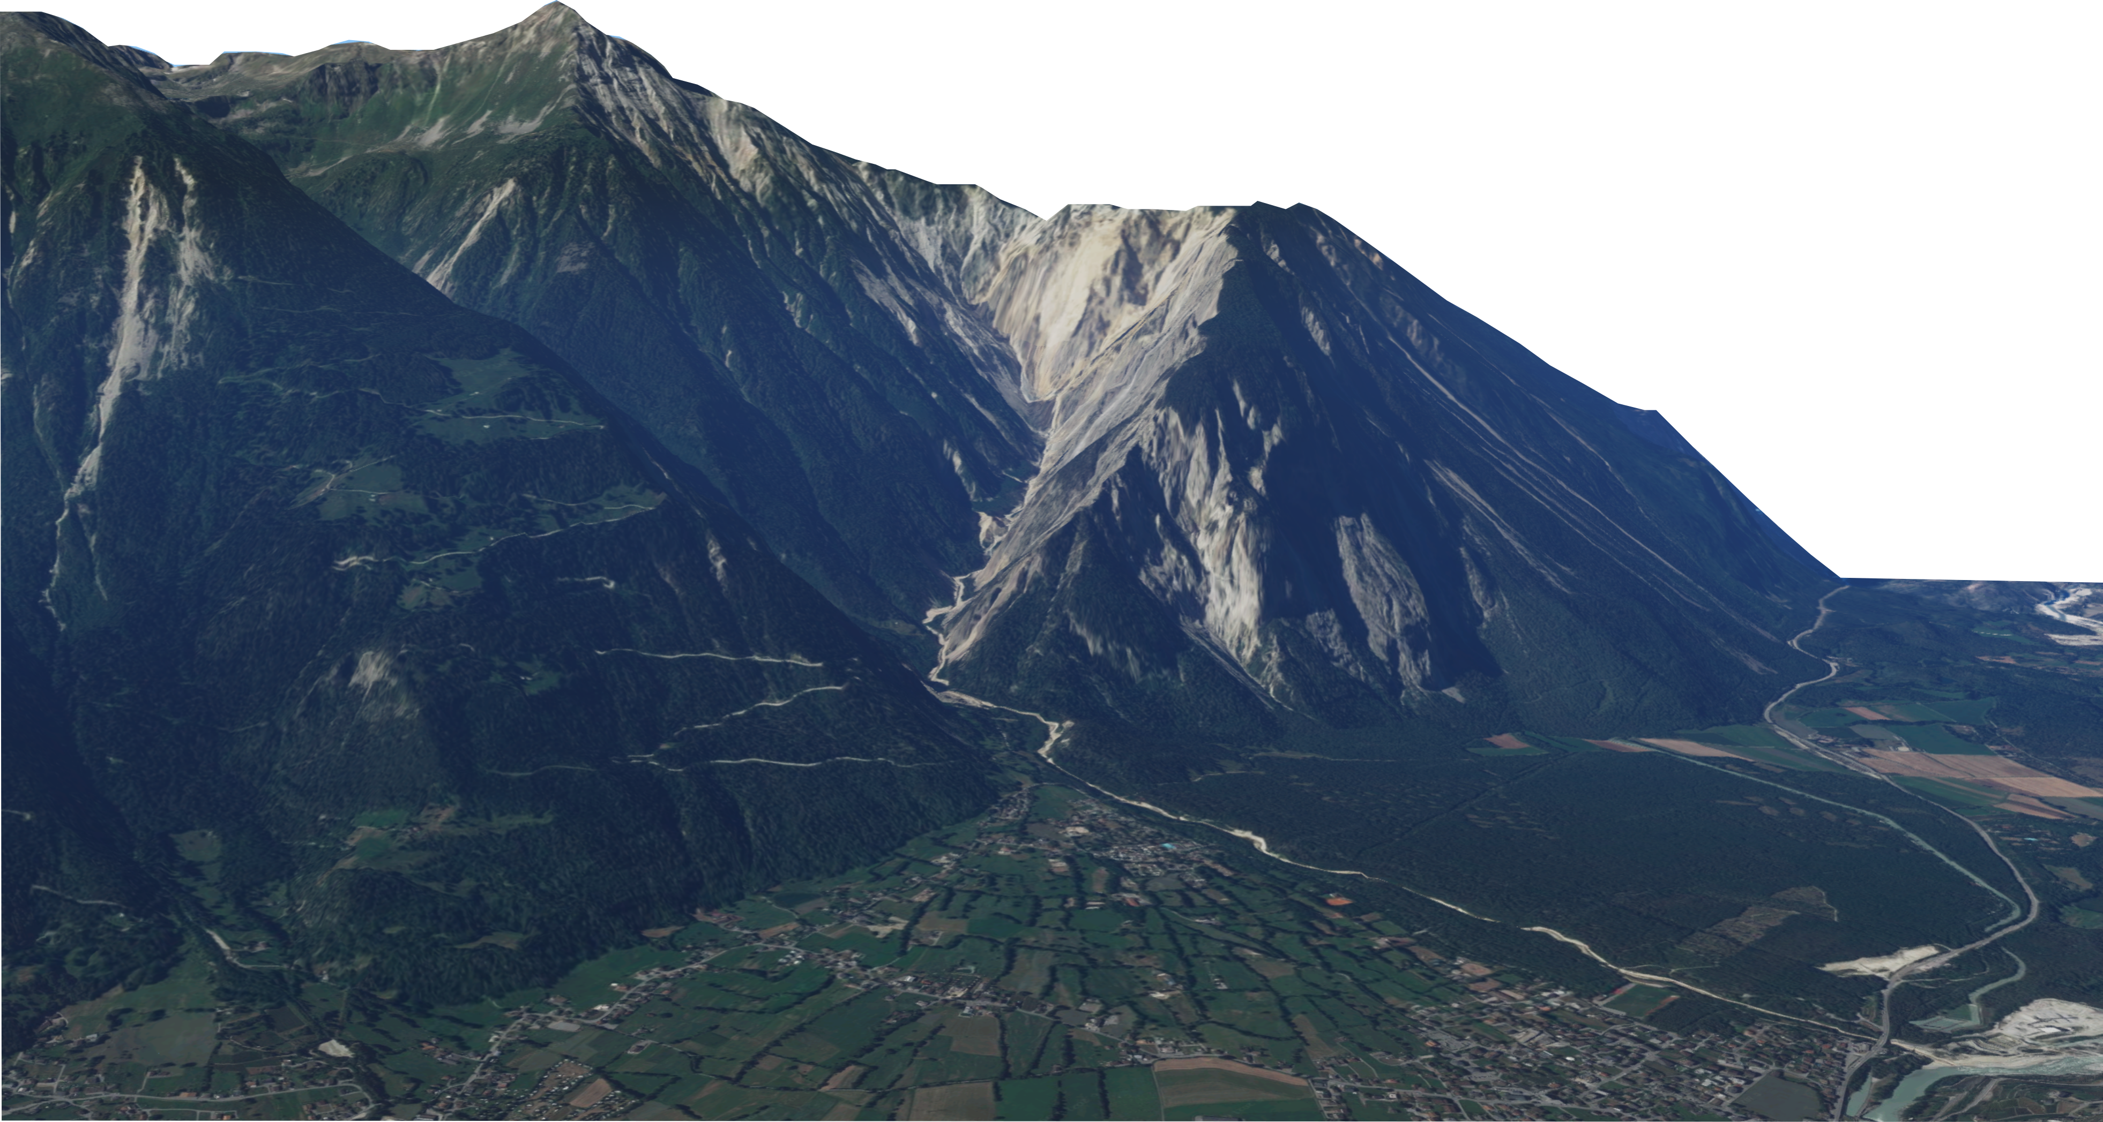
early debris flow
late debris flow
noise
A
B
CD1
100 s
ILL12
ILL15
ILL14
ILL13
ILL16
ILL17
ILL14
ILL18
Normalized ground vel. (m s⁻¹)
ILL16
CD1
N
ILL17
ILL12
ILL13
ILL18
ILL11
Time 1h
~2 km
Notes:
Introduce Illgraben network.
Chmiel et al.: distinguish between pre-, post-CD and noise (see next slide).
3

Slide 4
Chmiel et al.,2021, GRL:
2020 near real-time detections
13 debris flow and sediment transporting flood alarms, no false alarms
early
debris flow
late
debris flow
noise
Notes:
Quick summary of Chmiel et al. (2021).
4

Slide 5
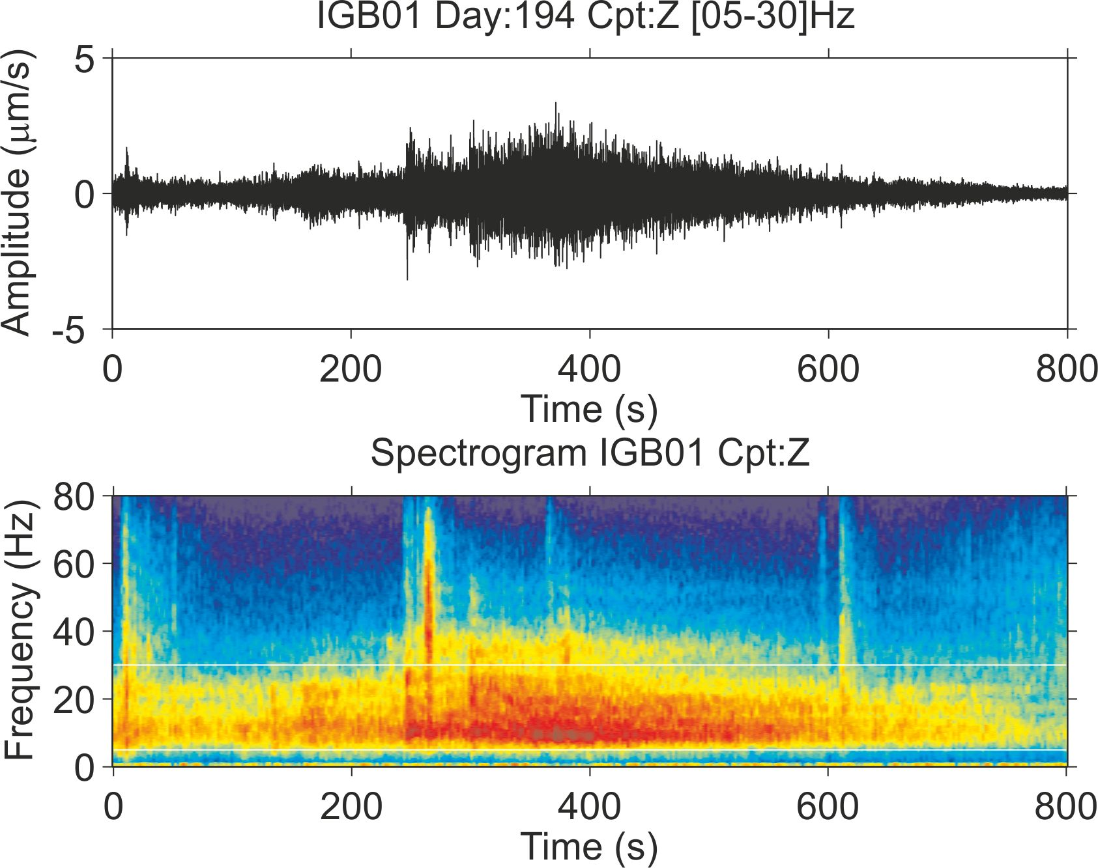
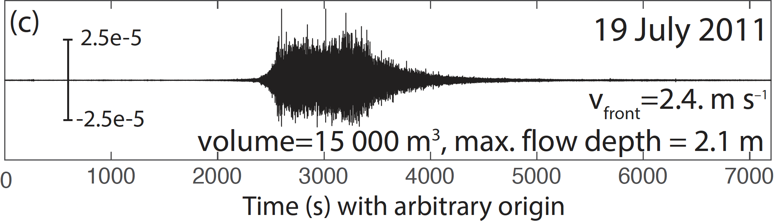
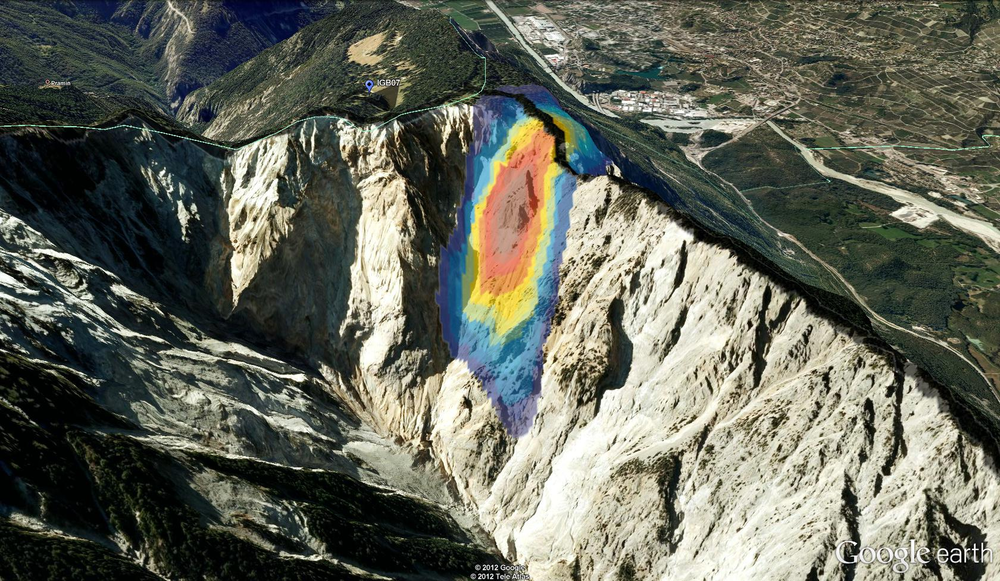
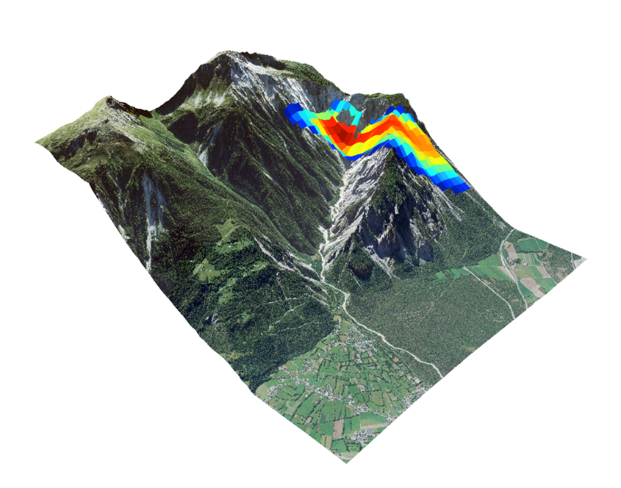
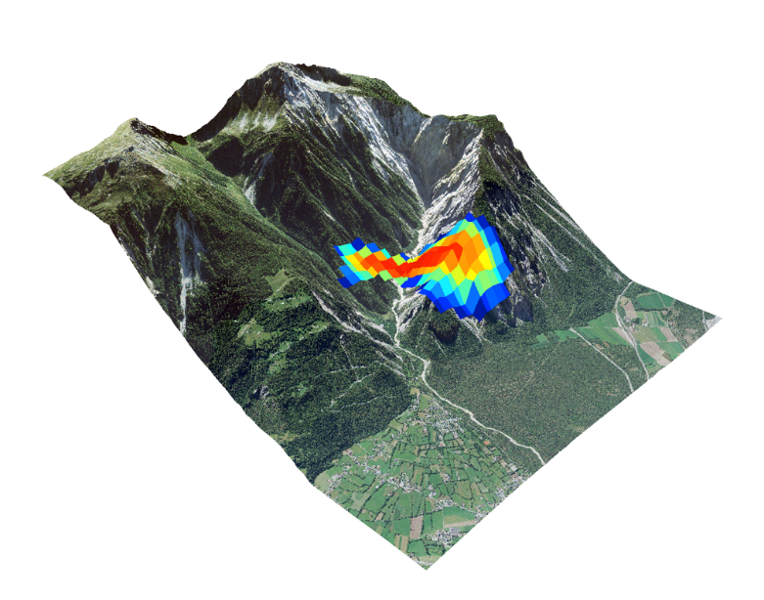
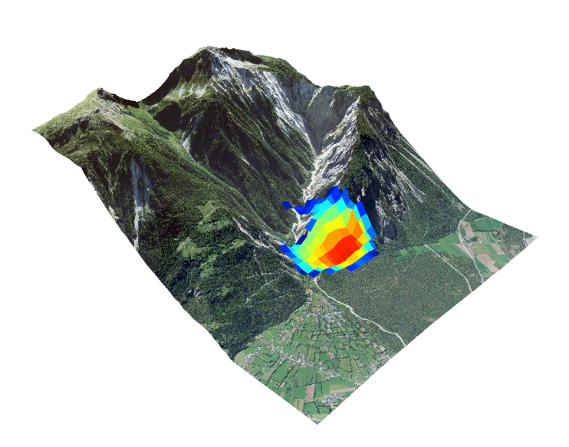
A
B
m/s
m/s
17:40:02
17:31:42
17:58:22
Credit: GFZ, Arnaud Burtin / Niels Hovius
Notes:
Alternative to machine learning: Amplitude Source Location.
1. We could gain lots of information with locations.
2. Not ideal since it yields lots of false positives and false negatives.
BUT: if we had more stations, detection accuracy may go up provided an algorithms can process all the data.

Slide 6

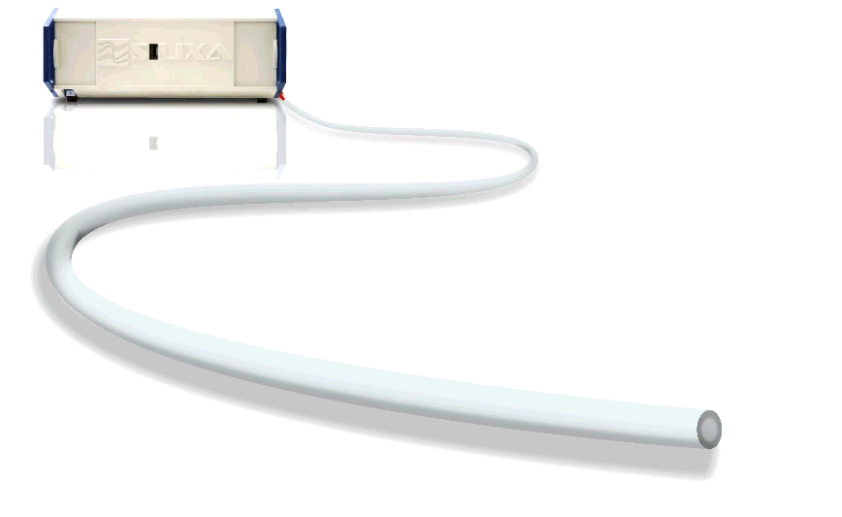
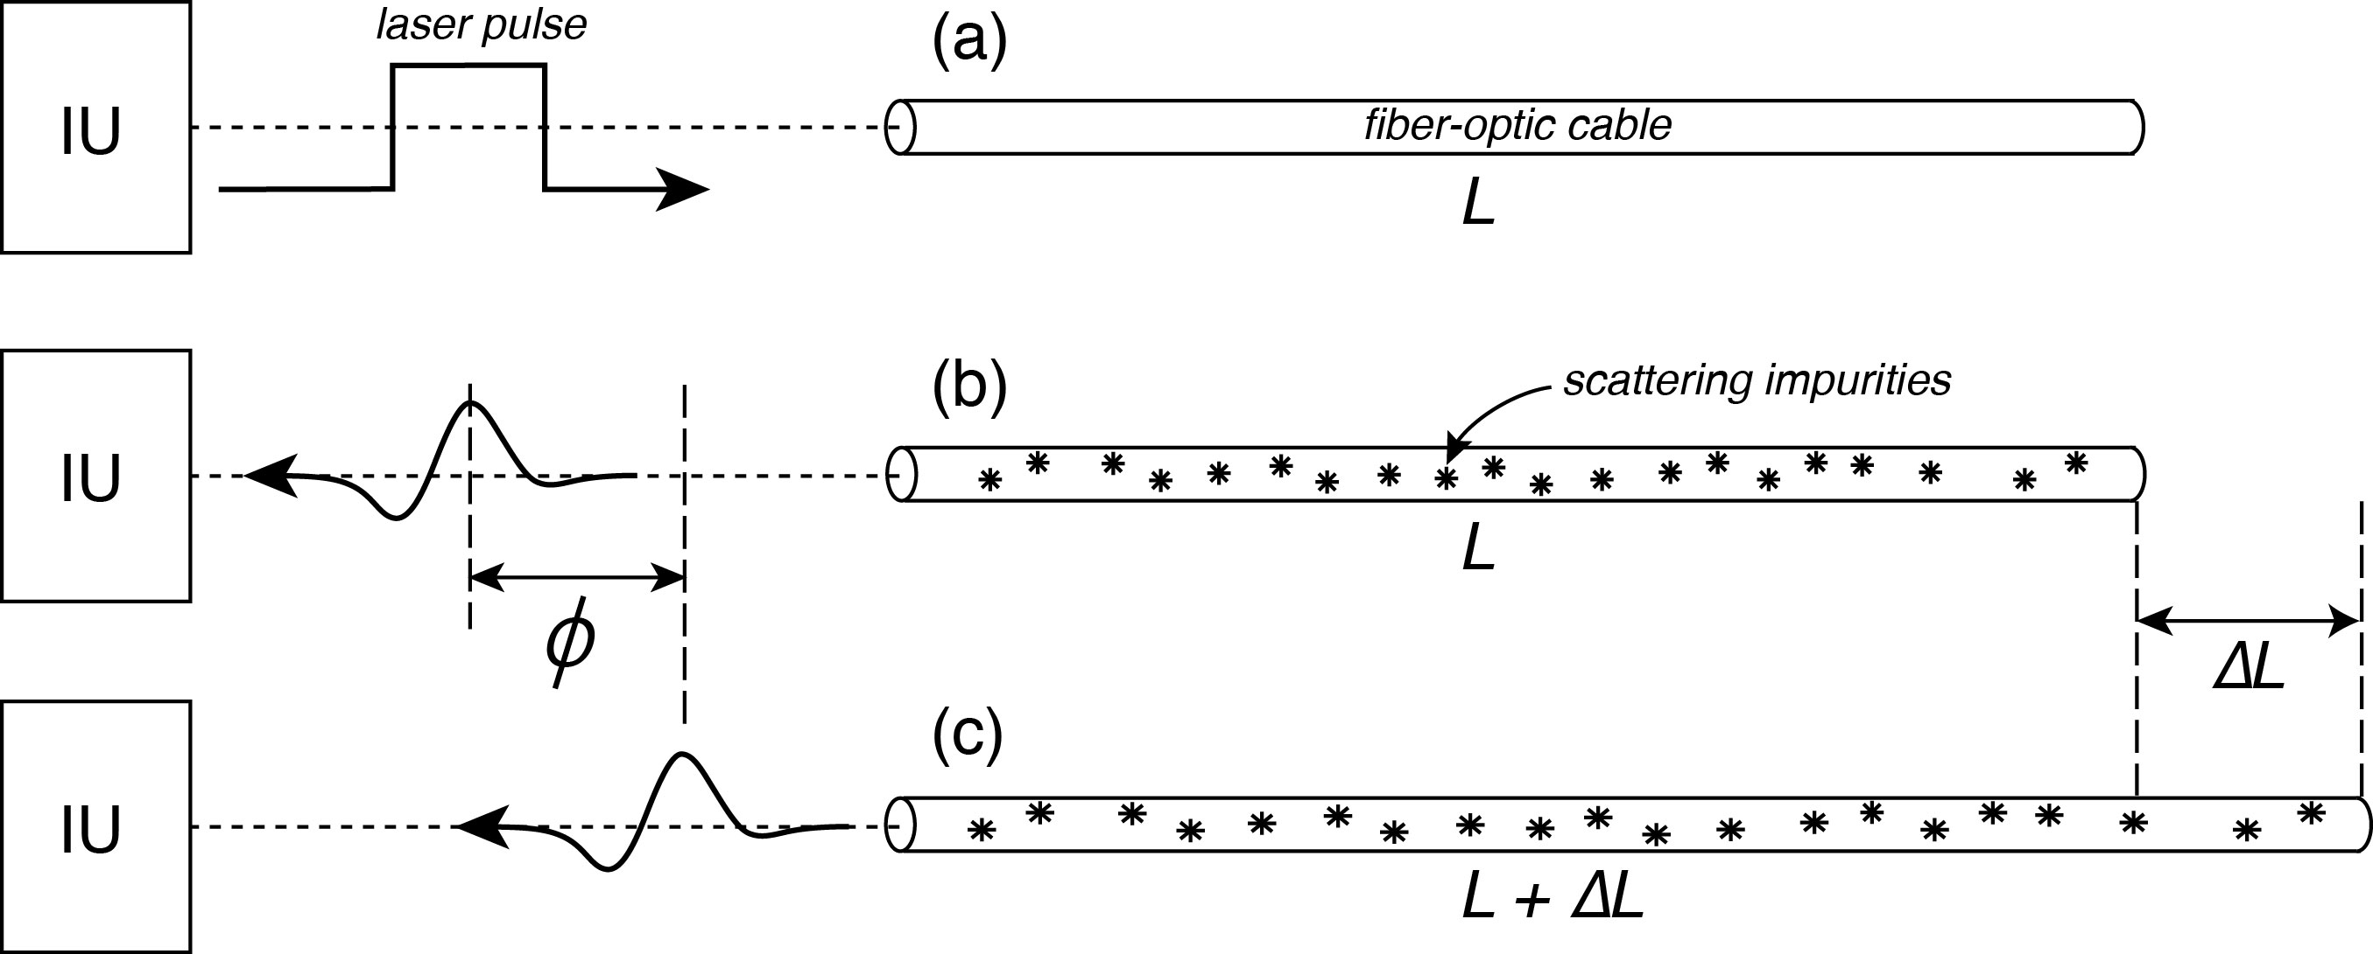
Novelty 2: Distributed Acoustic Sensing
Illustration of the DAS measurement principle. From Lowrie & Fichtner 2020. “Fundamentals of Geophysics”.
Scatter
Fibre
pulse 1
Backscattered light from pulse 2
Comparison
Notes:
Explain DAS as a method for realizing large numbers of seismic stations.
6

Slide 7
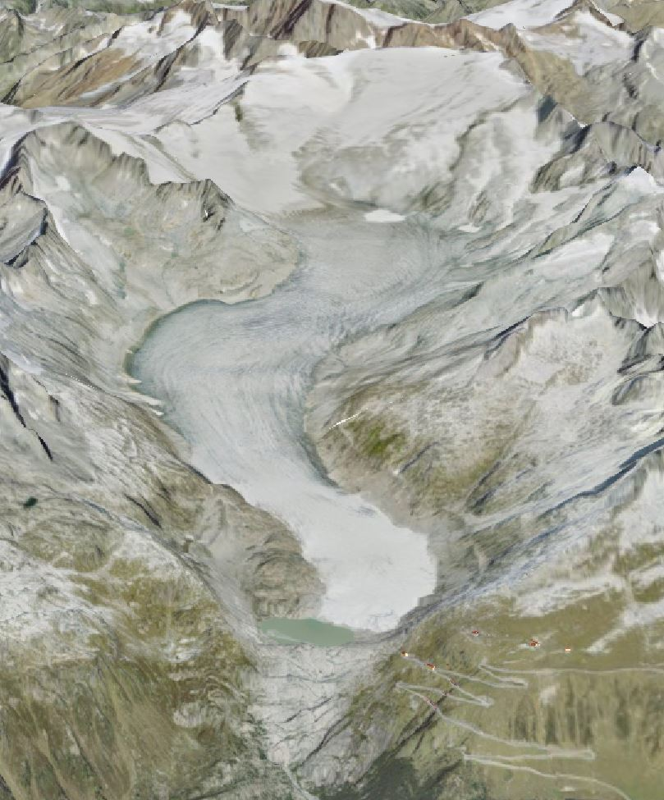
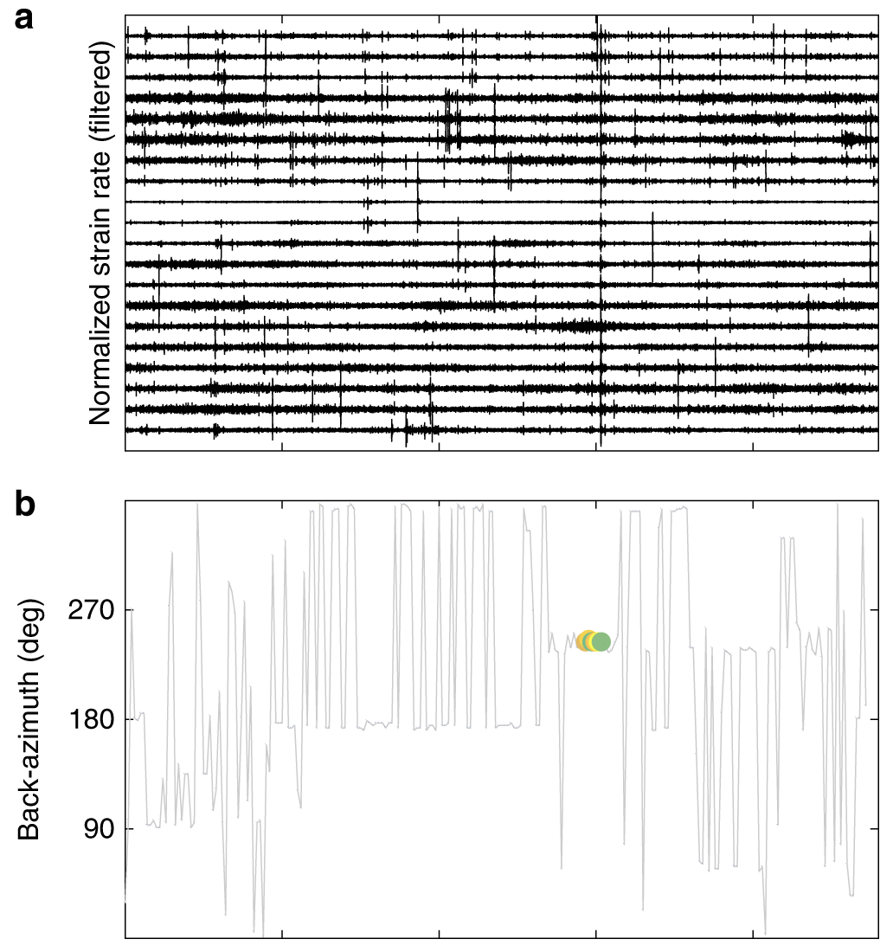
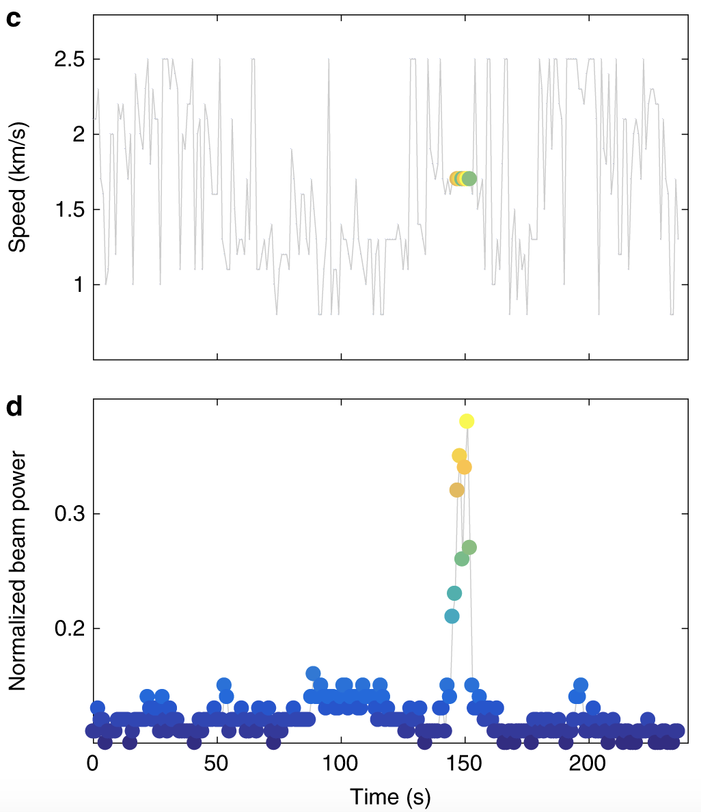

Rockfall Detection: DAS on Rhonegletscher (Switzerland)
Credit: swisstopo
Notes:
Exampls from Rhonegletscher: rock fall detection via beamforming on DAS data. Emphasize that this rockfall was actually witnessed.

Slide 8
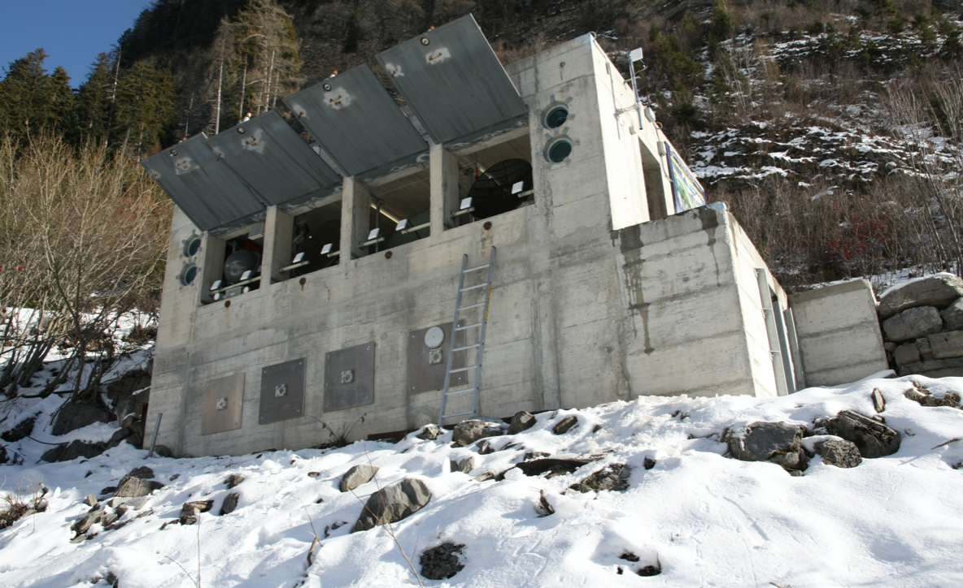
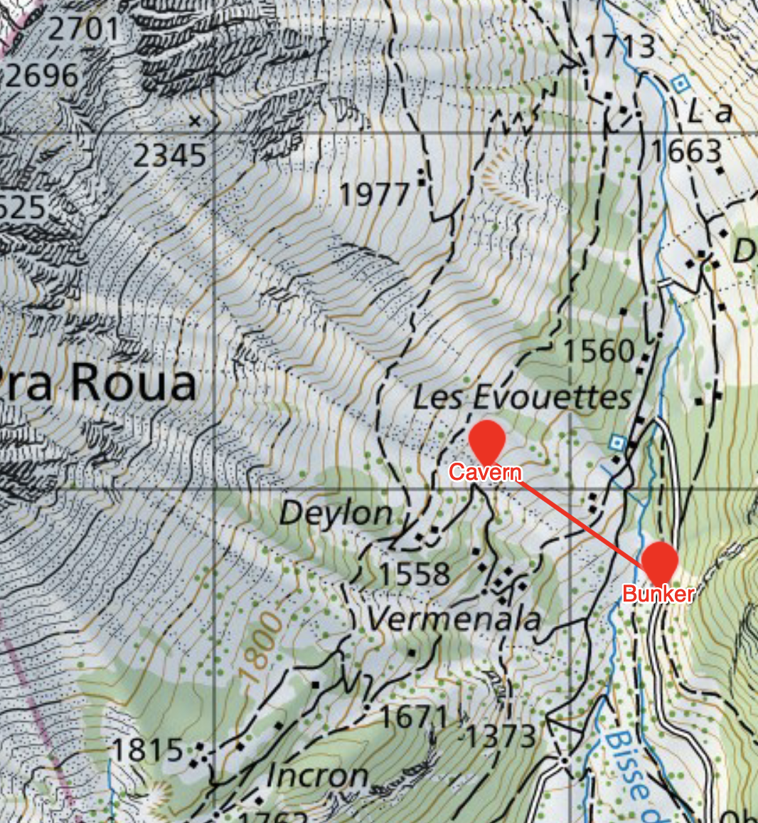
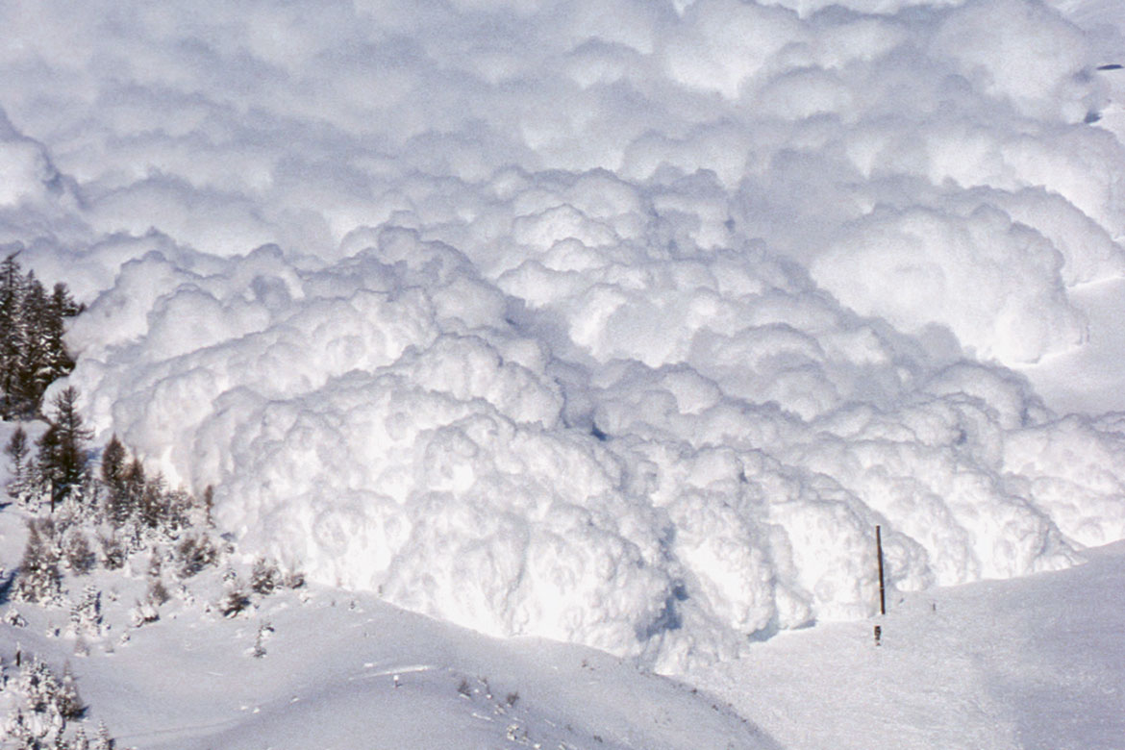
Snow Avalanches (SLF Test Site)
Notes:
Vallée de la Sionne: SLF avalanche test site; different sensor caverns connected to bunker with communication fiber optic cables. We hooked up an interrogator to the shown cable segment.

Slide 9
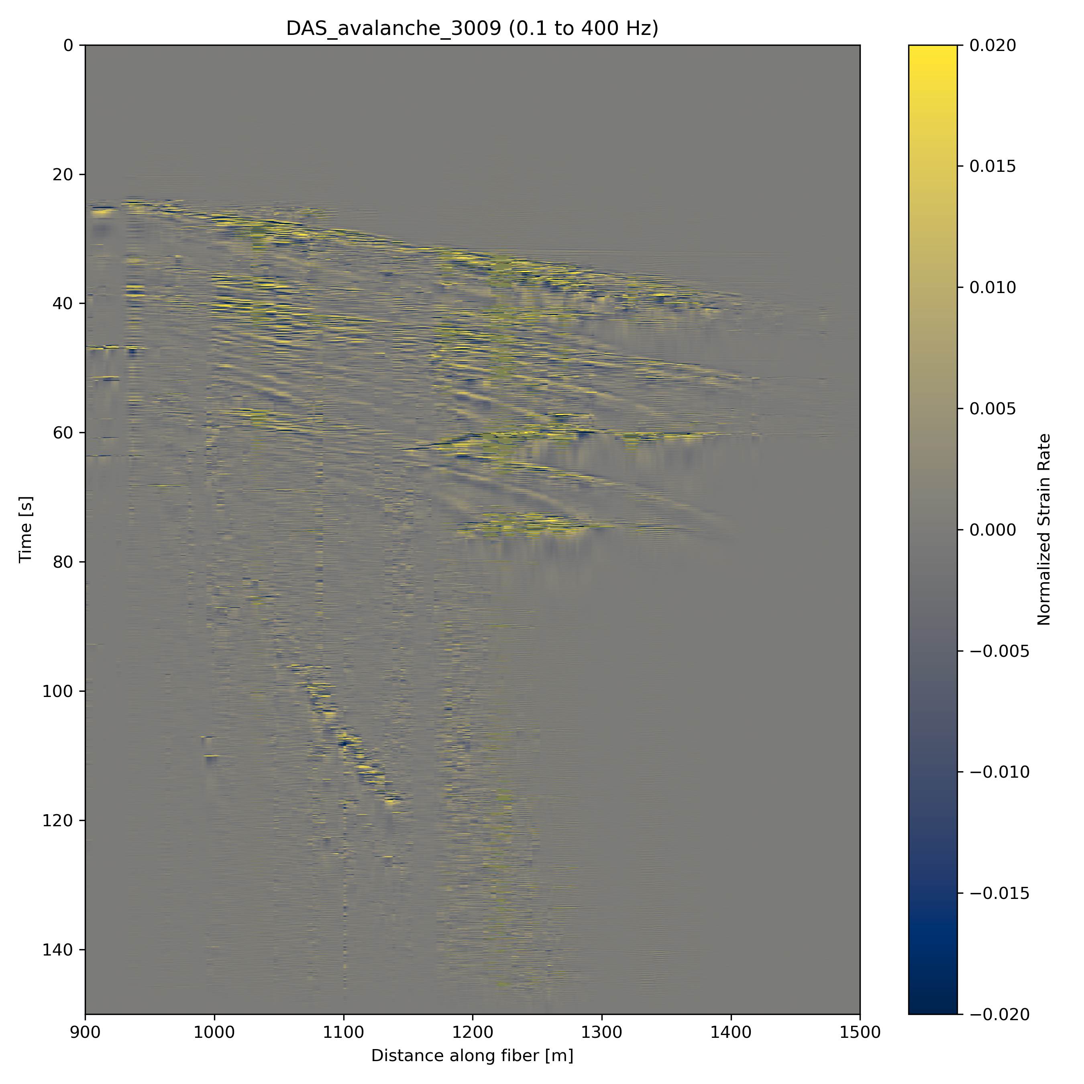
First arrival uphill
Downhill propagation
Snow Avalanches (SLF Test Site)
Different avalanche
surges
Ca. 500 m
Credit: P. Paitz, P. Edme, A. Fichtner (ETH), B. Sovilla (SLF)
Notes:
Explain record section of an avalanche running over the interrogated cable section.

Slide 10
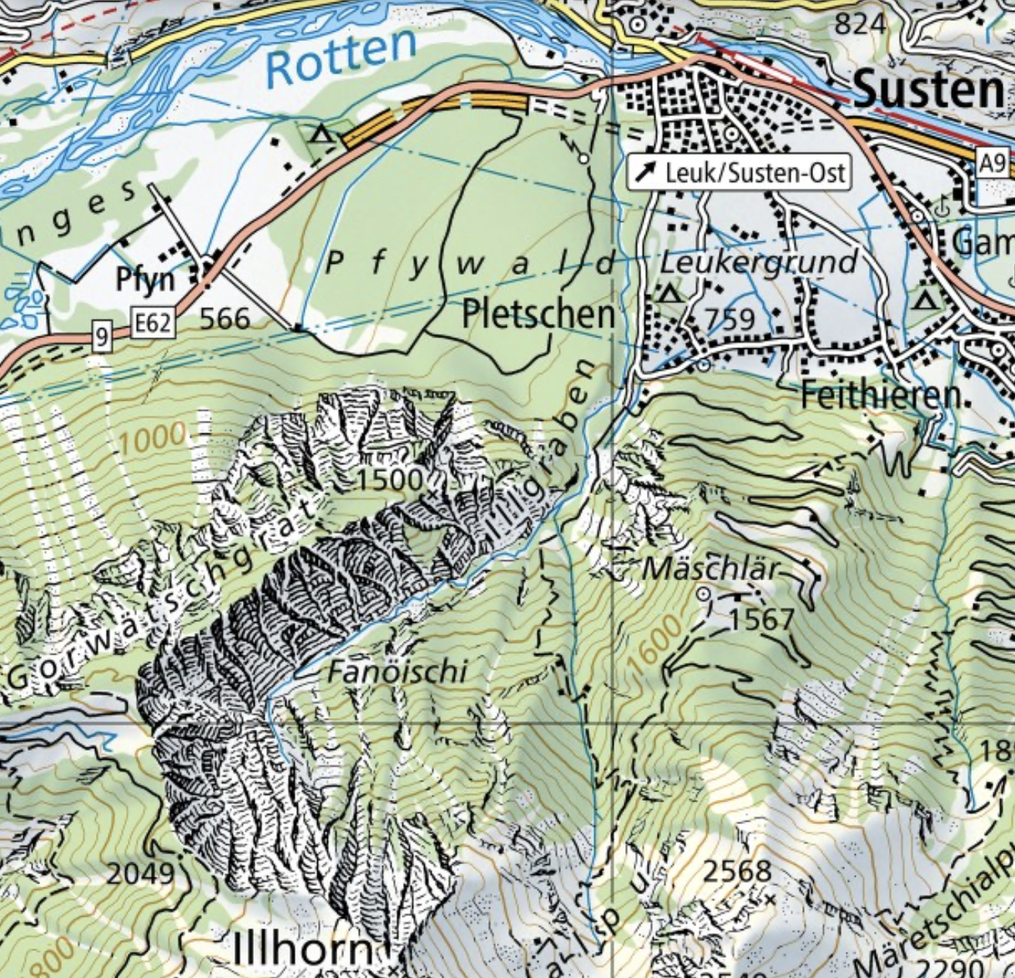
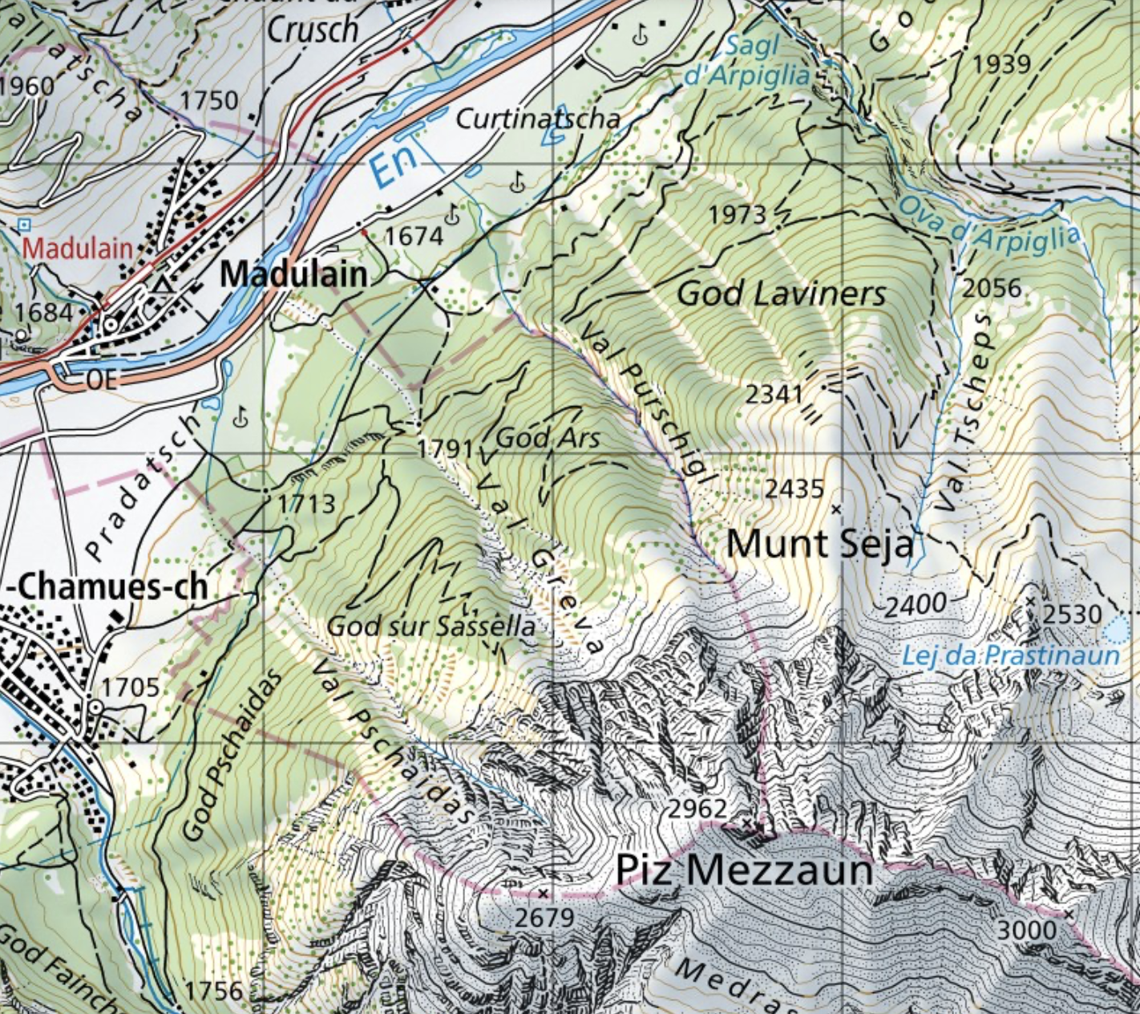
Plans:
Interrogate two cables along / near debris flow torrents
Install cables or use dark fibers
Software: program intelligent detection algorithms, leverage dense spatial coverage
Illgraben
Val Greva
Notes:
Two potential sites for installing/interrogating fiber optic cables for debris flow detection: Illgraben and Val Greva.

