Slide 1
Deep Learning for
Computer Vision
Part II: Convolutional
Neural Networks

Slide 2
[Figure from Krizhevsky, Sutskever and Hinton 2012 – Predictions on ImageNet with CNNs]

Slide 3
Today
Multilayered neural networks is an essential tool in computer vision and image analysis
Enhancement, detection, segmentation, recognition,…
[Figure from Ledig et al. 2017]
[Figure from Ren et al. 2016 - Faster R-CNN]

Slide 4
Outline
Introduction to neural networks – this week
Basics of neural networks
Convolutional neural networks– 13.12
Basic applications of deep learning to image analysis and computer vision
Advanced topics and applications – 20.12
Unsupervised learning and recurrent neural networks

Slide 5
Recap from the lecture on introduction to neural networks
We always considered x as a vector.
What to do when x is an image?
Hidden layers
Function view
…
Hidden layers

Slide 6
Naïve approach
…
Hidden layers
image
vectorized
image

Slide 7
The activation is a bit problematic
The linear transformation has two issues
Fully connected links leads to too many parameters.
  Assume the input is an image of size N₀xM₀, i.e.
  And the hidden layer has d₁ size, i.e.
  For example, (N₀xM₀) = (64,64) and (d₁) = (128) leads to
  524288 parameters in only the first layer!
  With a huge compression from 64x64 dimensions to 128!

Slide 8
The activation is a bit problematic
The linear transformation has three issues
Fully connected links leads to too many parameters.
Images are composed of a hierarchy of local statistics

Slide 9


Slide 10
The activation is a bit problematic
The linear transformation has two issues
Fully connected links leads to too many parameters.
Images are composed of a hierarchy of local statistics
Lack of translation invariance

Slide 11
The activation is a bit problematic
The linear transformation has two issues
Fully connected links leads to too many parameters.
Images are composed of a hierarchy of local statistics
Lack of translation invariance
Fully connected architecture
Convolutional architecture

Slide 12
The non-linearity will remain the same
Fully connected architecture
Convolutional architecture

Slide 13
Convolutional layers

Slide 14


Slide 15
Remember convolution
Convolution kernel: w
Image: x

Slide 16
Remember convolution
Convolution kernel: w
Image: x

Slide 17
a
b
c
a
b
c
d
e
f
d
e
f
g
h
j
Image
kernel
g
h
j

Slide 18
Convolutions instead of projections
Each h_{l-1,j} is an image of neurons and so is a_{l,k}.
There is a separate convolutional kernel linking images h_{l-1,j} and a_{l,k}. Same kernel applies to the entire image of neurons
In the literature h_{l,j} are called channels
w_{l,kj} are convolutional filters.
Each h_{l-1,j} is a number and so is a_{l,k}
Each h_{l} is a vector of neurons and a_{l} is a vector of activation
There is a separate w_{l,kj} that is linking each neuron h_{l-1,j} to each a_{l,k}.
High dimensions of h_{l-1} and a_{l} lead to high number of weights
Nonlinearities following activations remain similar

Slide 19
Image of neurons - channel
Fully connected
Vector of neurons form a layer
Convolutional architecture
Image of neurons form a channel

Slide 20
Vector of channels forms a layer
Fully connected
Vector of neurons form a layer
Convolutional architecture
Vector of channels form a layer

Slide 21
Analogy between two: each neuron becomes a channel
Fully connected
Vector of neurons form a layer
Convolutional architecture
Vector of channels form a layer

Slide 22
Tensor representation
d_{l}
N_{l}
d_{l}
M_{l}
Fully connected architecture:
Vector representation of layers
Convolutional architecture:
Tensor representation of layers

Slide 23
We can also use the same graphical representation
Fully connected architecture:
d_{l} neurons
Convolutional architecture:
d_{l} channels

Slide 24
Connections represent convolutions
Fully connected link
Multiplication followed by addition
Convolutional link
Convolution followed by addition

Slide 25
Connections represent convolutions
Same filter is used for all neurons in the same channel: Weight sharing
Convolutional link
Convolution followed by addition

Slide 26
Layer size and number of parameters at the beginning
Fully connected
Convolutional
Larger layers with sparser connections with lower number of parameters

Slide 27
Sparser connections
Naïve approach – fully connected
Convolutional link

Slide 28
Weight sharing – fewer parameters
Naïve approach – fully connected
Convolutional link

Slide 29
Larger hidden layers
d₁
Fully connected:
M₁
N₁
d₁
Image:
Convolutional:

Slide 30
Local vs. global information gathering
To retain similar level of information you need a large d₁
Don’t need a very large d₁ to retain information
Fully connected architecture:
The entire image needs to be represented in a single vector
Convolutional architecture:
Local neighborhoods are represented in a single vector

Slide 31
Layer size and number of parameters at an intermediate layer
Fully connected
Convolutional
Larger layers with sparser connections with lower number of parameters

Slide 32
Channel size
Channel size is linked with kernel size and the type of convolution
When the kernel is placed in the image – no problem

Slide 33
Channel size
Channel size is linked with kernel size and the type of convolution
When the kernel is placed in the image – no problem
When it is placed on the boundary – it is not well defined
Out-of-boundary values are not defined
Two options:
  Valid convolution: only evaluate convolution when all the elements are defined
  Padding (Same): pad the boundaries so that result of the convolution will have the same size

Slide 34
Valid convolution
If the kernel is centered, i.e. w₍₀₎₍₀₎ is the center of the kernel, then convolution can only be evaluated within the red area
You loose a pixel at each end of the picture
If the kernel center is the top left corner, then the green area is the valid area
You loose two pixels at the bottom and right of the image

Slide 35
Same padding
Alternatively you can pad the image on the boundaries so that channels will have the same size across layers
Where you pad depends on where the center of the kernel is.
Commonly you would use centered kernels – padding around the image as shown on the left
The value you pad is a parameter, 0 is used often but you can use symmetric padding for certain applications

Slide 36
Question: Number of parameters
Classification network with 16 possible output classes
How many parameters are in the following fully connected networks, where each arrow is a fully connected link
How many parameters and how many hidden neurons in each layer in the following convolutional neural network, where double arrows are convolutional links with 5x5 kernels and “valid” convolutions, and arrows are fully connected links

Slide 37
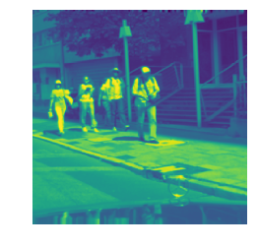
Hierarchically aggregating local spatial features
Extracting task specific features from the images.
As the layers progress, more global information is encoded.

Slide 38
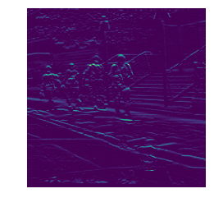
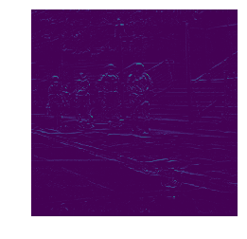
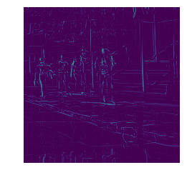


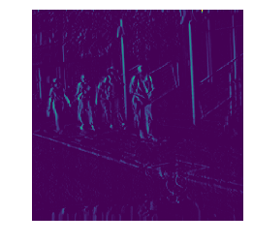
Hierarchically gathering local spatial statistics
Layer 1
Layer 2
x derivative after Relu
Different channels in the 2nd layer
Weighted sums of 2nd order derivatives
y derivative after Relu

Slide 39
Translation invariance is native to fully connected networks
These images will most likely lead to a very different activations in the hidden layer
Rest of the network will see different activations
In most vision applications, these images should lead to identical outputs

Slide 40
Question
What are some applications where these two images should lead to
Identical outputs
Different outputs

Slide 41
Question
What are some applications where these two images should lead to
Identical outputs
  Recognition
  Detection
Different outputs
  Localization
  Segmentation

Slide 42
Translation invariance is native to fully connected networks
These images will most likely lead to a very different activations in the hidden layer
Rest of the network will see different activations
In most vision applications, these images should lead to identical outputs
It is possible to teach a fully connected network to be invariant to translations

Slide 43
Question
How can we teach a fully connected network to be invariant to translations?

Slide 44
Translation invariance is native to fully connected networks
These images will most likely lead to a very different activations in the hidden layer
Rest of the network will see different activations
In most vision applications, these images should lead to identical outputs
It is possible to teach a fully connected network to be invariant to translations by having random translations of each image in your training set
Not the most elegant way
Convolution operation can help – it is translation equivariant

Slide 45
Translation equivariance
Equivariance: applying a transformation to the input yields the same result as applying the transformation to the output
Convolution is linear shift invariant, so?

Slide 46
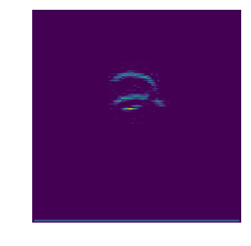
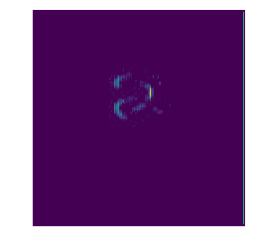
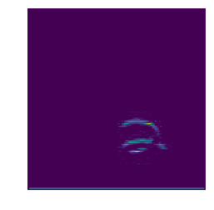

Translation equivariance
Equivariance: applying a transformation to the input yields the same result as applying the transformation to the output
Convolution is linear shift invariant, it has translation equivariance

Slide 47
Translation invariance
It does not have translation invariance
In what application do we need
translation equivariance
translation invariance

Slide 48
Translation invariance
It does not have translation invariance
In what application do we need
translation equivariance >> segmentation, localization
translation invariance >> recognition

Slide 49
Convolutional layers is a great idea but
Translation invariance would be very useful
Dimensionality reduction requires many parameters
Assume we use convolution kernels
of size 5x5 and valid padding in a recognition system >> output channel size should be 1x1 (with number channels equal to the number of classes)
You would need many layers.
Or very large kernels.
There might another way to do this…
128x128
124x124
120x120
116x116
…

Slide 50
Strides
In a normal convolution you only move one pixel in each direction, not skipping any pixels

Slide 51
Strides
In a normal convolution you only move one pixel in each direction, not skipping any pixels

Slide 52
Strides
In a normal convolution you only move one pixel in each direction, not skipping any pixels
However, you can decide to skip several pixels while shifting your kernel >> instead you can skip 2 pixels

Slide 53
Strides
Channel size change with valid convolutions
In a normal convolution you only move one pixel in each direction, not skipping any pixels
However, you can decide to skip several pixels while shifting your kernel >> instead you can skip 2 pixels
You take a stride of 3 instead of 1
Reduction in channel size increases

Slide 54
Strides
Assume we use convolution kernels
of size 5x5, valid padding with stride 2 in a recognition system >> output channel size should be 1x1 (with number channels equal to the number of classes)
The dimension drops very quickly. The rate of drop will be faster if stride is increased.
You lose information. Higher stride means higher loss of information.
You do not gain translation invariance.
If used, it is most common to use stride 2 in all directions.
128x128
124x124
120x120
116x116
…
62x62
29x29
12x12

Slide 55
Pooling layers

Slide 56

Cheap dimensionality reduction

Slide 57
Pooling
Pool information in a neighborhood
Represents the region with one number >> summarizes information
Applied to each channel separately
Max-pooling – maximum of the activation values
Min-pooling – minimum of the activation values
Both are non-linear operations, like median filtering
Averaging pooling – linear operator
Max-pooling is the most commonly used version

Slide 58
Max pooling
Represents the entire region with the neuron that achieves the highest activation
Leads to partial local translation invariance
617 in the highlighted area can be in any of the neurons, the pooled value will not change
Does not lead to complete translation invariance
Often applied with strides equal to the size of the kernel

Slide 59
Max pooling
Represents the entire region with the neuron that achieves the highest activation
Leads to partial local translation invariance
617 in the highlighted area can be in any of the neurons, the pooled value will not change
Does not lead to complete translation invariance
Often applied with strides equal to the size of the kernel

Slide 60
Dimensionality reduction
Leads to a substantial dimensionality reduction
Even when the pooling kernel is of size 2x2, it can halve the image!
As the size of the pooling kernel increase, the reduction increases as well
Non-linear dimensionality reduction
Only the most prominent activation is transmitted to the next layer
More advanced pooling mechanisms exist
CapsuleNets [Sabour, Frosst and Hinton 2017]
617
614
614
625

Slide 61

Recognition network with pooling

Slide 62
Network architecture for a simple object recognition system
Output
Number of neurons
equal number of classes
Convolution followed by non-linearity followed by max-pooling
Fully connected layer: transformation followed by non-linearity

Slide 63
Putting it all together: Basic
Convolutional neural network (CNN)

Slide 64
Remember backpropagation
…
Forward pass for prediction
Backward pass for
computing gradients

Slide 65
Putting it all together: Classification
Convolutional neural network (CNN)
Cost function
Optimization
Gradient based optimization

Slide 66
Progressively aggregating spatial information to reach a global decision
Local features are extracted and aggregated throughout the network
The last layers “sees” the entire image and the features encode global information

Slide 67
Essential blocks lead to powerful algorithms
Convolutional layers and pooling are the essential blocks
They have been used to create complicated networks
First one
Then silence for a long time
[Lecun, Bottou, Bengio and Haffner; Gradient-based learning applied to document recognition; 1998]

Slide 68
Why silence
Models had too many parameters
They overfit for small datasets
We did not have very large datasets
Even for large sets, we did not have enough computation power to train the models until…
General purpose Graphical Processing Units (GPUs)
Allowed parallel processing

Slide 69
Then first this happened in 2006
A fast algorithm to train deep belief networks by stacking restricted Boltzmann machines
Layer-wise pre-training with contrastive divergence
Set a state-of-the-art performance on MNIST
However, this did not use GPUs yet

Slide 70
Then in 2012
Krizhevsky et al. almost halved the error rate in the ImageNet challenge
A simple CNN
Network
First layer filters 11x11

Slide 71
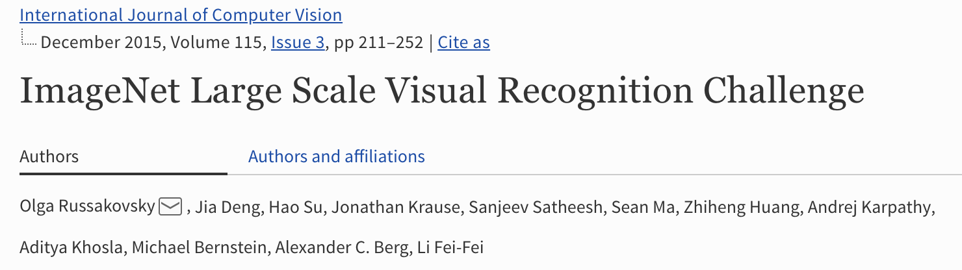
A word about the ImageNet challenge
Large scale object recognition challenge started in 2010
1.2 million training images
1000 object categories
200k validation and test images
2017 – 3 challenges:
  Object localization
  Object detection
  Object detection from video
[CVPR 2009]

Slide 72
Historical evolution of the ImageNet Challenge

Slide 73
How the networks evolved - 2012
GPU implementation of the basic CNN using two GPUs and communication between the units
Varying size of convolutional filters in the different layers

Slide 74
VGGNet- 2014
VGG network
[Table from the publication]
First deep network
3x3 convolutional filters across the network
Still the same principles as 1998

Slide 75
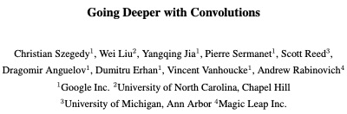
Inception - 2014
Combining different kernels –
a new idea
[Figures from the publication]
Allowed VERY deep networks
GoogLeNet
[CVPR 2015]

Slide 76
ResNet - 2015
Residual modeling – a new idea
[Figures from the publication]
Allowed VERY deep networks
[CVPR 2016]

Slide 77
More on the inception module
Conventional way was to combine multiple convolutional filters of same size.
Inception network combines multiple convolutional filters of different sizes.
1x1 convolutions do not aggregate information over space but only over different channels

Slide 78


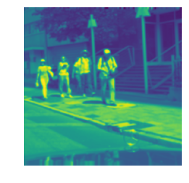

Image
3x3
5x5
Inception module aggregates
all this information in one
layer.
It learns to use the necessary
components from each filter size
7x7
9x9

Slide 79
More on Residual units and ResNet
Conventional layer
difficult to model an identity function
Residual layer
only modeling the residual allows identity maps

Slide 80
So far only image-wide classification

Slide 81
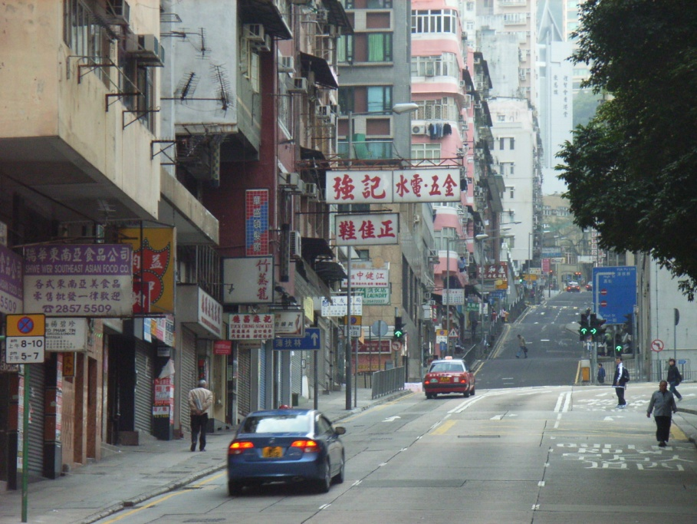

Detection via classification: recall
If object may be in a cluttered scene, slide a window around looking for it.
a brute-force approach with many local decisions.
Car/non-car Classifier
Slide adapted from Kristen Grauman

Slide 82


Regions with CNN features
[Images adapted from the article]
Very similar idea as sliding windows
However, instead of sliding windows, they use region proposal schemes to make the algorithm very fast.
Three modules:
Region proposals by selective search [Uijlings et al. 2012] and warp regions to a fixed size
CNNs to extract features
SVM to classify
Multi-stage method and can be slow

Slide 83
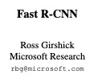
Fast Region-based CNN – Fast R-CNN
[Images adapted from publication]
Unifying the feature extraction and classification into one step
Region proposals are constructed
A CNN takes input the image and region proposals and classifies each region.
Roi pooling layer makes it possible
Unified multi-class training
Faster at test time

Slide 84
How do we extend this to segmentation?
Classification CNN progressively reduces the size of the network
Segmentation needs to keep the size of the image constant
Pixel-wise classification
Commonly used training loss is pixel-wise cross entropy

Slide 85
Two competing factors
Integrating larger context
Decision for each pixel should look at a large portion of the image to decide the semantic label.
But this means information for neighboring pixels are very similar – difficult to disambiguate boundaries.
Distinguishing neighboring boundary pixels
Network should be able to distinguish neighboring pixels – focusing on fine level details.
Only focusing on fine level details cannot integrate the larger image context and have trouble determining the semantic labels.

Slide 86
Naïve approach
Classification network for each pixel
Sliding window approach
Each window only predicts the central pixel’s class
Conceptually easy
Straightforward training
Can be slow in test time
Good in context not very good in boundaries

Slide 87

Fully convolutional network
Depth equals the number of possible semantic classes
Pixel-wise
Softmax

Slide 88
How did that happen?
The penultimate layer is deep but has a very small channel size
The last, output, layer has a very large channel size – as large as the input image
There are two basic ways of doing this: transposed convolutions and upsampling

Slide 89
Convolution
a
b
c
a
b
c
d
e
f
d
e
f
g
h
j
Image
kernel
g
h
j

Slide 90
a
b
c
d
e
Transposed Convolution
Sometimes referred to as deconvolution but that is not correct!
f
g
h
j
i
k
l
m
n
o
Image
a
b
c
d
e
p
q
r
s
t
f
g
h
i
j
k
l
m
n
o
p
q
r
s
t
kernel
u
v
w
x
y
u
v
w
x
y

Slide 91
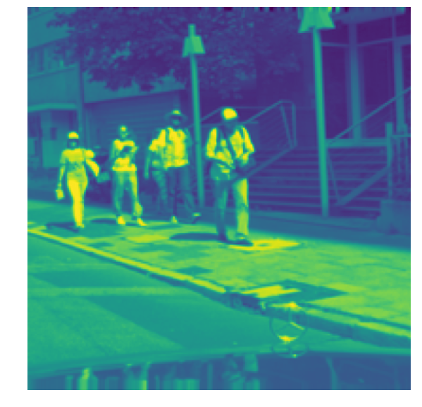
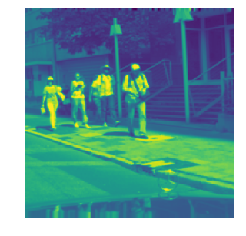
Up-sampling followed by convolution
Upsampling
e.g. bilinear
Convolution filter

Slide 92
Receptive fields
This channel must see large areas of the image so we can determine semantic labels for the pixels.
Due to the preceding convolutions and pooling each neuron in this channel sees a large area of the image – it has a receptive field

Slide 93
Receptive fields
Receptive field grows progressively as we go backwards through the network
Normally, to grow the receptive field the options are:
  Convolution, pooling, strides
  Pooling and strides reduce the size of the channels by a large margin
  Leads to resolution and coverage loss

Slide 94
Solves the context integration
Pixel-wise
Softmax

Slide 95
Trouble with distinguishing between boundary pixels
Some modifications can mitigate
the issue to some extent

Slide 96
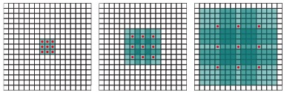
Alternative I: dilated convolutions
Convolution with dilated filters
Can achieve substantial increase in receptive field
No loss of resolution or coverage
Leads to results that do not lose resolution, maintaining high level details

Slide 97
Dilated Convolutions
[Image adapted from the publication]

Slide 98
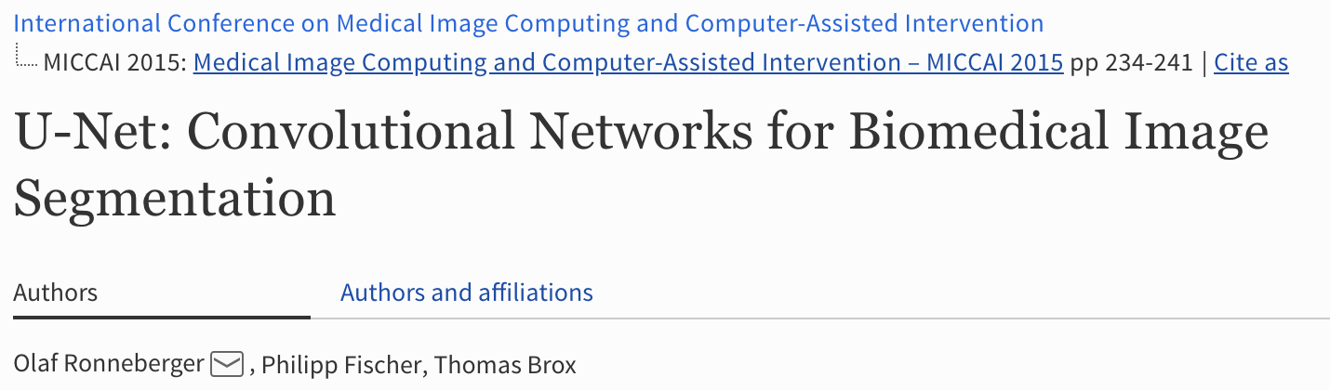
Alternative II: Skip Connections – U-Net
Encoding Part
Decoding Part
The encoding part of the network is like the fully convolutional network
It pools local information and achieve global representation at the bottom layers
The skip connections passes high-resolution information to retain information necessary to distinguish neighboring boundary pixels.

Slide 99

Context and fine level

Slide 100
To help with training
CNNs have large number of parameters
It is important to have lots of training images to be able to train deep networks
In smaller training size scenarios there are various tools that may help
  Normalization: batch, layer, …
  Drop-out
  Regularization
  Data augmentation
  Transfer learning

Slide 101
Data augmentation
Augment the training set with random transformations of the observed samples:
  Rotations, scaling, up-down & left-right flip, …
This simple approach is used very widely

Slide 102
Transfer learning – finetuning
There are many networks available online that has been trained with ImageNet – with > 1 million images
Transfer learning takes a pre-trained network and retrains it for the new task and new dataset starting from the learned weights
You can also consider taking a part of the network instead of the whole

